Slide 1
Original Article
Citric acid-based bicarbonate dialysate attenuates aortic arch calcification in maintenance haemodialysis patients: an observational study
Ken-ichi Akiyama, M.D., Ph.D.¹, Norio Hanafusa, M.D., Ph.D.^{2*}, Yutaka Miura, Ph.D.³, Momoko Seki, M.D.¹, Yoei Miyabe, M.D., Ph.D.¹, Yuko Iwabuchi, M.D., Ph.D.¹, Kazunori Karasawa, M.D., Ph.D.¹, Hidekazu Sugiura, M.D., Ph.D.⁴, Keiko Uchida, M.D., Ph.D.¹, Hiroshi Kawaguchi, M.D., Ph.D.⁵, Ken Tsuchiya, M.D., Ph.D.², Makoto Kuro-o, M.D., Ph.D.³, Kosaku Nitta, M.D., Ph.D.¹, Takahito Moriyama, M.D., Ph.D.¹
¹ Department of Nephrology, Tokyo Women’s Medical University, Tokyo, Japan
² Department of Blood Purification, Tokyo Women's Medical University, Tokyo, Japan
³ Division of Anti-Aging Medicine, Center for Molecular Medicine, Jichi Medical University, Shimotsuke, Tochigi, Japan
⁴ Department of Nephrology, Division of Medicine, Saiseikai Kurihashi Hospital, Kuki, Saitama, Japan
⁵ Department of Nephrology, Joban Hospital, Iwaki-city, Fukushima, Japan
Corresponding author: Norio Hanafusa*
Department of Nephrology, Tokyo Women’s Medical University
8-1 Kawada-Cho, Shinjuku-ku, Tokyo, 1628666, Japan
Tel.: +81-3-3353-8111

Slide 2
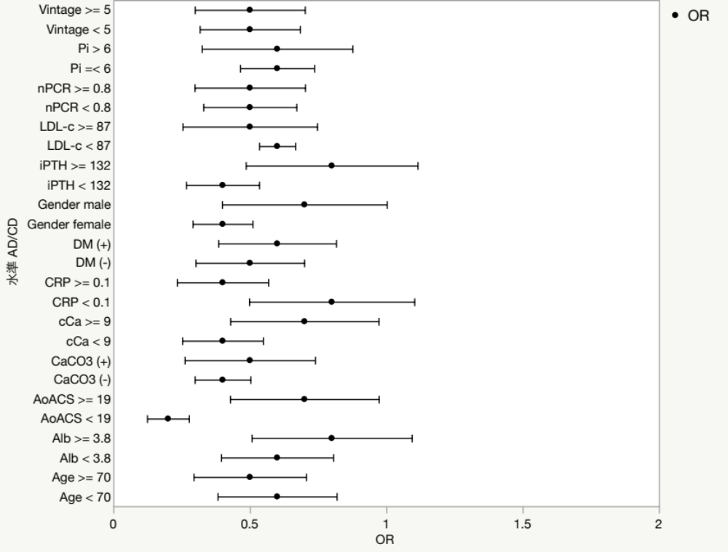
Supplementary Figure.
 |  | Main effect | Interaction
Vintage (years) | ≧ 5 < 5 | P=0.083 P=0.753 | P=0.957
Pi (mg/dL) | > 6 ≦ 6 | P=0.485 P=0.008 | P=0.932
nPCR (g/kg/day) | ≧ 0.8 < 0.8 | P=0.120 P=0.251 | P=0.688
LDL-c (mg/dL) | ≧ 87 < 87 | P=0.061 P=0.568 | P=0.715
iPTH (pg/mL) | ≧ 132 < 132 | P=0.613 P=0.036 | P=0.196
Gender | Male Female | P=0.377 P=0.093 | P=0.518
DM | (+) (−) | P=0.346 P=0.091 | P=0.647
CRP (mg/dL) | ≧ 0.1 < 0.1 | P=0.041 P=0.753 | P=0.294
cCa (mg/dL) | ≧ 9 < 9 | P=0.456 P=0.044 | P=0.437
CaCO3 | (+) (−) | P=0.096 P=0.163 | P=0.820
AoACS (%) | ≧ 19 < 19 | P=0.485 P=0.008 | P=0.045
Alb (g/dL) | ≧ 3.8 < 3.8 | P=0.582 P=0.236 | P=0.324
Age (years) | ≧ 70 < 70 | P=0.174 P=0.242 | P=0.907
CD better
AD better

Slide 3
Supplementary Table.
(mEq/L) |  |  |  |  |  |  |  |  | (mg/dL)
 | Na ⁺ | K ⁺ | Ca ⁺⁺ | Mg ⁺⁺ | Cl⁻ | CH₃COO⁻ | Citrate | HCO3⁻ | C₆H₁₂O₆
AD | 140 | 2 | 2.75 | 1 | 112.25 | 8 | 0 | 27.5 | 125
CD | 140 | 2 | 3 | 1 | 111 | 0 | 2 | 35 | 150

