Slide 1
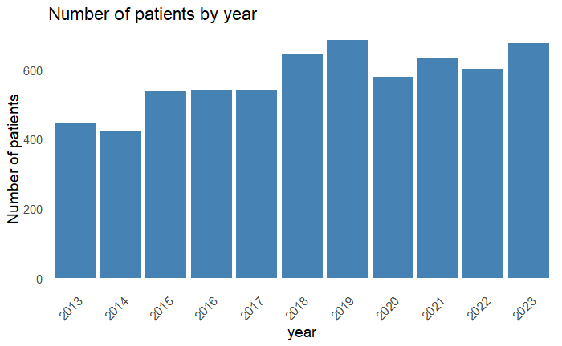
Supplementary Figure 1
800
600
Number of patients
400
200
0
2013
2014
2015
2016
2017
2018
2019
2020
2021
2022
2023
Year

Slide 2
Supplementary Figure 1
800
600
Number of patients
400
200
0
2013
2014
2015
2016
2017
2018
2019
2020
2021
2022
2023
Year

Slide 3
Supplementary Figure 2
Japan
China
South Korea
100
P <0.01
100
P <0.01
100
P =0.64
75
75
75
Proportion (%)
Proportion (%)
Proportion (%)
50
50
50
25
25
25
0
0
0
2015
2013
2015
2017
2019
2021
2023
2013
2015
2017
2019
2021
2023
2013
2017
2019
2021
2023
Year
Year
Year
Taiwan
Turkey
100
P =0.28
100
P =0.75
75
75
HBV
Proportion (%)
Proportion (%)
50
50
HCV
25
25
HBV+HCV
0
0
2015
ALD
2013
2015
2017
2019
2021
2023
2013
2017
2019
2021
2023
Year
Year
MAFLD
Indonesia
Mongolia
MAFLD+eAL
100
P =0.67
100
P <0.01
Autoimmune
75
75
Proportion (%)
Proportion (%)
Cryptogenic
50
50
25
25
Others
0
0
2015
2013
2015
2017
2019
2021
2023
2013
2017
2019
2021
2023
Year
Year

Slide 4
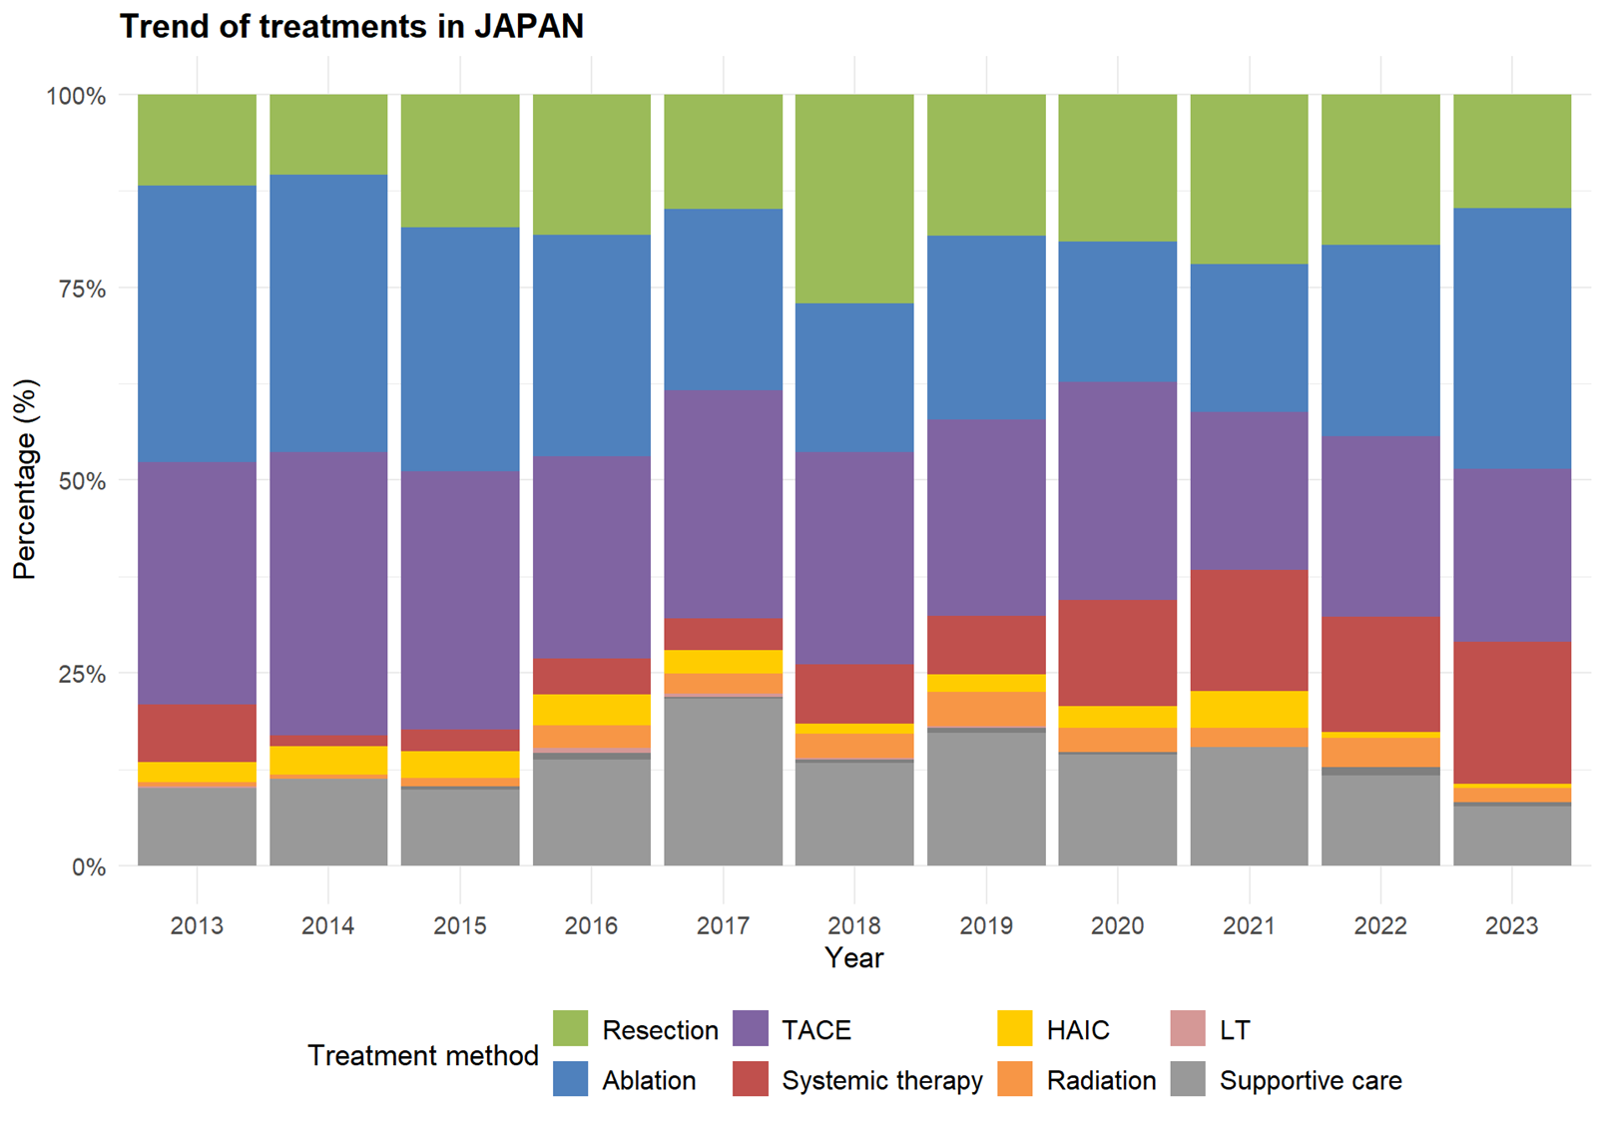
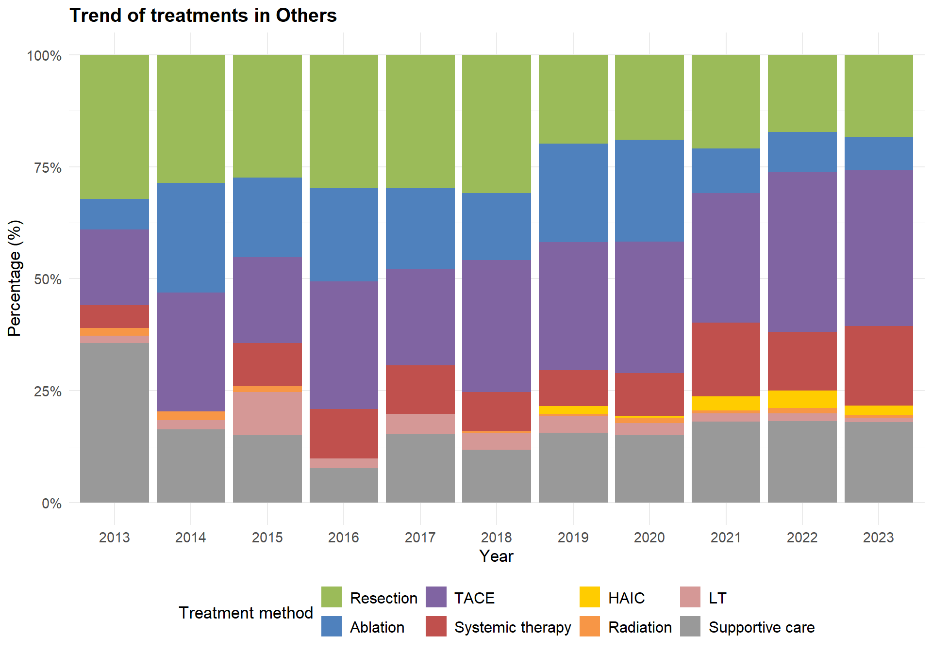
Supplementary Figure 3
Japan
Other countries
100
100
P <0.01
P <0.01
75
75
Proportion (%)
Proportion (%)
50
50
25
25
0
0
2013
2015
2017
2019
2021
2023
2013
2015
2017
2019
2021
2023
Year
Year
Resection
Ablation
TACE
Systemic therapy
HAIC
Radiation
LT
Supportive care

Slide 5
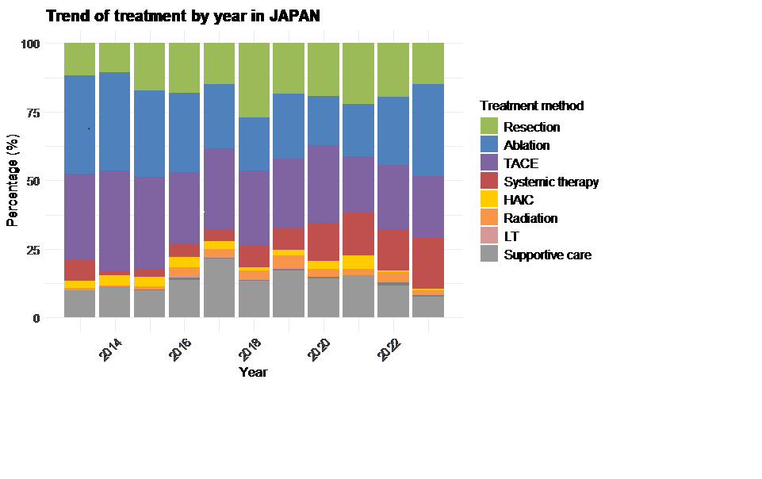
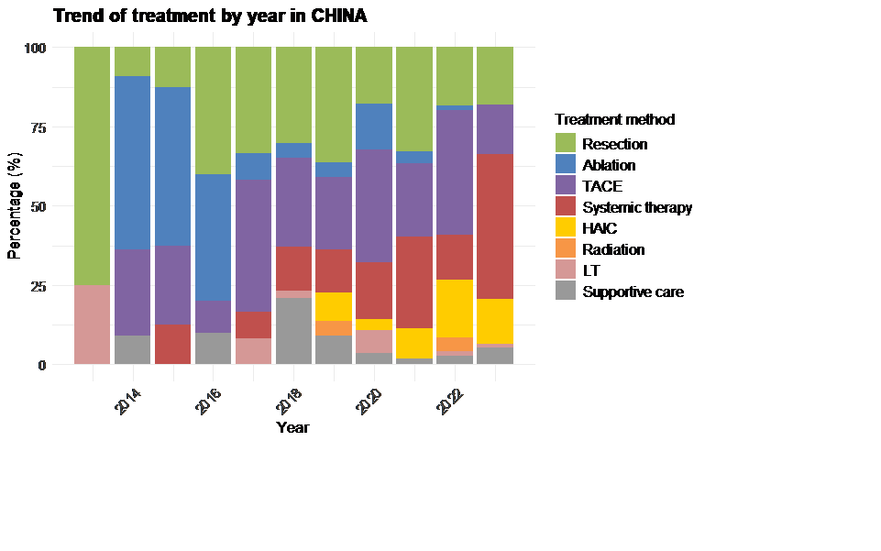
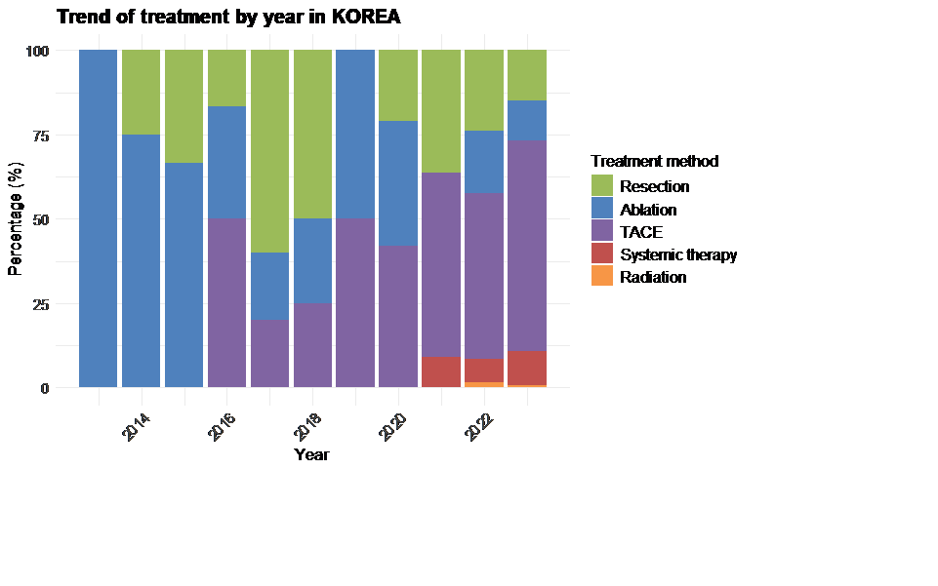
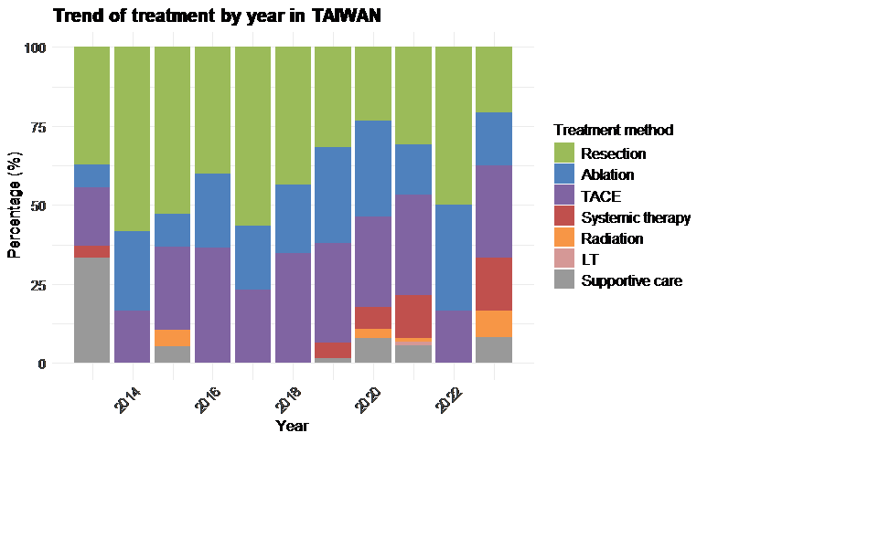
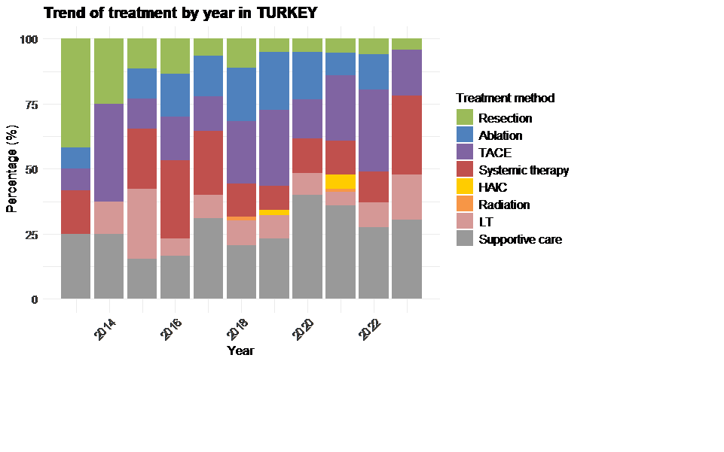
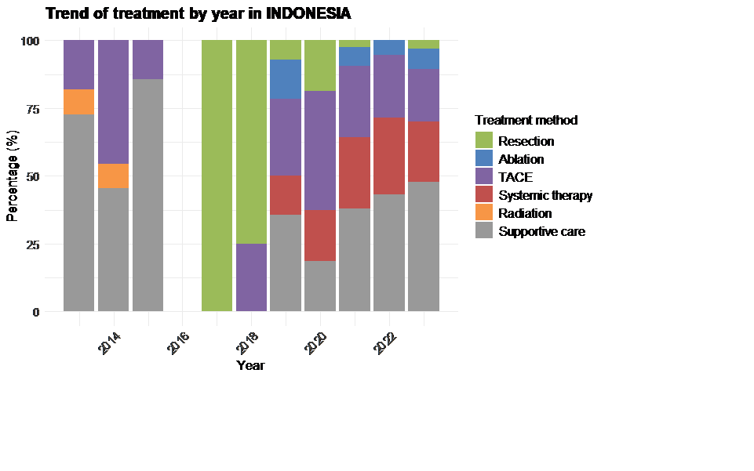
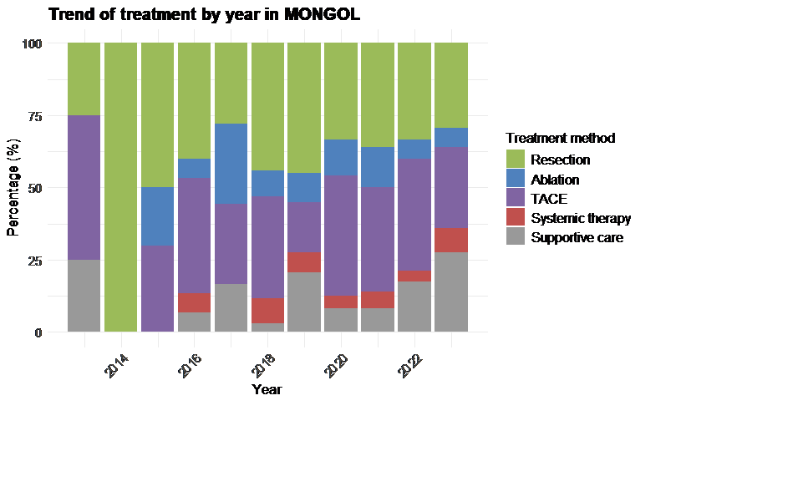
Supplementary Figure 4
Japan
China
South Korea
100
P <0.01
100
P <0.01
100
P =0.034
75
75
75
Proportion (%)
Proportion (%)
Proportion (%)
50
50
50
25
25
25
0
0
0
2015
2013
2015
2017
2019
2021
2023
2013
2015
2017
2019
2021
2023
2013
2017
2019
2021
2023
Year
Year
Year
Taiwan
Turkey
100
P <0.01
100
P =0.31
75
75
Resection
Proportion (%)
Proportion (%)
50
50
Ablation
25
25
TACE
0
0
2015
Systemic therapy
2013
2015
2017
2019
2021
2023
2013
2017
2019
2021
2023
Year
Year
HAIC
Indonesia
Mongolia
Radiation
100
P <0.01
100
P =0.25
LT
75
75
Proportion (%)
Proportion (%)
Supportive care
50
50
25
25
0
0
2015
2013
2015
2017
2019
2021
2023
2013
2017
2019
2021
2023
Year
Year

