Slide 1
Additional file 1
Tests | Specification
Anti-HIV 1-2 Ab | Negative
HIV NAT | Undetectable (PCR)
HCV NAT | Undetectable (PCR)
HBV NAT | Undetectable (PCR)
Anti-HCV Ab | Negative
HBs Ag | Negative
Anti-HBc | Negative
HTLV I and II Ab | Negative
Syphilis | Negative
CMV | IgG-/IgM- or IgG+/IgM-
EBV | IgG-/IgM- or IgG+/ IgM-
Toxoplasma Gondii | IgG-/IgM- or IgG+/ IgM-
SARS-Cov2* | Undetectable (nasopharyngeal PCR)

Slide 2
Additional file 2
Cytokines | References
Interferon-γ (IFNγ) | 285-IF (R&D Systems)
Tumor necrosis factor-α (TNFα) | 210-TA (R&D Systems)
IFNγ + TNFα | 285-IF/210-TA
Interleukin 6 (IL6) | RP8619 (Invitrogen)
Interleukin 1β (IL1β) | BMS331 (Invitrogen)
Granulocyte macrophage colony-stimulating factor (GM-CSF) | BMS324 (Invitrogen)
IFNγ + TNFα + IL6 + IL1β + GM-CSF (Mix) | See above

Slide 3
Additional file 3
Markers | Antibodies | Clone | Volume (µL) | References
ISCT® mesenchymal markers | Anti-CD90 FITC | 5E10 | 0.625 | 555595 (BD Biosciences)
 | Anti-CD105 PC7 | TEA3/17.1.1 | 1,25 | B43293 (Beckman Coulter)
 | Anti-CD73 PerCP-efluor710 | AD2 | 2.5 | 46-0739-42 (Thermo Fisher)
Adhesion molecules | Anti-CD44 efluor506 | IM7 | 5 | 69-0441-82 (Thermo Fisher)
 | Anti-CD29 PE | MAR4 | 2.5 | 555443 (BD Biosciences)
 | Anti-CD166 SB600 | 3A6 | 5 | 63-1668-42 (Thermo Fisher)
Hematopoietic & endothelial markers | Anti-CD14 APC-H7 | MφP9 | 5 | 560180 (BD Biosciences)
 | Anti-CD45 AF700 | HI30 | 5 | 560566 (BD Biosciences)
 | Anti-CD31 APC | REA730 | 2 | 130-110-670 (Miltenyi)
Pericyte marker | Anti-CD146 BV421 | P1H12 | 0.315 | 564325 (BD Biosciences)
Immunogenic markers | Anti-HLA-ABC APC | REA230 | 1 | 130-101-467 (Miltenyi)
 | Anti-HLA-DR PerCPCy5.5 | LN3 | 5 | 45995642 (ebiosciences)
Co-stimulatory molecules | Anti CD40-BV421 | 5C3 | 5 | 563396 (BD Biosciences)
 | Anti-CD80 PE | L307.4 | 5 | 557227 (BD Biosciences)
 | Anti-CD86 PE-VIO770 | FM95 | 2 | 130-113-573 (Miltenyi)
Activation markers | Anti-CD54 (ICAM-1) Alexa Fluor 700 | HA58 | 5 | 56-0549-41 (Thermo Fisher)
 | Anti-CD274 (PD-L1) eFluor 450 | B7-H1 | 5 | 48-5983-41 (Thermo Fisher)
 | Anti-CD106 (VCAM-1) PE-Cy7 | STA | 5 | 25-1069-41 (Thermo Fisher)
 | Anti-CD200 APC | OX104 | 5 | 17-9200-41 (Thermo Fisher)
 | Anti-CD119 (IFNγ-R) PE | GIR-208 | 5 | 12-1199-41 (Thermo Fisher)
 | Anti-CD120b (TNF-RII) FITC | REA520 | 2 | 130-107-708 (Miltenyi)

Slide 4
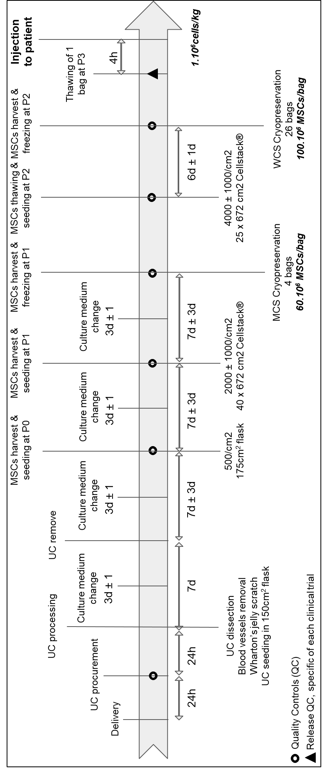
Additional file 4

Slide 5
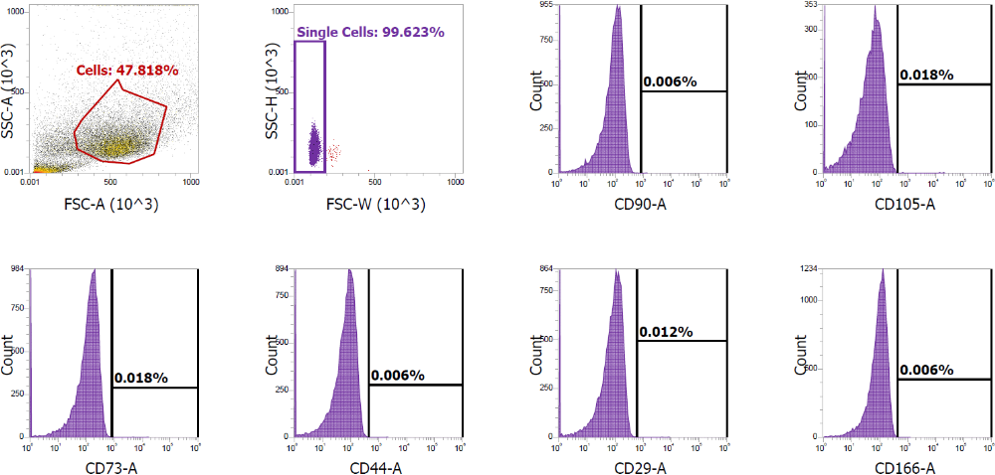
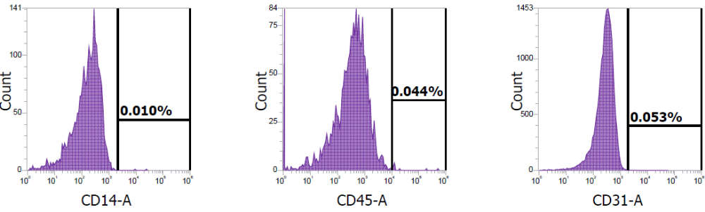
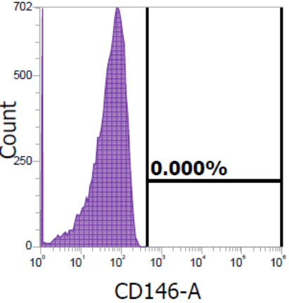
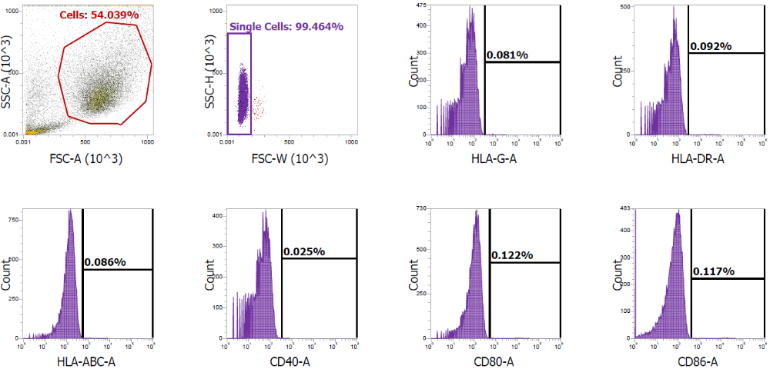
Additional file 5

Slide 6
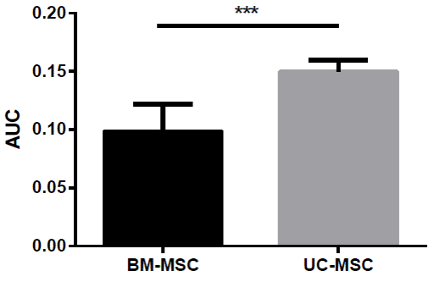
Additional file 6

