Slide 1
Supporting Information
Bae et al., 2021

Slide 2
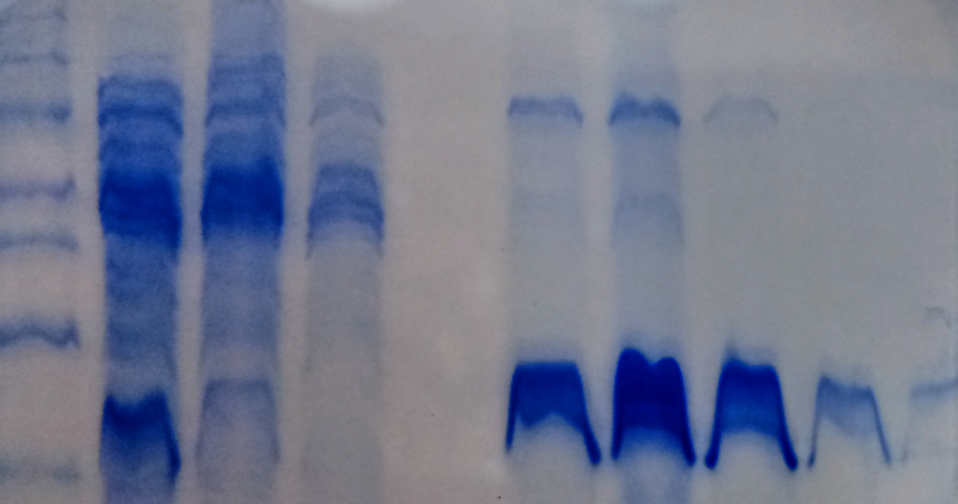
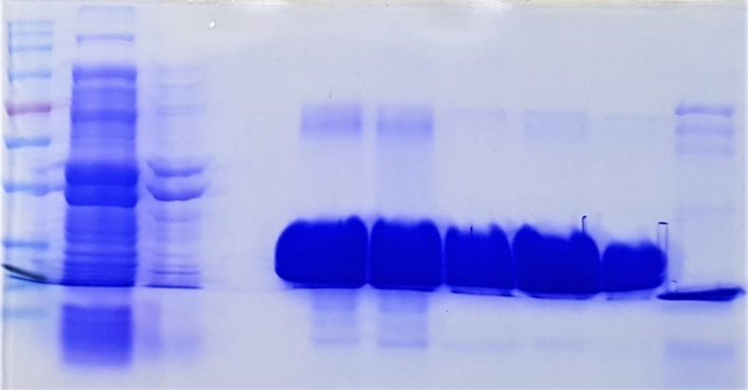
Figure S1
Dgeo_0257
M p2 p3 w3 w20 e2 e3 e4 e5 e6
kDa
60
50
30
20
Dgeo_0281
M p3 w3 w20 e2 e3 e4 viva n/viva 0257
kDa
70
50
30
20

Slide 3
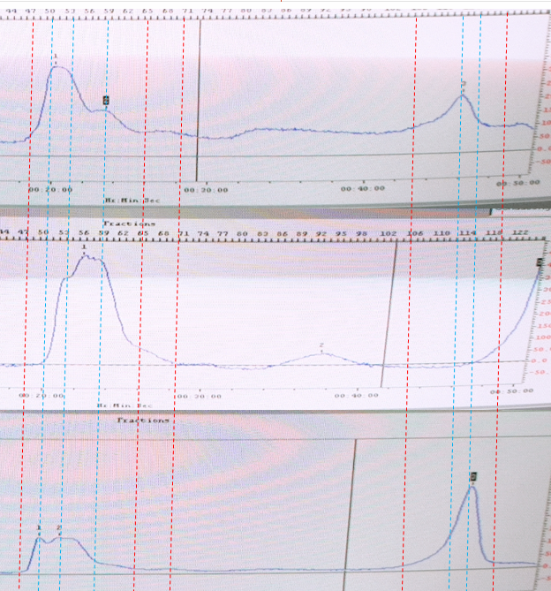
Figure S2
A
1
2
3
4
Protein only
Fe(II) 1mM
Fe(III) 1mM
Notes:
Gel filtration of Dgeo_0257 with/without various metal ions. A; Calibration of gel filtration. Marker used: 1: 440 kDa, 2: 75 kDa, 3: 43 kDa, 4: 29kDa. B: Protein only
C: Add Fe(II) 1mM, D; Add Fe(III) 1mM

Slide 4
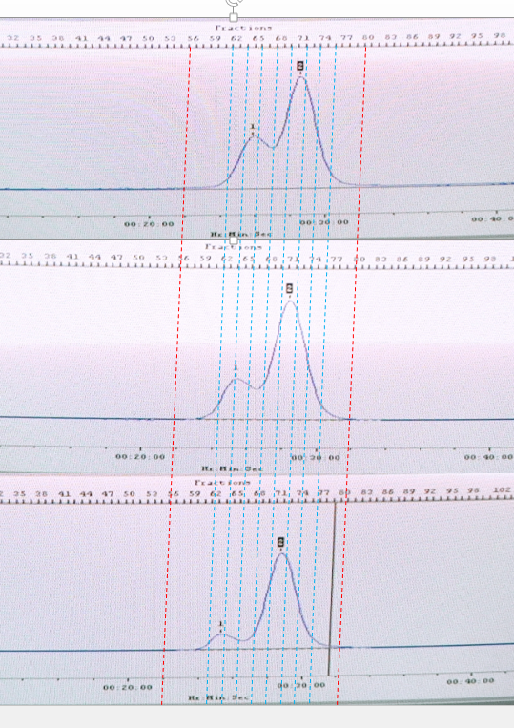
Figure S2
B
1
2
3
4
#56
#80
Protein only
+ Fe(II) 1mM
+ Fe(III) 1mM
Notes:
Gel filtration of Dgeo_0281 with/without various metal ions. A; Calibration of gel filtration. Marker used: 1: 440 kDa, 2: 75 kDa, 3: 43 kDa, 4: 29kDa. B: Protein only C: Add Fe(II) 1mM D: Add Fe(III) 1mM

Slide 5
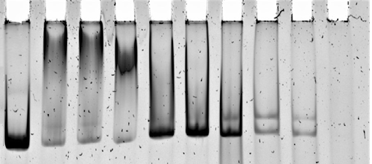
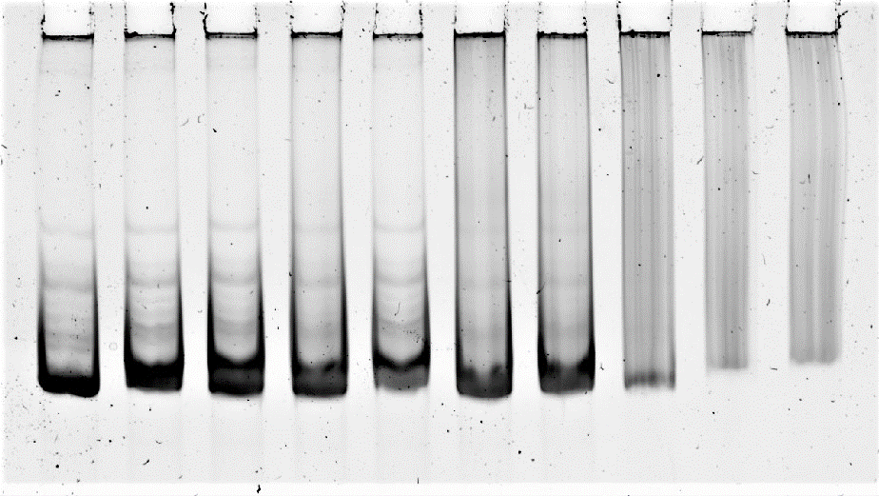
Figure S3
A
DNA
Dgeo_0257 - µM
Fe (II) - - 0.02 0.1 0.2 0.3 0.5 1.0 1.5 2.0 mM
ORF region
10
1 2 3 4 5 6 7 8 9 10
DNA
Dgeo_0281 - - µM
Fe (II) - 0.1 - 0.1 0.5 1 2 3 4 5 mM
ORF region
30
1 2 3 4 5 6 7 8 9 10

Slide 6
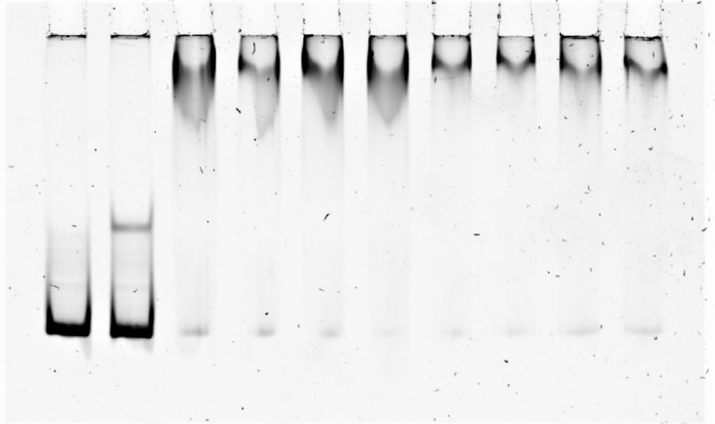
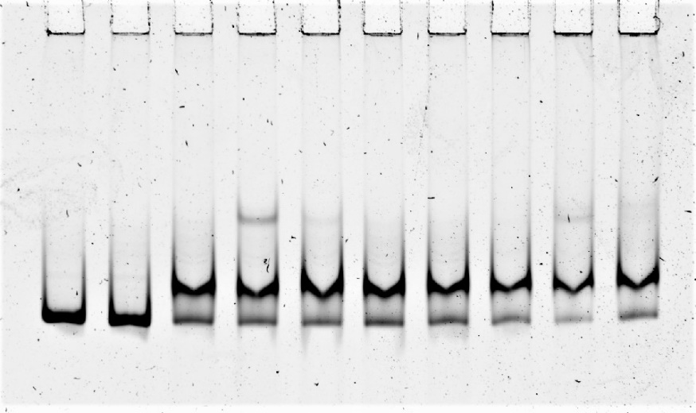
Figure S3
B
DNA
Dgeo_0257 - - µM
Pb - 0.1 - 0.1 0.5 1 2 3 4 5 mM
Promoter region
10
1 2 3 4 5 6 7 8 9 10
DNA
Dgeo_0281 - - µM
Pb - 0.1 - 0.1 0.5 1 2 3 4 5 mM
Promoter region
30
1 2 3 4 5 6 7 8 9 10

Slide 7
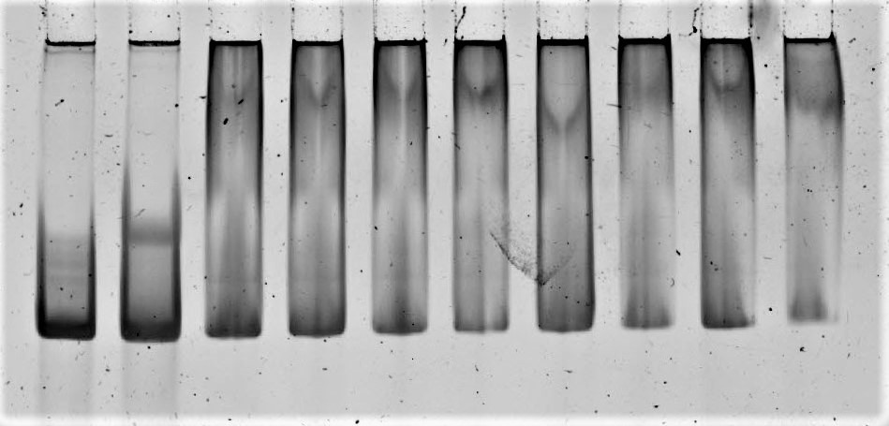
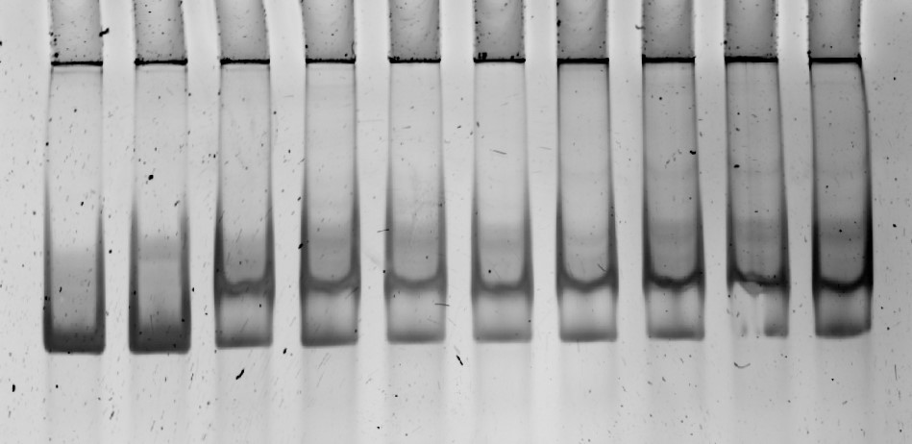
Figure S3
C
DNA Orf region
Dgeo_0257 10
Co 0 0.1 0 0.1 0.5 1 2 3 4 5 mM
µM
1 2 3 4 5 6 7 8 9 10
DNA Orf region
Dgeo_0281 45 µM
Co 0 0.1 0 0.1 0.5 1 2 3 4 5 mM
1 2 3 4 5 6 7 8 9 10
Notes:
EMSA in a 6% Native gel as increasing protein concentration in the presence Co ions

Slide 8
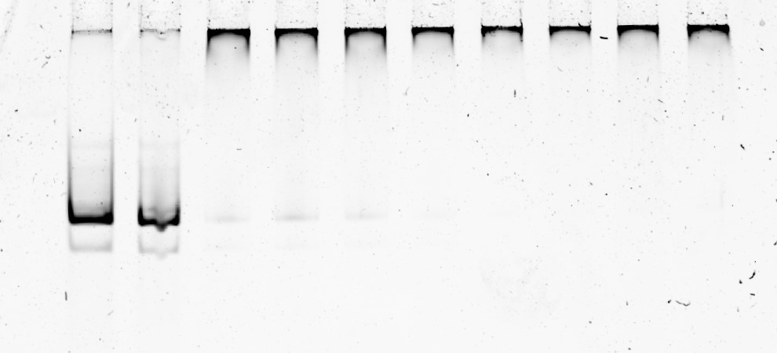
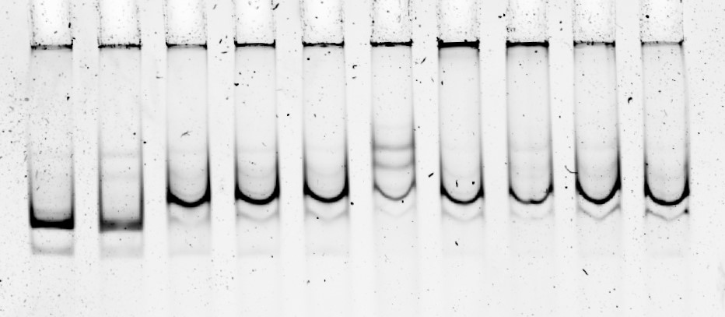
Figure S3
D
DNA Orf region
Dgeo_0257 10 µM
Cu 0 0.1 0 0.1 0.5 1 2 3 4 5 mM
1 2 3 4 5 6 7 8 9 10
DNA Orf region
Dgeo_0281 45 µM
Cu 0 0.1 0 0.1 0.5 1 2 3 4 5 mM
1 2 3 4 5 6 7 8 9 10
Notes:
EMSA in a 6% Native gel as increasing protein concentration in the presence Cu ions

Slide 9
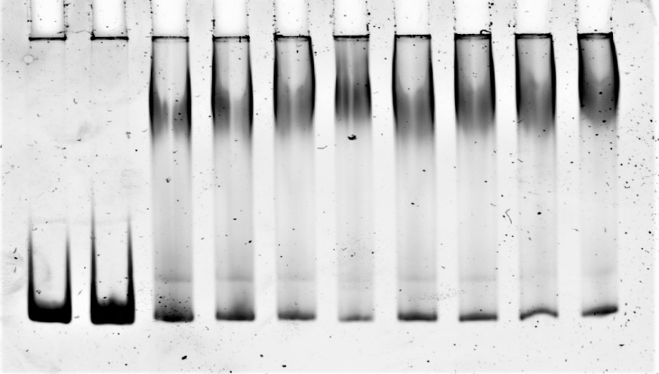
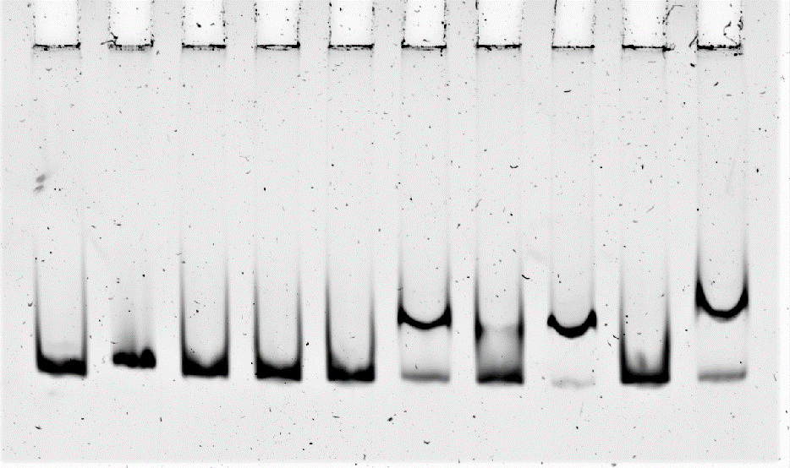
Figure S3
E
DNA
Dgeo_0257 - - µM
Cs - 0.1 - 0.1 0.5 1 2 3 4 5 mM
Promoter region
10
1 2 3 4 5 6 7 8 9 10
DNA
Dgeo_0281 - - µM
Cs - 0.1 - 0.1 0.5 1 2 3 4 5 mM
Promoter region
30
1 2 3 4 5 6 7 8 9 10
Notes:
철 대신 Cs를 첨가 했을 때의 complex 변화 측정이다. Cs의 양이 증가해도 super-shift 된 complex 위치는 일정하게 유지된다.

Slide 10
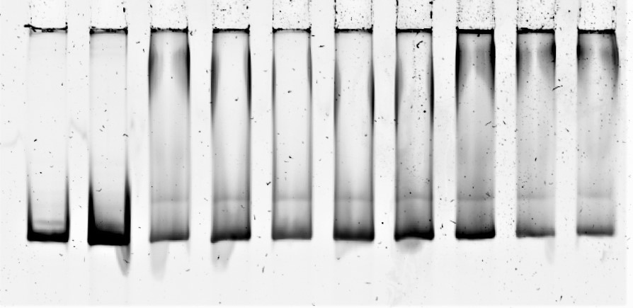
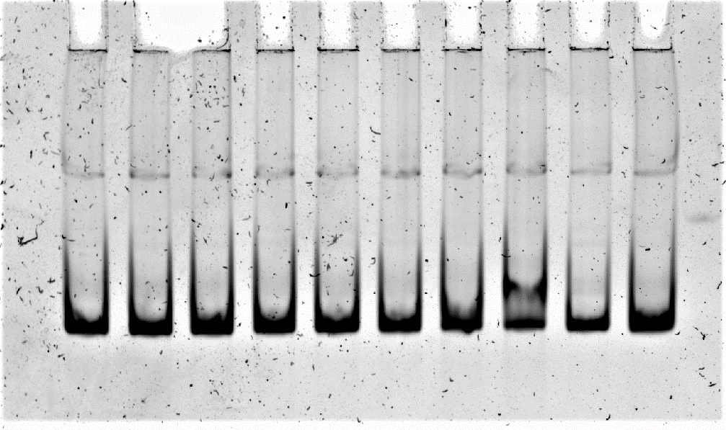
Figure S3
F
DNA
Dgeo_0257 - - µM
Cr - 0.1 - 0.1 0.5 1 2 3 4 5 mM
Promoter region
10
1 2 3 4 5 6 7 8 9 10
DNA
Dgeo_0281 - - µM
Cr - 0.1 - 0.1 0.5 1 2 3 4 5 mM
Promoter region
30
1 2 3 4 5 6 7 8 9 10

Slide 11
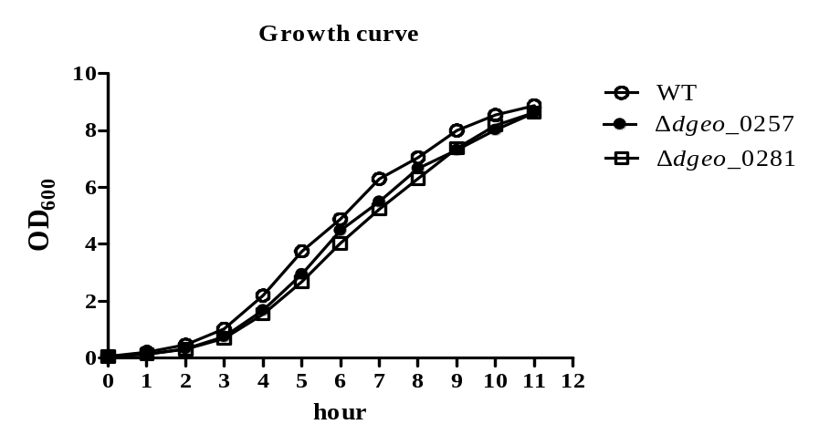
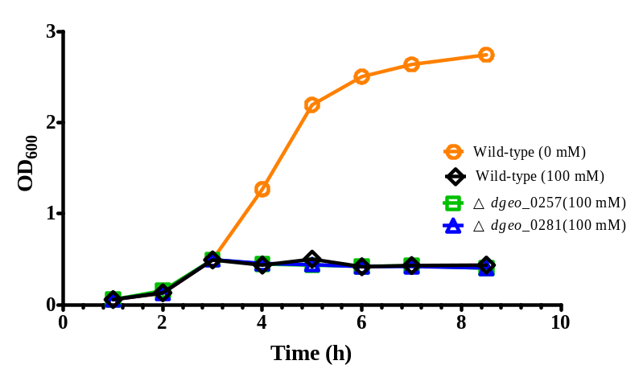
Figure S4
A
B
H₂O₂
Notes:
3h (OD1.470) 에서 H2O2 100mM treatment

