Slide 1
Graphical abstract

Slide 2
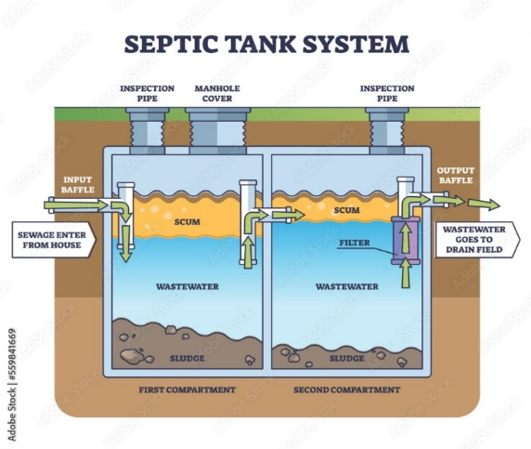
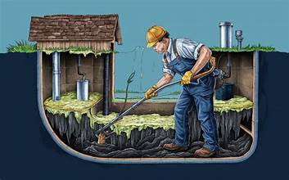
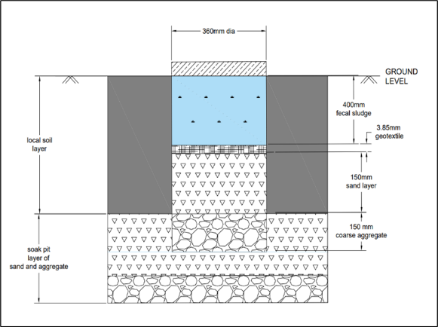
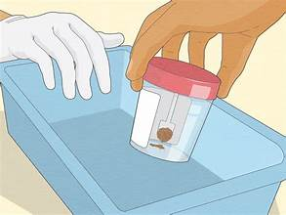


Placed the sludge in treatment plant
Sludge in septic tank
Collection of sludge
A Low-Cost Household-Scale Fecal Sludge Treatment
Analysis the result
Collection of sample
Test the sample in Lab

