Slide 1
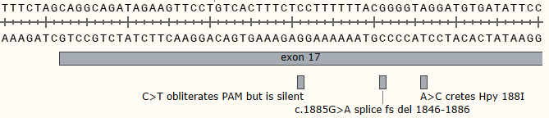




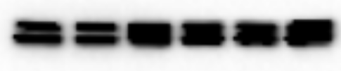
Suppl Figure 1: Characterization of Precision Cell Line Models for c.1885G>A in NF1 Exon 17
A
D
+/+ A15 B6 B48 B52 -/-
NF1
actin
B
Sub-cloning results
Clone | WT Allele | Mut allele
A15 | 0 | 20
B6 | 17 | 3
B48 | 10 | 10
B52 | 6 | 14
C
RT-PCR
+/+ A15 B6 B48 B52 -/-
pERK
WT
ERK
c.1885G>A
E
F
G

