Slide 1

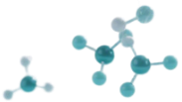

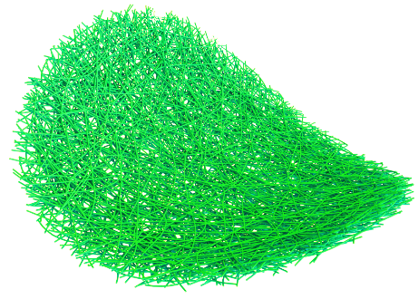
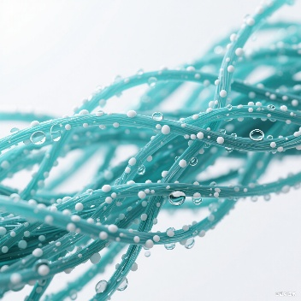


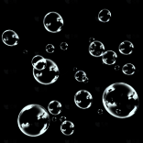

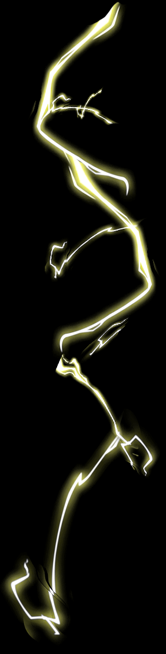
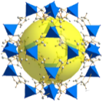


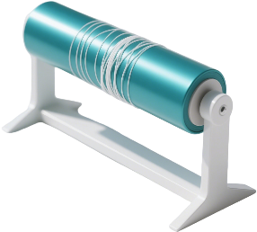

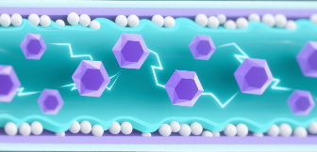
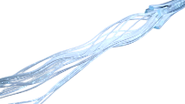
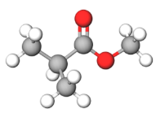

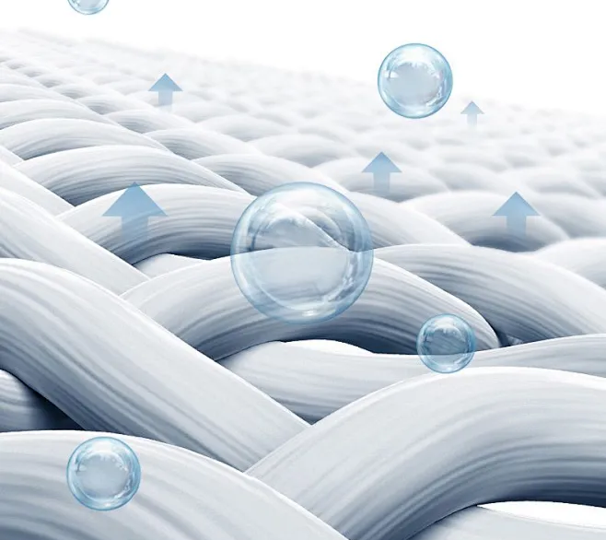


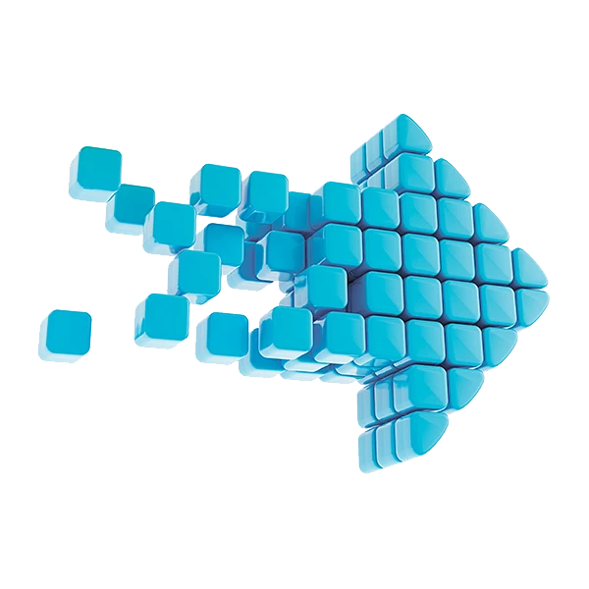


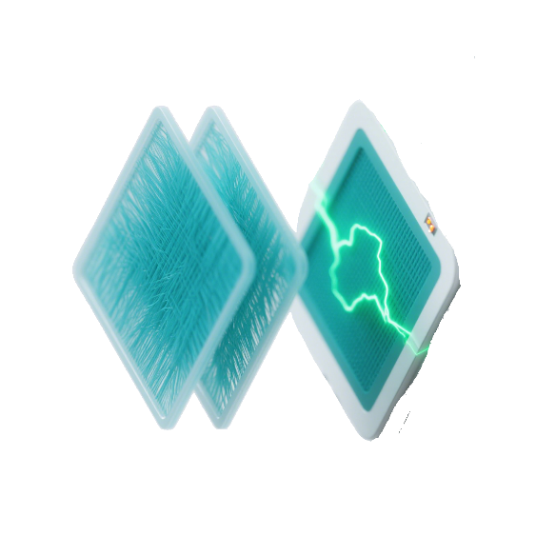

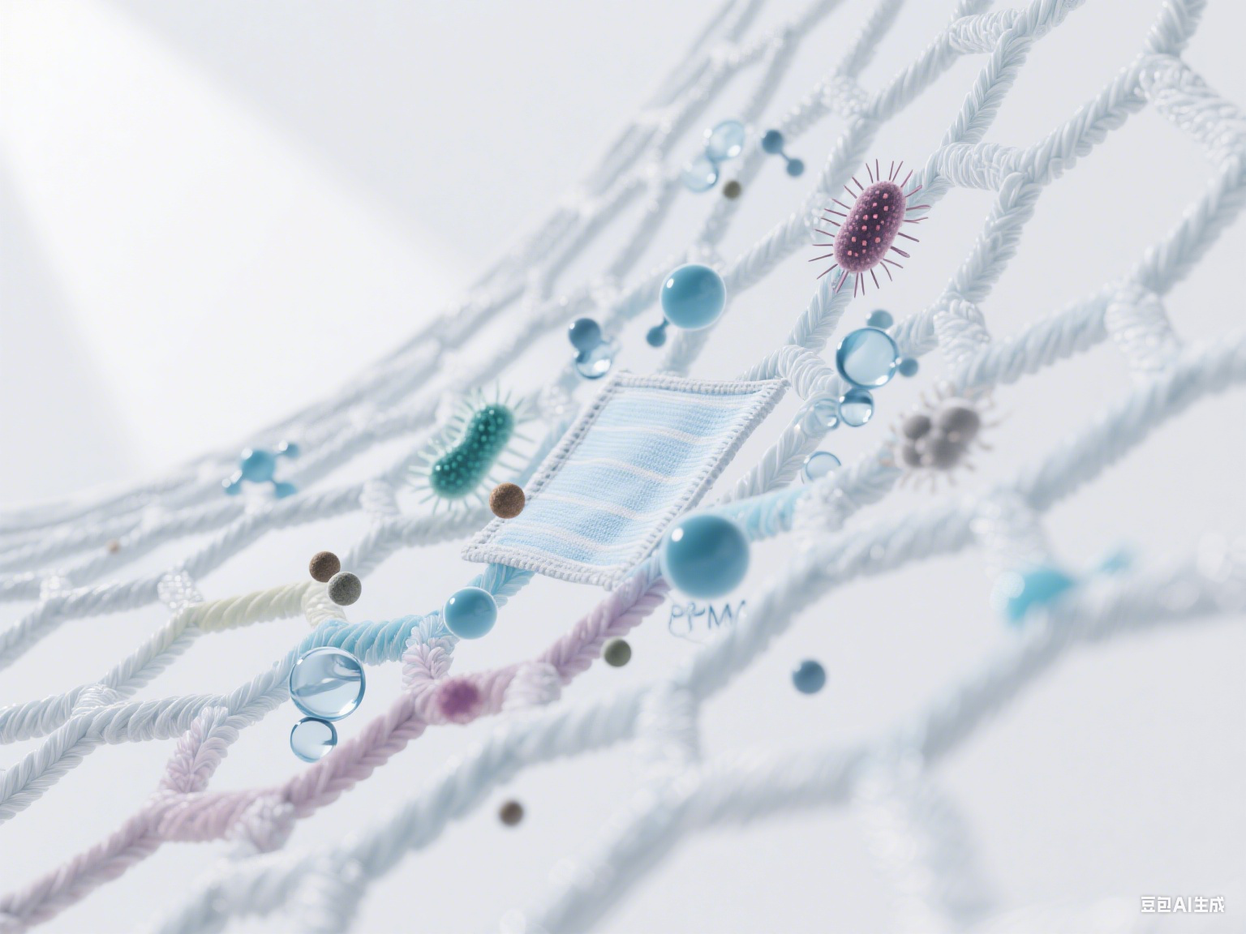
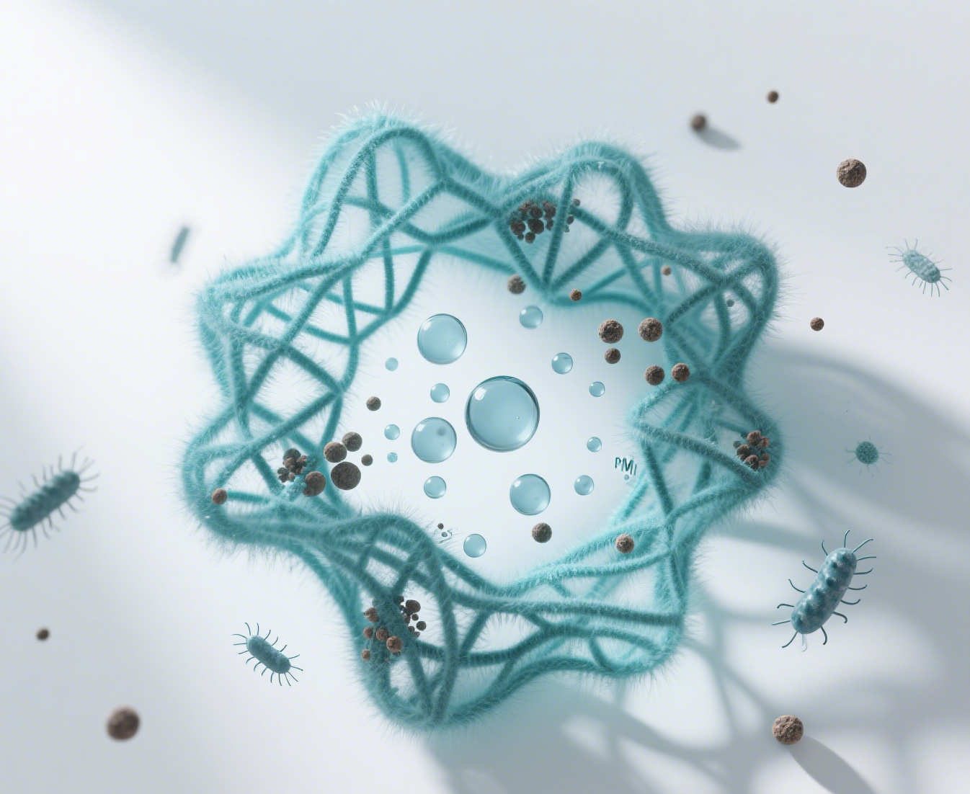

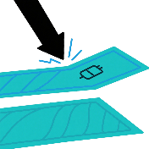
Figure 1
a
Microenvironment-Regulating and Self-Decontaminating (MRSD) Meta-Membranes
Electrospray
Isolation protection
Charge redistribution
Electron migration
Nanoblocks
Nanocrystals
PLA
Electrospinning
Hierarchically heterogeneous structured interfaces
b
Breathable
Waterproof
Purification
Hydrophobicity
Water vapor transmission
Permeability
MRSD-PLA
Multifunctional integration
Antibacterial
Decontaminating
Mechanical energy
Blood splash protection
Electrical energy
Multifunctional protection
Multiple mechanisms
Electrical signal transmission

Slide 2
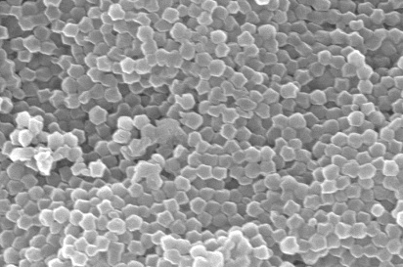
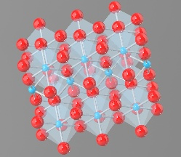
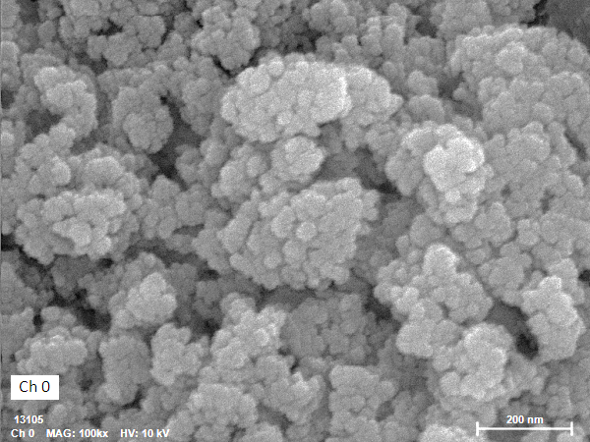
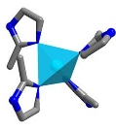
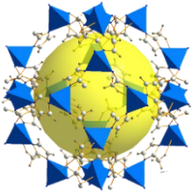
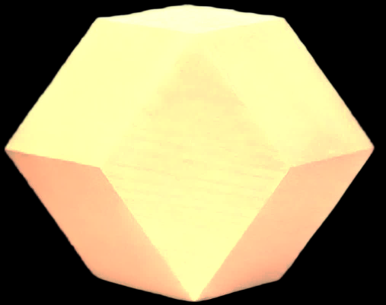

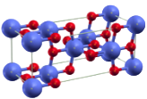
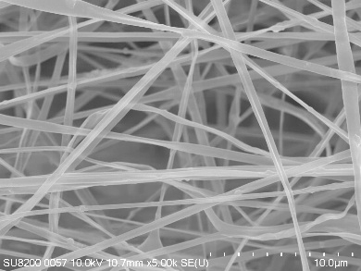
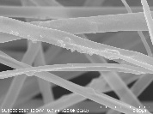
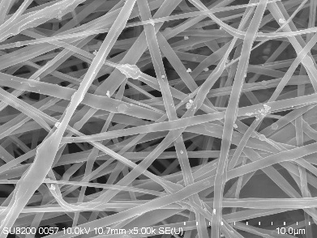
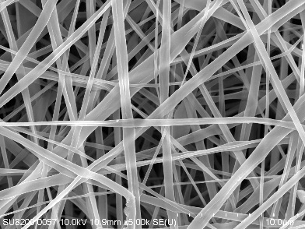
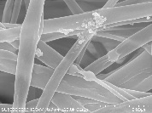
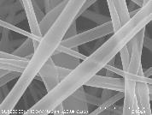
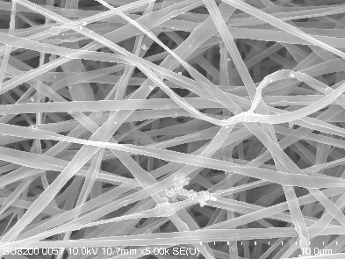
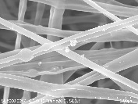
Figure 2
a
ZIF-8 nanocrystals
b
F-TiO₂ nanoblocks
500 nm
200 nm
High porosity, High electrochemical activity
Low surface energy, High electronegativity
c
d
e
f
1 μm
F-TiO₂
1 μm
F-TiO₂
1 μm
F-TiO₂
1 μm
ZIF-8
5 μm
ZIF-8
5 μm
5 μm
5 μm
ZIF-8
g
h
i
j
Transmittance (a.u.)
Transmittance (a.u.)
1452
O−O
Transmittance (a.u.)
1184
Transmittance (a.u.)
1088
C−O
MRSD-PLA6
1452
1383
−CH₃/O−O
MRSD-PLA4
1383
1184
1089
1453
C=N
MRSD-PLA2
1382
1185
1089
1454
C=O
P-PLA
1380
1186
1090
−CH₃
C−O
C−O
k
Wavenumber (cm^{‒1})
l
Wavenumber (cm^{‒1})
m
Wavenumber (cm^{‒1})
n
Wavenumber (cm^{‒1})
Intensity (a.u.)
Quantity Adsorbed (cm³/g)
Stress (MPa)
（011）
（002）
（112）
（110）
MRSD-PLA6
16.0
MRSD-PLA4
14.5
Tensile Strength (MPa)
MRSD-PLA2
12.8
11.1
P-PLA
P-PLA
MRSD-PLA2
MRSD-PLA4
2 Theta (Degree)
Relative Pressure (P/P₀)
Strain (%)
MRSD-PLA6

Slide 3

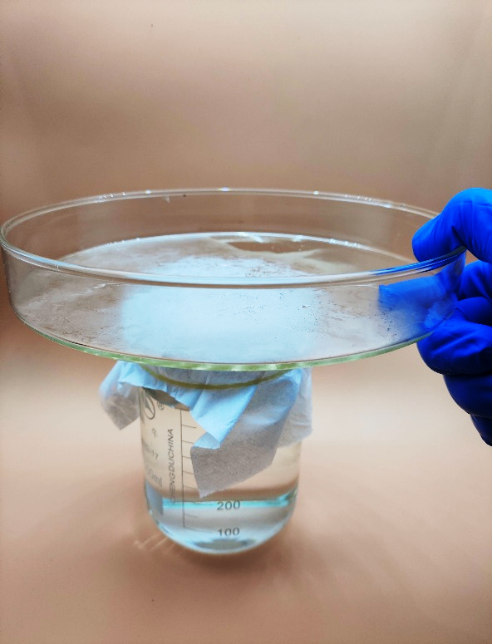

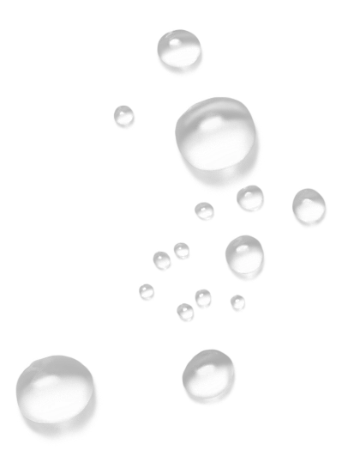
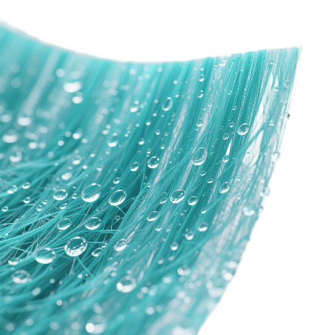
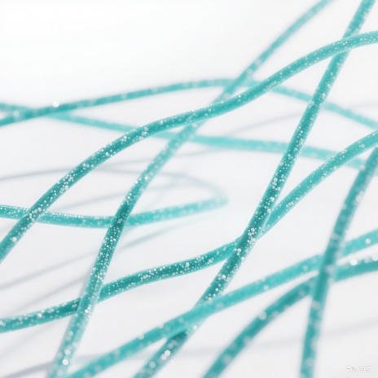

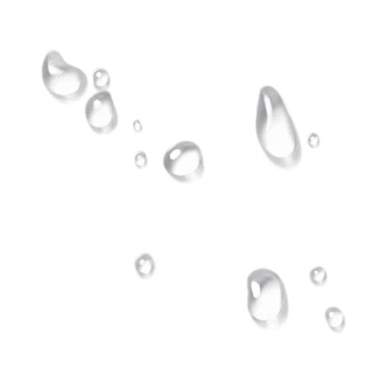






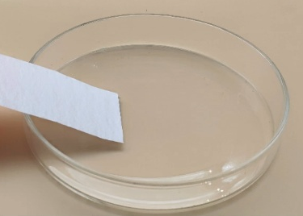
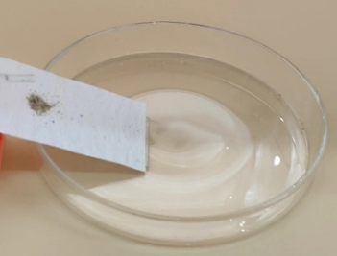

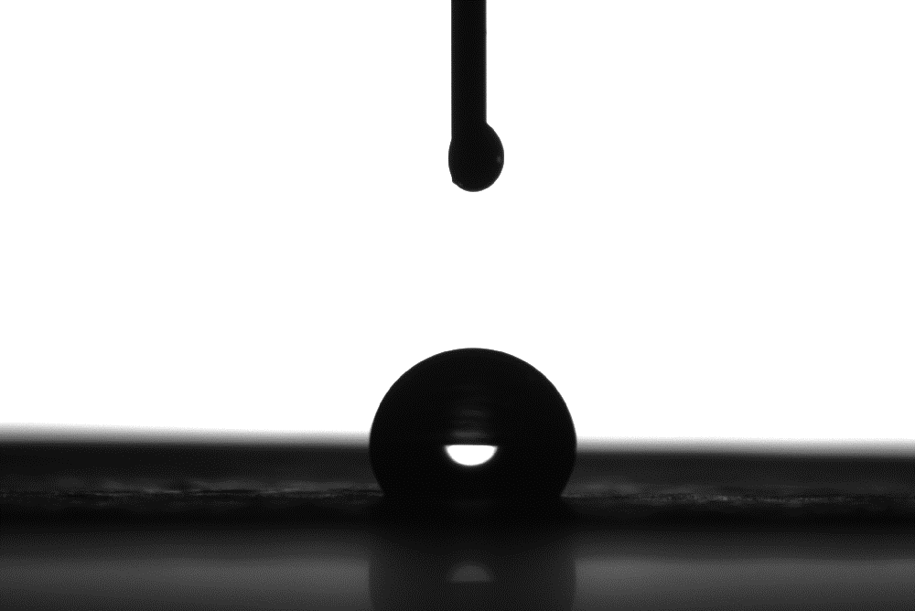





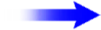
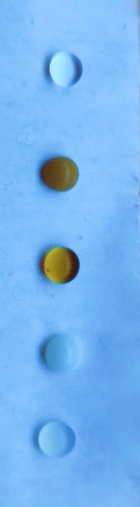
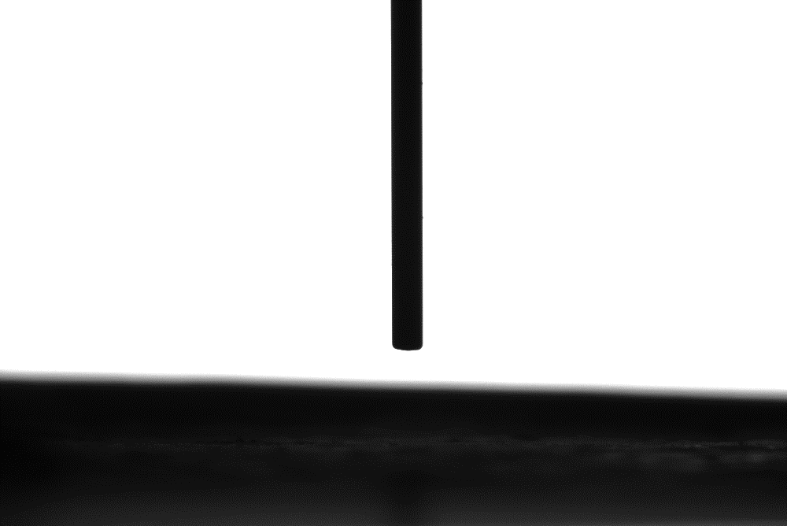
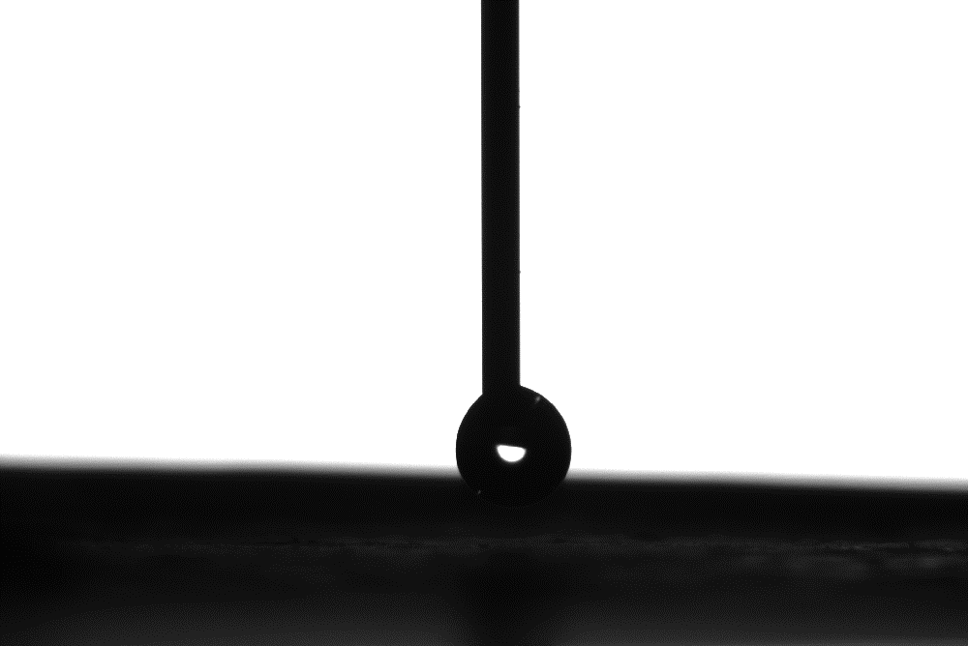
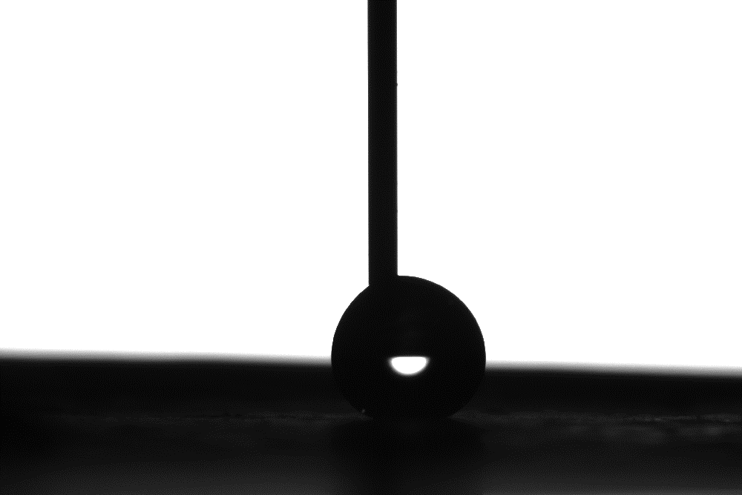
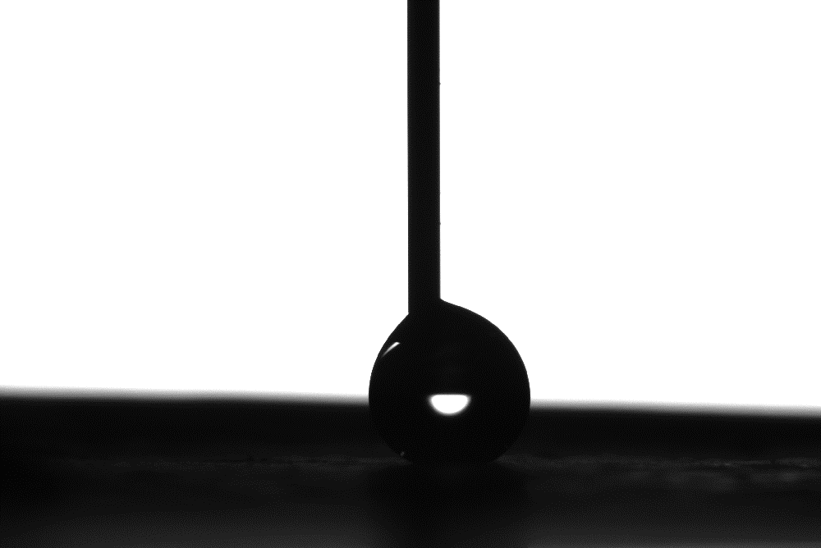
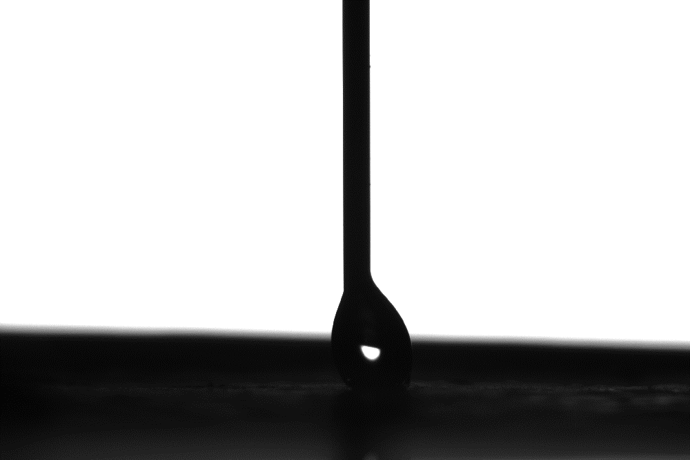
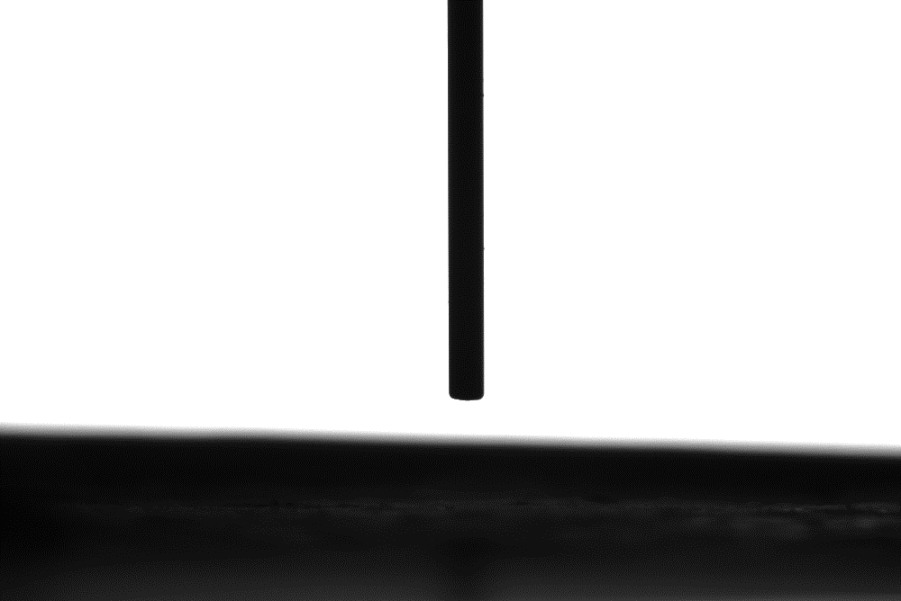
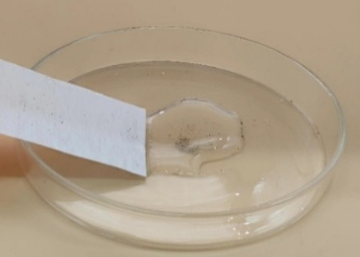
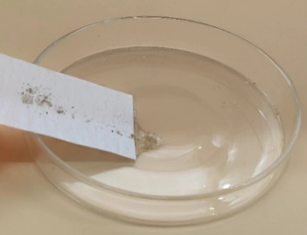

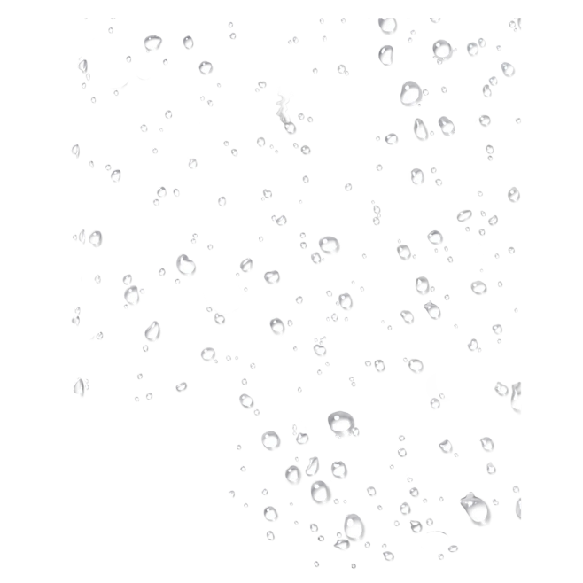









Figure 3
a
b
c
Multifunctional protection
Microenvironment regulation
Charge redistribution
Condensed Water Vapor
MRSD-PLA6
137.4
MRSD-PLA4
125.1
Waterproof
e⁻
e⁻
MRSD-PLA2
119.1
e⁻
Breathable
e⁻
P-PLA
112.6
e⁻
MRSD-PLA6
2 cm
Hot Water
WCA (°)
MRSD-PLA meta-membranes
Interconnected network
Heterogeneous interface
d
0 s
1 min
2 min
3 min
4 min
5 min
e
f
Water
MRSD-PLA6
Sand
Water
Coffee
Rich pores
(Breathable)
Injection
Hydrophobic
Stable
Suction
Detached
Cola
Milk
Self-cleaning
Tumble
Tea
3 cm
g
h
i
j
3976
3997
4018
74.9
69.5
68.9
Rich pores
(Breathable)
3697
3731
Fiber
Heterogeneous structure
46.8
WVTR (g·m⁻²·d⁻¹)
Air Permeability (mm·s⁻¹)
Transmission pathway
ZIF-8
Selective transmembrane transport
P-PLA
MRSD-PLA2
MRSD-PLA4
Mask
PP
MRSD-PLA6
P-PLA
Cotton
MRSD-PLA6
Inter-fiber
Surface
Micropore

Slide 4














Figure 4
a
b
c
d
Surface Potential (kV)
5.3
5.5
5.8
1.72-MRSD-PLA6
Surface Potential (kV)
4.9
5.2
4.5
1.50-MRSD-PLA4
-9.000e⁻²
3.3
1.43-MRSD-PLA2
MRSD-PLA6
2.6
Dielectric Constant
Before polarization
Day 0
Day 0
Day 0
Day 0
1.39-P-PLA
Day 90
Day 90
Day 90
Day 90
Dust particles
9.000e⁻²
P-PLA
MRSD-PLA4
MRSD-PLA2
MRSD-PLA6
Frequency (Hz)
Relative Dielectric Constant
After polarization
e
f
g
Electron migration
Ⅰ
Ⅱ
High electronegativity
3
Charge
3×10⁵
2
1
Heterogeneous interfaces
0
Ⅳ
Ⅲ
-1
-2
e⁻
-3
Charge capture and storage
Deep trap
-3×10⁵
Charge redistribution
h
i
j
k
Output Voltage (V)
22.3
Output Current (nA)
67.5
Output Charge (nC)
8.2
Output Voltage (V)
22.3
19.4
41.5
22.1
20.0
14.9
20.8
28.3
5.5
6.4
2.0
P-PLA
0.8
MRSD-PLA2
MRSD-PLA4
P-PLA
MRSD-PLA2
MRSD-PLA4
MRSD-PLA6
MRSD-PLA6
P-PLA
MRSD-PLA2
MRSD-PLA4
MRSD-PLA6
60% RH
80% RH
95% RH
Time (s)
Time (s)
Time (s)
Time (s)
l
l₁
l₂
Output Voltage (V)
Output Voltage (V)
Output Voltage (V)
l₁
l₂
l₃
l₄
Time (s)
Time (s)
l₃
l₄
Time (s)
Time (s)
Time (s)

Slide 5







Figure 5
a
b
c
10 L/min
85 L/min
32 L/min
65 L/min
419.2
Quality Factor (Pa⁻¹)
Filtration Efficiency (%)
Pressure Drop (Pa)
Figure 5
0.0699
a
b
280.0
c
0.0430
234.0
10 L/min
85 L/min
32 L/min
65 L/min
419.2
163.7
Quality Factor (Pa⁻¹)
0.0302
Filtration Efficiency (%)
Pressure Drop (Pa)
142.8
82.4
99.3
0.0157
0.0699
59.1
280.0
0.0147
0.0081
0.0430
234.0
0.0067
163.7
0.0029
0.0302
142.8
P-PLA
MRSD-PLA2
99.3
P-PLA
MRSD-PLA4
MRSD-PLA6
MRSD-PLA2
MRSD-PLA4
MRSD-PLA6
d
Airflow Capacity (L/min)
e
59.1
82.4
f
0.0157
0.0147
0.0081
0.0067
P-PLA
MRSD-PLA6
P-PLA
MRSD-PLA6
Filtration Efficiency (%)
MRSD-PLA6
Filtration Efficiency (%)
97.5
97.0
Filtration Efficiency (%)
98.6
97.0
0.0029
95.6
96.1
94.1
92.9
P-PLA
MRSD-PLA2
MRSD-PLA4
89.1
P-PLA
d
Airflow Capacity (L/min)
e
86.4
MRSD-PLA6
f
MRSD-PLA2
MRSD-PLA4
MRSD-PLA6
90.8
91.6
90.7
74.5
PM-filtered
P-PLA
MRSD-PLA6
P-PLA
MRSD-PLA6
Filtration Efficiency (%)
97.5
88.2
Filtration Efficiency (%)
98.6
65.4
Filtration Efficiency (%)
MRSD-PLA6
95.6
97.0
96.1
94.1
97.0
92.9
86.4
89.1
90.8
91.6
90.7
74.5
2 μm
PM-filtered
88.2
65.4
g
Airflow Capacity (L/min)
h
Airflow Capacity (L/min)
i
Time (min)
2 μm
Filtration Efficiency (%)
98.4
P-PLA
MRSD-PLA6
Pressure Drop (Pa)
P-PLA
632 Pa
MRSD-PLA6
Percentage (%)
93.2
89.5
g
Airflow Capacity (L/min)
h
Airflow Capacity (L/min)
i
Time (min)
76.4
Filtration Efficiency (%)
98.4
P-PLA
MRSD-PLA6
Pressure Drop (Pa)
P-PLA
632 Pa
MRSD-PLA6
Percentage (%)
89.5
263 Pa
222 Pa
93.2
76.4
59 Pa
263 Pa
222 Pa
j
Time (min)
k
Time (min)
Time (min)
l
Pore Size (μm)
59 Pa
Heterogeneous structured interface
Porosity (%)
88.7
84.0
83.0
F-TiO₂
77.7
PM
Time (min)
Time (min)
Time (min)
e⁻
e⁻
e⁻
j
k
l
Pore Size (μm)
Heterogeneous structured interface
Porosity (%)
88.7
F-TiO₂
e⁻
e⁻
e⁻
77.7
84.0
83.0
PM
e⁻
e⁻
e⁻
ZIF-8
e⁻
e⁻
e⁻
Closed-loop
e⁻
e⁻
e⁻
e⁻
e⁻
e⁻
P-PLA
MRSD-PLA2
MRSD-PLA4
MRSD-PLA6
ZIF-8
Capture–storage–regeneration cycle
Dynamic charge equilibrium
e⁻
e⁻
e⁻
Closed-loop
e⁻
e⁻
e⁻
P-PLA
MRSD-PLA2
MRSD-PLA4
MRSD-PLA6
Capture–storage–regeneration cycle
Dynamic charge equilibrium

Slide 6




































Figure 6
Antibacterial Efficiency (%)
a
Blank
P-PLA
MRSD-PLA2
MRSD-PLA4
MRSD-PLA6
b
90.3
61.6
37.3
25.5
2 cm
2 cm
2 cm
2 cm
2 cm
P-PLA
MRSD-PLA2
MRSD-PLA4
MRSD-PLA6
c
d
Ubiquinate
Visible light
Collapsing cell wall
Zn²⁺
ROS
ROS
Mesosome
Protein
Zn²⁺
DNA, RNA
e⁻
Q
e⁻
Q
e⁻
NADH
CydB
Binding with protein
2H⁺+1/2 O₂
2H⁺+1/2 O₂
NAD⁺+H⁺
H₂O
H₂O
DNA
Electrostatic interference
Photocatalytic activity
Electron transport chain
O₂
O₂⁻
DNA fragment
O₂⁻
POD CAT
Aggregated proteins
SOD
×
H₂O+O₂
Inhibit respiration chain
H₂O₂
ROS
Meta-membranes
Multi-mechanism antibacterial
Permeability changed
Antibacterial
e
0 days
14 days
28 days
42 days
56 days
70 days
84 days
P-PLA
5 cm
0 days
14 days
28 days
42 days
56 days
70 days
84 days
MRSD-PLA6
5 cm

Slide 7







Figure S1
a
b
Hydrophobic process
F-TiO₂
PFOTES
TiO₂
F-TiO₂
200 nm
c
d
(c)
Ti
200 nm
200 nm
Element
Atomic wt %
Counts
Ti
21.13
O
F
O
75.25
F
3.62
200 nm
200 nm
Energy (keV)

Slide 8













Figure S2
e
PLA@ZIF-8
f
EDS mapping
EDS mapping
ZIF-8
ZIF-8
20 μm
5 μm
C
O
N
Zn
g
h
i
j
Surface Potential (kV)
3981
3983
3984
Filtration Efficiency (%)
PLA@ZIF-8 PM_{0.3}
Pressure Drop (Pa)
4.2
4.0
1.40 PLA@ZIF-8
WVTR (g·m⁻²·d⁻¹)
Dielectric Constant
PLA@ZIF-8
Day 0
Day 30
1st
2nd
3rd
Frequency (Hz)
Airflow Capacity (L/min)

Slide 9



Figure S3
Relative Frequency (%)
a
b
c
=531 nm
=37 nm
$$\overline{D}$$
$$\overline{D}$$
=110 nm
$$\overline{D}$$
F-TiO₂
ZIF-8
P-PLA
Diameter (nm)
Diameter (nm)
Diameter (nm)
Relative Frequency (%)
d
e
=434 nm
f
$$\overline{D}$$
=326 nm
$$\overline{D}$$
=476 nm
$$\overline{D}$$
MRSD-PLA2
MRSD-PLA4
MRSD-PLA6
Diameter (nm)
Diameter (nm)
Diameter (nm)

Slide 10





Figure S4
a
C
Zn
b
Residual Weight (%)
O
F
2 μm
Temperature (°C)

Slide 11



Figure S5
MRSD-PLA6
MRSD-PLA6
Nonwoven material
Water
Coffee
Cola
Milk
Tea
Different types of liquids
Dye droplets
Dye droplets

Slide 12





Figure S6
a
Water Droplet
b
Water Vapor
High RH
Water Vapor
Nanofiber
Pores
Low RH
Fick’s Law:J =－D $\frac{∂c}{∂x}$

Slide 13





Figure S7
a
b
Ⅰ
Ⅱ
Fully Pressed
Releasing
e⁻
Ⅳ
Ⅲ
Pressing
I
Fully Released
MRSD-PLA Meta-membrane
Electrode Membrane
3×10⁵
-3×10⁵
3
2
1
0
-1
-2
-3
Working mechanism
COMSOL simulation

Slide 14
Figure S8
10 L/min
32 L/min
65 L/min
85 L/min
Upstream
Downstream
PM Concentration (N/cm³)
P-PLA
PM Concentration (N/cm³)
MRSD-PLA2
PM Concentration (N/cm³)
MRSD-PLA4
MRSD-PLA6
PM Concentration (N/cm³)
Particle size (nm)
Particle size (nm)
Particle size (nm)
Particle size (nm)

Slide 15
Figure S9
10 L/min
32 L/min
65 L/min
85 L/min
Upstream
Downstream
PM Concentration (N/cm³)
P-PLA
PM Concentration (N/cm³)
MRSD-PLA2
PM Concentration (N/cm³)
MRSD-PLA4
PM Concentration (N/cm³)
MRSD-PLA6
Particle size (μm)
Particle size (μm)
Particle size (μm)
Particle size (μm)

Slide 16








Figure S10
2 μm
2 μm
5 μm
5 μm
P-PLA
MRSD-PLA2
2 μm
2 μm
5 μm
5 μm
MRSD-PLA4
MRSD-PLA6

Slide 17













Figure S11
a
b
After regeneration
After washing
ZIF-8
ZIF-8
1 μm
1 μm
F-TiO₂
F-TiO₂
5 μm
5 μm
c
C
N
C
N
Zn
F
Zn
F
1 μm
1 μm

Slide 18




Figure S12
b
a
MRSD-PLA6
MRSD-PLA6
Charge Loss
After washing
Hot Air
2 μm
2 μm
Charge Migration

Slide 19







Figure S13
a
MRSD-PLA6
Charge density distribution
ESP (kcal/mol)
b
c
-18.8
18.8
d
-18.8
18.8
Density-of-states
5.8
5.6
5.8
Surface Potential (kV)
Capture barrier (eV)
0.62
MRSD-PLA6 with H₂O
Energy (eV)
0.08
MRSD-PLA6
After regeneration
Unsaturated Zn²⁺
After washing
Saturated Zn²⁺

Slide 20






Figure S14
Bacterial community
Photosynthesis
CO₂
O₂
H₂O
MRSD-PLA

Slide 21




Figure S15
P-PLA
MRSD-PLA6
microorganisms
5 μm
5 μm
10 μm
10 μm

Slide 22










Figure S16
a
0 days
14 days
28 days
42 days
56 days
P-PLA
0 days
14 days
28 days
42 days
56 days
MRSD-PLA6
b
c
40 °C, moist soil
Aqueous degradation
MRSD-PLA6
Mass retention ratio (%)
Mass retention ratio (%)
MRSD-PLA6
P-PLA
~25%
~10%
~19%
P-PLA
~5%
Time (d)
Time (d)

