Slide 1
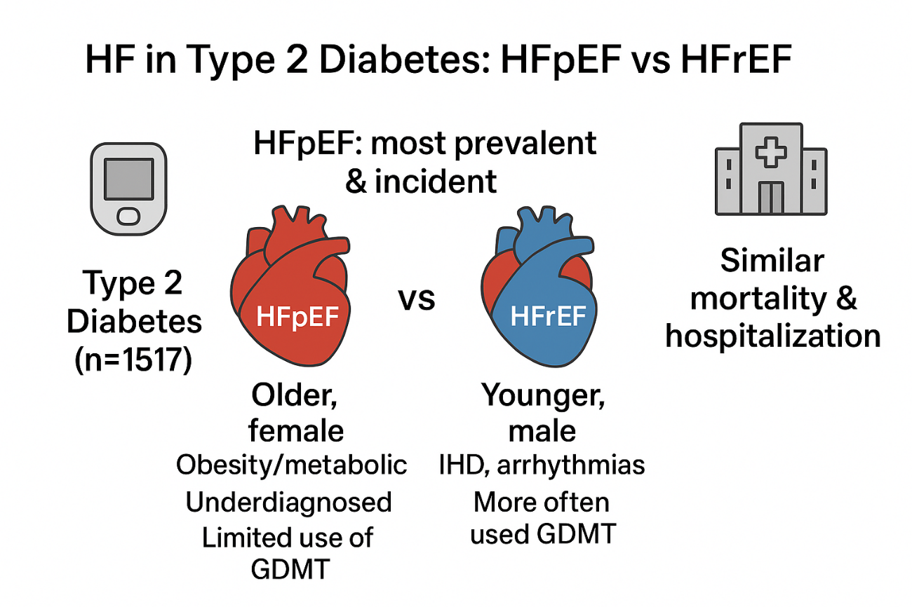
Gil-Millán P, Gimeno-Orna JA, Rodríguez-Padial L, Muñiz J, Barrios V, Anguita M, Pérez A on behalf of DIABET-IC Investigators. HFpEF as the Predominant and Underrecognized Heart Failure Phenotype in Type 2 Diabetes: Evidence from the DIABET-IC Study.

