Slide 1
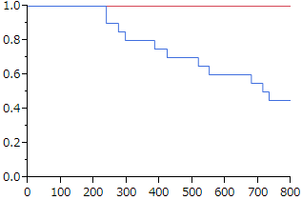
−: Negative
−: Positive
p-value=0.056
Recurrence-free survival rate
Recurrence-free survival period
Number at risk
24 24 24 21 19 18 16 15 13

