Slide 1
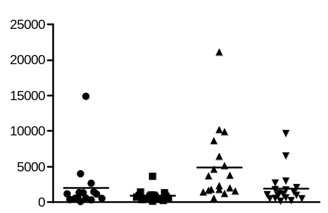
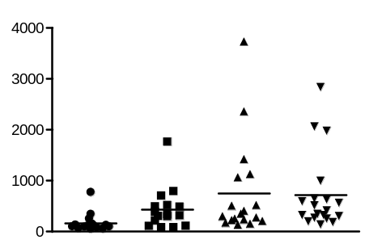
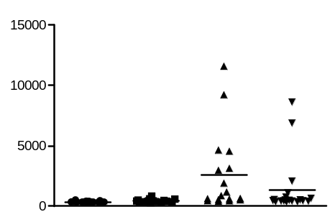
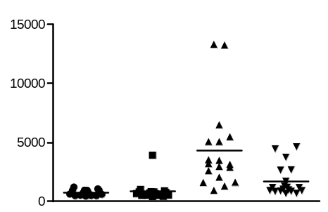
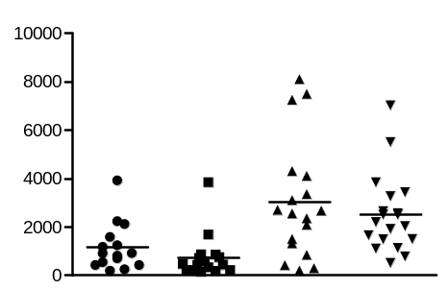
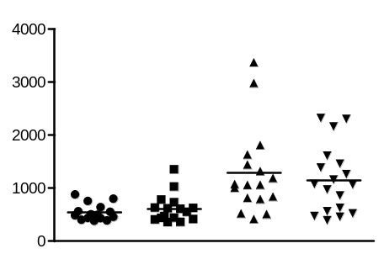
Additional file 1
Figure S1
n.s.
n.s.
n.s.
*
n.s.
n.s.
*
n.s.
n.s.
IgM (μg/ml)
IgA (μg/ml)
IgG1 (μg/ml)
Sh3bp2 | +/+ | Δ/Δ | +/+ | Δ/Δ
Fas | +/+ | +/+ | lpr/lpr | lpr/lpr
 | +/+ | Δ/Δ | +/+ | Δ/Δ
 | +/+ | +/+ | lpr/lpr | lpr/lpr
 | +/+ | Δ/Δ | +/+ | Δ/Δ
 | +/+ | +/+ | lpr/lpr | lpr/lpr
***
**
**
n.s.
**
n.s.
n.s.
n.s.
n.s.
IgG2b (μg/ml)
IgG2c (μg/ml)
IgG3 (μg/ml)
Sh3bp2 | +/+ | Δ/Δ | +/+ | Δ/Δ
Fas | +/+ | +/+ | lpr/lpr | lpr/lpr
 | +/+ | Δ/Δ | +/+ | Δ/Δ
 | +/+ | +/+ | lpr/lpr | lpr/lpr
 | +/+ | Δ/Δ | +/+ | Δ/Δ
 | +/+ | +/+ | lpr/lpr | lpr/lpr

Slide 2
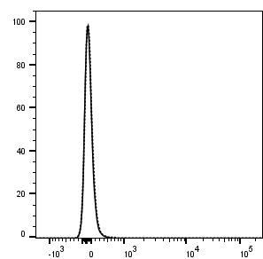
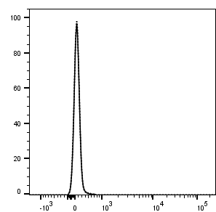
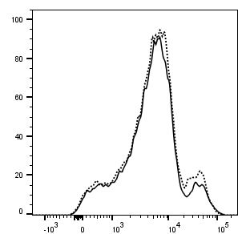
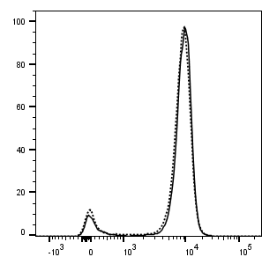
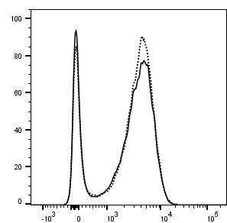
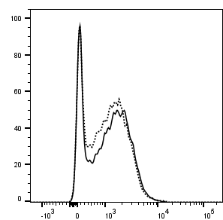
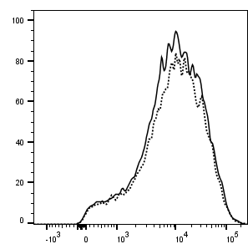
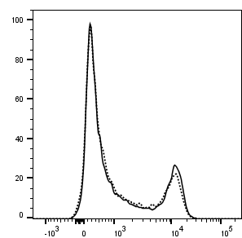
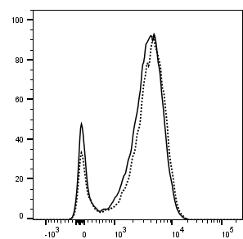
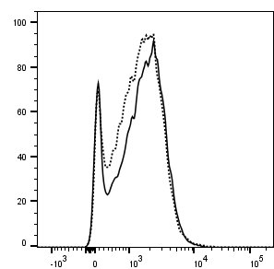
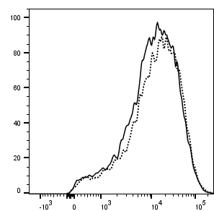
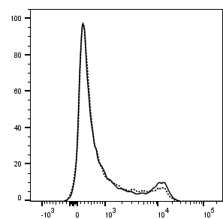
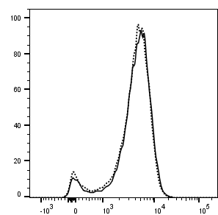
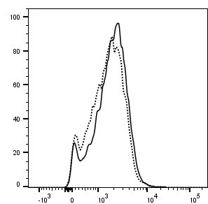
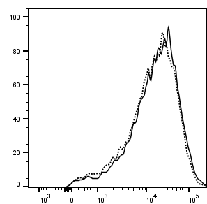
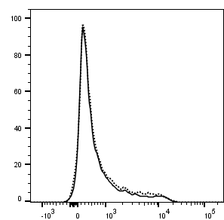
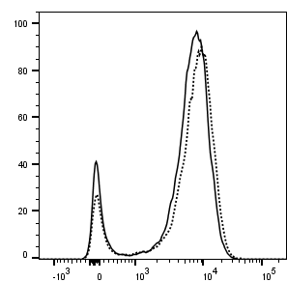
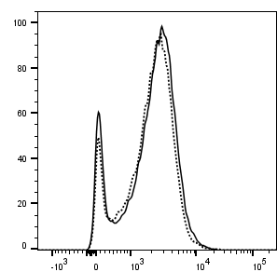
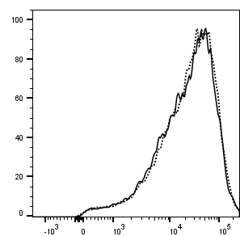

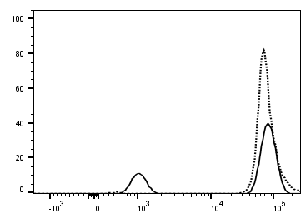
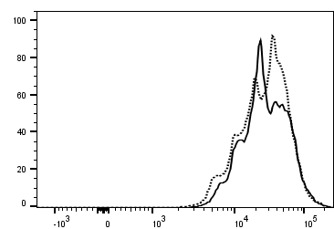
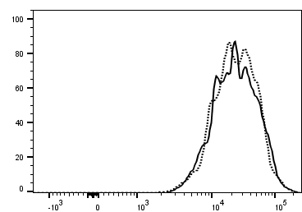
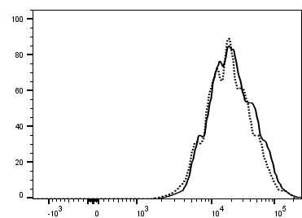
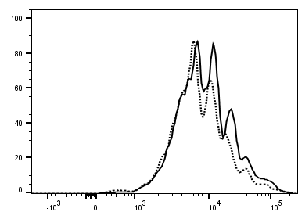
Additional file 2
Figure S2
a
Non-stimulation
Anti-CD3
5 μg/ml
Anti-CD3
10 μg/ml
Anti-CD3
20 μg/ml
Anti-CD3/CD28
10 μg/ml+2 μg/ml
Sh3bp2^{+/+}
Sh3bp2^{Δ/Δ}
CD69
CD25
CD44
CD62L
b
Non-stimulation
Anti-CD3
5 μg/ml
Anti-CD3
10 μg/ml
Anti-CD3
20 μg/ml
Anti-CD3/CD28
10 μg/ml+2 μg/ml
CFSE
Notes:
Supplementary Figure 2. SH3BP2 deficiency does not affect the in vitro activation and proliferation of CD4⁺ T cells. A, Flow cytometry analyses for cell surface protein expression on CD4⁺ T cells. Isolated CD4⁺ T cells were stimulated with immobilized anti-CD3/anti-CD28 at indicated concentrations for 24 h. B, In vitro proliferation of CD4⁺ T cells was measured by CFSE dilution at 72 h upon in vitro stimulation (anti-CD3 and anti-CD28 antibodies). Representative flow cytometry histograms are shown. CFSE, carboxyfluorescein succinimidyl ester.

Slide 3
Additional file 3
Figure S3
a
2
Cd80
b
2
Cd86
1.5
1.5
1
1
Relative mRNA expression
Relative mRNA expression
0.5
0.5
0
0
Sh3bp2 | +/+ | Δ/Δ | +/+ | Δ/Δ
Fas | +/+ | +/+ | lpr/lpr | lpr/lpr
Sh3bp2 | +/+ | Δ/Δ | +/+ | Δ/Δ
Fas | +/+ | +/+ | lpr/lpr | lpr/lpr
c
Tnf
Sh3bp2^{+/+}
Sh3bp2^{Δ/Δ}
Sh3bp2^{+/+} Fas^{lpr/lpr}
Relative mRNA expression
Sh3bp2^{Δ/Δ} Fas^{lpr/lpr}
Non-stimulation
LPS
10 ng/ml
LPS
100 ng/ml
Poly(I:C)
100 ng/ml
Poly(I:C)
1000 ng/ml
ssRNA
0.1 µg/ml
ssRNA
1 µg/ml
ODN
0.1 µM
ODN
1 µM

