Slide 1
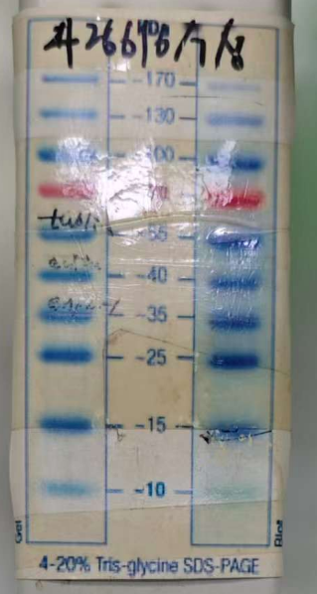
Control
Control
m
CNP
CNP
CASPASE-3
m
m
m
35 kDa
Cleaved-
CASPASE-3
25 kDa
15 kDa
Control
CNP
Control
ATG12-ATG5-50 kDa
CNP
55 kDa
40 kDa
ATG5-32 kDa
35 kDa
25 kDa
15 kDa
m
m
10 kDa
Control
Control
m
CNP
CNP
m
m
m
35 kDa
LC3B-I
25 kDa
LC3B-II
15 kDa
Control
CNP
Control
Β-ACTIN-43 kDa
CNP
55 kDa
m
m
40 kDa
Control
Control
m
CNP
CNP
m
m
m
70 kDa
TUBULIN
55 kDa
40 kDa

