Slide 1
Original Full Length Western Blots

Slide 2
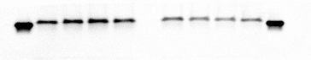
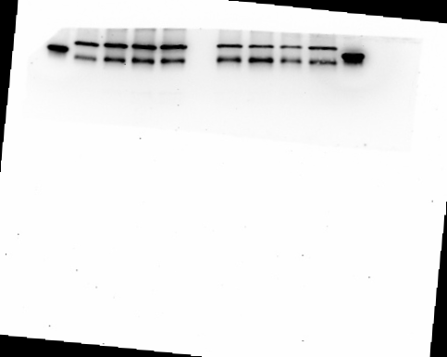
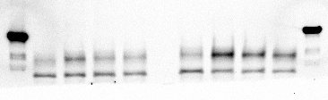
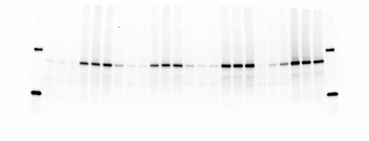
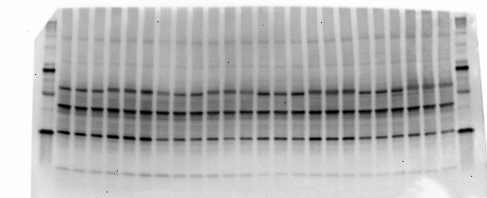
For Figure S1
PHB1
30 KD
PHB2
~34KD
30 KD
80 KD
β Actin
~45KD
For Figure 2
P-AKT-S473
(liver)
80 KD
~60KD
30 KD
80 KD
AKT
(liver)
~60KD
30 KD

Slide 3
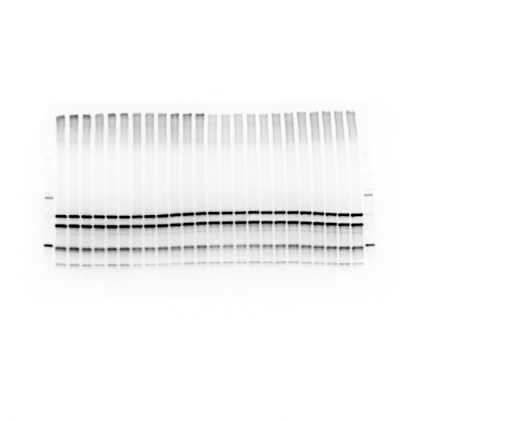
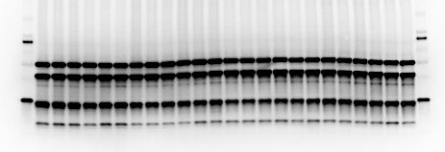
For Figure S2.B
80 KD
CV-ATP5A-55KD
CIII-UQCRC2-48KD
CIV-MTCO1-40KD
30 KD
CII-SDHB-30KD
CI-NDUFB8-20KD
Higher exposure
80 KD
β Actin
~45 KD
30 KD

Slide 4
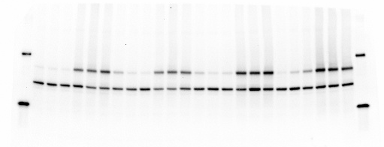
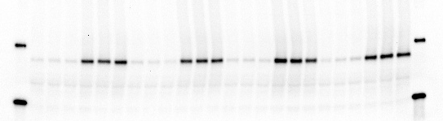
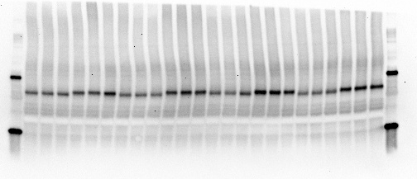
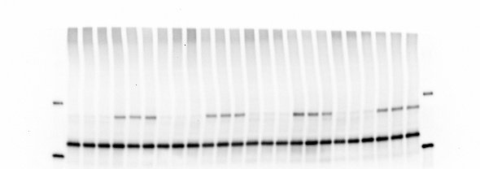
For Figure 2
80 KD
P-AKT-S473
β Actin
(liver)
~45 KD
30 KD
80 KD
P-AKT-S473
(muscle)
~60 KD
30 KD
80 KD
AKT
(muscle)
~60 KD
30 KD
80 KD
GAPDH
(muscle)
~36 KD
30 KD

Slide 5
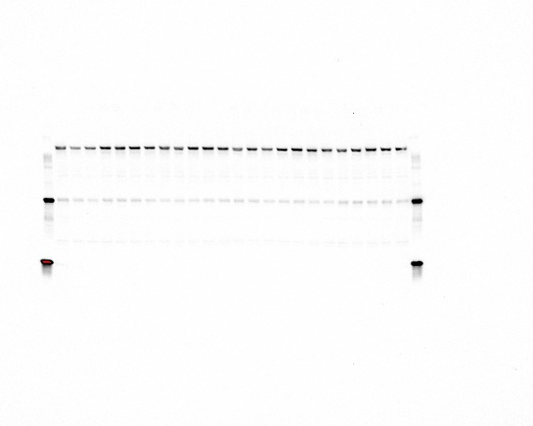
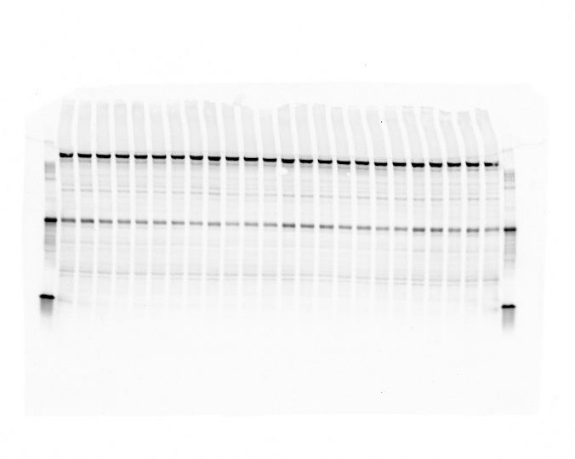
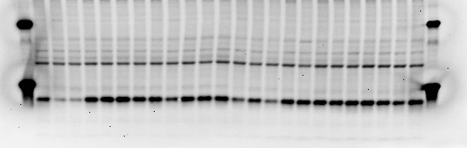
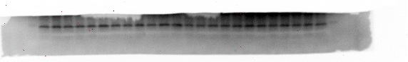
For Figure 5.A
P-mTORC-S2448
~290 KD
80 KD
30 KD
mTORC
~290 KD
80 KD
30 KD
80 KD
P-4EBP1-S65
30 KD
~20 KD
4EBP1
~20KD

Slide 6
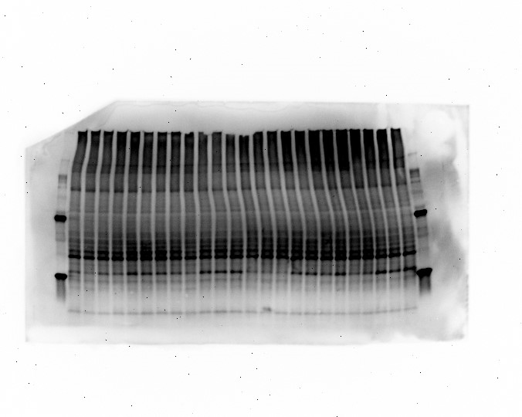
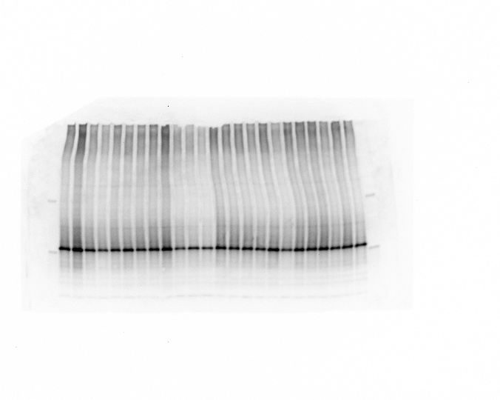
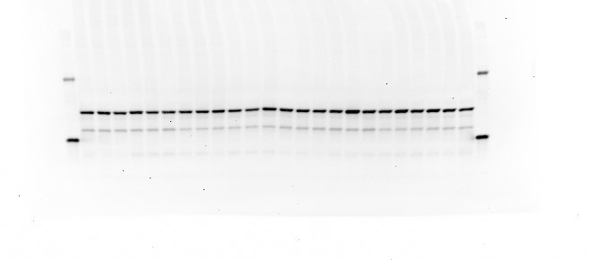
For Figure 5.A
80 KD
~32 KD
P-S6-(S235/236)
30 KD
80 KD
~32 KD
S6
30 KD
80 KD
β Actin
~45 KD
30 KD

Slide 7
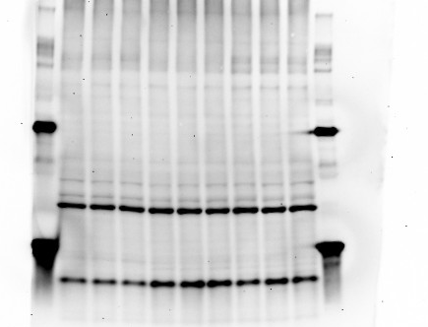
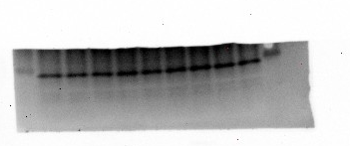
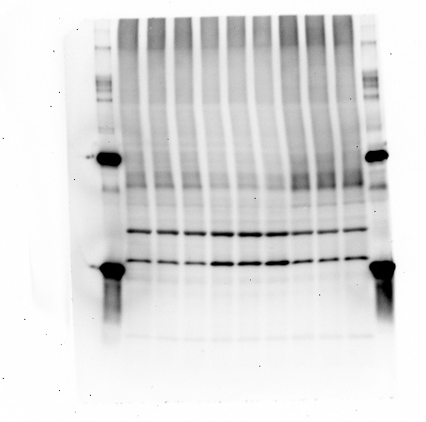
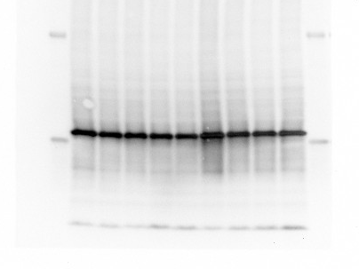
Figure 5.B
80 KD
30 KD
P-4EBP1-S65
~20 KD
4EBP1
~20 KD
80 KD
P-S6-(S240/244)
~32 KD
30 KD
80 KD
S6
~32 KD
30 KD

Slide 8
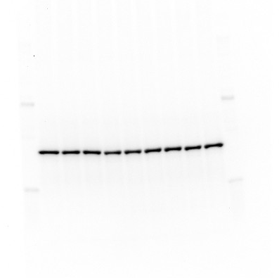
For Figure 5.B
80 KD
β Actin
~45 KD
30 KD

Slide 9
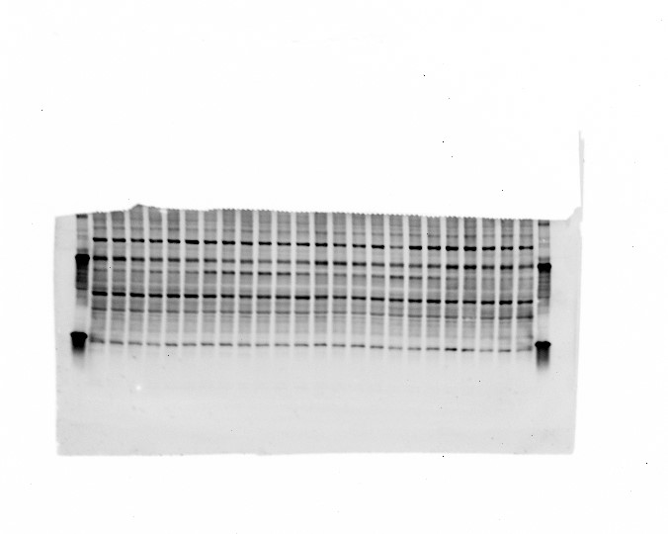
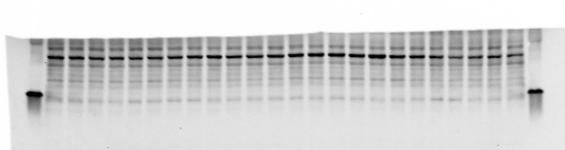
For Figure S4
Lipin1
~125 KD
80 KD
30 KD
β Actin
~45 KD
30 KD

Slide 10
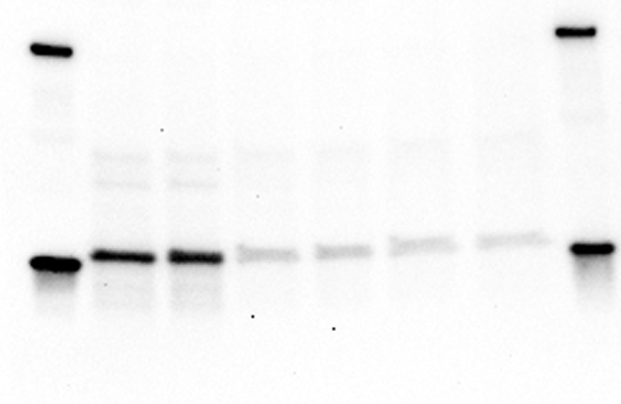
For Figure S5
80 KD
PHB1
30 KD

Slide 11
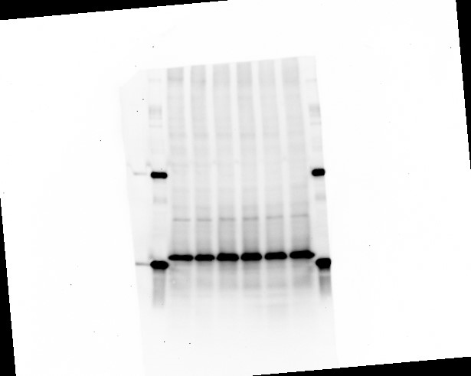
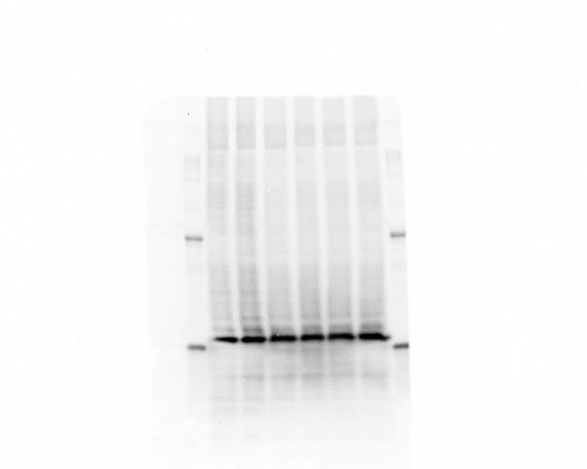
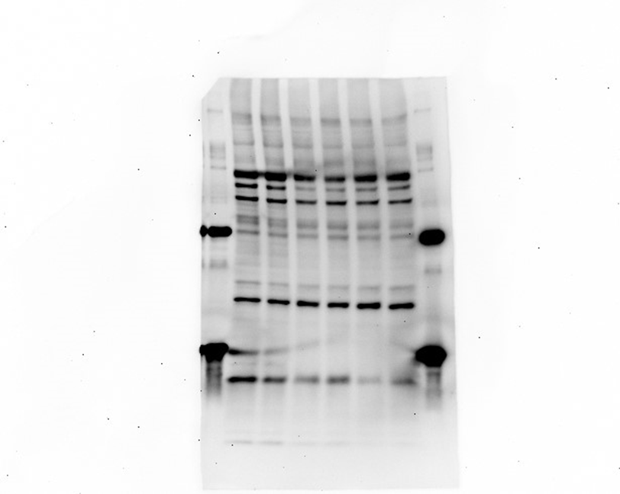
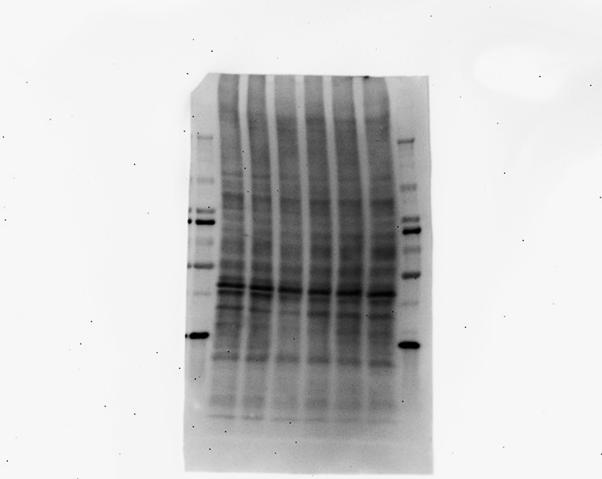
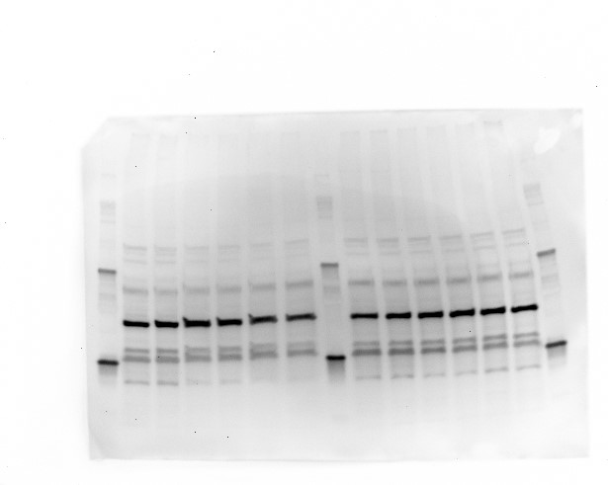
For Figure S5
80 KD
P-S6-(S235/236)
~32 KD
30 KD
80 KD
S6
~32 KD
30 KD
80 KD
80 KD
4EBP1
30 KD
~20 KD
P-4EBP1-S65
30 KD
~20 KD
80 KD
β Actin
~45 KD
30 KD

