Slide 1
Supplementary Figures

Slide 2
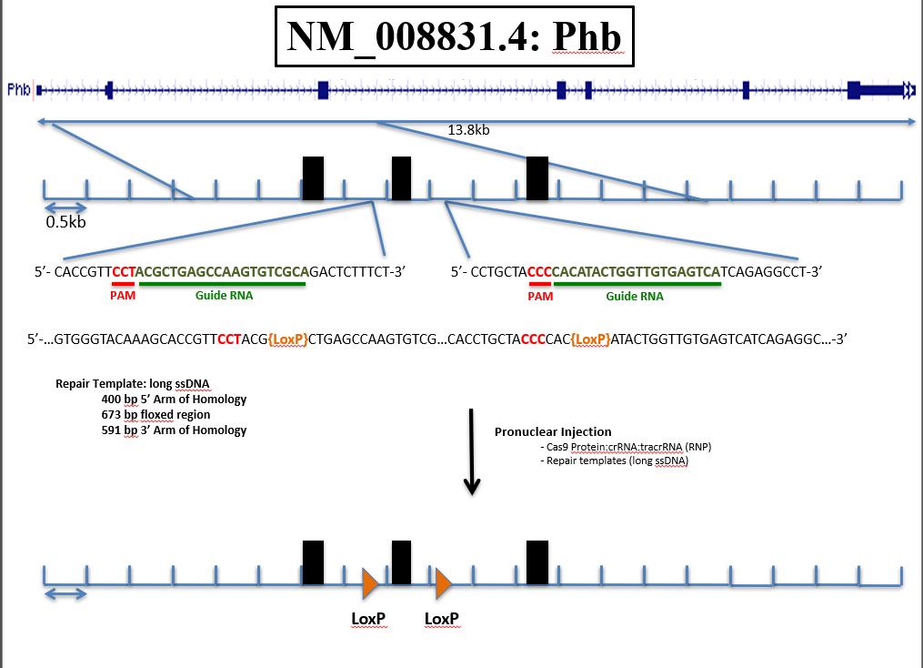
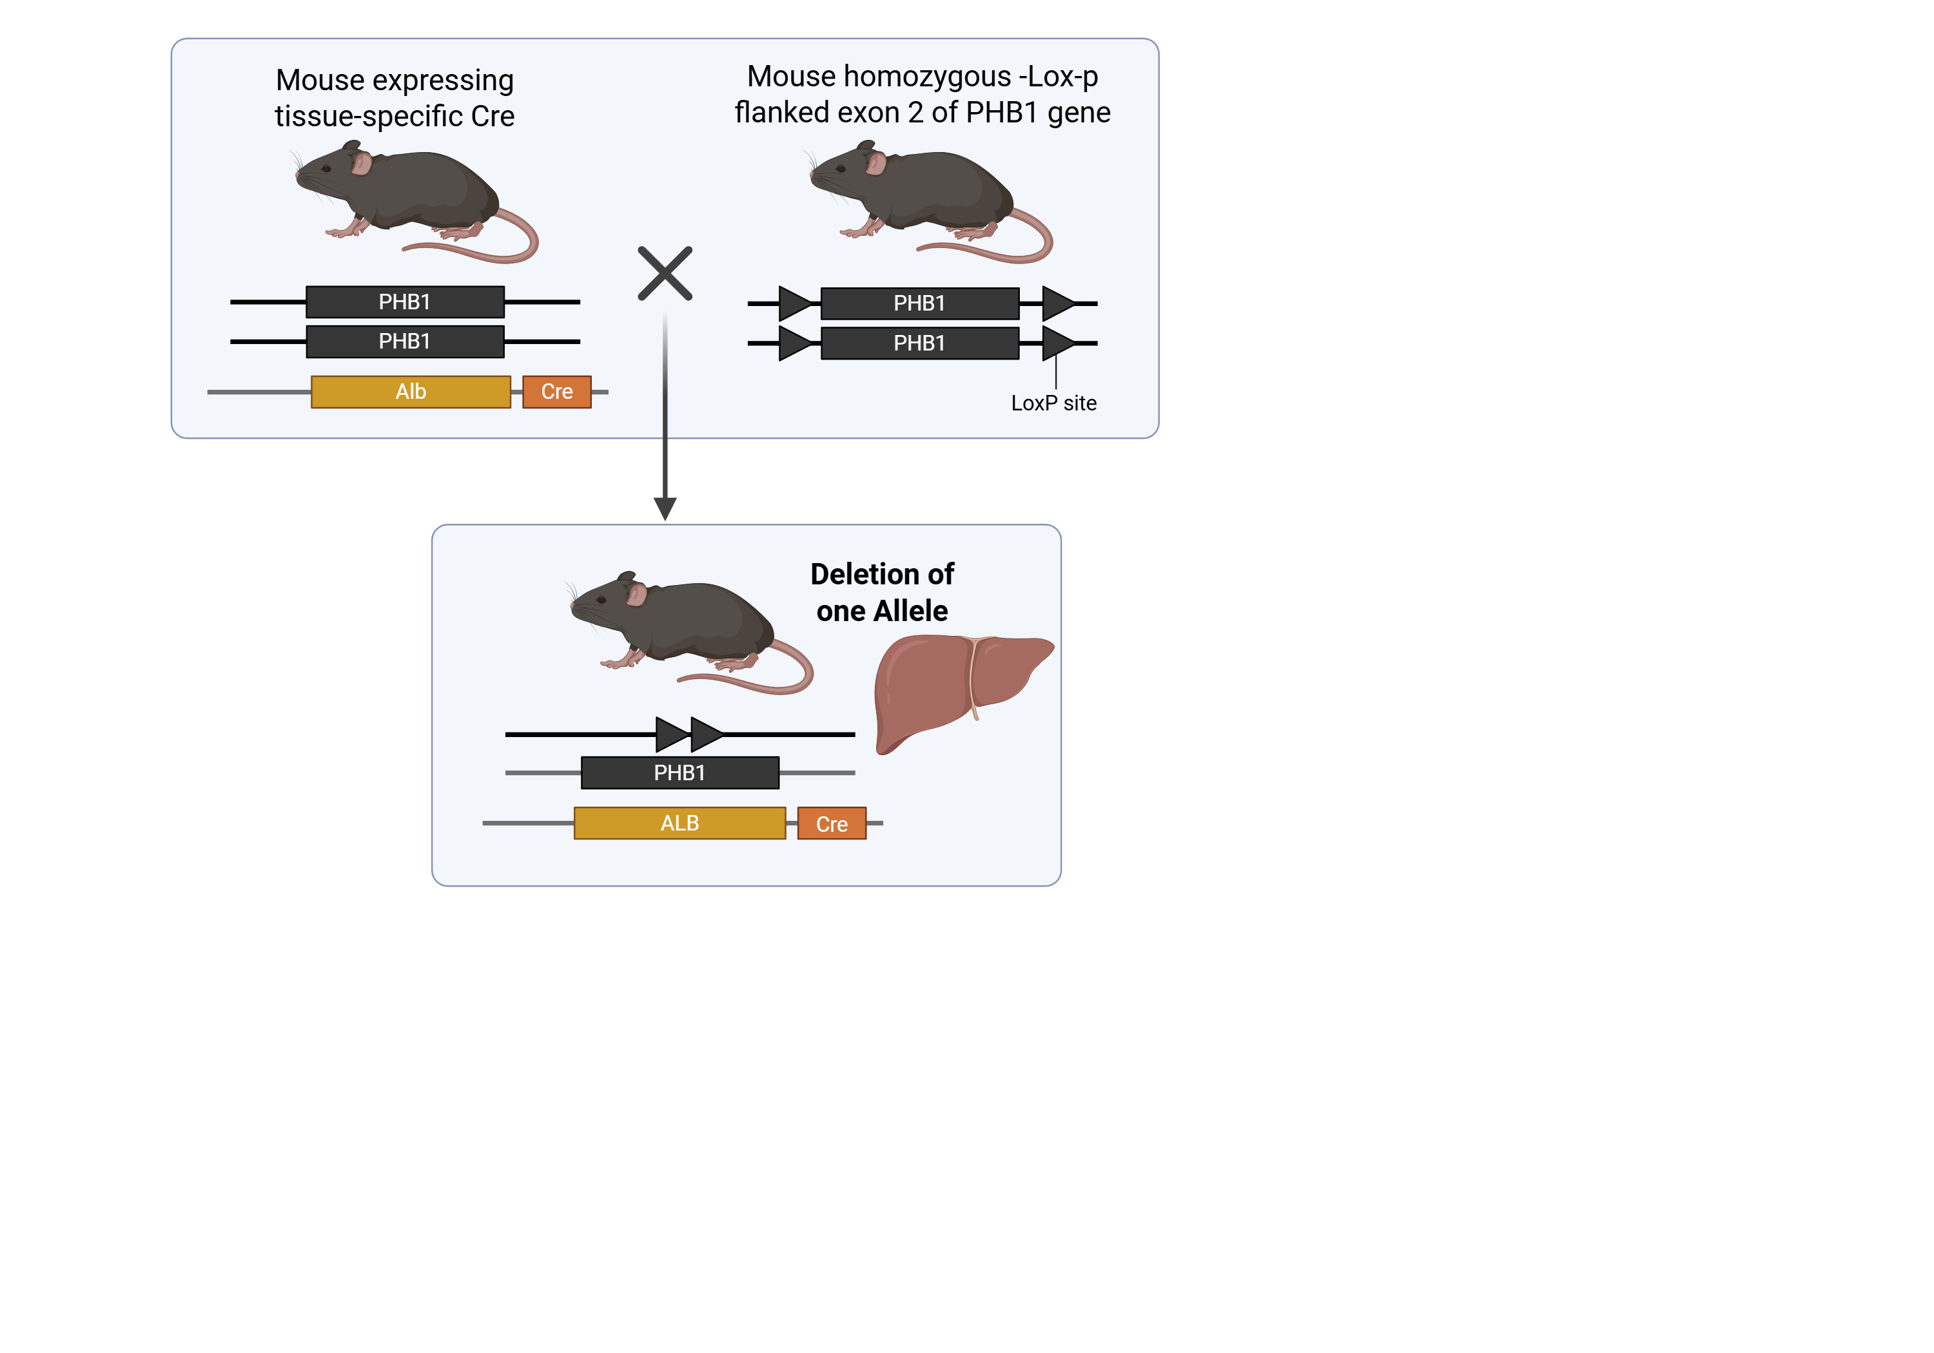
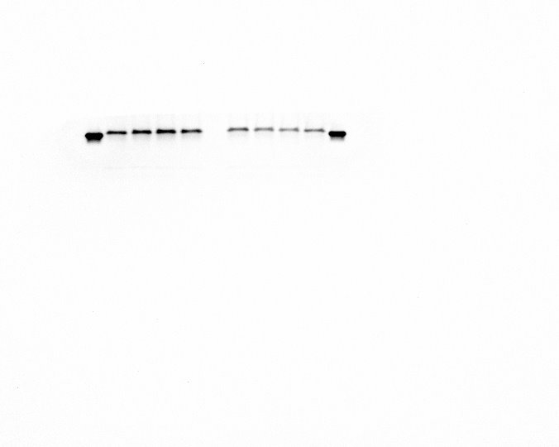
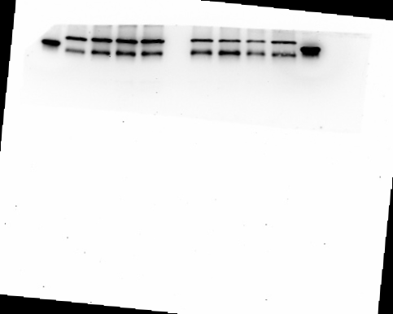
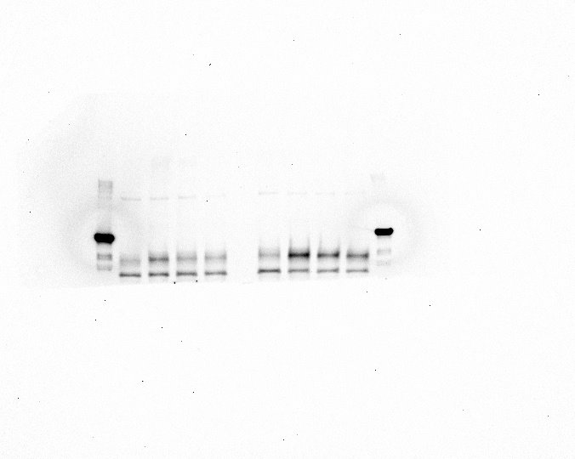
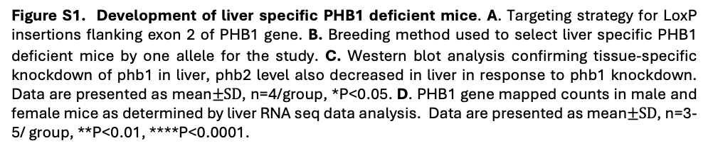
A
B
C
WT
KD
D
M
F
M
F
M
F
M
F
PHB1
PHB2
βActin
Figure S1. Development of liver specific PHB1 deficient mice. A. Targeting strategy for LoxP insertions flanking exon 2 of PHB1 gene. B. Breeding method used to select liver specific PHB1 deficient mice by one allele for the study. C. Western blot analysis confirming tissue-specific knockdown of phb1 in liver, phb2 level also decreased in liver in response to phb1 knockdown. Data are presented as mean$±SD$, n=4/group, *P<0.05. D. PHB1 gene mapped counts in male and female mice as determined by liver RNA seq data analysis. Data are presented as mean$±SD$, n=3-5/ group, **P<0.01, ****P<0.0001.
Notes:
Targeted Genomic
417 – 817 5’ Arm of Homology
(-29) – 57 Exon 1
818 – 851 LoxP
859 – 1532 Floxed Region
1094 – 1208 Exon 2
1534 – 1567 LoxP
1843 – 2434 3’ Arm of Homology

Slide 3
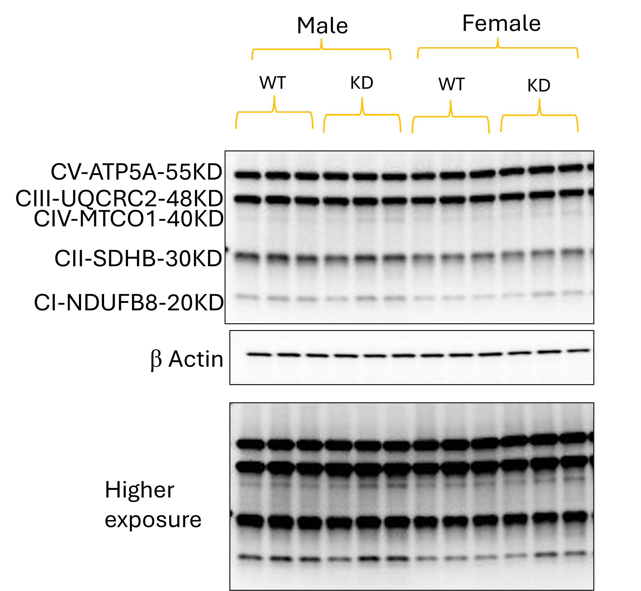
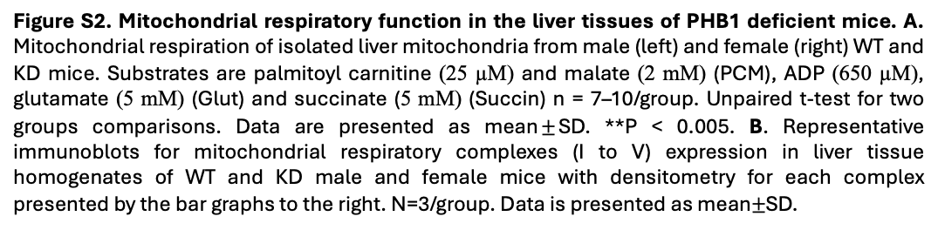
A
B
Figure S2. Mitochondrial respiratory function in the liver tissues of PHB1 deficient mice. A. Mitochondrial respiration of isolated liver mitochondria from male (left) and female (right) WT and KD mice. Substrates are palmitoyl carnitine (25 µM) and malate (2 mM) (PCM), ADP (650 µM), glutamate (5 mM) (Glut) and succinate (5 mM) (Succin) n = 7–10/group. Unpaired t-test for two groups comparisons. Data are presented as mean$±$SD. **P < 0.005. B. Representative immunoblots for mitochondrial respiratory complexes (I to V) expression in liver tissue homogenates of WT and KD male and female mice with densitometry for each complex presented by the bar graphs to the right. N=3/group. Data is presented as mean$±$SD.

Slide 4
A
Figure S3. Assessment of liver gluconeogenesis in PHB1-KD mice.
A. Blood glucose monitoring for pyruvate tolerance test in mice following i.p. pyruvate/lactate administration (upper panel) and quantification of corresponding total AUC in the lower panel. (n = 8-12 /group). Unpaired t-test was used for comparison between genotypes within the same sex group. Data is presented as mean ± SD.

Slide 5
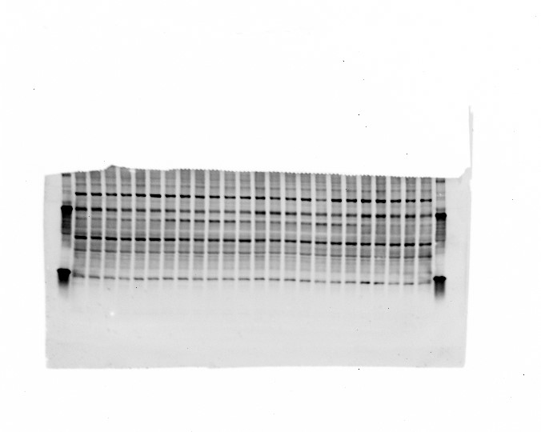
A
Male
Female
WT
KD
WT
KD
Insulin
-
-
-
+
+
+
-
-
-
+
+
+
-
-
-
+
+
+
-
-
-
+
+
+
Lipin1
β Actin
Figure S4. Lipin1 expression in liver of PHB1 deficient mice. A. Representative immunoblot showing lipin1 expression in liver tissue homogenates of WT and hepatic PHB1-KD mice. Mice were fasted for 6 hours followed by i.p. insulin stimulation 10 units/kg (n = 3 /group). All data are presented as mean ± SD.

Slide 6
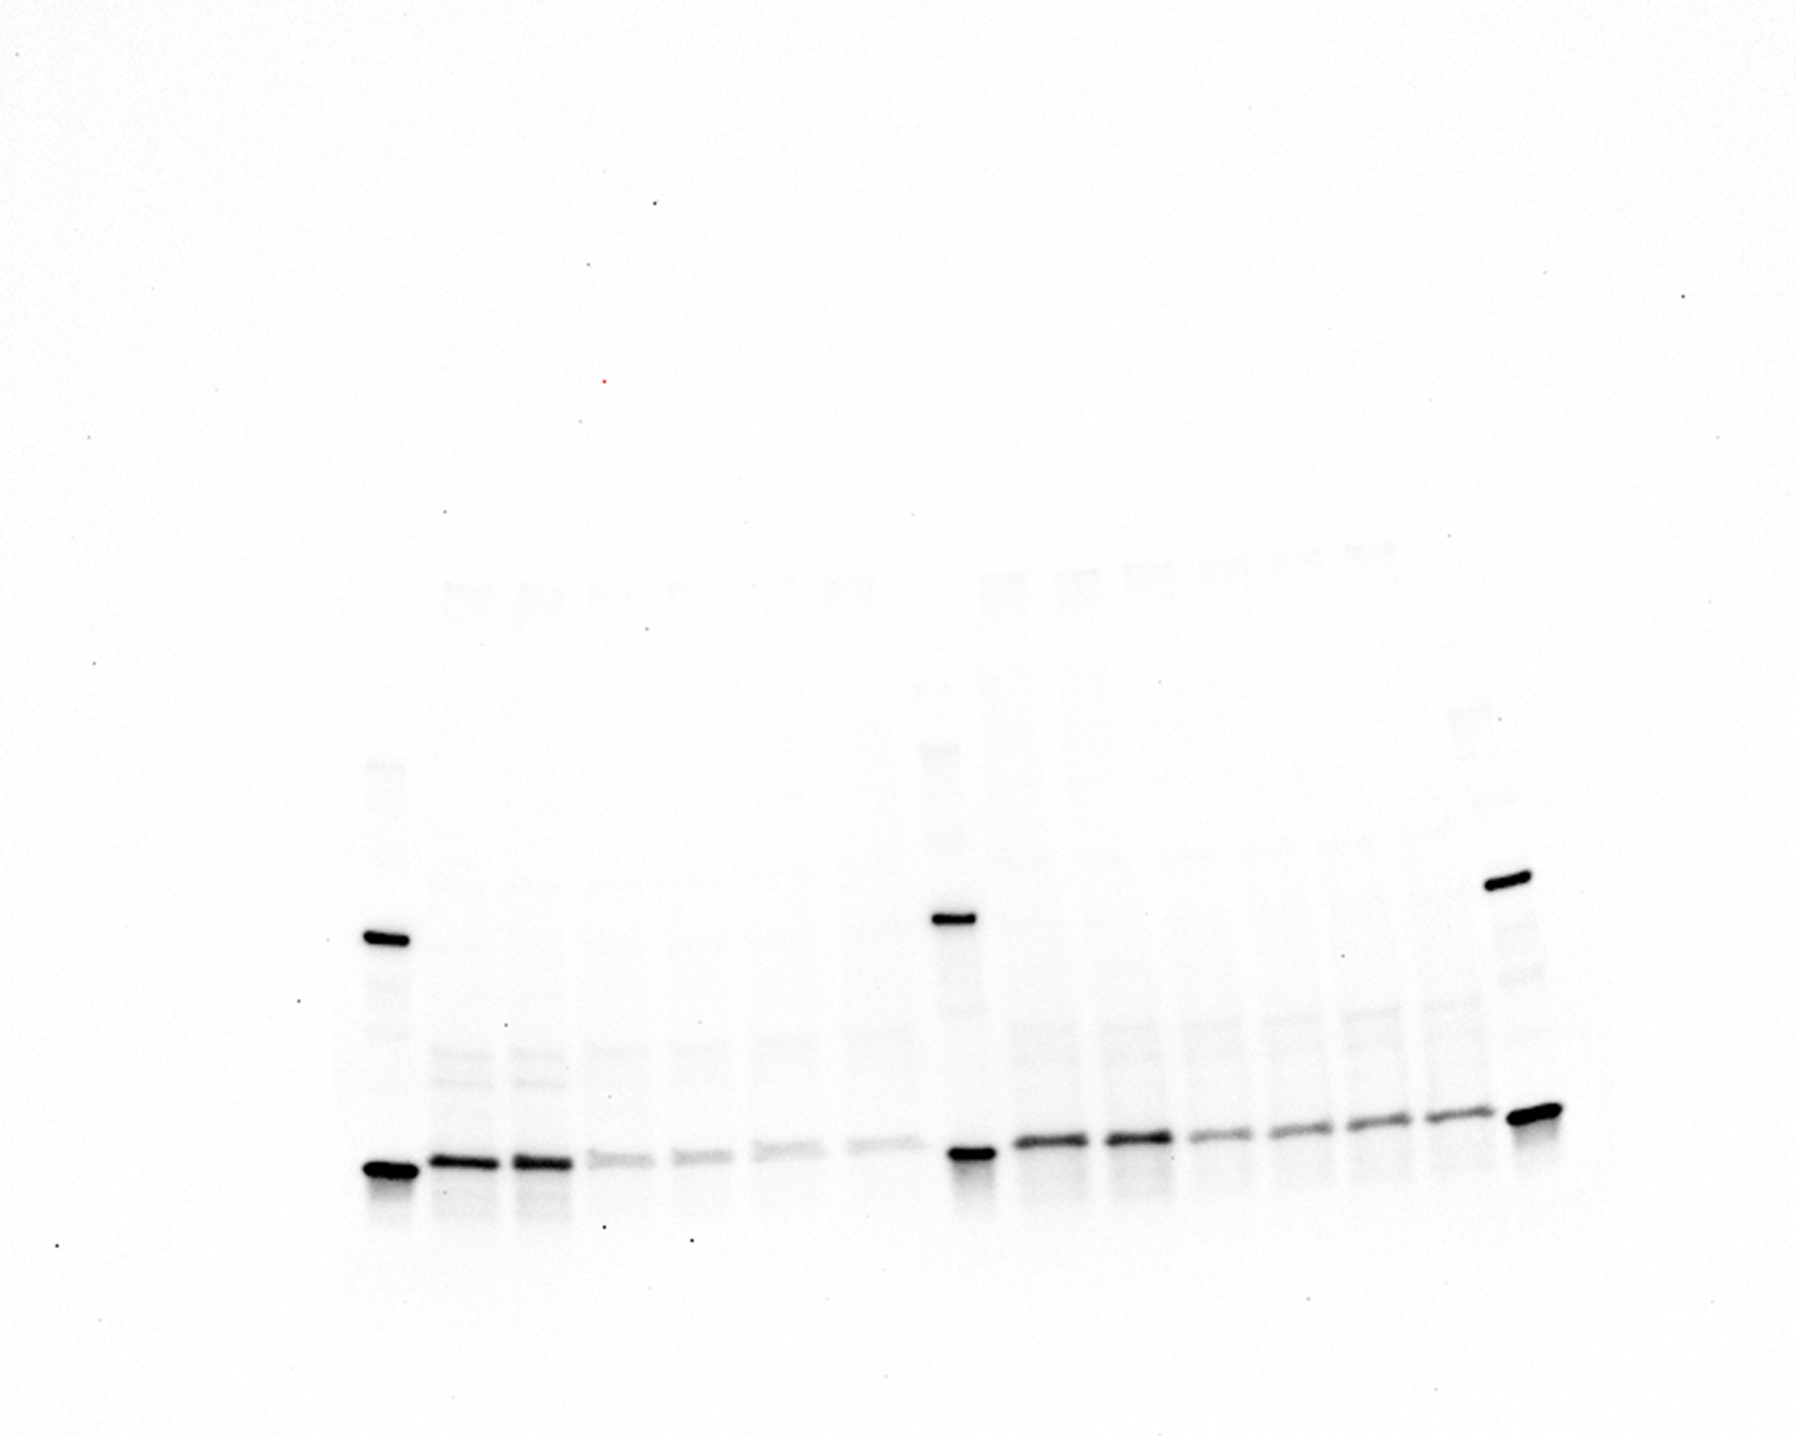
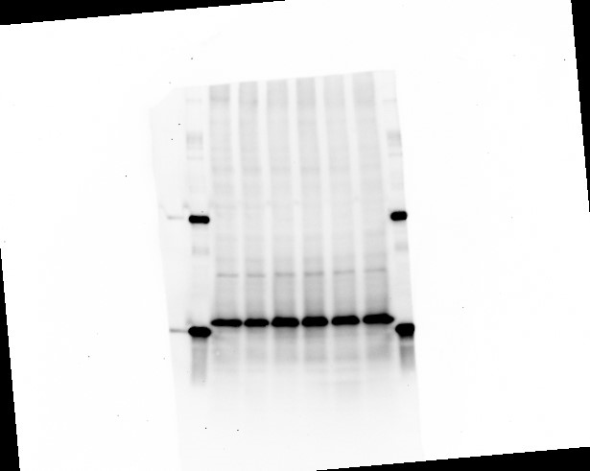
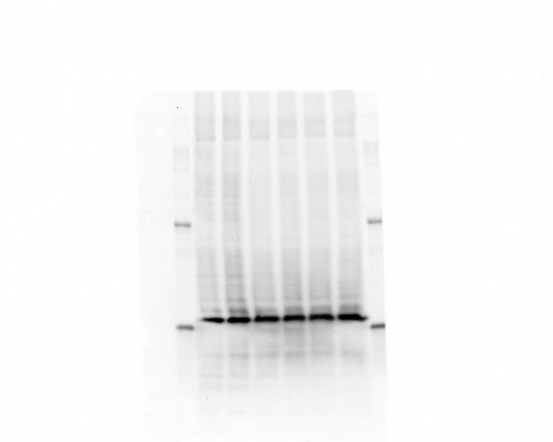
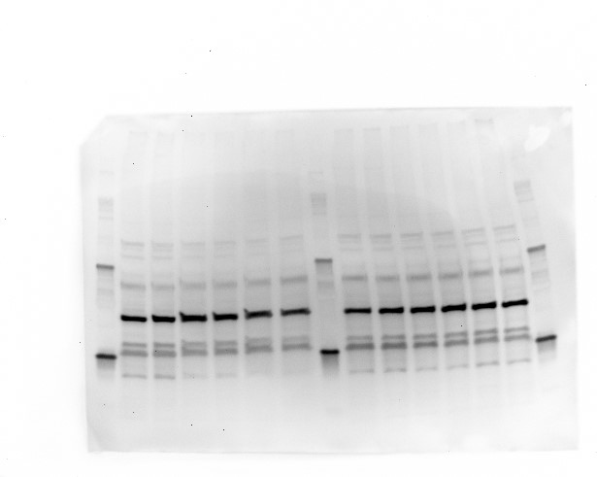
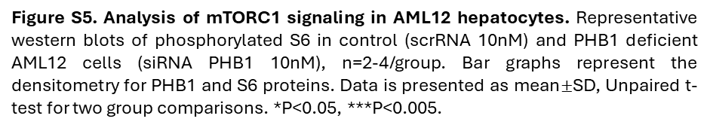
Scr RNA
siRNA PHB1
PHB1
P-S6K-S240/244
S6K
β Actin
Figure S5. Analysis of mTORC1 signaling in AML12 hepatocytes. Representative western blots of phosphorylated S6 in control (scrRNA 10nM) and PHB1 deficient AML12 cells (siRNA PHB1 10nM), n=2-4/group. Bar graphs represent the densitometry for PHB1 and S6 proteins. Data is presented as mean$±$SD, Unpaired t-test for two group comparisons. *P<0.05, ***P<0.005.
Notes:
AML12 siRNA phb1 Dharmacon reverse transfection reverse transfection 10nM

