Slide 1
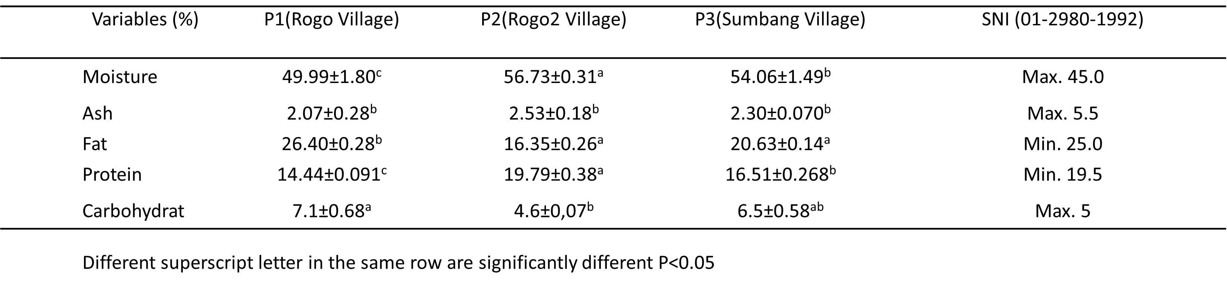
4. Table
Table 1. Nutritional value of Dangke collected from three locations

Slide 2
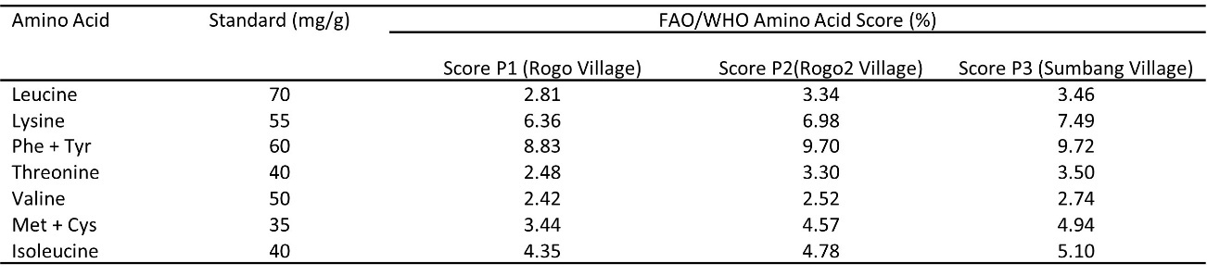
Table 2. Amino acid score according to standards reported by the FAO/WHO

Slide 3
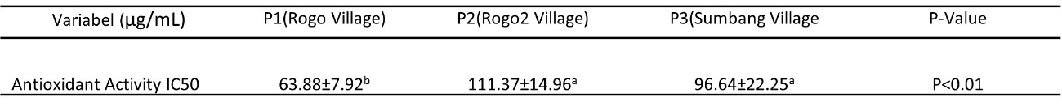
Table 3. Antioxidant Activity
Different superscript letter in the same row are significantly different at P<0.01.

Slide 4
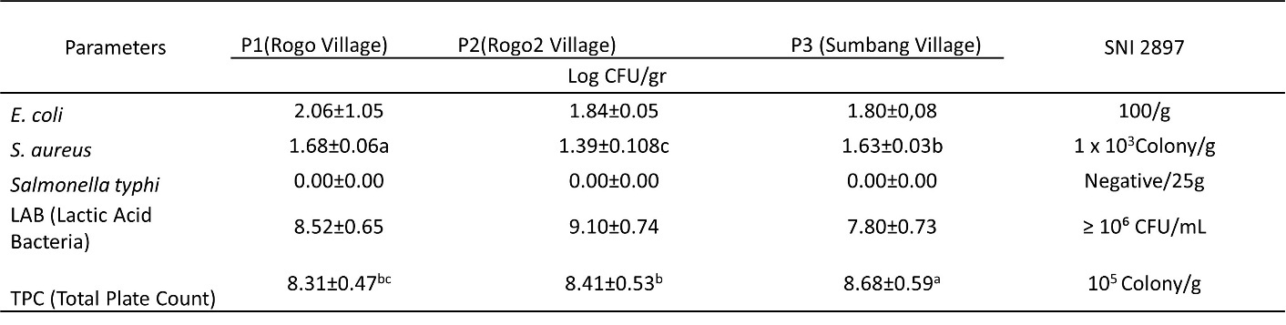
Table 4. Microbiological Quality
Different superscript letter in the same row are significantly different at P<0.05.

Slide 5
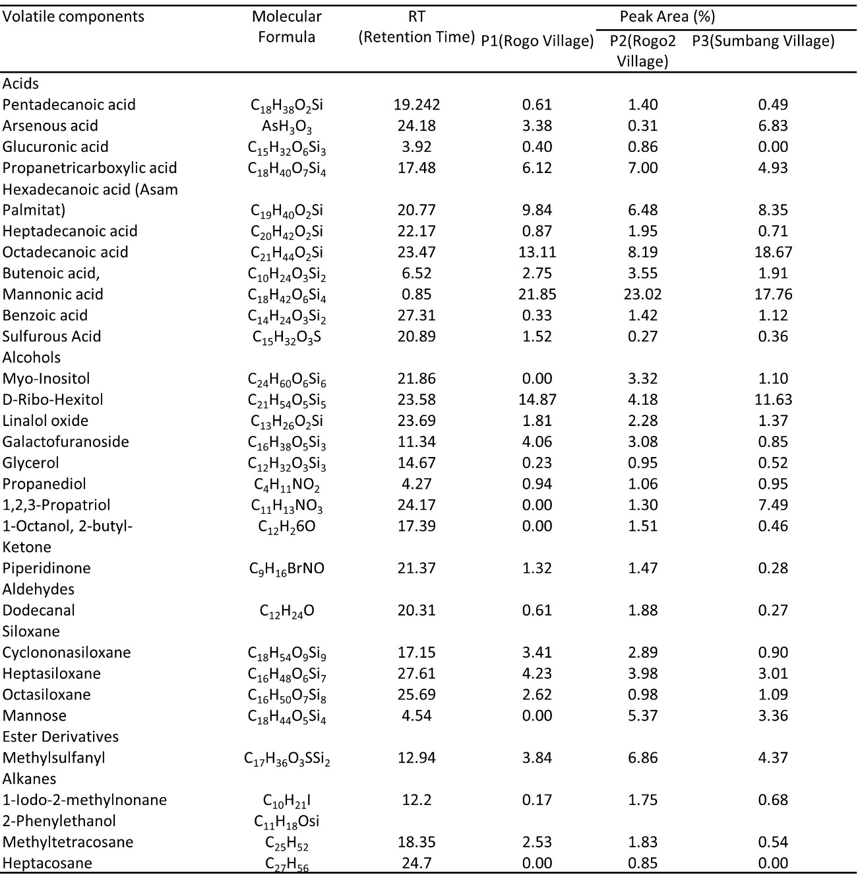
Table 5. Volatile components of Dangke

