Slide 1
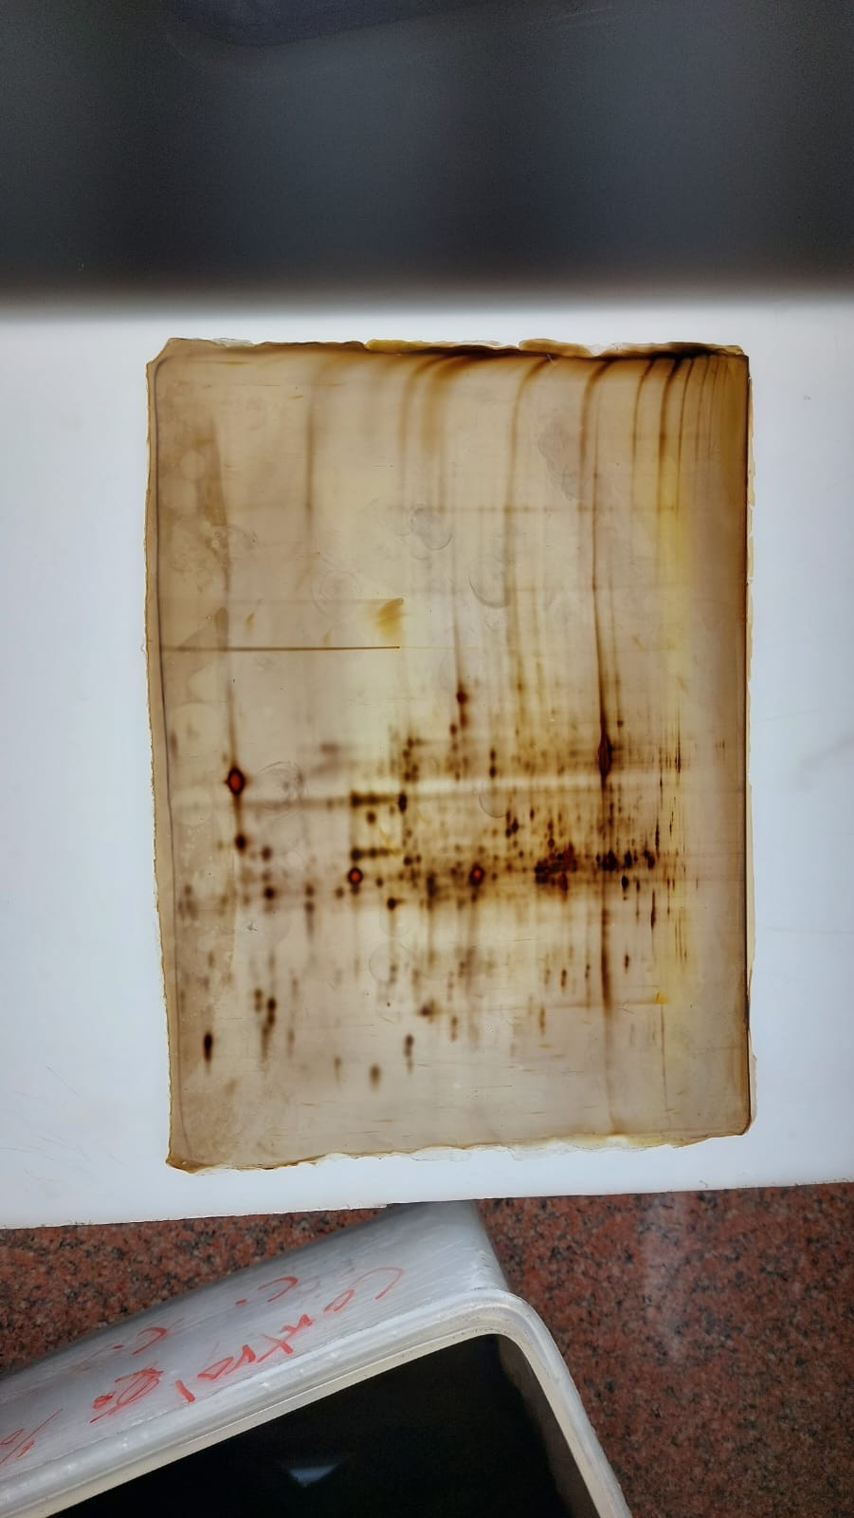
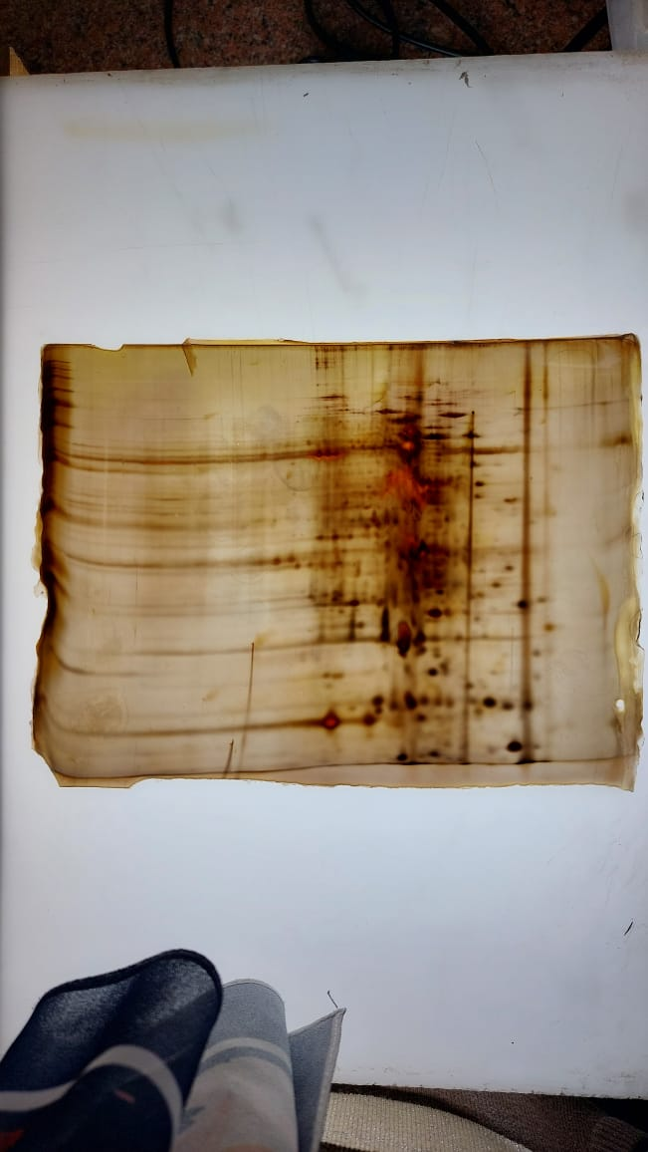
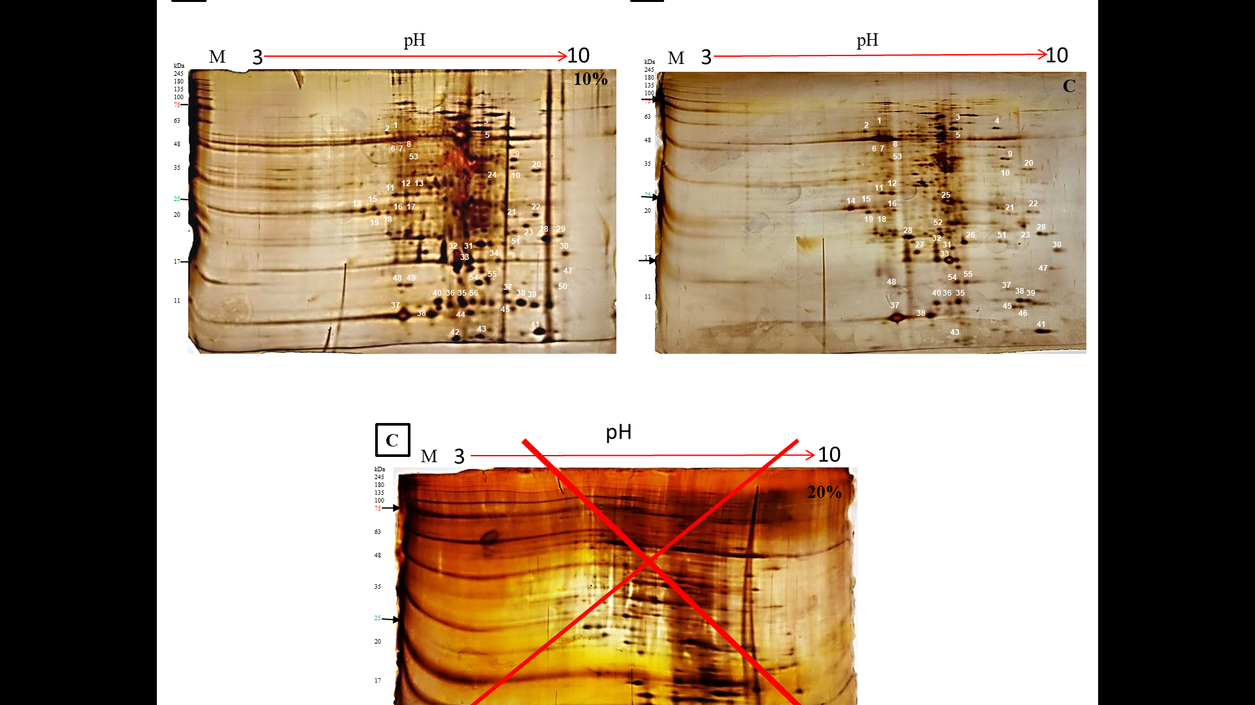
A
B
C
D

Slide 2
Figure S1. The two-dimensional gel electrophoresis (2-DE) before and after editing. (A) gel of protein before editing at normal condition (control) . (B) gel of protein before editing at 10% drought condition. (C) gel of protein after editing at normal condition (control) . (D) gel of protein after editing at 10% drought condition.

Slide 3
(A) gel of protein before editing at normal condition (control)

Slide 4
(B) gel of protein before editing at 10% drought condition.

