Slide 1
A
B
C
D
E
F
Notes:
Supplementary Figure 1: (A) Correlation between brain regional glucose uptake and markers of insulin resistance. * indicates correlations that passed FDR correction (Benjamini-Hochberg) for multiple comparisons at q < 0.05. Sample sizes contributing to linear regression between regional glucose uptake and insulin resistance markers are: n=70 (HC=17, IR=53) for fasting glucose, fasting insulin, and HOMA-IR; n=69 (HC=17, IR =52) for fasting C-peptide; and n=68 (HC=17, IR=51) for HbA1c. (B) Inclusion criteria for the three independent study cohorts included age, BMI, and fasting glucose. These criteria were used to designate the cohorts as “Healthy Controls” (HC) or “Insulin Resistant” (IR) at screening. (C) Additional demographic information displaying the distribution of markers of metabolic health with distinct differences between HC and IR groups. Two-sided Student’s t-tests were used to compare group differences in panels A and B, and group sample sizes for all measurements in panes A and B are HC=18 and IR=56. (D) Glucose uptake in all quantified brain regions measured by ¹⁸FDG-PET and displayed as relative standardized uptake values (SUVr) (HC, n=17; IR, n=55). Two-sided Student’s t-tests were used to compare group differences and regions with significantly different (P<0.05) glucose uptake are displayed in the main manuscript in Figure 1J and indicated here with an *. (E) Composite cognitive function scores measured using the NIH Toolbox Assessment in HC (n=18) and IR (n=56) show no significant differences between groups. (F) Correlation between brain regional glucose uptake and composite cognitive scores. No correlation passed FDR correction (Benjamini-Hochberg) for multiple comparisons at q < 0.05. Sample size contributing to linear regression between regional glucose uptake and cognitive scores was n=70 (HC=17, IR=53).

Slide 2
A
B
C
D
E
F
G
H
I
J
K
L
M
N
O
P
W
X
Q
R
S
T
U
V
Notes:
Supplementary Figure 2: (A) Absolute whole brain volume (in mm³) is not different between Healthy Controls (HC; n=17; green) and Insulin Resistant (IR; n=56; purple) groups, with considerable variability due to sex (males = dark circles; females = light diamonds). (B) Absolute whole brain volume is not significantly correlated with fasting glucose. (C) Estimated total intracranial volume (eTIV) is not different between groups (HC vs IR) and is highly influenced by sex. (D) Absolute whole brain volume and eTIV are strongly correlated. (E) Normalizing absolute whole brain volume to eTIV reduces variability due to sex. (F) Normalized whole brain volume (mm³/eTIV) has a significant negative relationship with fasting glucose. (G-I) eTIV-normalized total white matter, total grey matter, and hippocampus volumes are displayed as mean (bars) with participants represented as individual dots (men) and diamonds (women). (J-V) eTIV-normalized regional white matter brain volumes with significant differences between HC and IR, as displayed in the main manuscript in Figure 3E, are shown here with individual data points distinguishing between men and women as dark circles and light diamonds, respectively. (W) Correlation between regional brain volumes and markers of insulin resistance. * indicates correlations that passed FDR correction (Benjamini-Hochberg) for multiple comparisons at q < 0.05. Sample sizes contributing to linear regression between regional glucose uptake and insulin resistance markers are: n=73 (HC=17, IR=56) for fasting glucose, fasting insulin, and HOMA-IR; n=72 (HC=17, IR =55) for fasting C-peptide; and n=71 (HC=17, IR=54) for HbA1c. (X) Correlation between regional brain volumes and composite cognitive scores using the NIH Toolbox assessment. * indicates P<0.05. n=73 (HC=17, IR=56).

Slide 3
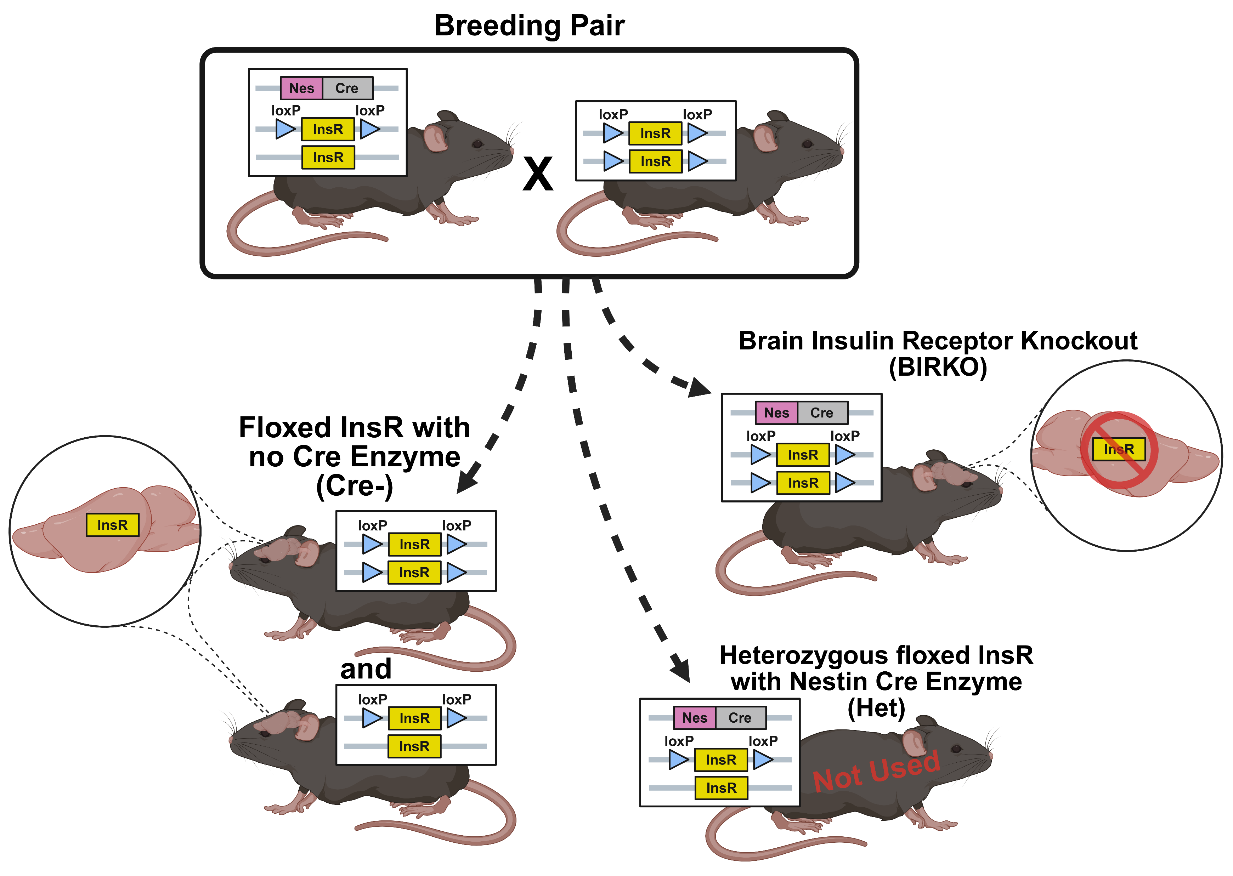
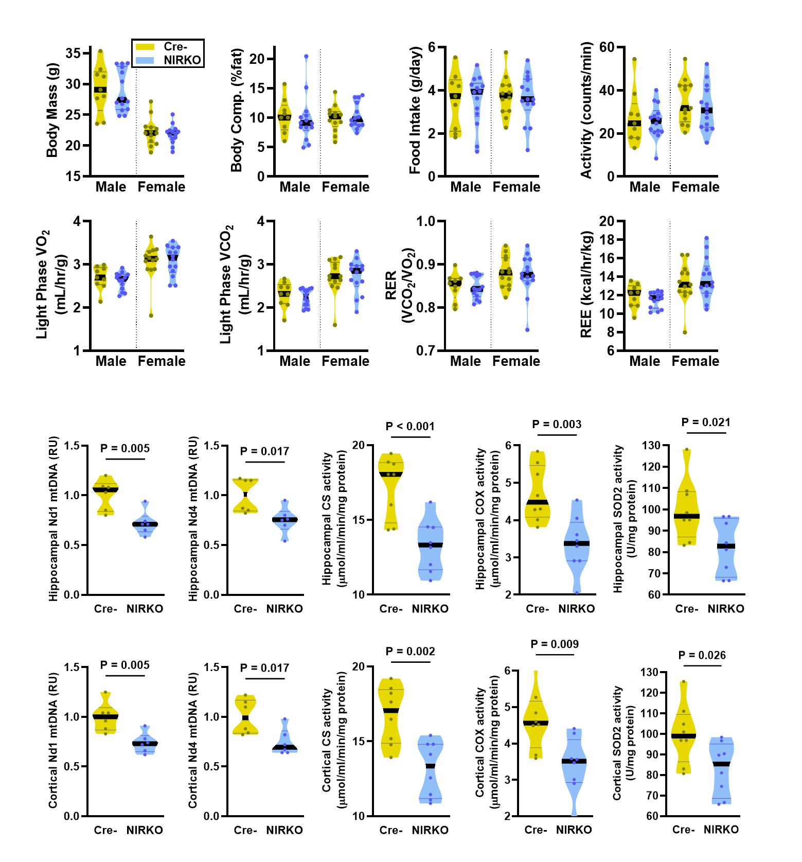
A
B
C
Notes:
Supplementary Figure 3: (A) Breeding scheme used to generate mice with floxed insulin receptor (InsR) driven by the Nestin promoter what were negative (Cre-) or positive carriers of the CreERT2 gene (NIRKO; Neuron Insulin Receptor Knockout). (B) Body mass, fat%, total daily food intake, total daily ambulatory activity, light phase VO₂ and VCO₂ in the fed-state, RER in the fed-state, and REE in the light phase at 4 weeks post-tamoxifen inject. (C) Mitochondrial DNA copy number (Nd1 and Nd4; n=6 per group), and isolated mitochondrial citrate synthase activity (n=8 per group), cytochrome c oxidase (COX; complex IV) activity (n=8 per group) and superoxide dismutase 2 (SOD2) activity (marker of mitochondrial antioxidant defense; n=8 per group) in the hippocampus and cerebral cortex.

Slide 4
A
B
C
D
E
F
G
H
Notes:
Supplemental Figure 4: (A) The summary of adverse events in each treatment group reported by study participants over the 40-week trial. (B) Mean plasma metformin concentrations at each month in the participants (represented as individual dots) that received metformin. At baseline, Months 5-9, and End the n=20. At months 1-4 the n=18, and at month 10 the n=16. (C) Plasma vitamin B12 levels measured at baseline (Pla n=14, Met n=15), 1 month (Pla n=17, Met n=19), 3 months (Pla n=18, Met n=20), 6 months (Pla n=20, Met n=19), and at the end of the study (Pla n=20, Met n=20). Data are presented as mean (bars) ± SD (error bars), with dots representing individual participants. (D-G) Plasma glucose, insulin, and c-peptide during an oral mixed meal tolerance test before (Pre) and after (Post) either 40-weeks of Placebo (teal) or metformin (orange), with orange * representing significantly (P<0.05) lower values in the Post vs Pre metformin group at a given timepoint. Lines graphs presented are presented as mean ± SEM. Area under the curve (AUC) was calculated for c-peptide and presented as violin plot with black lines representing the median and dots representing individual participants. n=19 per group. (H) The change in controlled fasting insulin (Pla, n=20; Met, n=20), C-peptide (Pla, n=20; Met, n=19), HOMA-IR (Pla, n=20; Met, n=20), insulin sensitivity (SI; Pla, n=16; Met, n=17), total β-cell responsivity (Φ_{tot}; Pla, n=18; Met, n=17), basal β-cell responsivity (Φ_{b}; Pla, n=19; Met, n=17), dynamic β-cell responsivity (Φ_{d}; Pla, n=16; Met, n=16), static β-cell responsivity (Φ_{s}; Pla, n=18; Met, n=17), and disposition index (DI; Pla, n=15; Met, n=15) were calculated using the oral glucose and c-peptide minimal models.

Slide 5
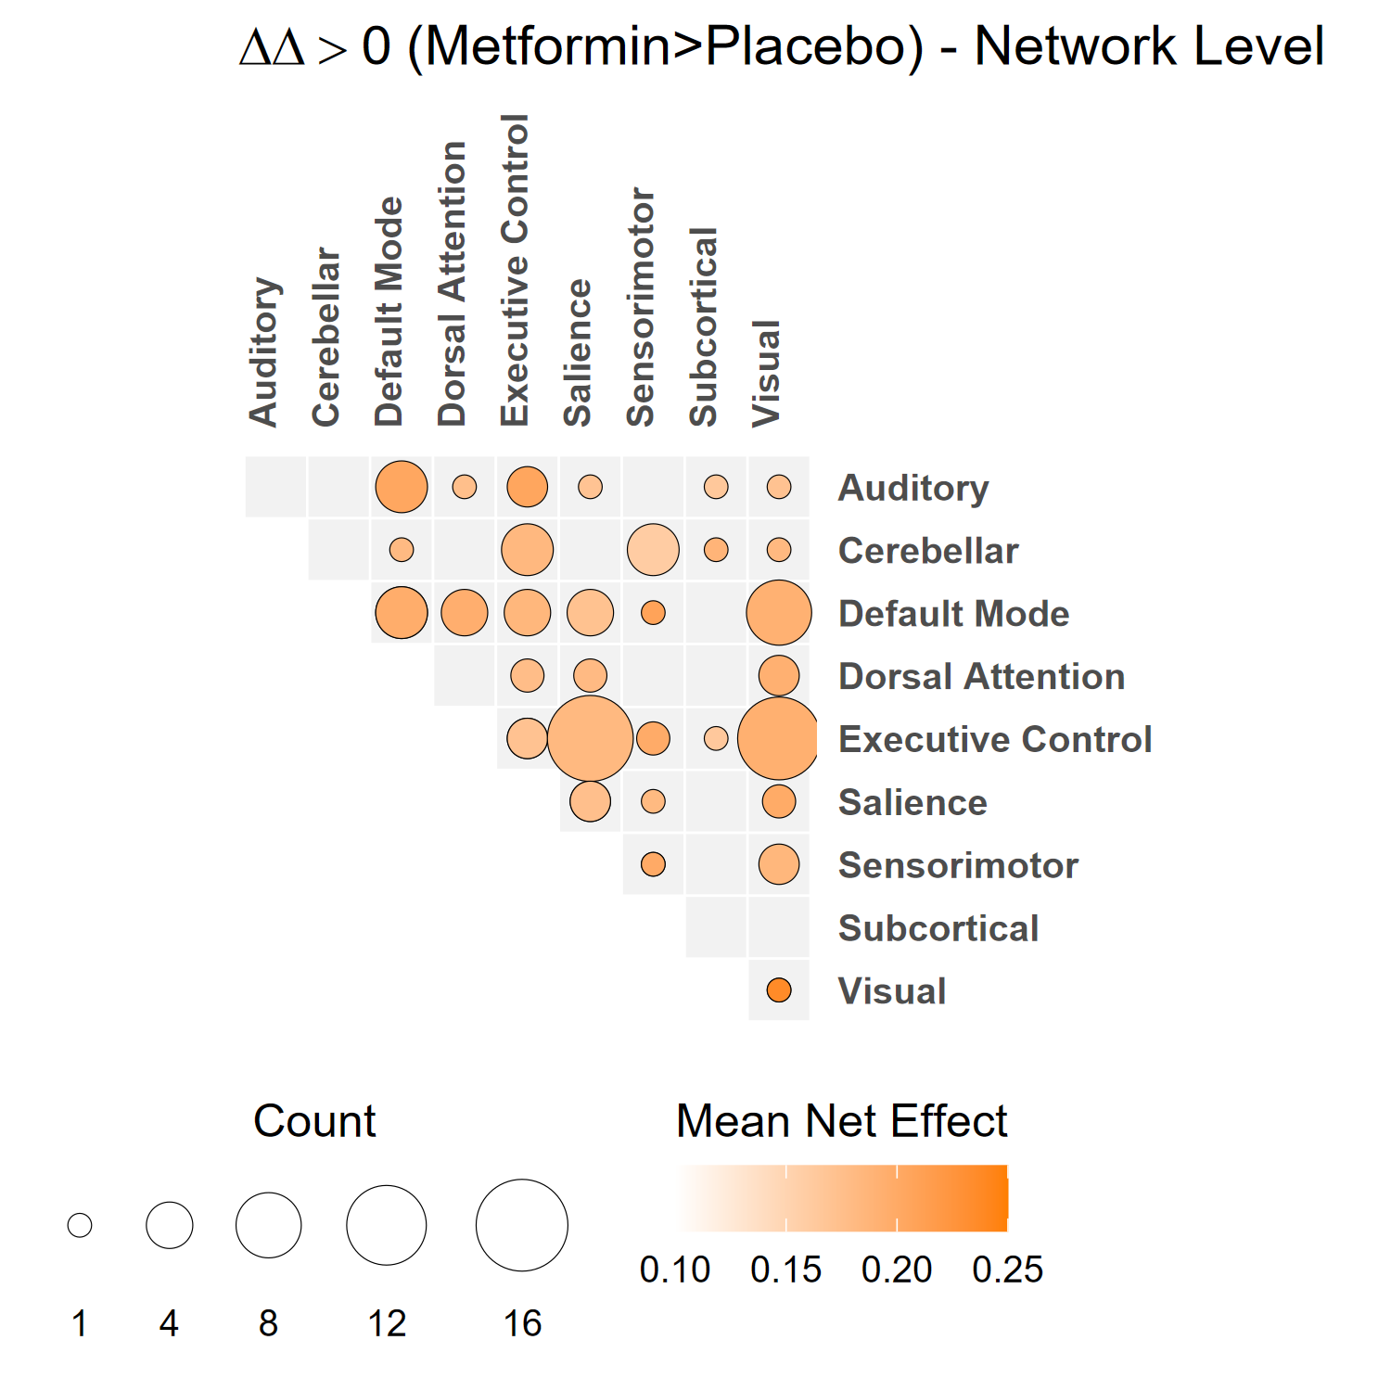
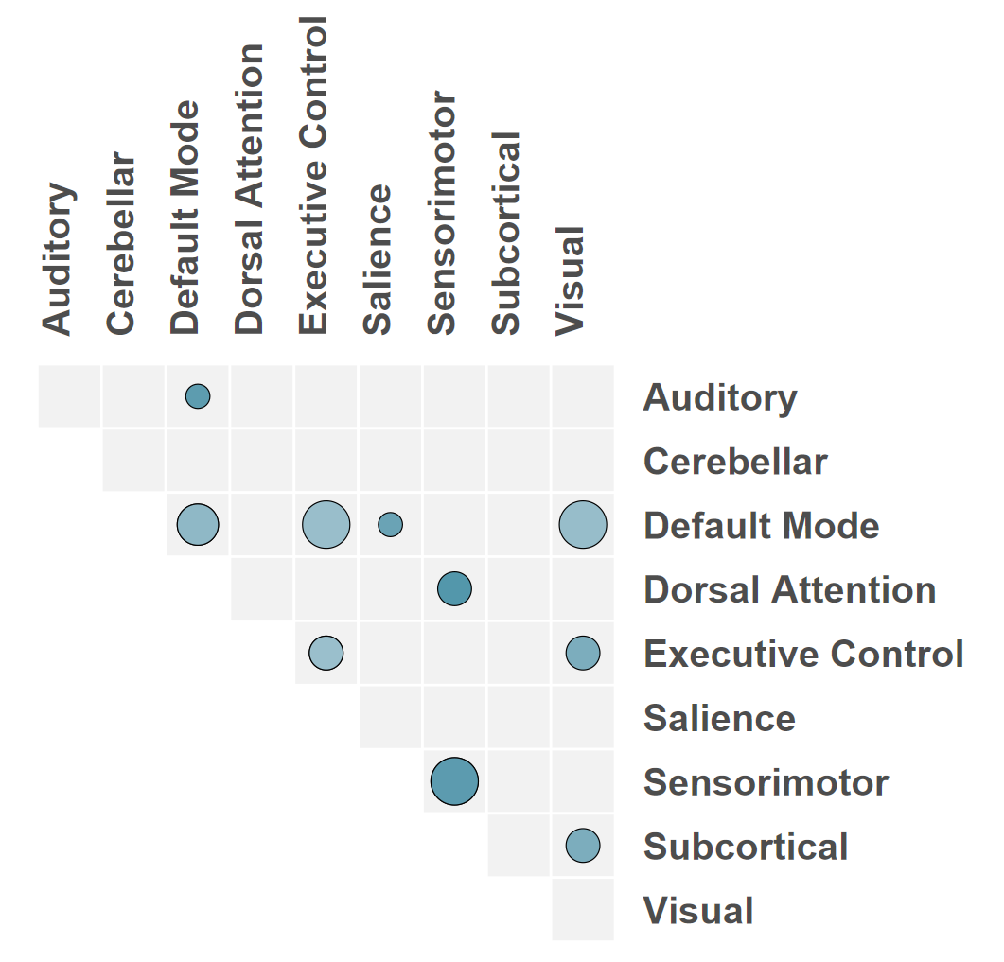
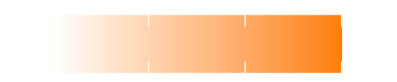
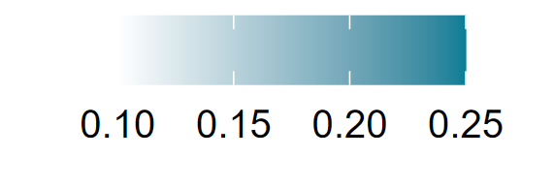
A
B
C
Count of Connections
Mean Net Effect
Metformin Δ >Placebo Δ
Placebo Δ > Metformin Δ
D
Notes:
Supplementary Figure 5: (A) Change in glucose uptake in all quantified brain regions measured by ¹⁸FDG-PET and displayed as Δ relative standardized uptake values (SUVr) (Pla, n=18; Met, n=20). Two-way ANOVAs were used to compare group differences in Pre vs Post Intervention values and the p-value of the interaction effect is displayed in the main manuscript in Figure 5E-H and indicated here with an *. (B) The functional connections that became more positive with metformin or less positive with placebo, respectively, were included in a bubble diagram demonstrating the functional networks responsible for significant group differences. (C) The functional connections that became more positive with placebo or less positive with metformin, respectively, were included in a bubble diagram demonstrating that few functional networks were altered by 40 weeks of placebo. (D) The change (Δ) in regional white matter volumes measured by volumetric MRI after 40-weeks of intervention (Placebo, Teal, n=18; Metformin, Orange, n=17). Two-way ANOVAs were used to compare group differences in Pre vs Post Intervention values and the p-value of the interaction effect is displayed in the main manuscript in Figure 5J-K and indicated here with an *.

Slide 6
Notes:
Supplementary Figure 6: The change in cognitive function was determined using the Patient-Reported Outcomes Measurement Information System (PROMIS) instruments in the NIH Toolbox assessment. The change in the T scores from baseline to 40-weeks was compared between placebo or metformin (n=20 per group). Data are presented as mean ± SD, with dots representing individual participants.

