Slide 1
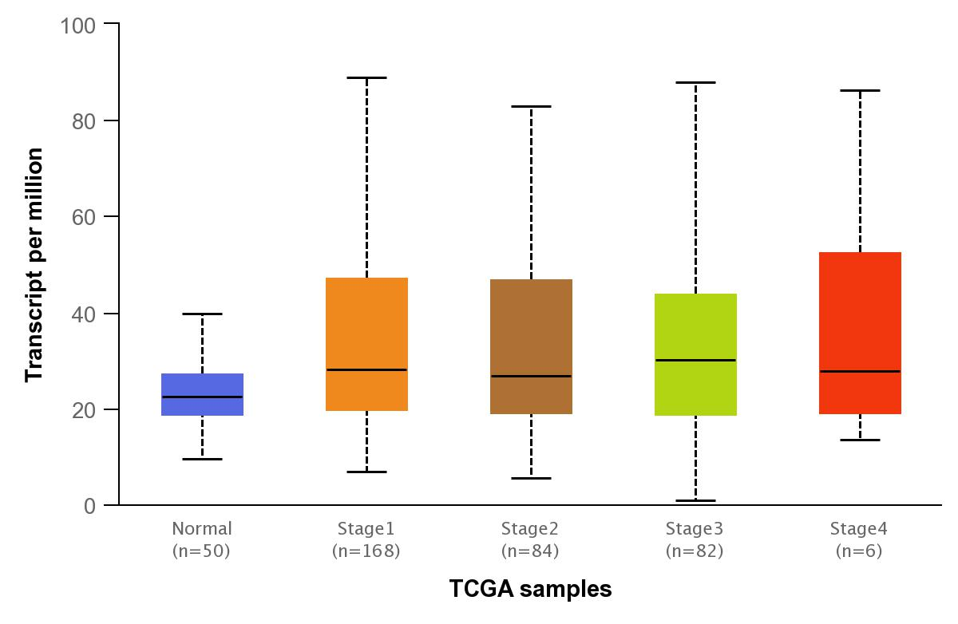
Expression of AHNAK mRNA in liver hepatocellular carcinoma based on individual cancer stages
p=0.274
p=3.63E-04
p=3.38E-04
p=1.36E-07

Slide 2
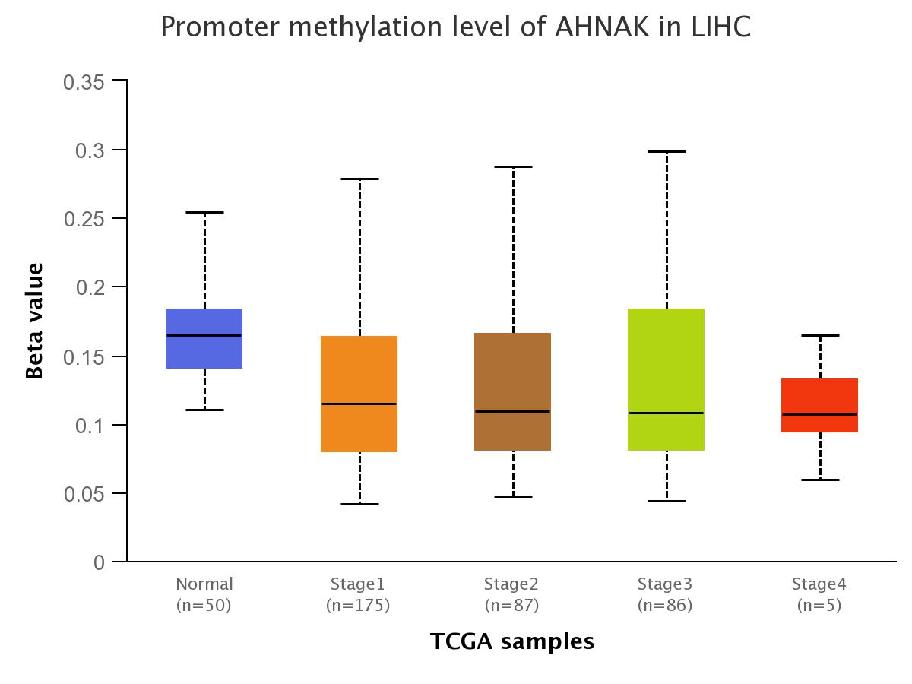
Promoter methylation level of AHNAK in Liver hepatocellular carcinoma
p=3.88E-03
p=0.106
p=1.05E-03
p=1.78E-06
Illumina Id | RefGene_group
cg23447569 | TSS1500
cg18341059 | TSS200
cg08740862 | TSS200
cg22134923 | TSS1500
cg21038682 | TSS1500
cg20518446 | TSS1500
cg19764555 | TSS1500

