Slide 1
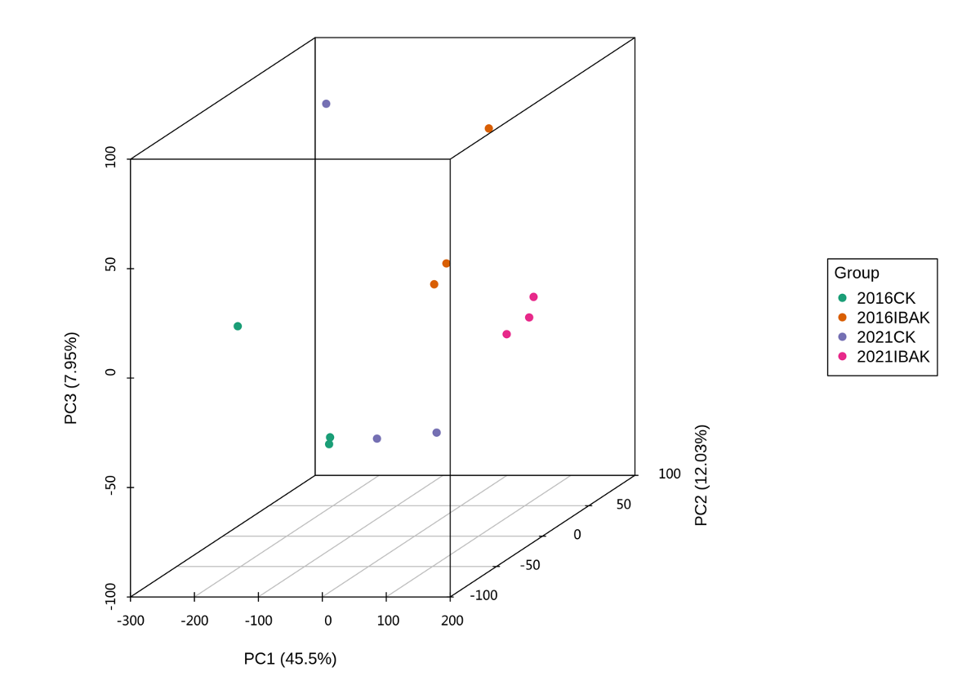
Figure S1. Principal Component Analysis (PCA) analysis of transcriptomic.

