Slide 1
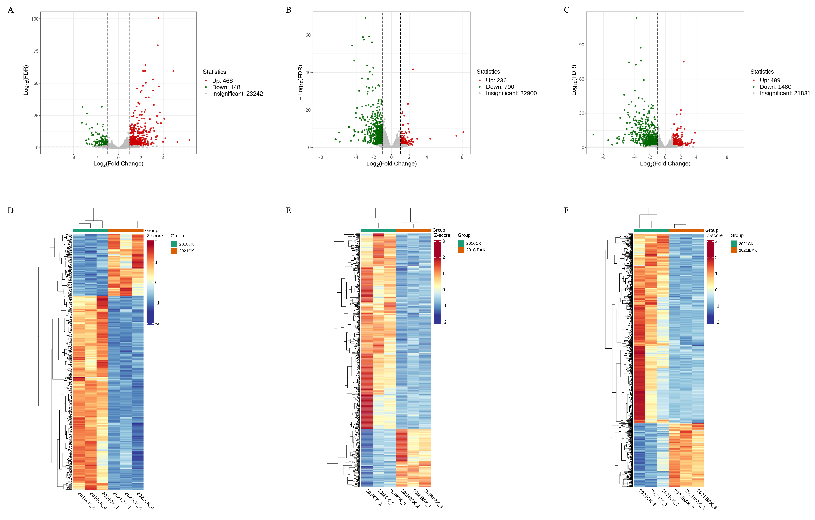
Figure S2. Transcriptome data analysis
Volcanic maps of 16CK vs 21CK. (B) Volcanic maps of 16IBAK vs 16CK. (C) Volcanic maps of 21IBAK vs 21CK.
(D) Heatmap of the change patterns of DEGs 16CK vs 21CK. (E) Heatmap of the change patterns of DEGs 16IBAK vs 16CK.
(F) Heatmap of the change patterns of DEGs 21IBAK vs 21CK.

