Slide 1
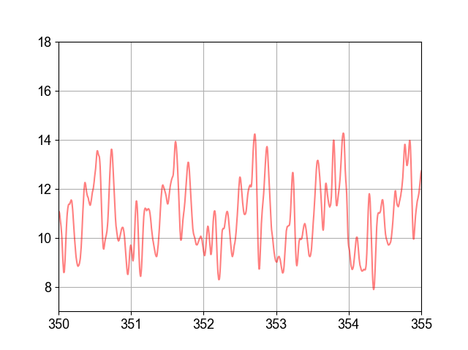
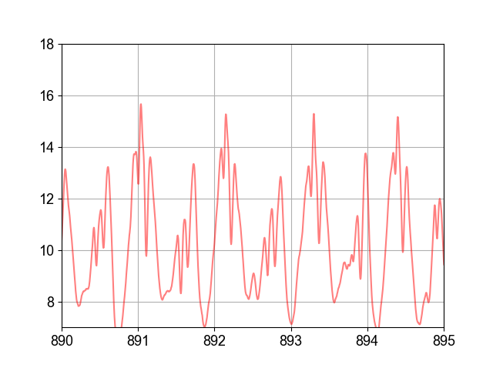
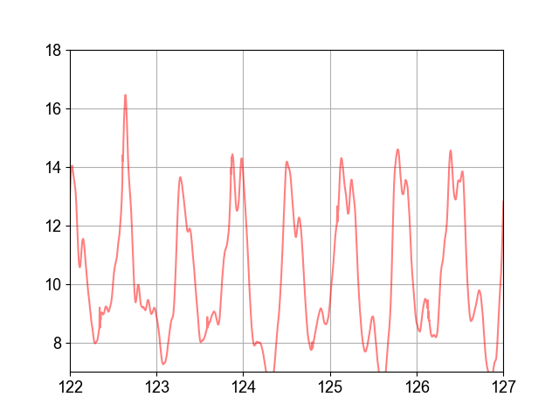
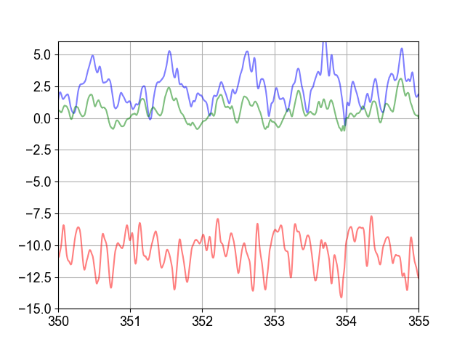
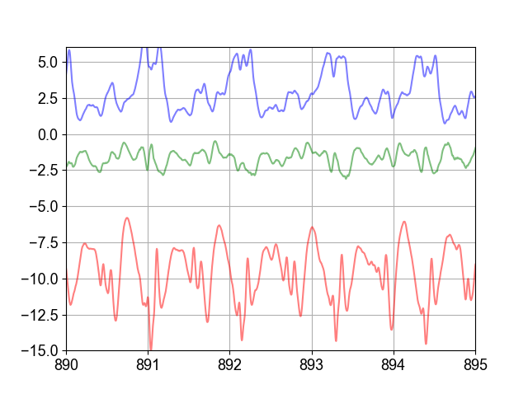
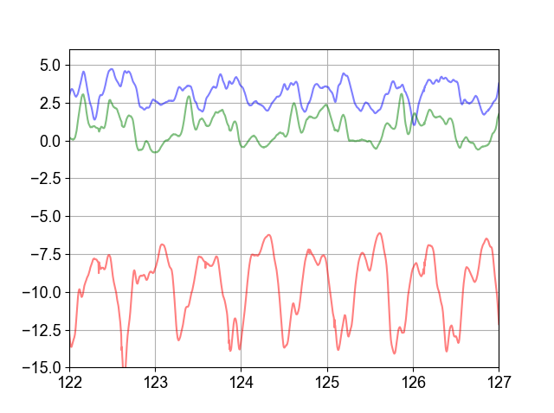
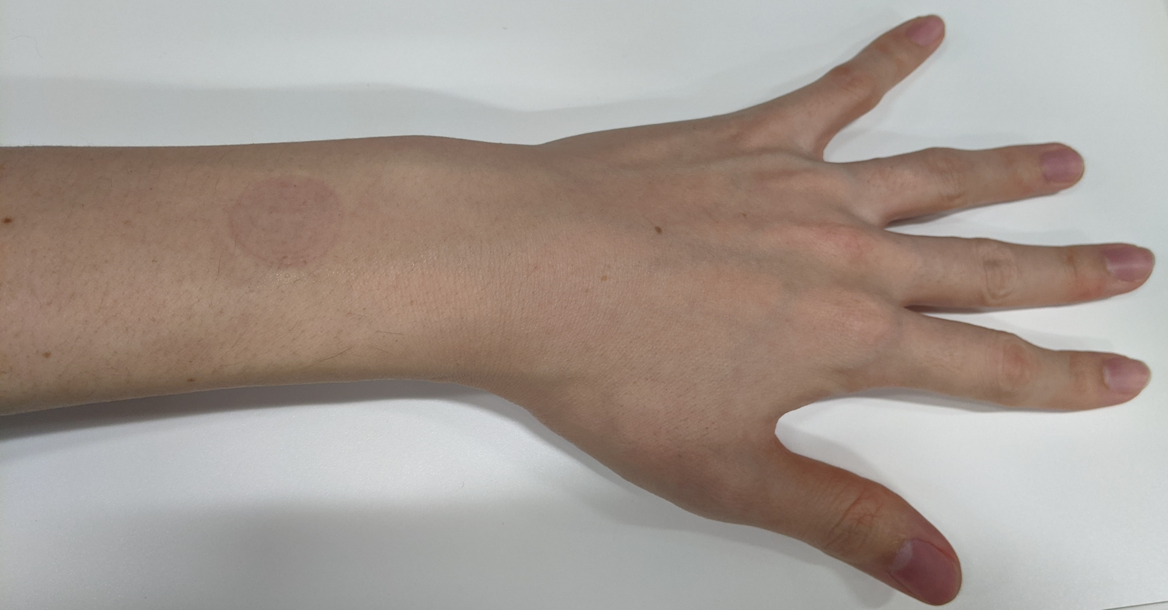
Supplemental Figure 1
a
b
c
[m/s²]
Subject #3
[m/s²]
Subject #4
[m/s²]
Subject #6
[s]
[s]
[s]
d
e
f
[m/s²]
Subject #3
[m/s²]
Subject #4
[m/s²]
Subject #6
X axis
X axis
Z axis
X axis
Z axis
Z axis
Y axis
Y axis
Y axis
[s]
[s]
[s]
g
Z
Y
X

