Slide 1
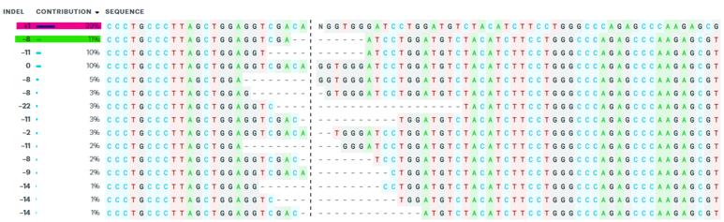
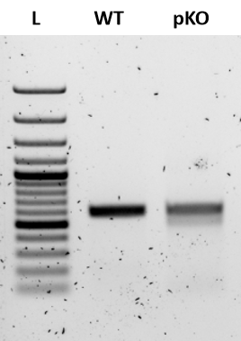
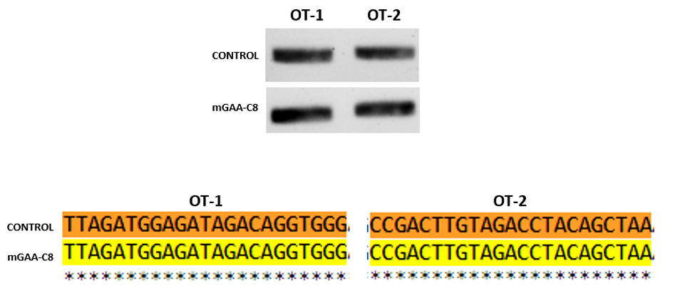
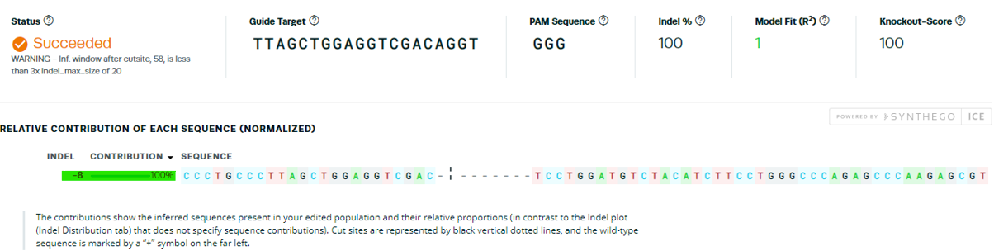
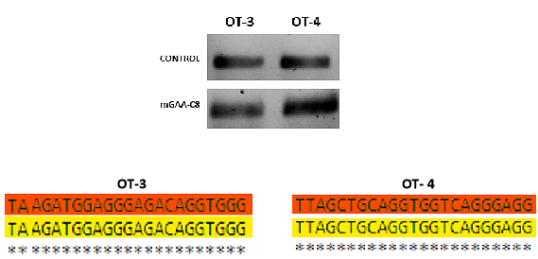
Supplementary figure 1
A
B
T7EI
C
ICE ANALYSIS FOR EDITING
D
E
WT
C8
Supplementary figure 1. A) ICE analysis showing the percentage of different edits in the polyclonal hESC population. B) T7E1 assay confirming the presence of editing in the target region. C) & D) ICE analysis revealed the percentage of editing in each clone after single cell cloning. 100% (homozygous) editing efficiency was obtained in C8 clone. E) Sanger sequencing of predicted off-target regions showed no off-target editing.

Slide 2
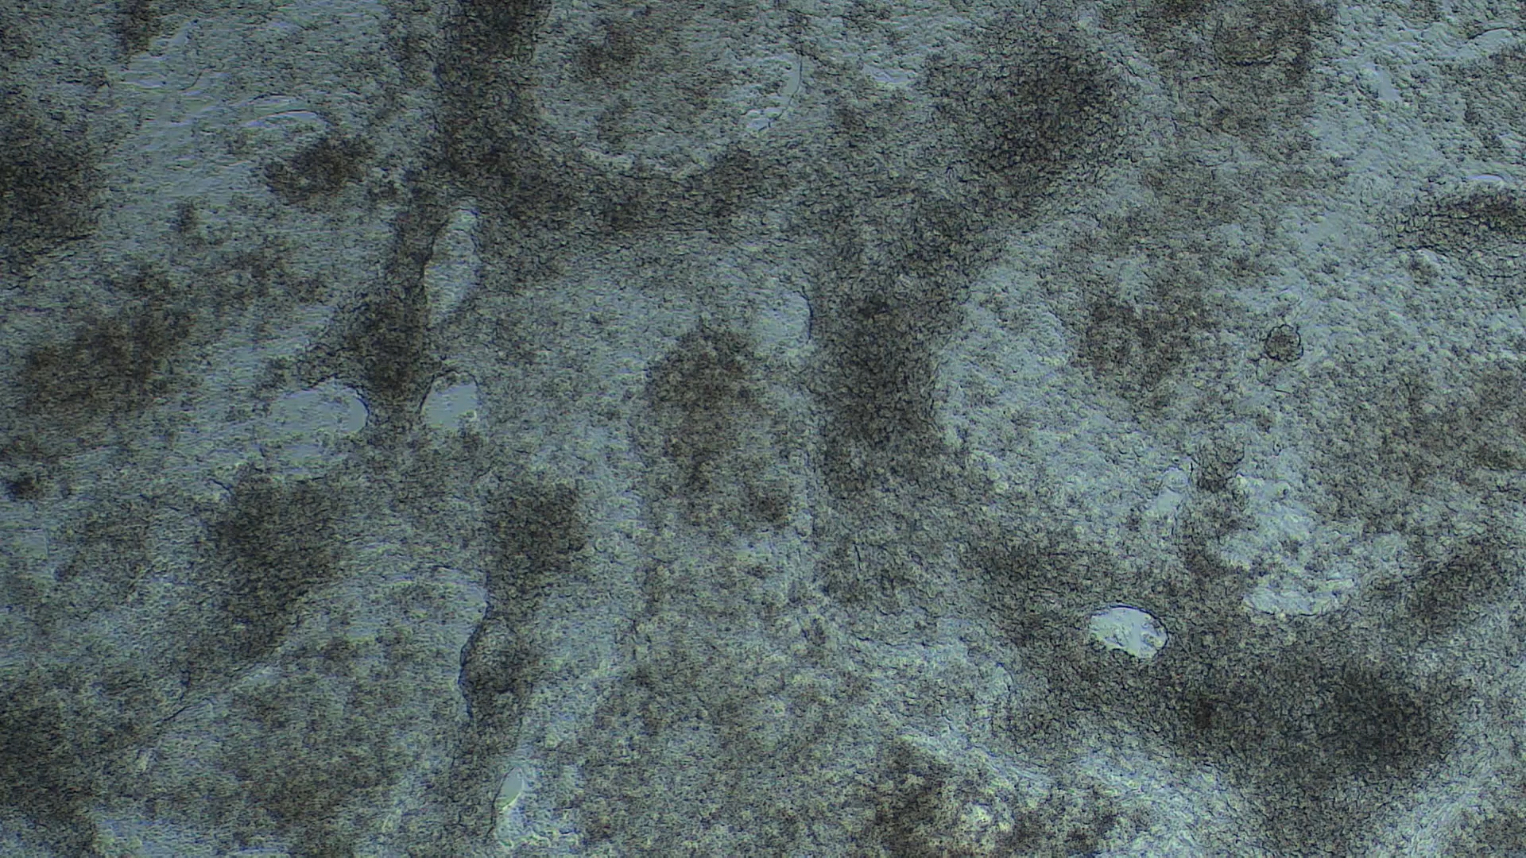
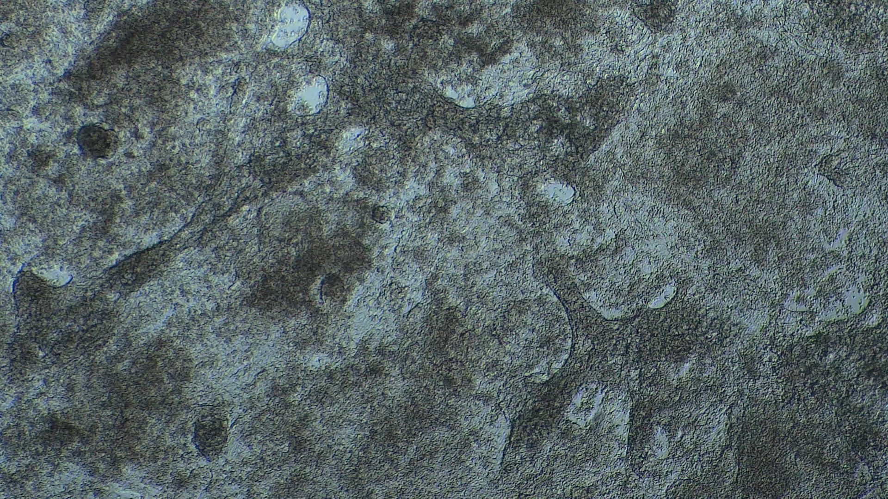
(A)
(B)
Supplementary video 1. Video graphs showing beating of cardiomyocytes derived from WT and C8 hESCs
(A) & (B) The C8 Pompe cardiomyocytes displayed much slower beating than the WT cardiomyocytes, indicating defect in contraction.

Slide 3
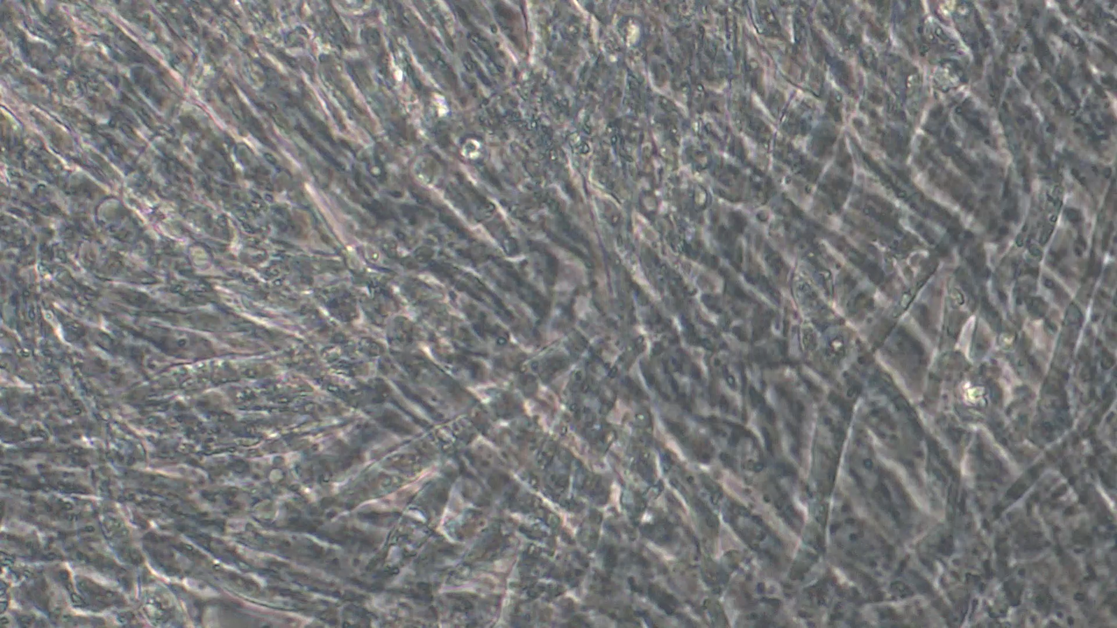
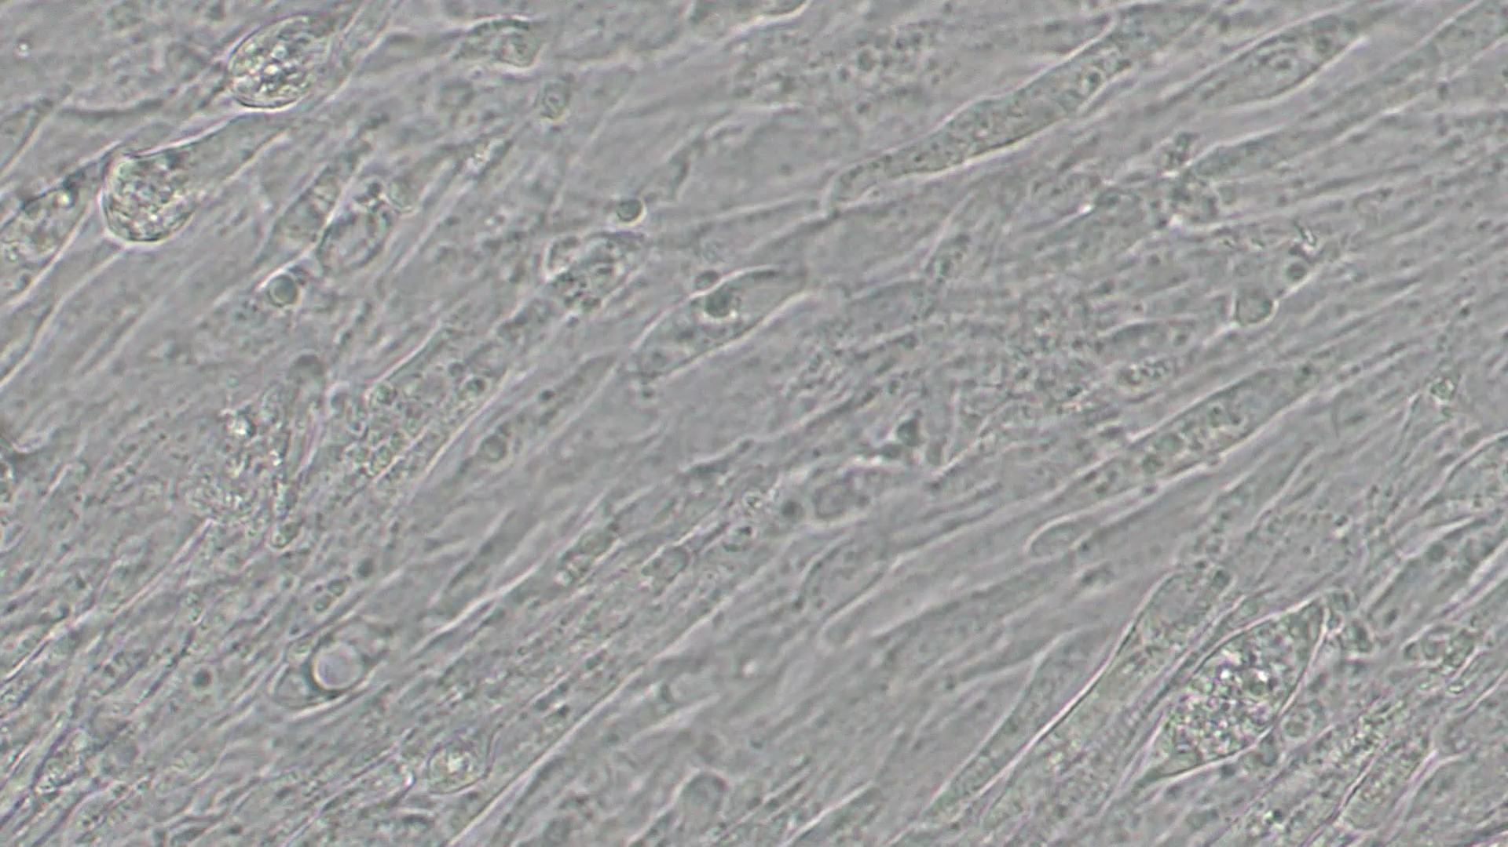
(A)
(B)
Supplementary video 2. Video graphs showing beating of cardiomyocytes derived from WT and C8 hESCs
(A) & (B) The C8 Pompe myotubes displayed much slower twitching than the WT myotubes, indicating defect in contraction.

