Slide 1
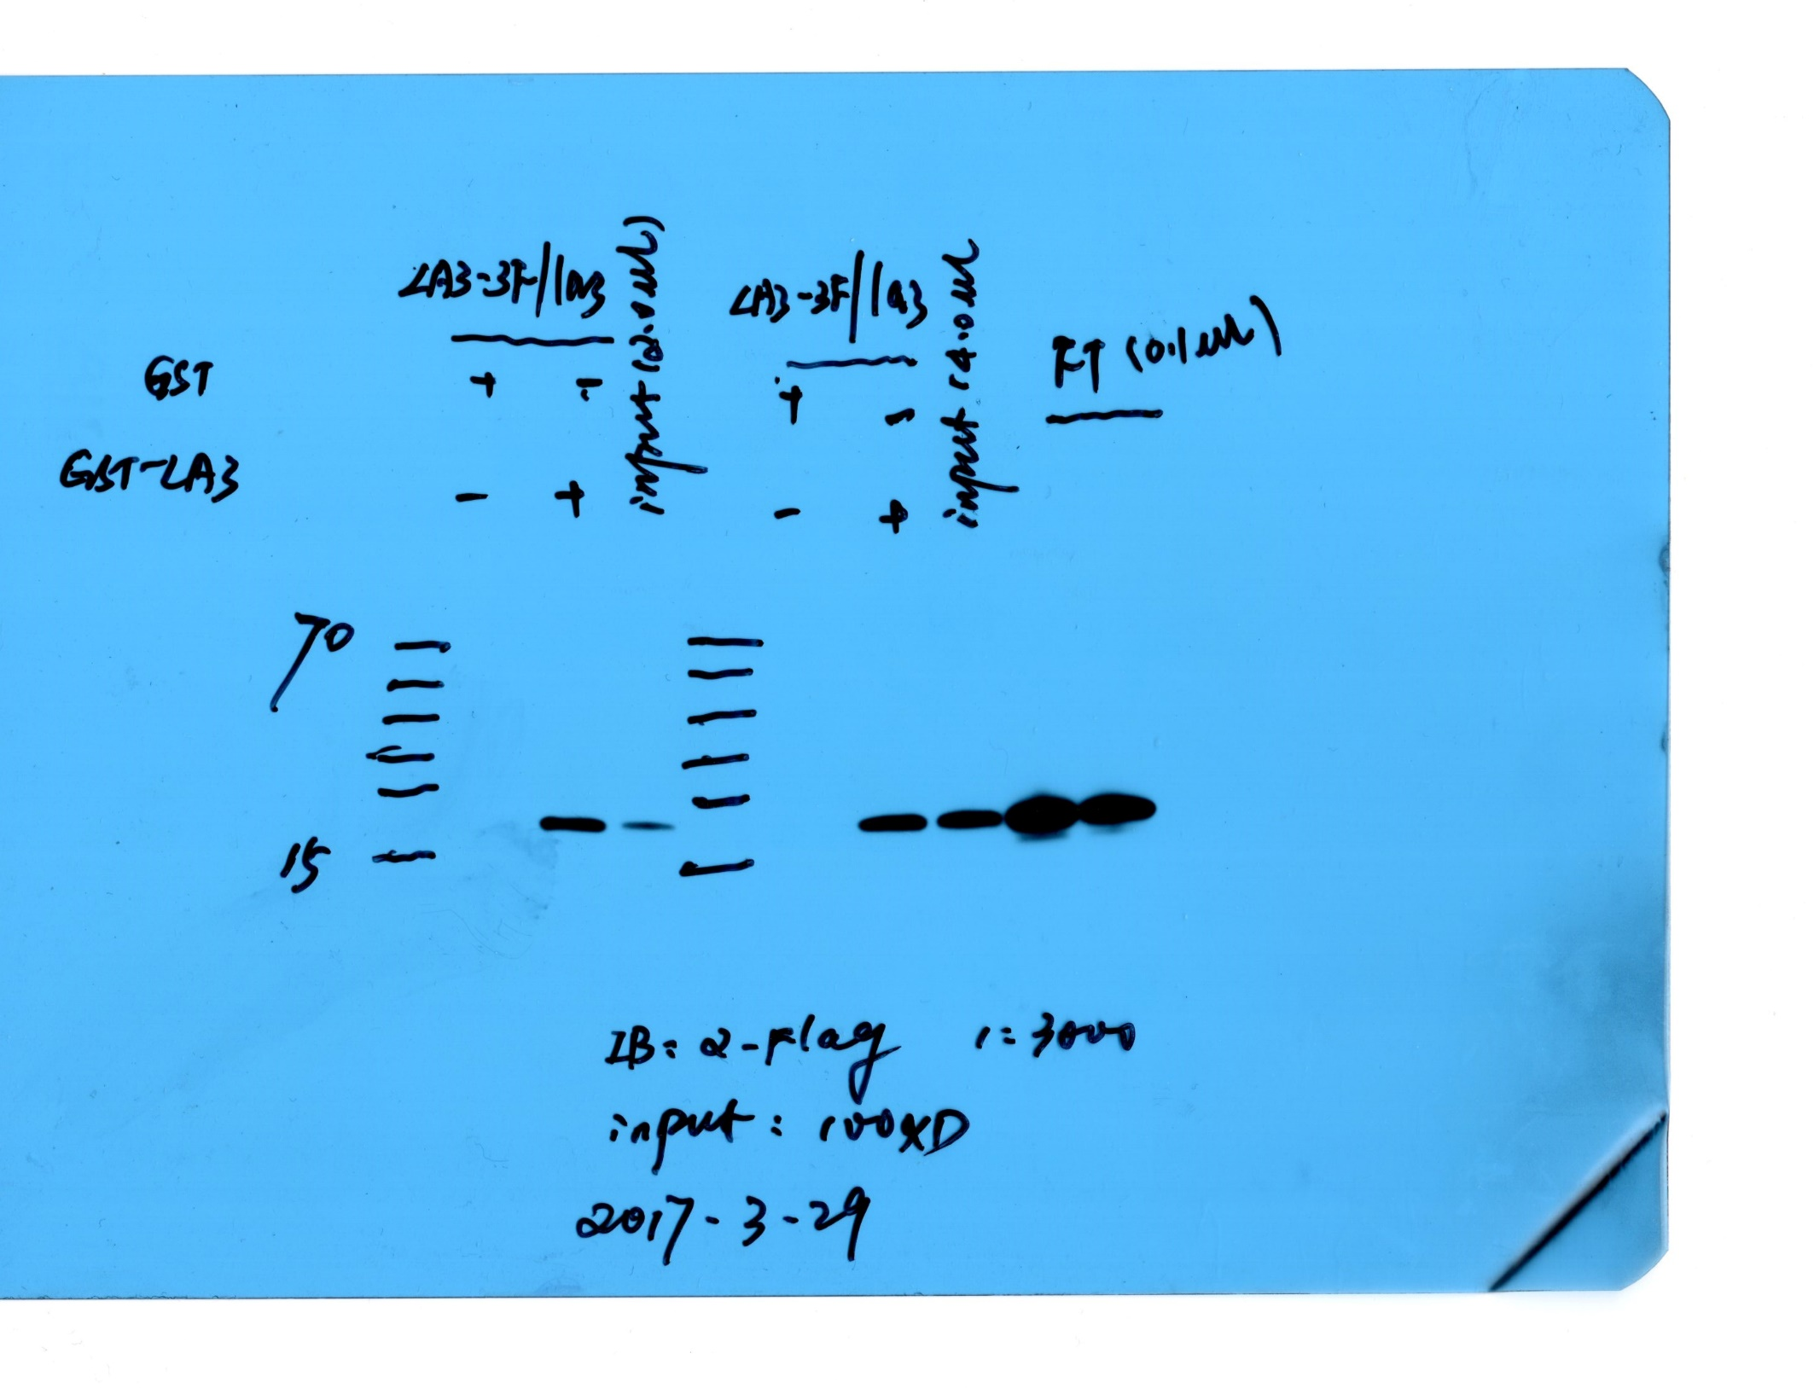
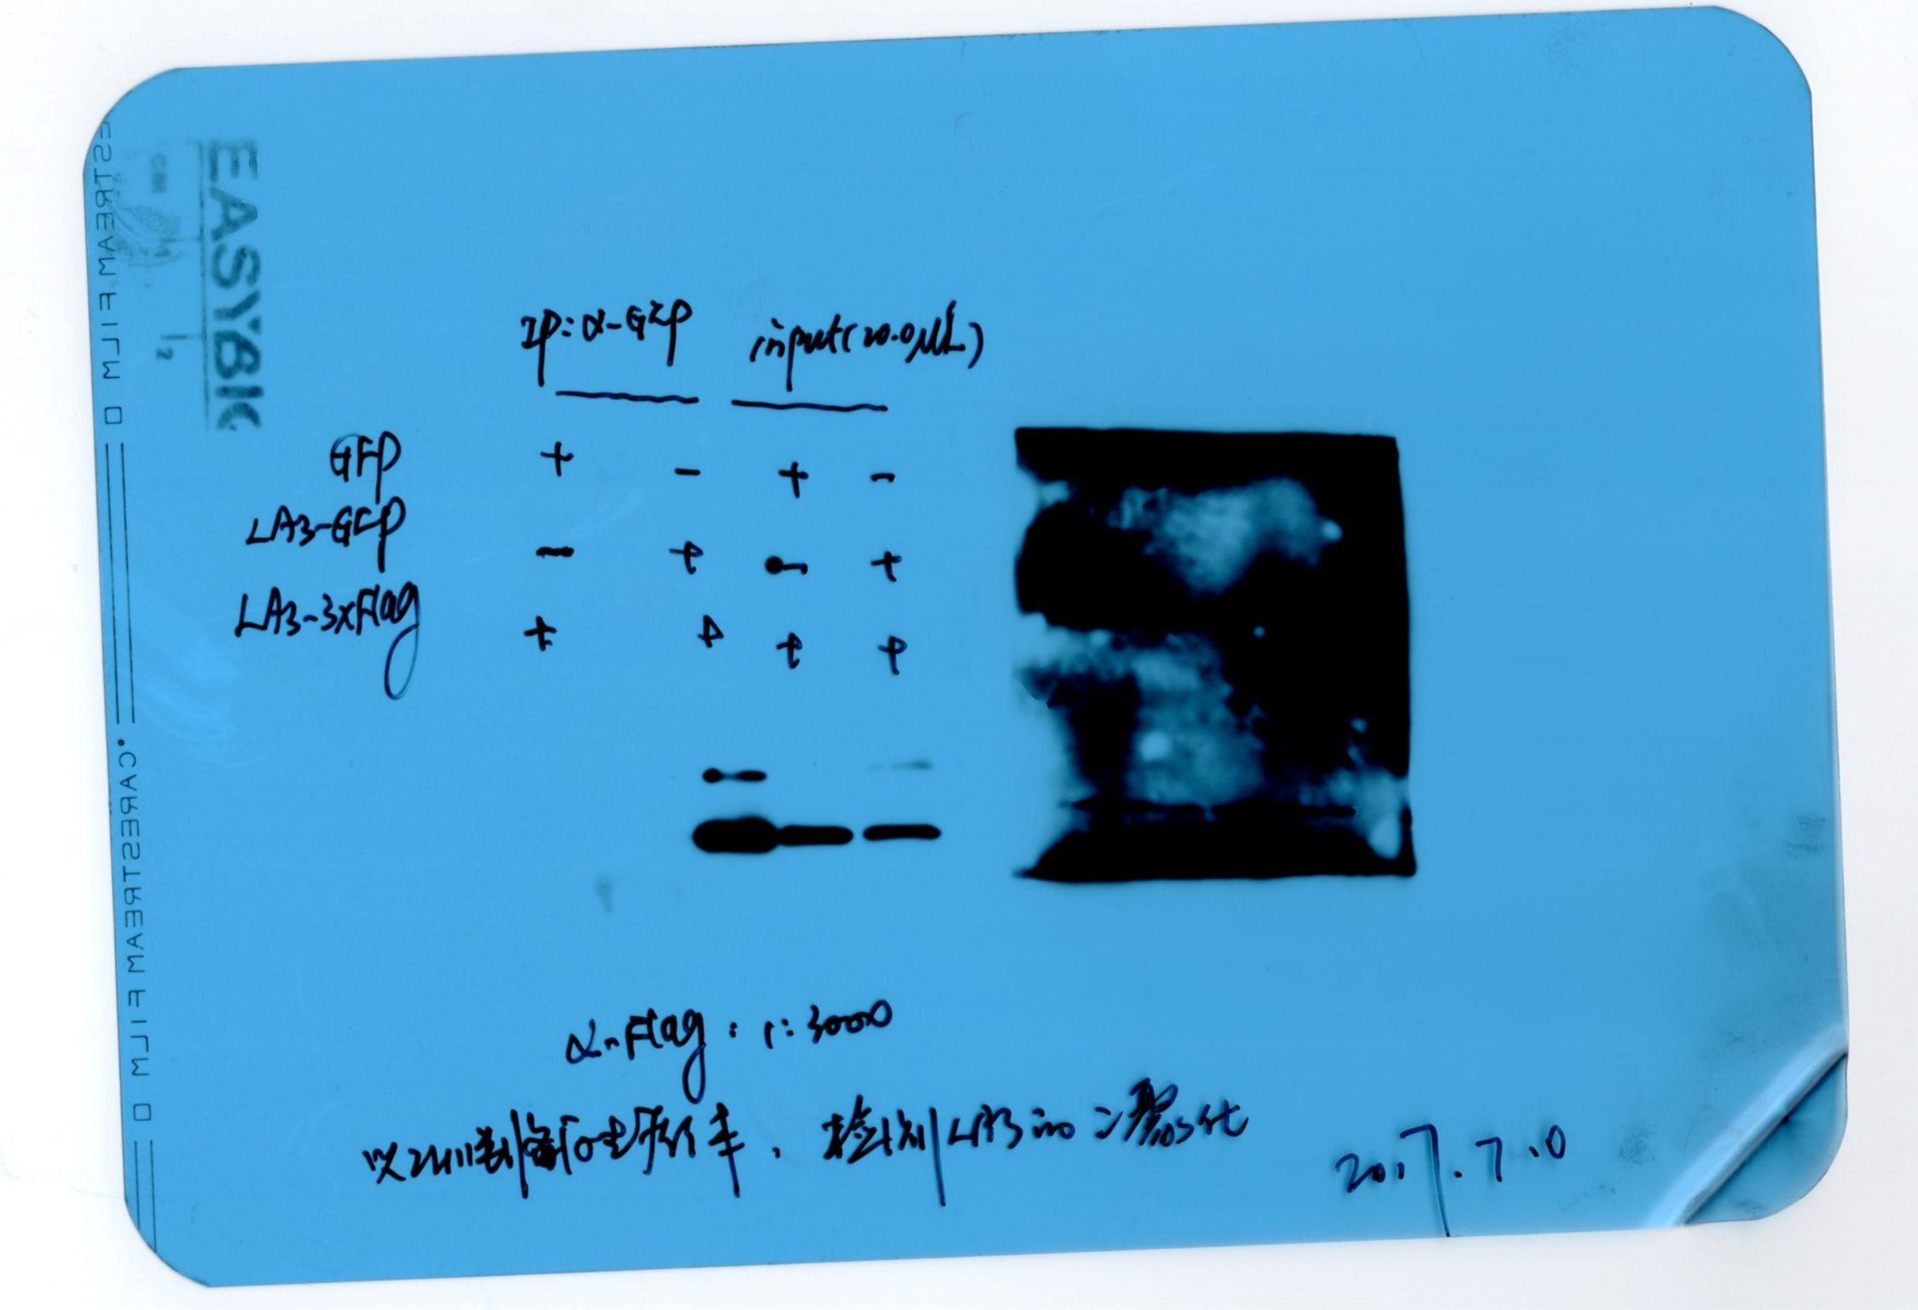
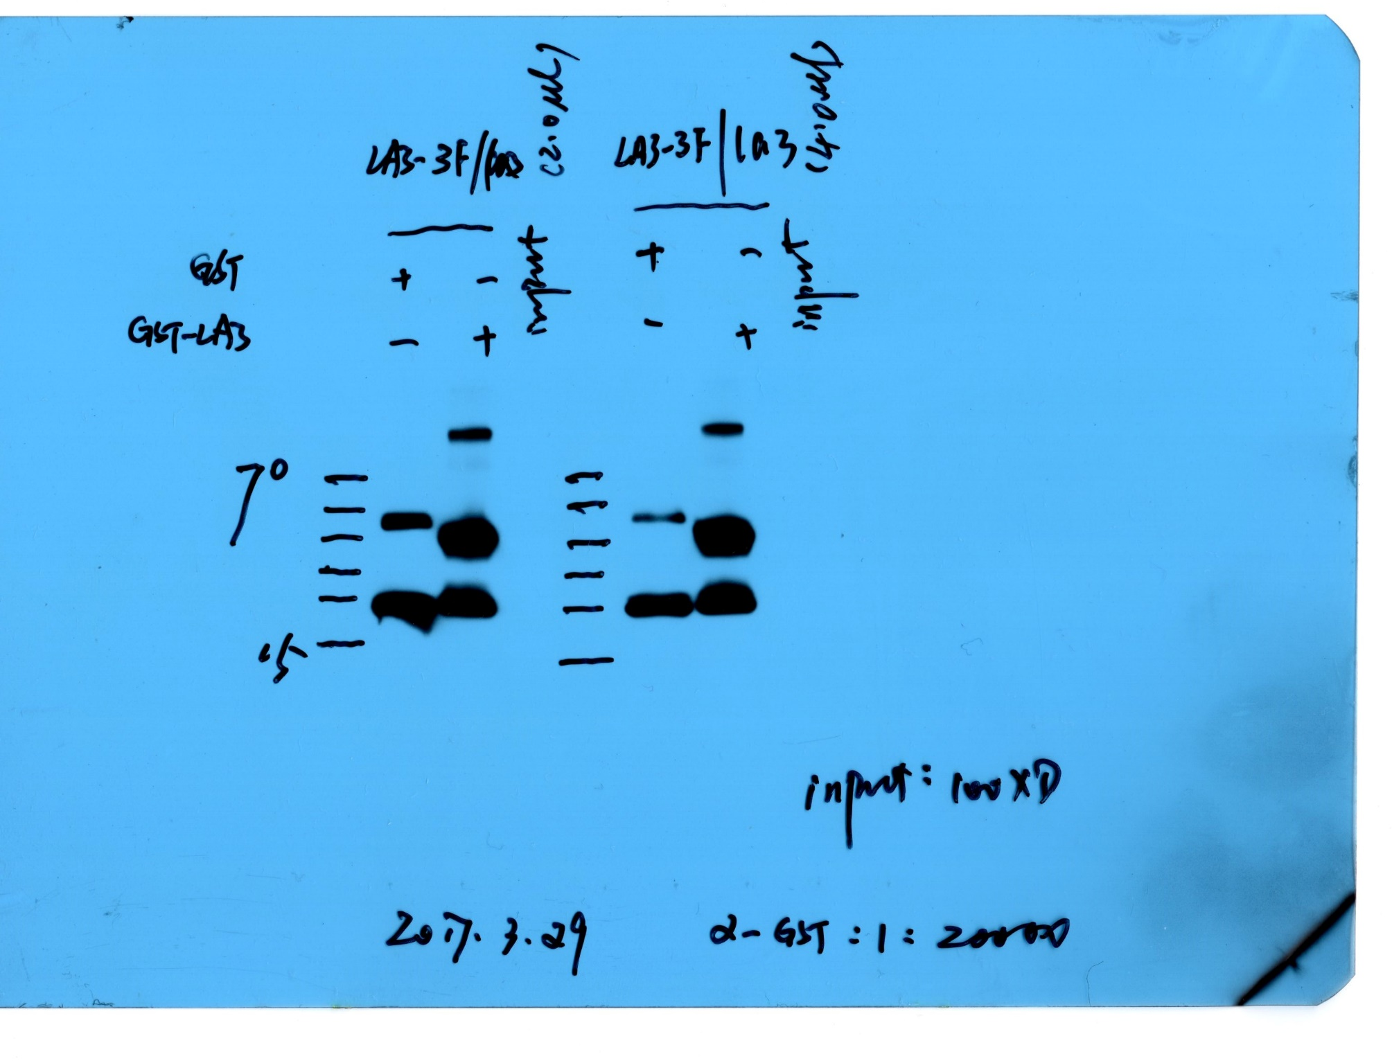
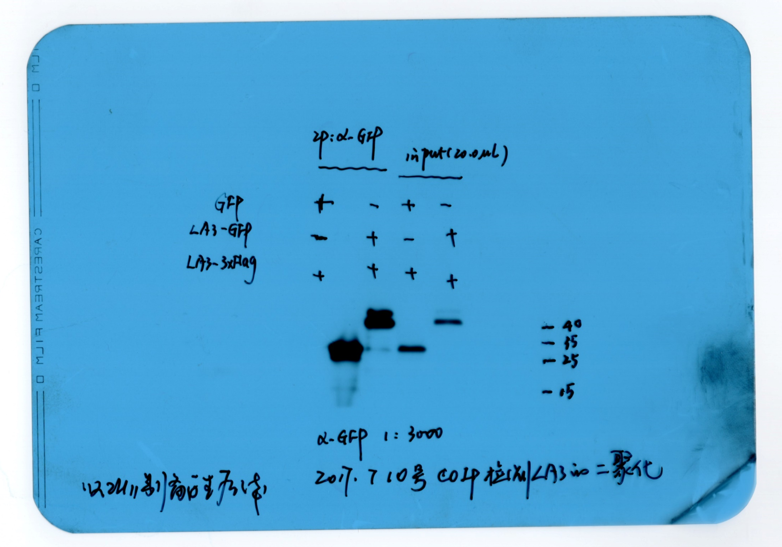
Note: Prior to the publication of our 2021 article on its role in regulating tiller angle (New Phytologist), this gene was initially referred to as LA3 in our study. It was subsequently renamed LAZY2 because it was published earlier than another gene previously named LAZY2.

