Slide 1
Fig. S1 Expression pattern of LA2 in different rice tissues.
RT-qPCR analysis of transcription level of LA2 in various rice tissue samples. Values are given as means ± SEM (n = 3). The rice Ubiquitin was used as endogenous control.

Slide 2
Fig. S2 Expression pattern of LA3 in different rice tissues.
RT-qPCR analysis of transcription level of LA3 in various rice tissue samples. Values are given as means ± SEM (n = 3). The rice Ubiquitin was used as endogenous control

Slide 3
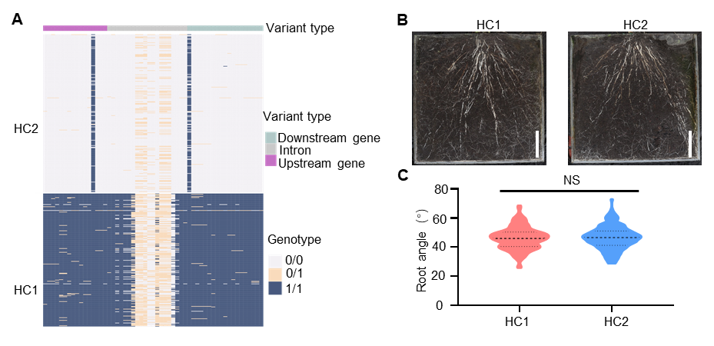
Fig. S3 Haplotype analysis of LA3 and their contributions to root angle.
(A) Haplotype clusters of LA3. The different colors on the top of the heat map indicated
variant type. HC1~HC2 indicated different haplotype clusters of LA3.
(B) The representative root architecture of HC1 and HC2 of LA3. Scale bars, 5cm.
(C) Statistical analysis of root angle of HC1 and HC2 of LA3. n=129~147. **P<0.01, Student’s t-test.

