Slide 1
Saturated hydrocarbons (alkanes)

Slide 3
150
%
Peak #25 RT: 26.47 min
100
57.1
Hit# 3 : Nonadecane : C19H40
43.1
85.1
50
41.0
99.1
69.1
0
-50
-100
-150
m/z
25
50
100
150
200
250
300
350
400
450
500

Slide 6
150
%
Peak #124 RT: 43.24 min
100
57.1
Hit# 2 : Dotriacontane : C32H66
85.1
50
43.1
99.1
41.1
69.1
127.1
0
-50
-100
-150
m/z
26
50
100
150
200
250
300
350
400
450
500
150
%
Peak #130 RT: 44.37 min
150
%
Peak #55 RT: 46.27 min
100
57.1
Hit# 2 : Tritriacontane : C33H68
100
57.1
Hit# 3 : Tetratriacontane : C34H70
71.1
85.1
50
43.1
99.1
50
99.2
69.1
127.1
55.1
0
0
-50
-50
-100
-100
-150
m/z
-150
m/z
17
50
100
150
200
250
300
350
400
450
500
27
50
100
150
200
250
300
350
400
450
500

Slide 7
150
%
Peak #57 RT: 47.99 min
100
57.1
Hit# 3 : Pentatriacontane : C35H72
85.1
50
55.1
99.1
113.2
0
-50
-100
-150
m/z
27
50
100
150
200
250
300
350
400
450
500

Slide 8
Unsaturated hydrocarbons (alkenes)
150
%
Peak #2 RT: 9.99 min
100
55.1
Hit# 3 : 2-Undecene : C11H22
56.1
83.1
50
57.1
97.1
42.1
67.1
0
-50
-100
-150
m/z
26
50
100
150
200
250
300
350
400
450
500

Slide 9
150
%
Peak #9 RT: 14.69 min
100
55.1
Hit# 2 : 3-Tridecene, (E)- : C13H26
41.1
70.1
97.1
50
43.1
84.1
111.1
182.1
0
-50
-100
-150
m/z
15
50
100
150
200
250
300
350
400
450
500

Slide 10
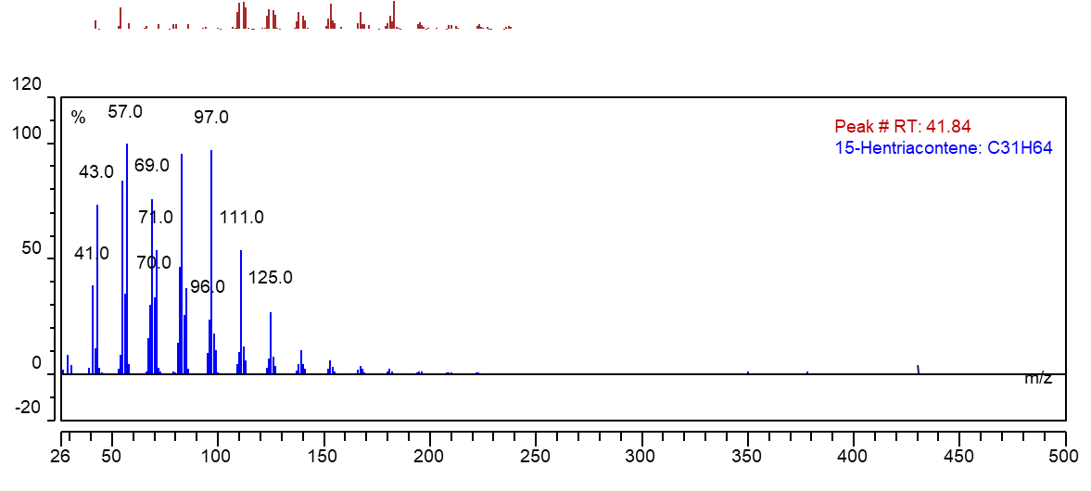
150
%
Peak #55 RT: 39.65 min
100
97.1
Hit# 2 : Z-9-Nonacosene : C29H58
57.1
83.1
111.1
50
41.1
71.1
96.1
125.1
67.1
0
-50
-100
-150
m/z
40
100
150
200
250
300
350
400
450
500

