Slide 1
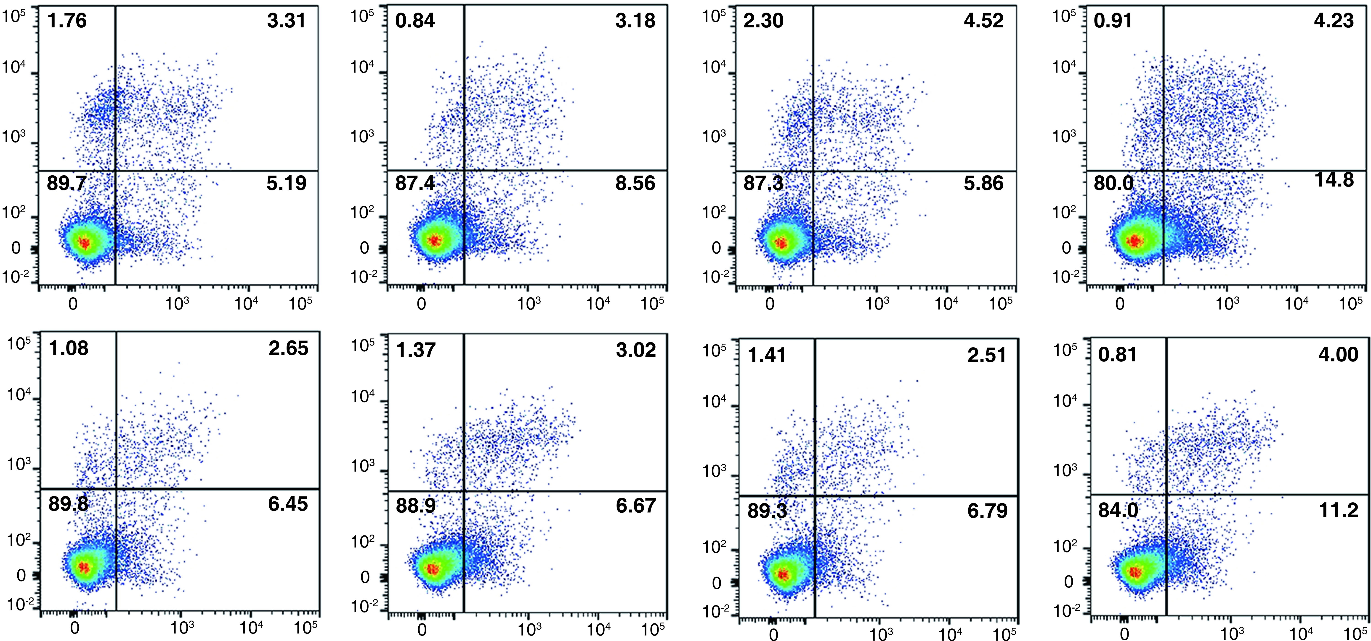
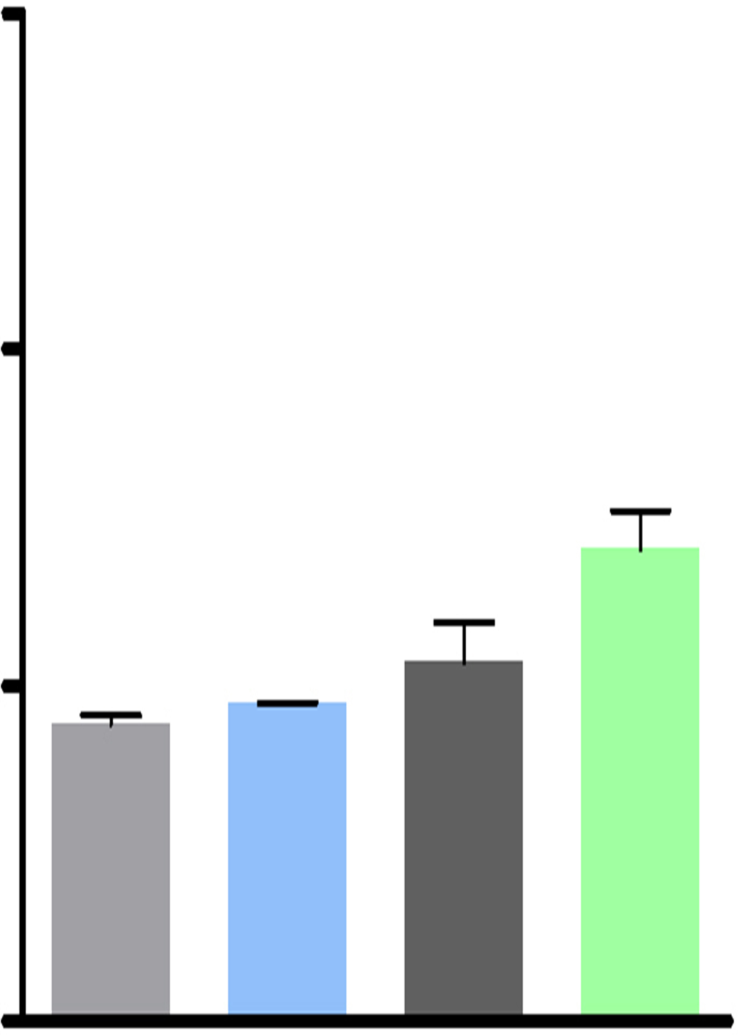
SPC-A1
a c
d
b
e f g
SPC-A1
Cytosolic extract
Nuclear extract
exo-miR-NC
Cytosolic extract
Nuclear extract
CGP57380
-
-
+
+
-
-
+
+
exo-miR-7-5p
-
+
-
-
+
-
-
+
-
-
+
-
EVE
-
+
-
+
-
+
-
+
EVE
-
-
+
-
-
+
-
-
+
-
-
+
p-MNK1^{Thr197/202}
-
-
-
+
+
+
-
-
-
+
+
+
p-eIF4E^{S209}
p-MNK1^{Thr197/202}
p-eIF4E^{S209}
GAPDH
GAPDH
Histone H3
Histone H3
(1) (2)
(3) (4)
(1) Mimics NC
(2) EVE+ Mimics NC
SPC-A1
(3) miR-7-5p mimics
Cytosolic extract
Nuclear extract
(4) miR-7-5p mimics+ EVE
LV-miR-7-5p
-
-
+
+
-
-
+
+
30
***
EVE
-
+
-
+
-
+
-
+
SPC-A1
PI
***
p-MNK1^{Thr197/202}
20
**
p-eIF4E^{S209}
Apoptosis rate
GAPDH
10
Histone H3
0
Annexin V
(1) (2) (3) (4)
SPC-A1
SPC-A1
LV-miR-7-5p
SPC-A1
-
-
+
+
LV-miR-7-5p
EVE
-
+
-
+
LV-miR-7-5p
-
-
+
+
EVE
-
-
+
+
EVE
-
+
-
+
Bcl-xL
-
+
-
+
c-PARP
DR4
Bak
caspase-3
DR5
Bad
c-caspse-3
GAPDH
Bax
GAPDH
GAPDH
Liu, et al , Figure S4

