Slide 1
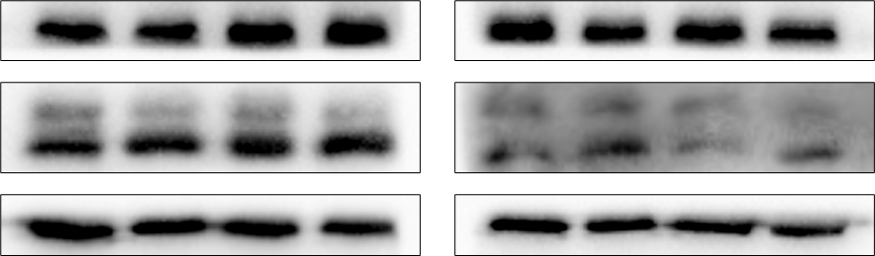




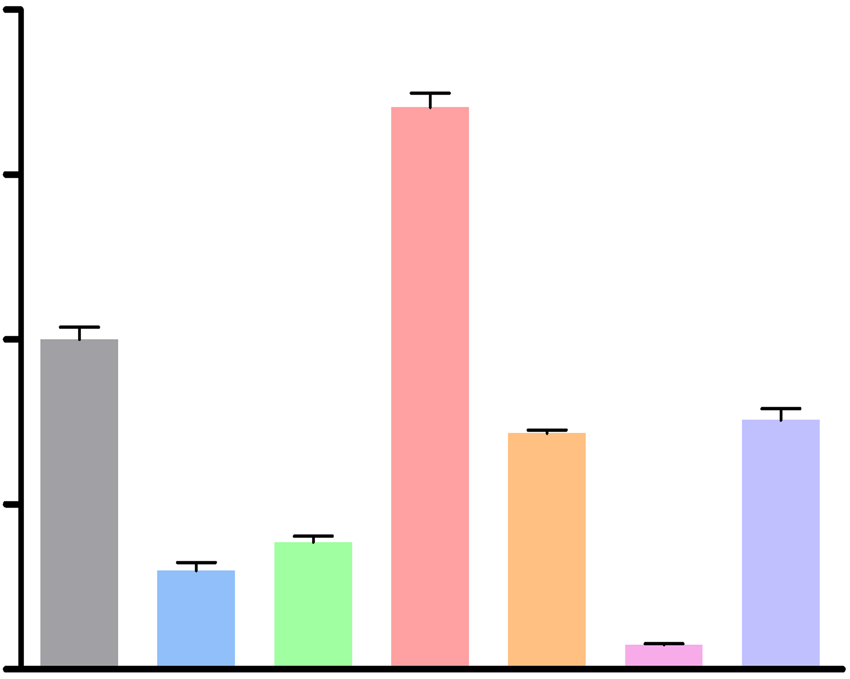
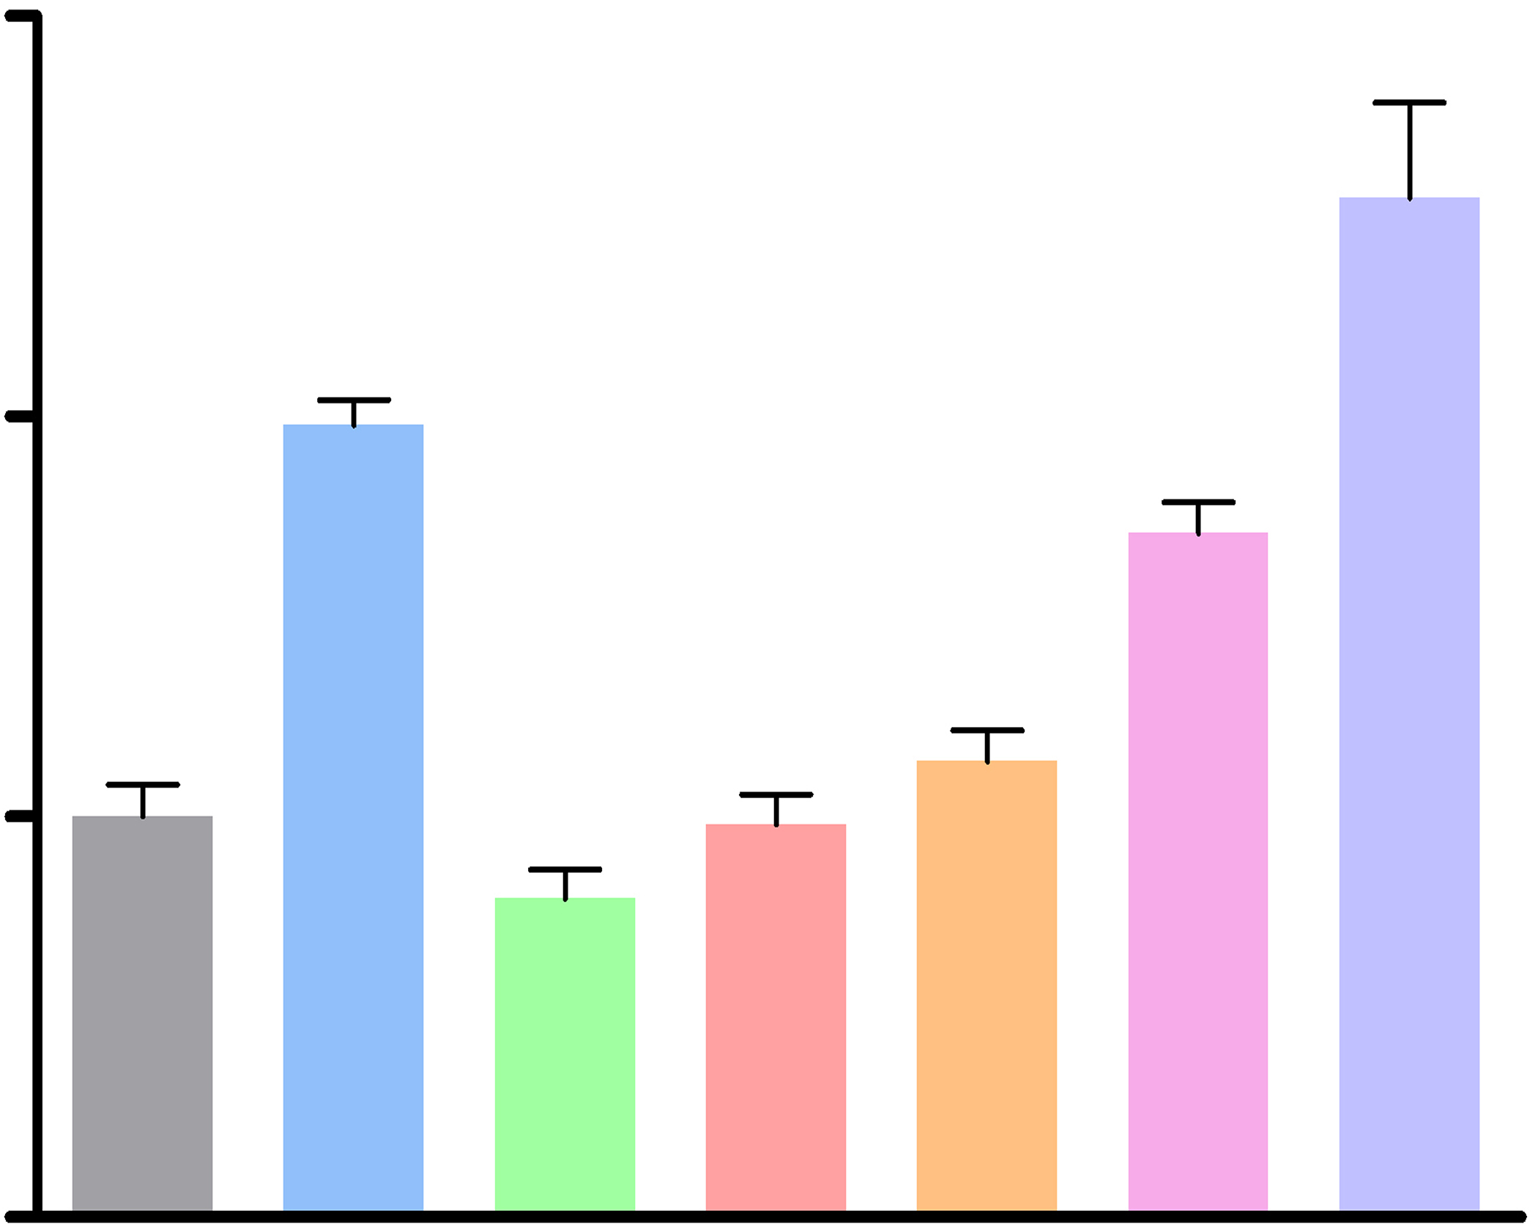
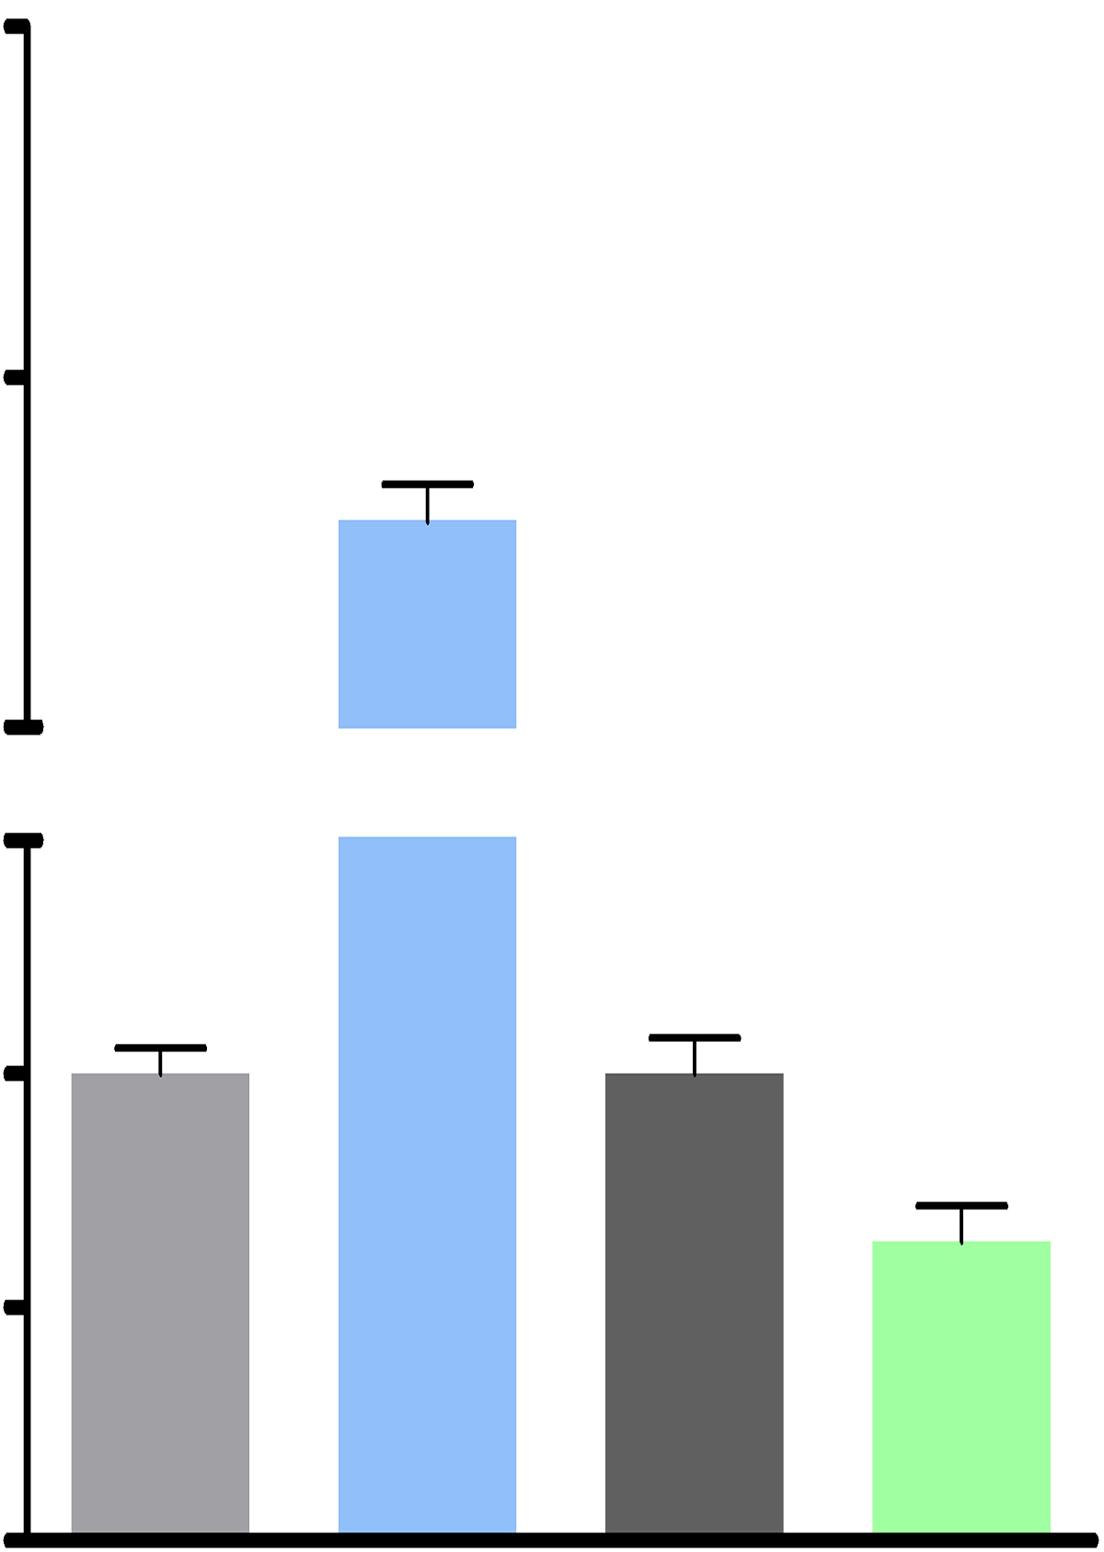
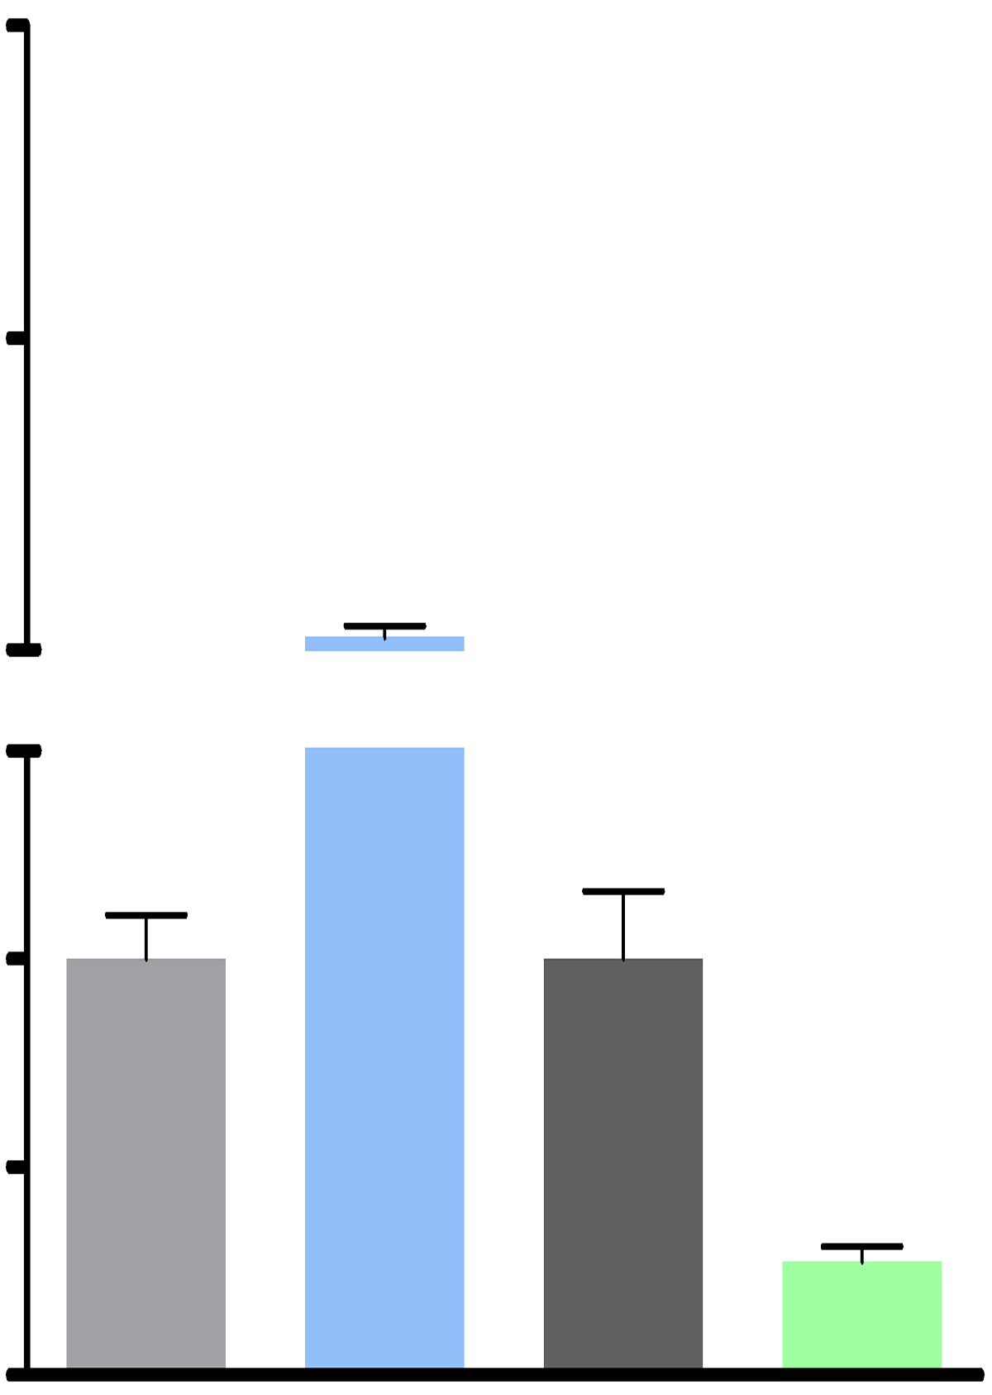
a
b c
d e
A549 SPC-A1
2.5mM 3-MA - - + + - - + +
Everolimus - + - + - + - +
Beclin 1
LC3A/B
GAPDH
A549
A549
Si TSC1 - - + +
Si Rab27A - - + +
Everolimus - + - +
Everolimus - + - +
mTOR
TSC1
Tubulin-α
Rab27A
GAPDH
A549
A549
Si TSC2 - - + +
Si Rab27B - - + +
Everolimus - + - +
Everolimus - + - +
mTOR
TSC2
Tubulin-α
Rab27B
GAPDH
NC mimics
Inhibitor NC
3.0
2.0
1.0
0
miR-7-5p mimics
miR-7-5p inhibitor
2.0
1.5
1.0
0.5
0
***
*** ***
*** ***
***
***
***
**
Relative miR-7-5p level / U6
Relative MNK1 expression / Action
800
350
100
1.0
0
800
350
100
1.0
0
A549
Relative miR-7-5p level / U6
SPC-A1
Relative miR-7-5p level / U6
H358
H520
HBE
H157
H460
H358
H520
A549
HBE
H157
H460
A549
SPC-A1
SPC-A1
Liu, et al , Figure S1

