Slide 1
Figure S1. Seedlings growth of ZS97B and SYD2 under heat treatment at 0, 2 and 6 days.

Slide 2
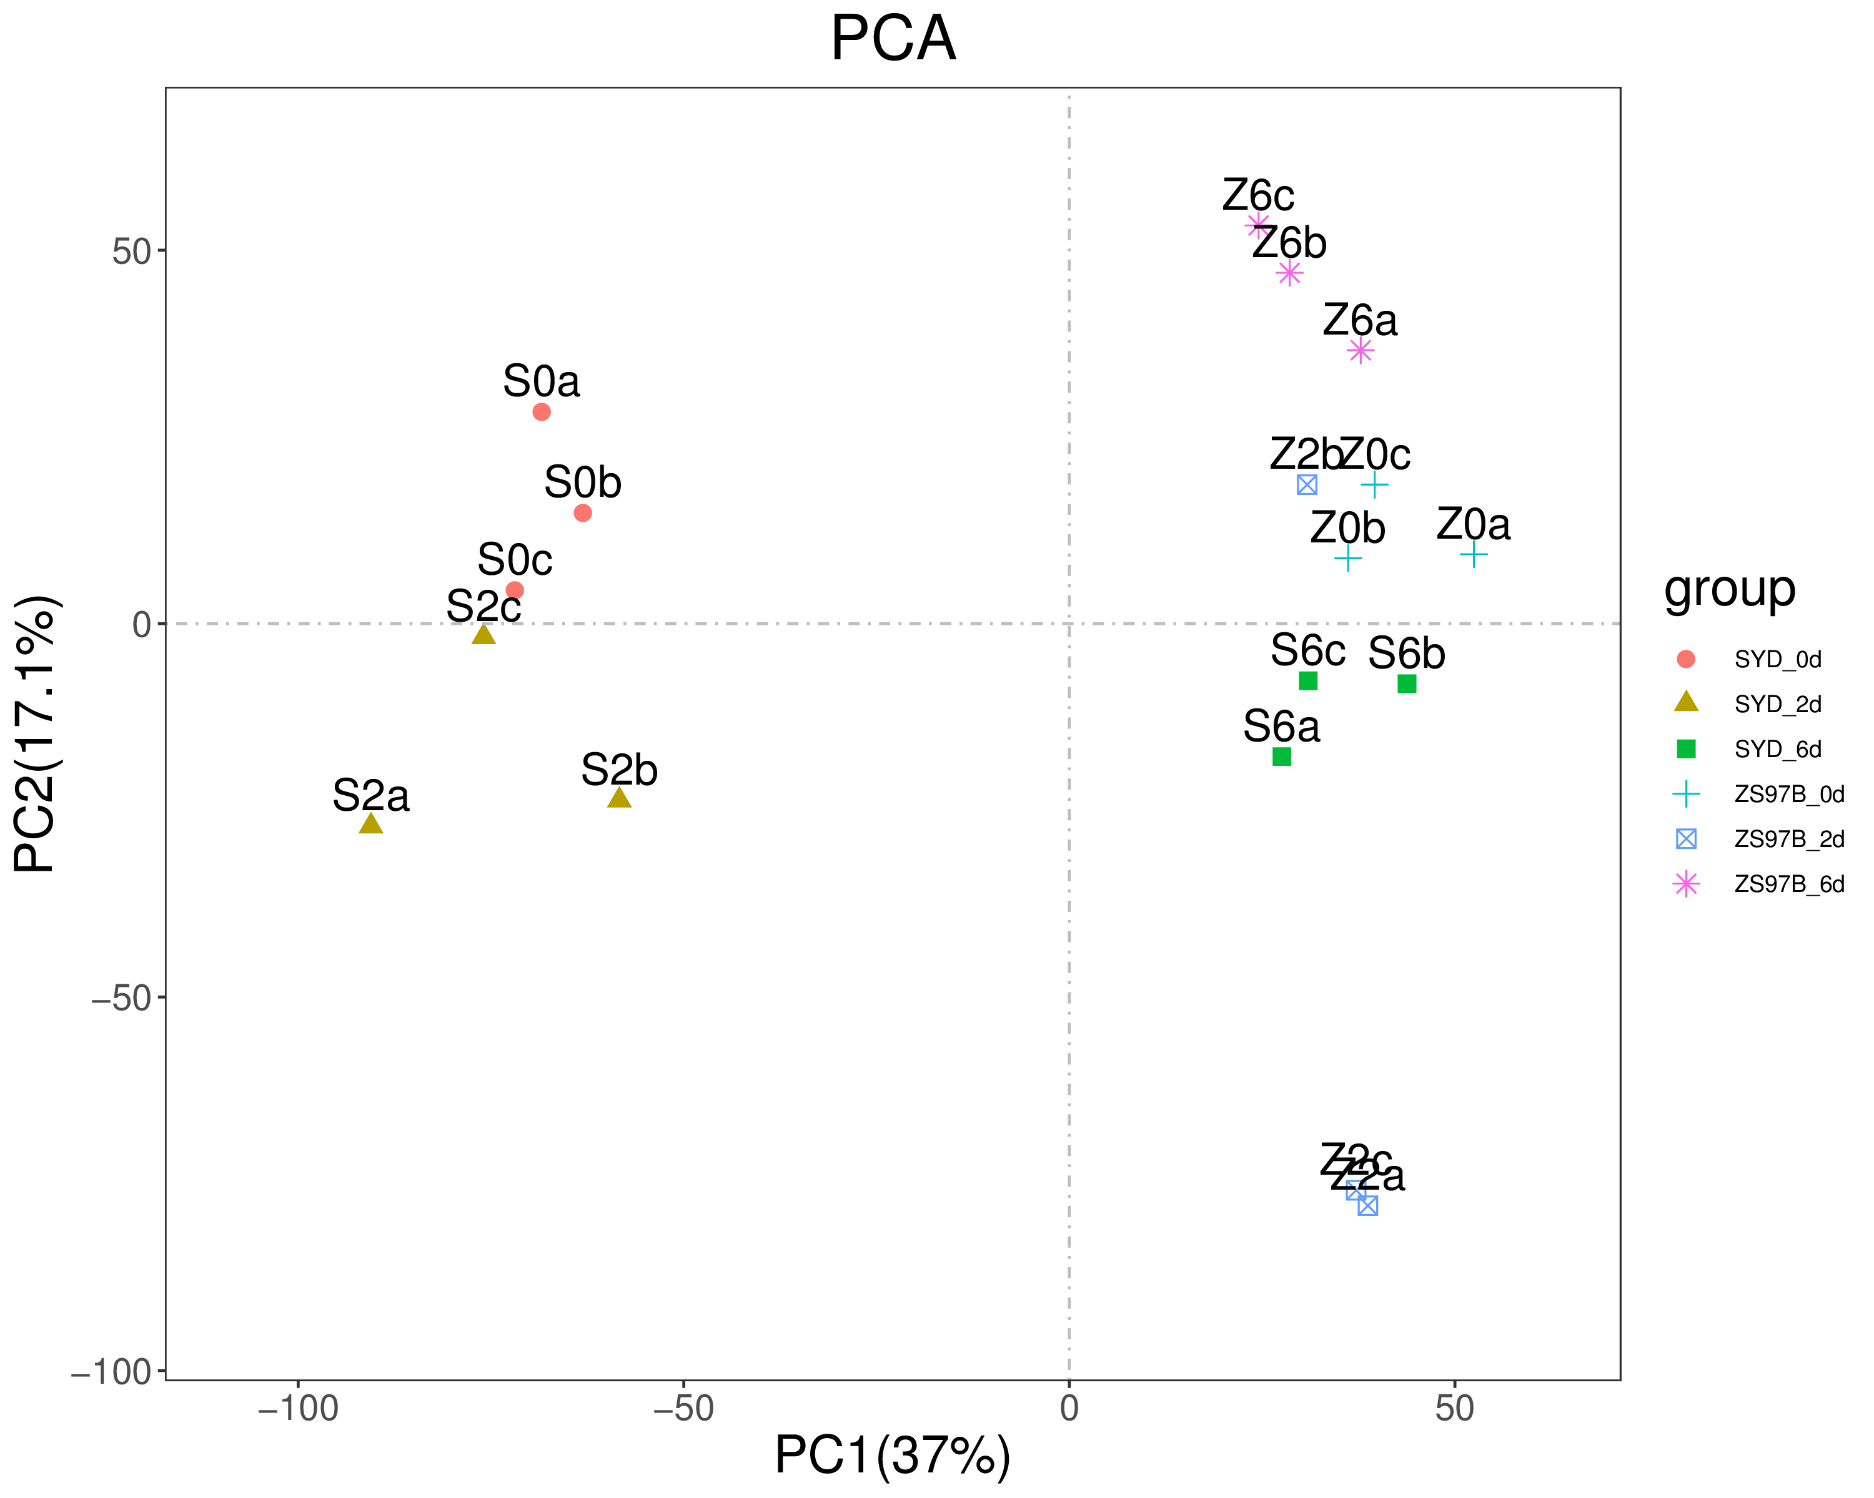
Figure S2. Principal component analysis of samples in this study. a, b, c indicates three replicates of each variety under a specific condition.

Slide 3
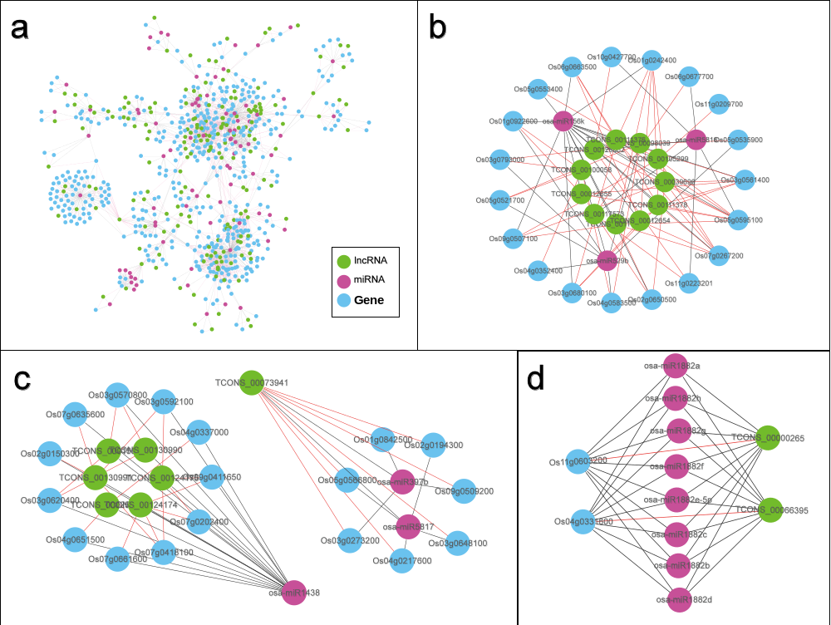
Figure S3. Interaction network of ceRNAs(lncRNAs) identified in this study with their targets and relevant miRNAs. Green circle, lncRNA; red circle, miRNAs; blue circle, genes.

Slide 4
a
A
B
Figure S4. GO and KEGG enrichment analysis of coding gene targets of lncRNAs identified in this study. (A) GO enrichment analysis of coding gene targets of lncRNAs identified in this study. (B) KEGG enrichment analysis of lncRNA targets.
注：(a) GO二级分类柱状图；(b) KEGG二级分类柱状图
Notes:
整体来说，这些lncRNA的靶基因在功能上分布比较广泛，参与细胞的许多过程，

Slide 5
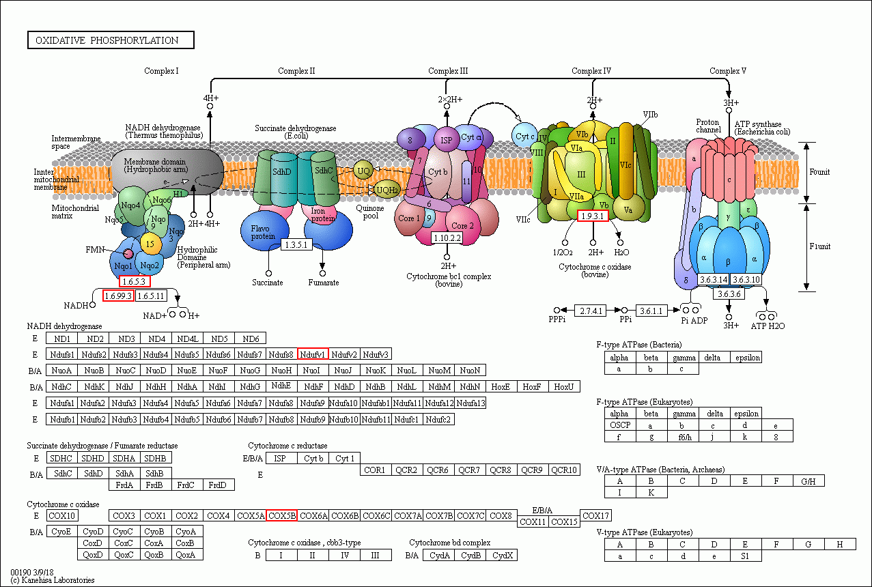
Figure S5 The KEGG oxidative phosphorylation pathway including coding gene targets of DELs under heat treatments. The KEGG Ribosome pathway map can be found online at http://www.kegg.jp/pathway. The red boxes indicate the proteins encoded by the gene targets of DELs under heat treatments.

Slide 6
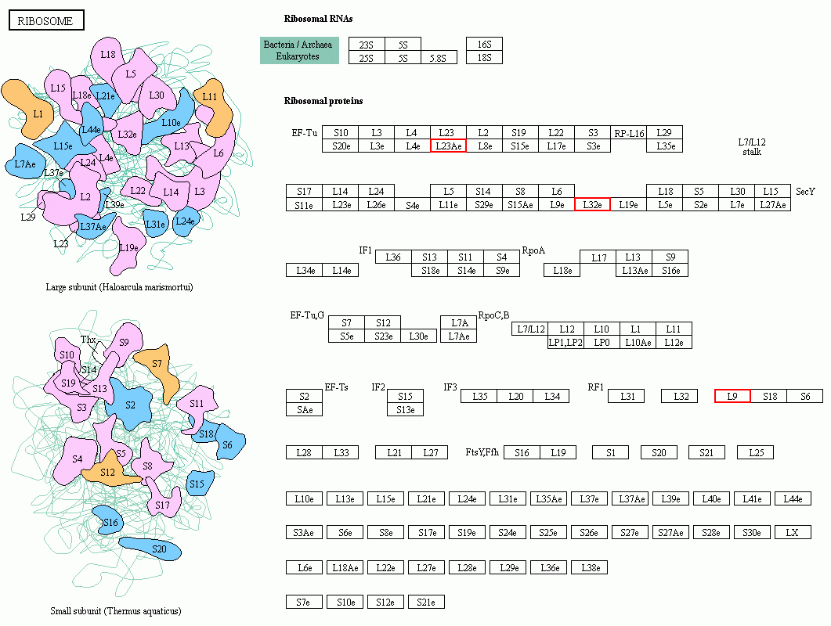
Figure S6. The KEGG Ribosome pathway including coding gene targets of DELs under heat treatments. The KEGG Ribosome pathway map can be found online at http://www.kegg.jp/pathway. The red boxes indicate the proteins encoded by the gene targets of DELs under heat treatments.

Slide 7
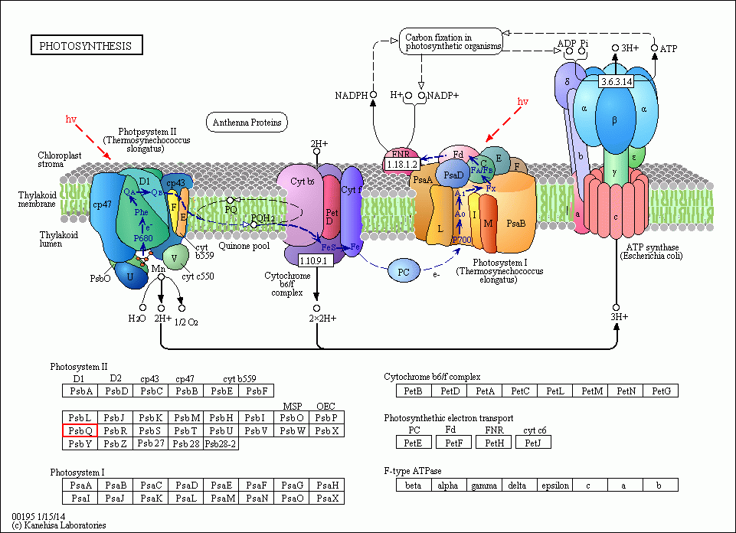
Figure S7. The KEGG photosynthesis pathway including coding gene targets of DELs under heat treatments. The KEGG Ribosome pathway map can be found online at http://www.kegg.jp/pathway. The red boxes indicate the proteins encoded by the gene targets of DELs under heat treatments.

Slide 8
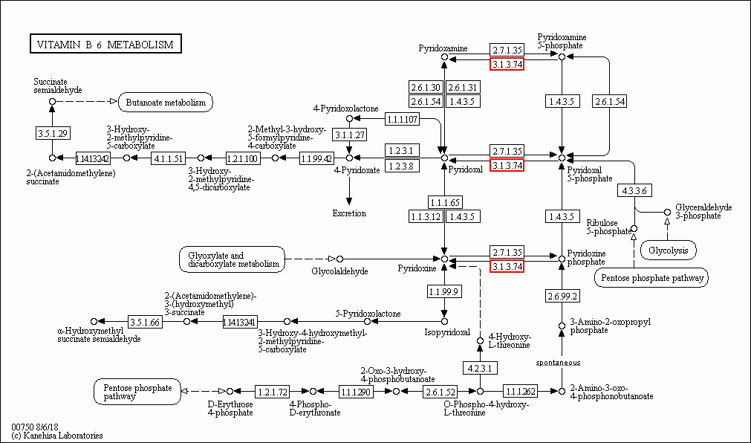
Figure S8. The KEGG vitamin B 6 metabolism pathway including coding gene targets of DELs under heat treatments. The KEGG Ribosome pathway map can be found online at http://www.kegg.jp/pathway. The red boxes indicate the proteins encoded by the gene targets of DELs under heat treatments.

Slide 9
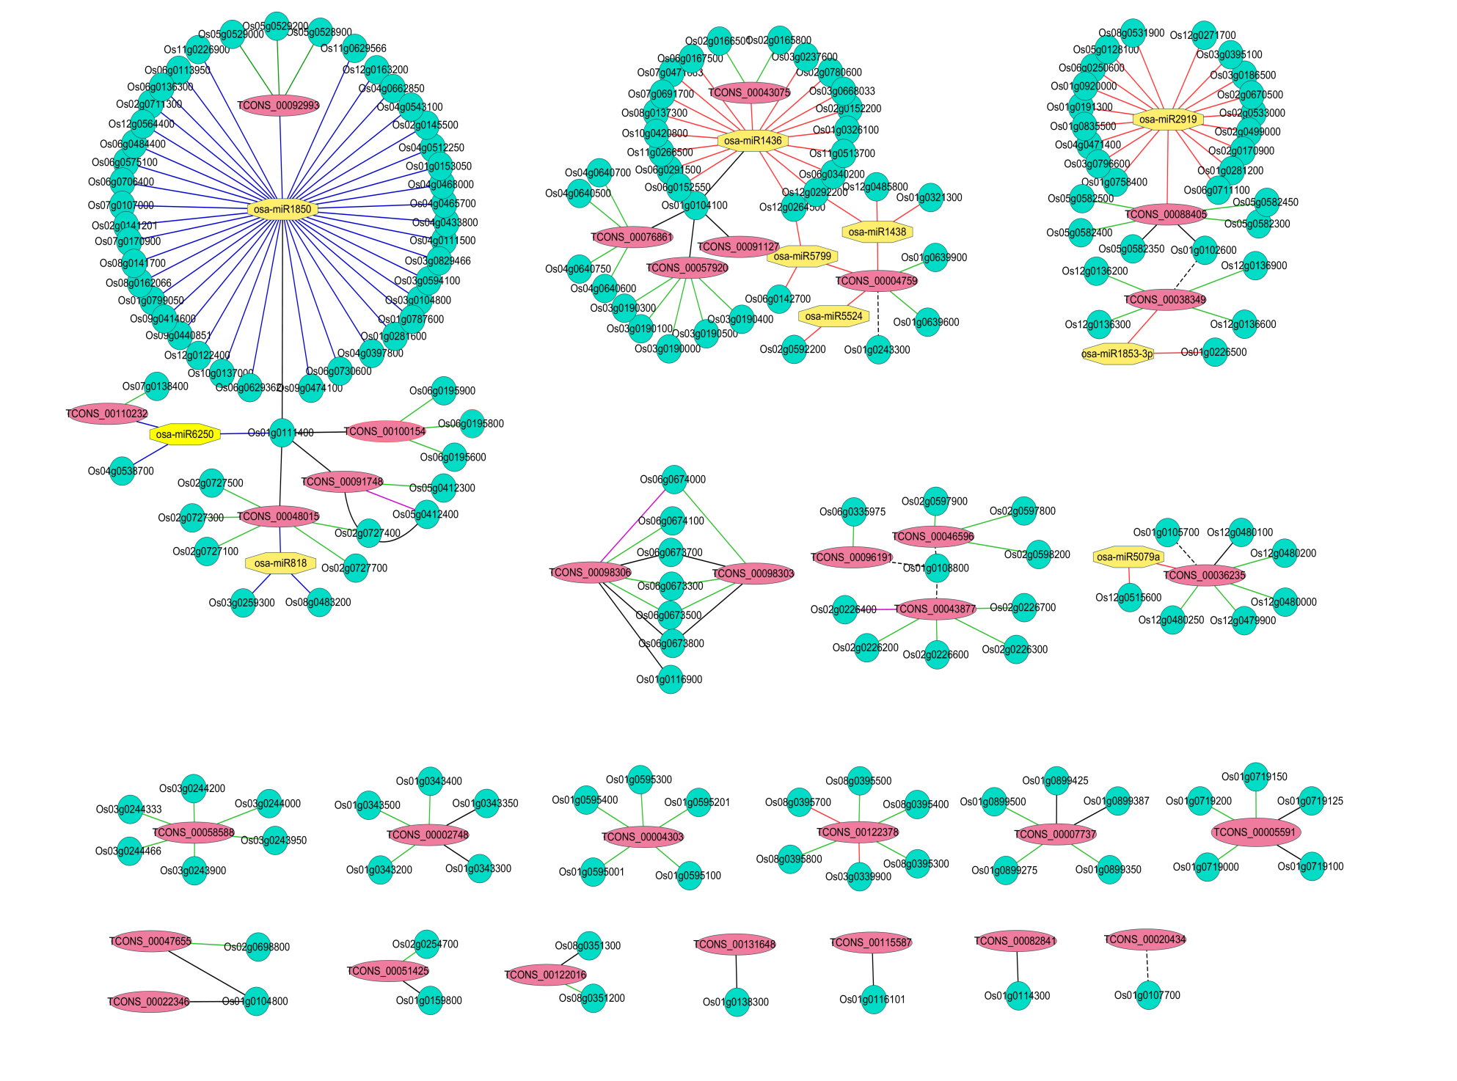
Pre-miRNA
cis
ceRNA
antisense
Positive relative
Negative relative
Figure S9. Interaction network of lncRNAs differentially expressed in both varieties upon heat treatment and their target coding genes and relevant miRNAs. The relationship of lncRNAs and mRNAs shown in different colors or shapes of lines as indicated in the legends. Red ellipse, lncRNA; green circle, mRNAs; yellow Octagon, miRNAs.

Slide 10
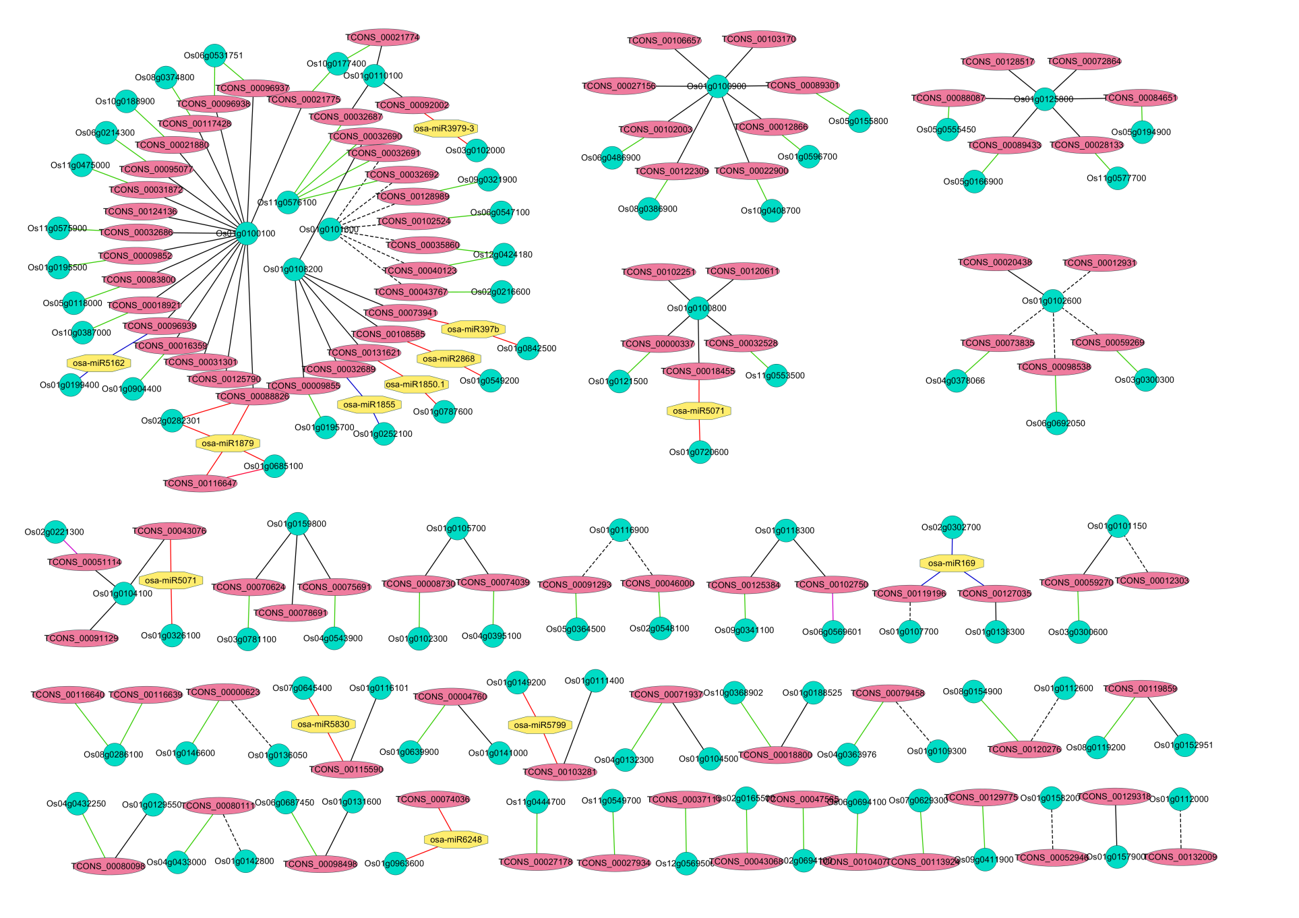
Figure S10. Interaction network of lncRNAs differentially expressed in ZS97B upon heat treatment and their target coding genes and relevant miRNAs. The relationship of lncRNAs and mRNAs shown in different colors or shapes of lines as indicated in the legends in Figure S7. Red ellipse, lncRNA; green circle, mRNAs; yellow Octagon, miRNAs.

Slide 11
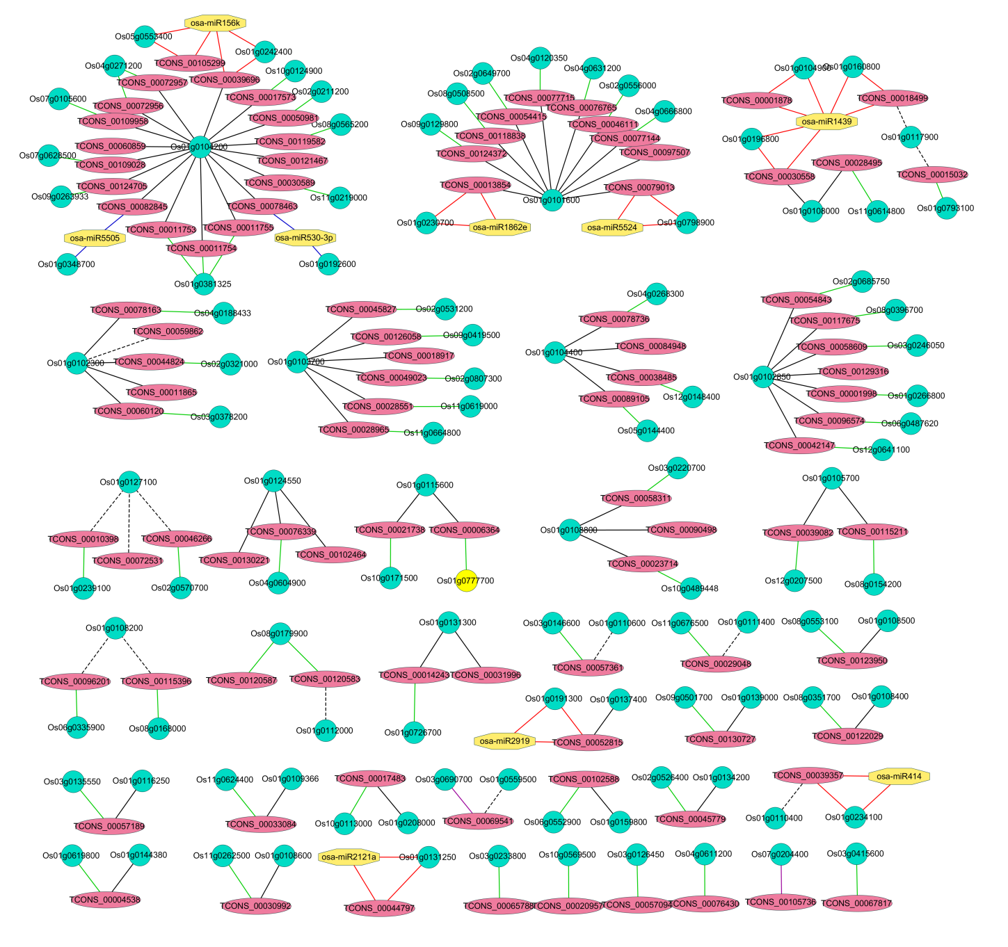
Figure S11. Interaction network of lncRNAs differentially expressed in SYD2 upon heat treatment and their target coding genes and relevant miRNAs. The relationship of lncRNAs and mRNAs shown in different colors or shapes of lines as indicated in the legends in Figure S7. Red ellipse, lncRNA; green circle, mRNAs; yellow Octagon, miRNAs.

