Slide 1
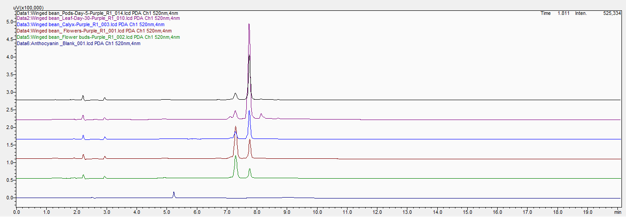
C3G
D3G
Supplementary Fig. 1. Chromatogram displaying the differential accumulation of cyanidin 3-glucoside (C3G) and delphinidin-3-glucoside (D3G) in various plant parts of winged bean (WB Purple-3). Data points 1–5 represent different plant parts: (1) 05-day-old pod, (2) leaf, (3) calyx, (4) mature flower, (5) flower bud. Data point 6 is the blank (solvent). The chromatogram’s colors correspond to the distinct profiles of C3G and D3G in each plant part.

