Slide 1
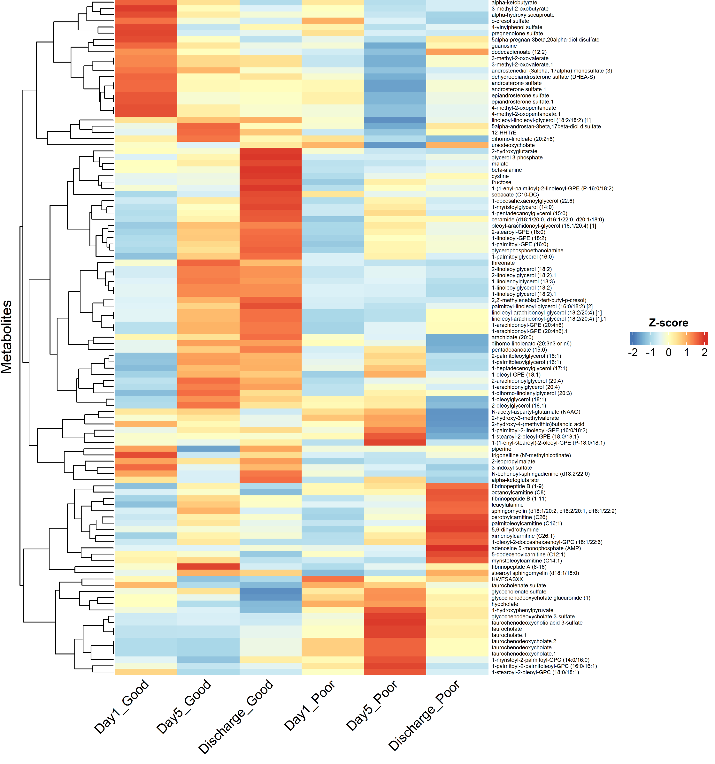
Multivariate Analysis Heatmap
Figure S1
Amino acids related metabolites
Supplementary Figure S1: Hierarchically clustered heatmap of differential metabolite profiles across outcome groups and time points. Columns show group–time combinations (Day 1, Day 5, Discharge for Good vs Poor outcome). Each row is a metabolite. The annotated bracket on the right groups metabolites into broad chemical classes based on predominant membership. Cell values are Z-scores computed within each metabolite (mean-centered, unit-variance); red = higher and blue = lower relative abundance. Rows and columns are ordered by unsupervised hierarchical clustering, with dendrograms indicating similarity. Color bar shows the Z-score range (−2 to +2)
Androgen related metabolites
Cellular bioenergetics related metabolites
Glycerides and
phosphatidylethanolamines
metabolites
Mitochondrial related bioenergetics
metabolites
Bile acid metabolites
Glycerophospholipid metabolites

Slide 2
Figure S2
Enriched Chemical Classes in in ARF Survivors
A
B
C
10.0
7.5
15
OH-FA_18_0_2
10
keto acids
OH-FA_23_4_2
keto acids
phosphatidylethanolamines
-log (pvalue)
10
5.0
-log (pvalue)
diglycerides
-log (pvalue)
saturated_lysophospholipids
5
carnitine
2.5
5
saturated FA
cholic acids
cluster_18
glycerides
0
0.0
0
5
10
15
1
2
3
4
median XlogP of clusters
median XlogP of clusters
0.64
0.66
0.68
0.70
0.72
Day 1
median XlogP of clusters
Discharge
Day 5
Supplementary Figure S1. Chemical‐similarity enrichment of all metabolites at three clinical time points (A) Day 1 (ICU admission), (B) Day 5 post-admission, and (C) Hospital discharge, using a ChemRICH‐style bubble plot. Each bubble represents a structurally coherent cluster of metabolites (cluster names shown), with bubble area proportional to the number of metabolites in that cluster. The x-axis displays the cluster’s median predicted octanol–water partition coefficient (XLogP), and the y-axis shows the enrichment significance (–log₁₀ p-value, Fisher’s exact test with FDR correction). Bubble color indicates the direction of change in patients with Poor versus Good six-month SPPB outcomes (blue = enriched in patient with good SPPB score, red = enriched in patient with poor SPPB score). Clusters such as “keto acids” and “cholic acids” are highlighted at Day 1, whereas a broader range of lipid and fatty‐acid clusters emerges by discharge.

Slide 3
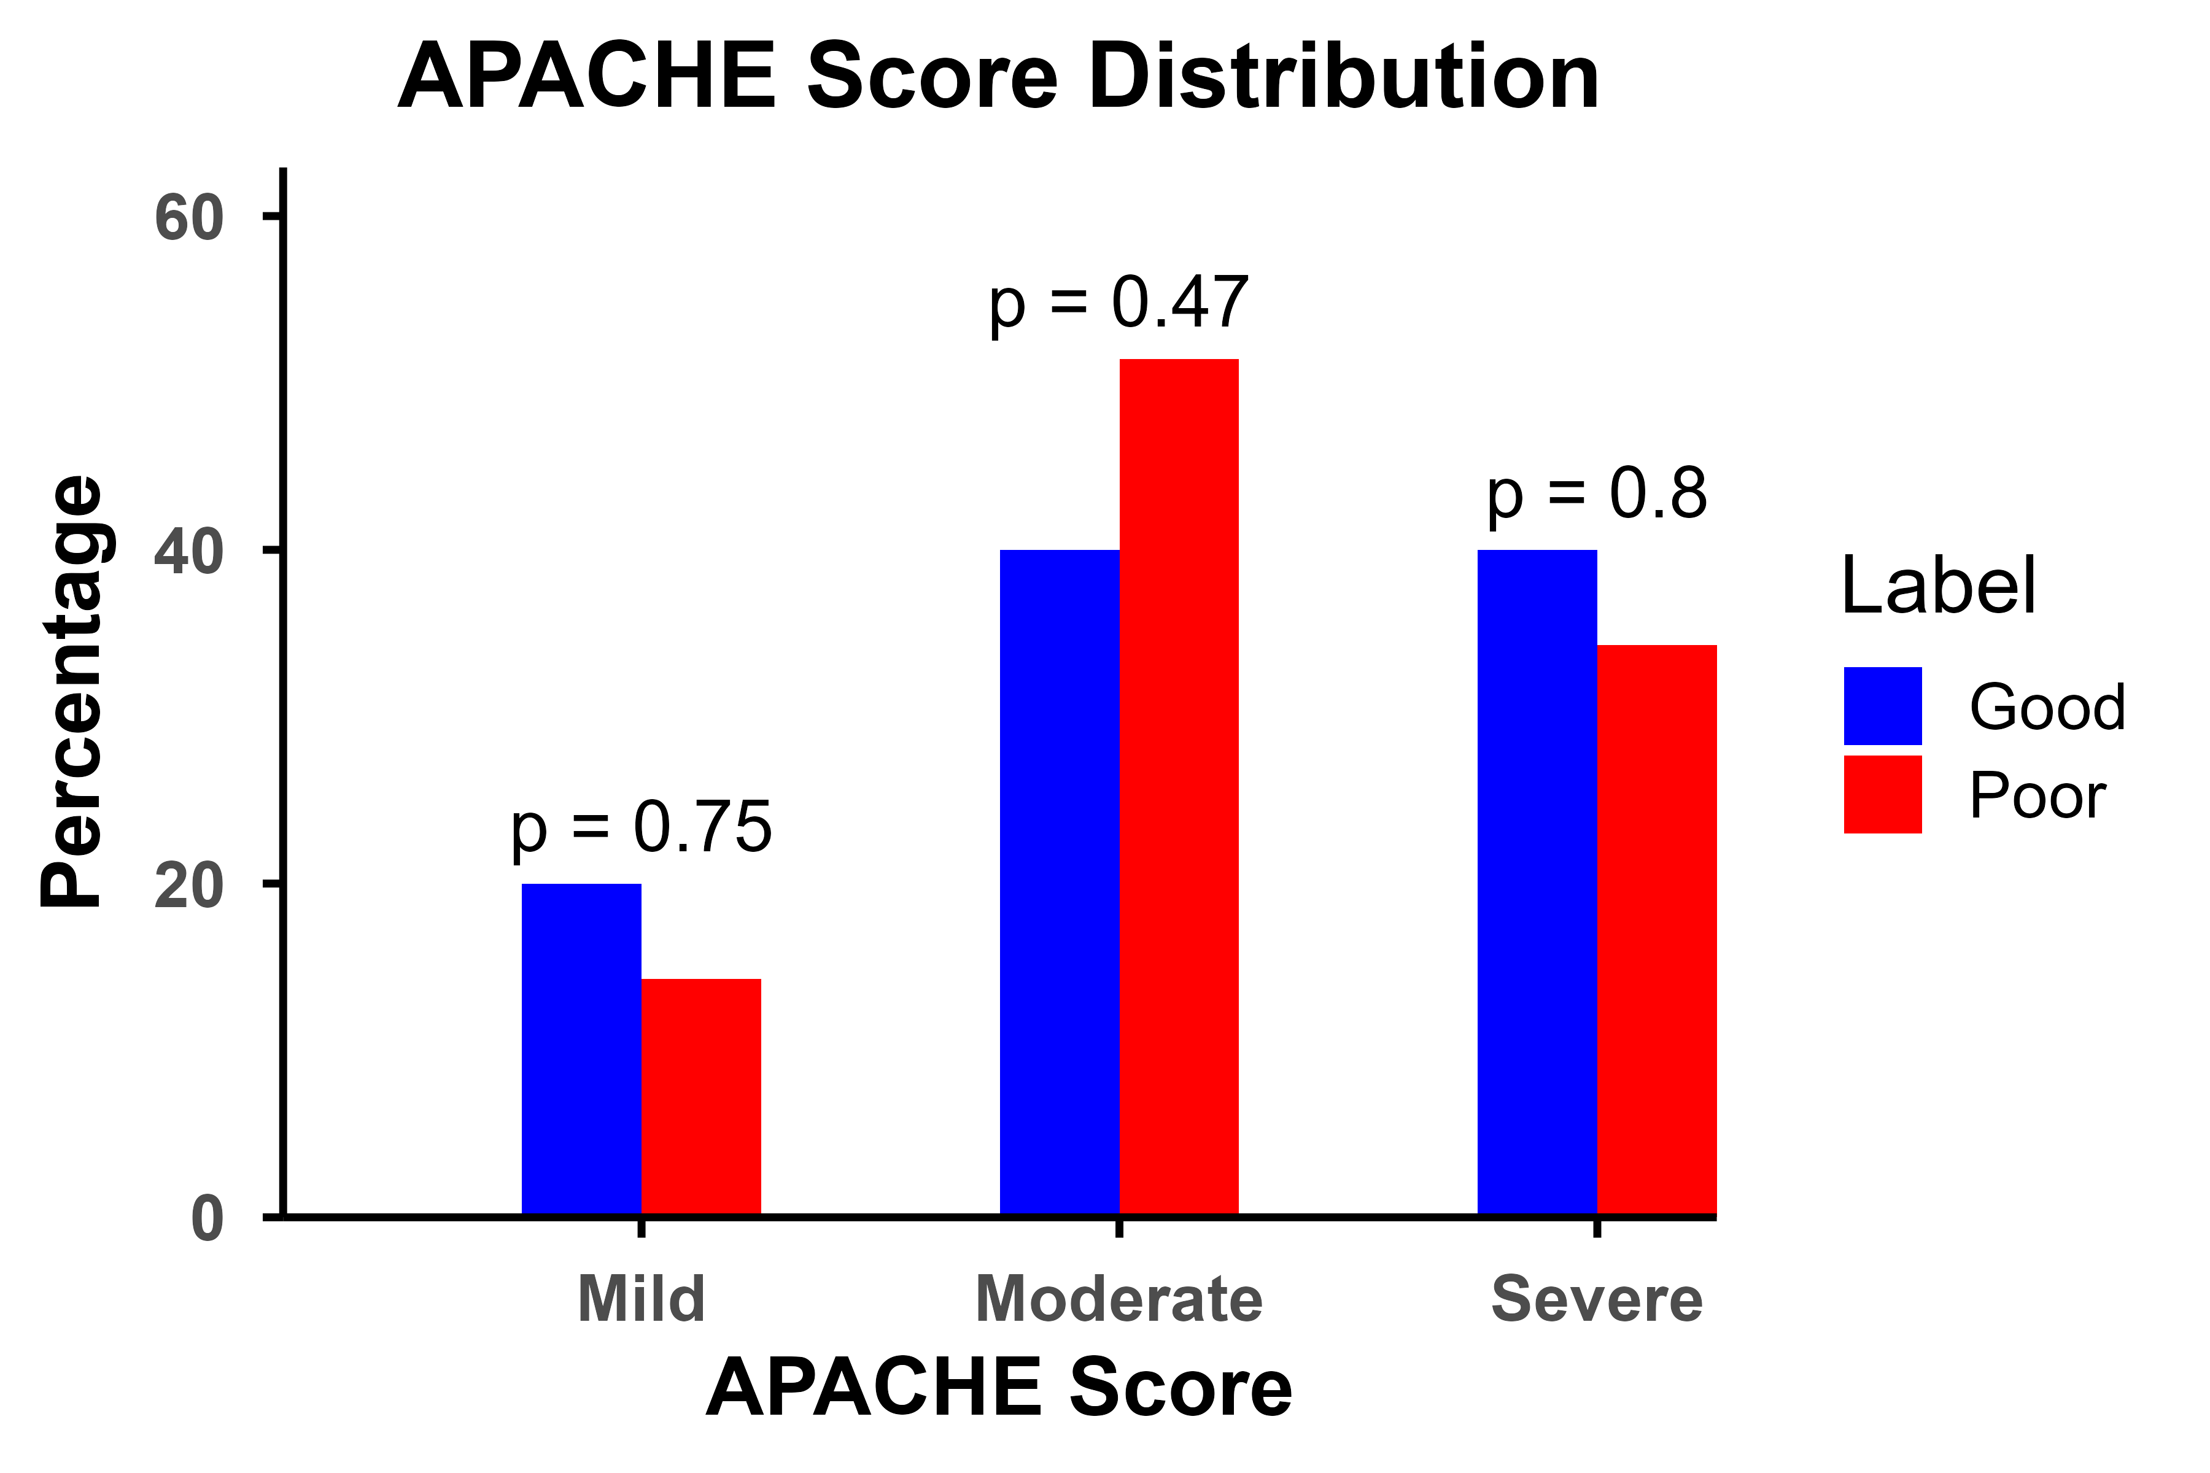
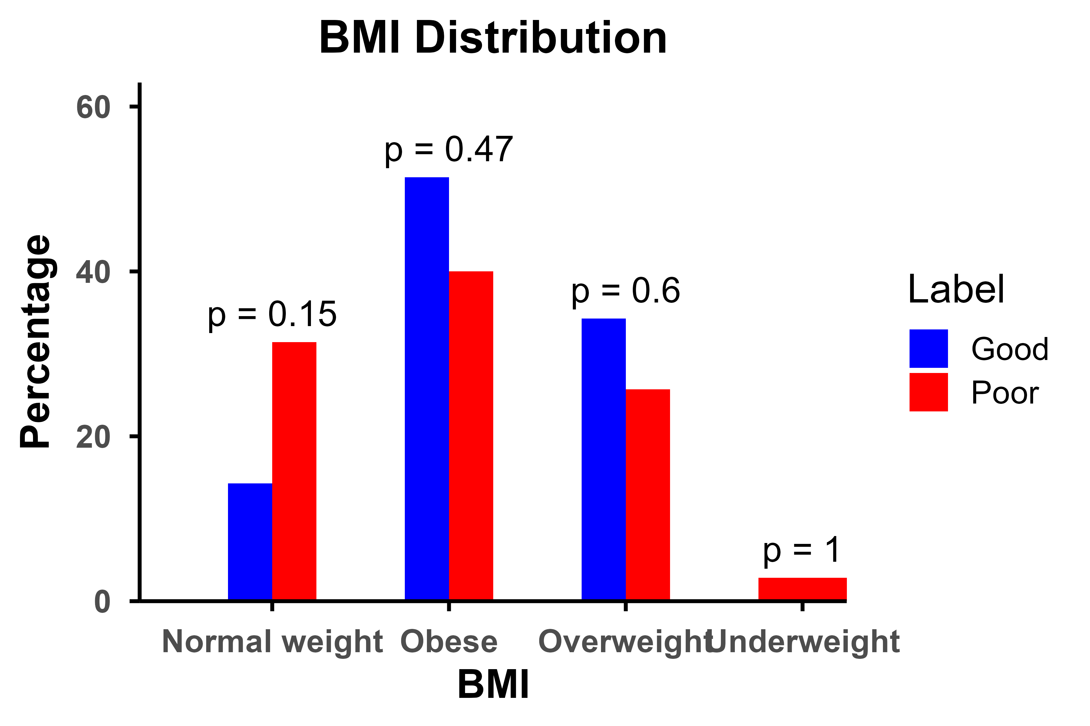
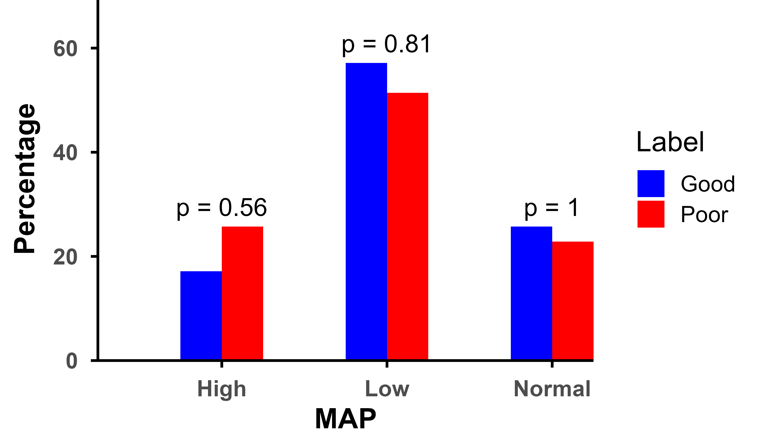
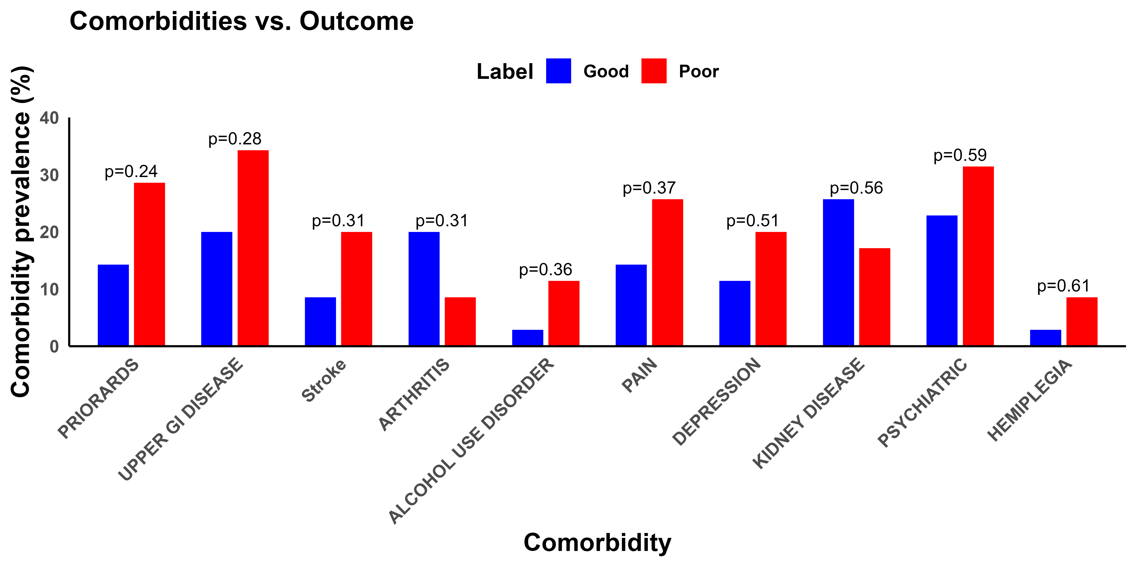
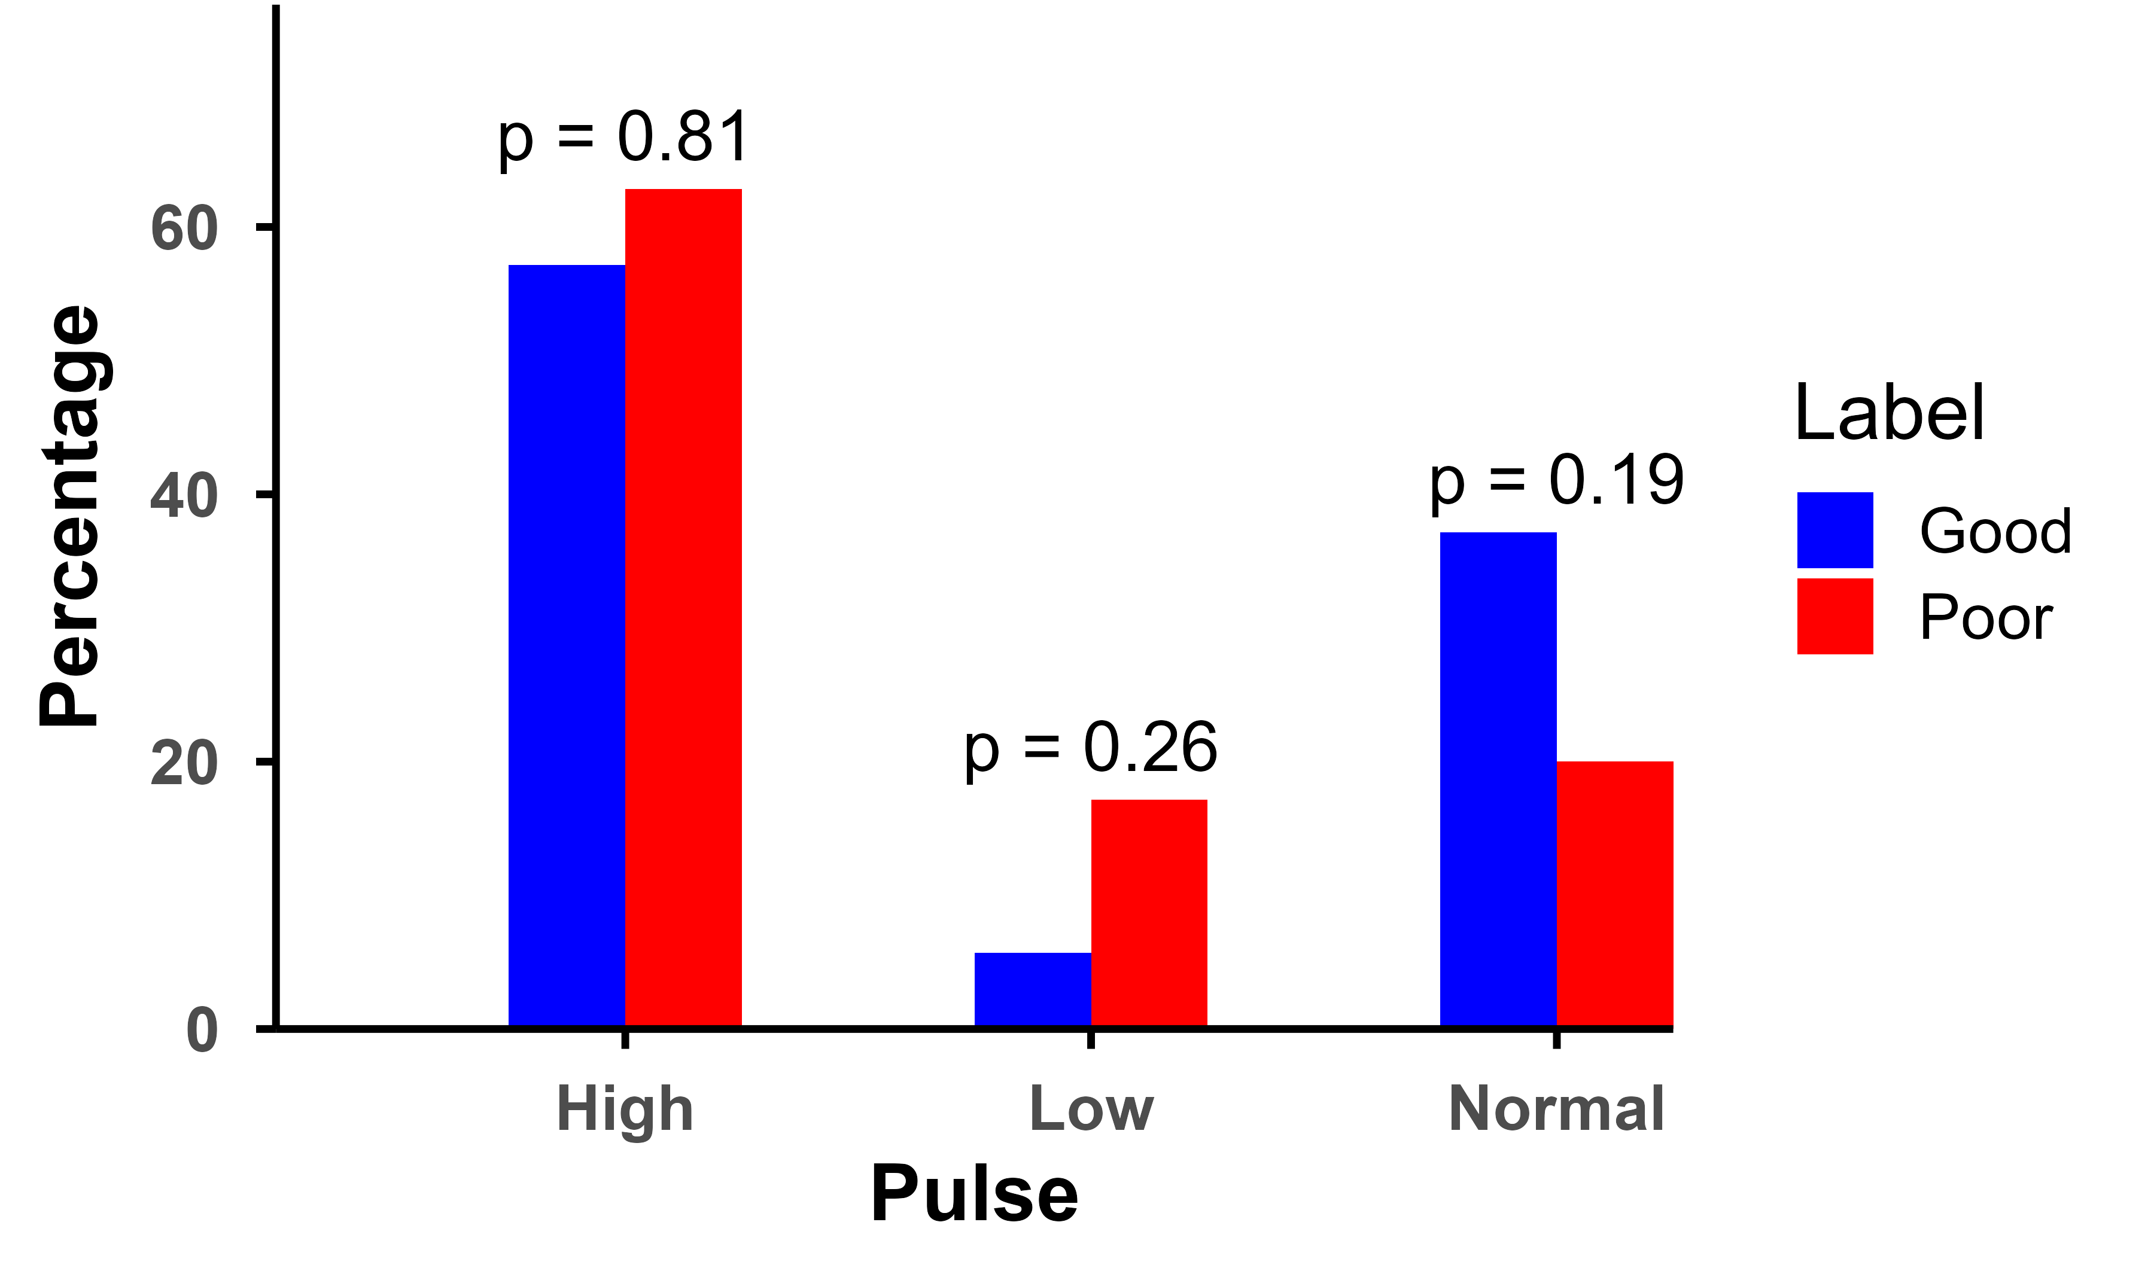
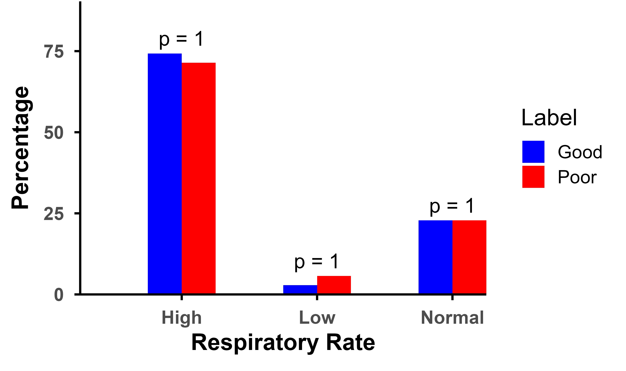
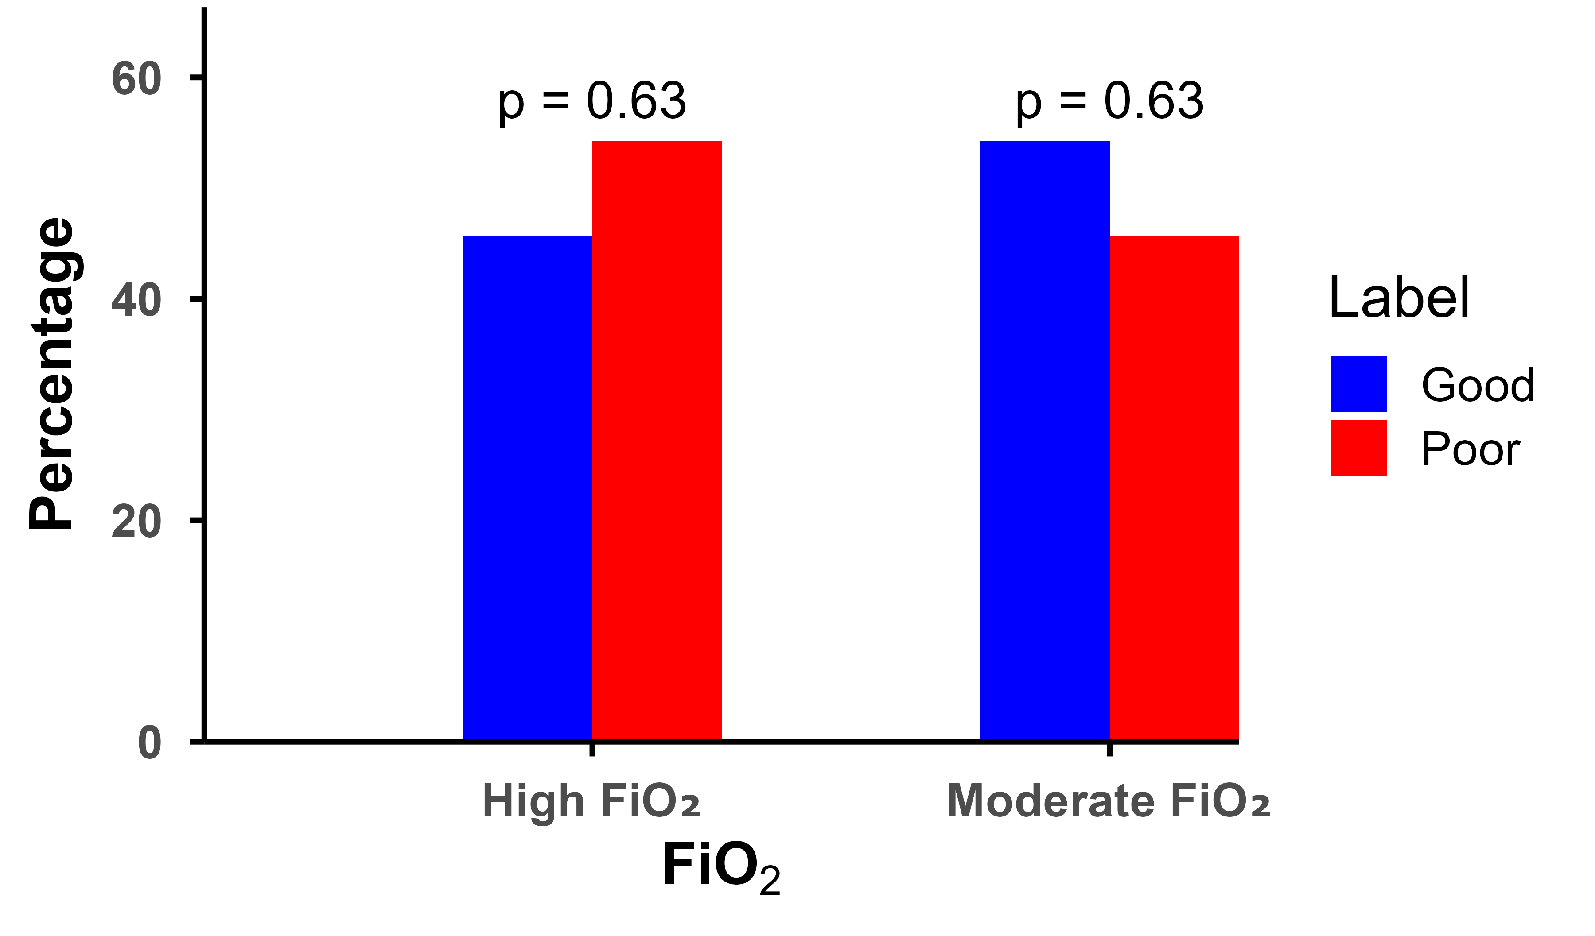
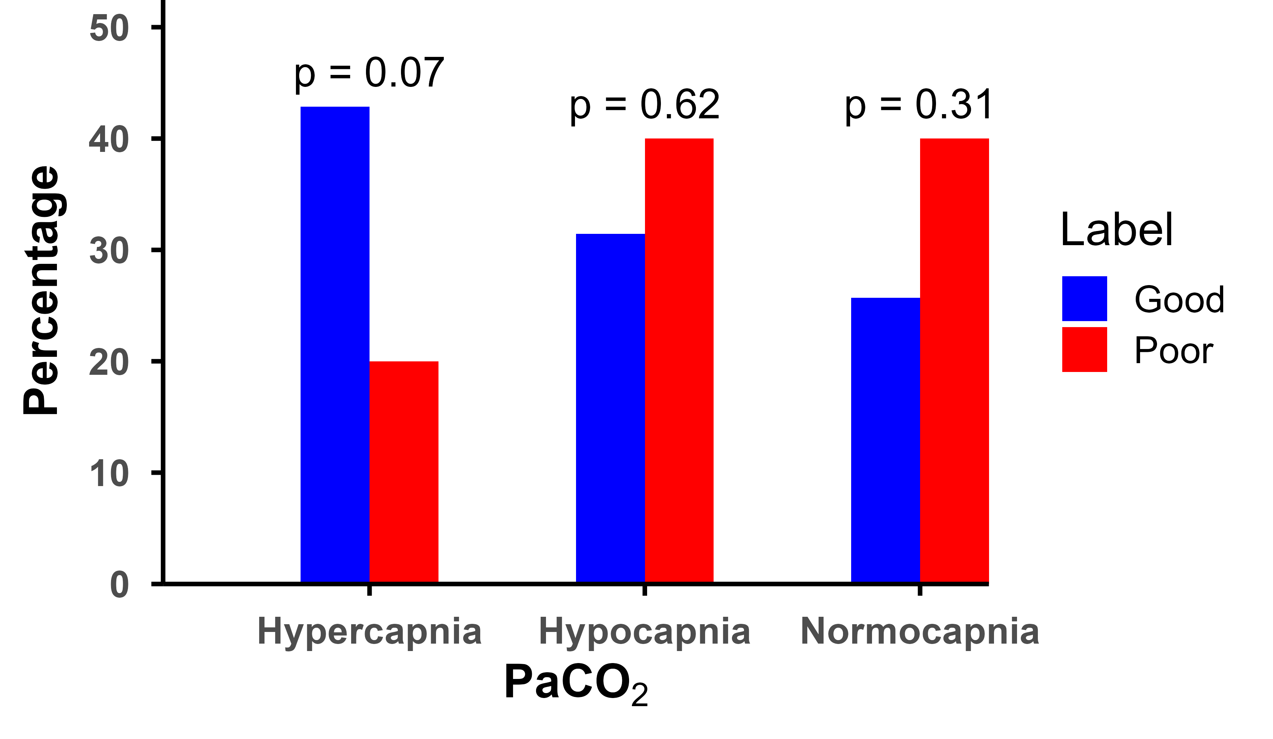
Figure S3
Correlation of Comorbidities, APACHE III Score and Other
Clinical Parameter Measurements with SPPB Outcomes
A
B
C
D
E
F
G
H
Supplementary Figure S2. Acute illness severity, comorbidities, and clinical parameters by discharge physical function (SPPB ≤6 = Poor; SPPB ≥7 = Good)
(A) Distribution of APACHE (Acute Physiology and Chronic Health Evaluation) IV scores among patients stratified by discharge physical function status (SPPB ≤6 [Poor] vs. SPPB ≥7 [Good]). APACHE Scores were grouped into three categories: mild (0–50), moderate (51–75), and severe (>75). No statistically significant differences in APACHE scores were observed across severity levels between the two groups, indicating similar acute illness severity at baseline.
(B) Prevalence of comorbid conditions across the two discharge groups. Assessed chronic conditions included prior acute respiratory distress syndrome, upper gastrointestinal disease, stroke, arthritis, alcohol use disorder, chronic pain, depression, kidney disease, psychiatric disorders, and hemiplegia. While trends in specific conditions were noted, none reached statistical significance, suggesting physical function outcomes were not strongly associated with any single chronic diagnosis. (C–H) Enrollment clinical parameters categorized as follows: Body mass index (BMI): <18.5, 18.5–24.9, 25–29.9, ≥30 kg/m²; Mean arterial pressure (MAP): <70, 70–100, >100 mmHg; Pulse: <60, 60–100, >100 bpm; Respiratory rate: <12, 12–20, >20 b/m; Arterial partial pressure of oxygen (PaO₂): <80, 80–100, >100 mmHg; Fraction of inspired oxygen (FiO₂): ≤0.21, 0.22–0.50, >0.50; Arterial partial pressure of carbon dioxide (PaCO₂): <35, 35–45, >45 mmHg. Bars show group-wise percentages; per-level p-values (Fisher’s exact) are annotated; no parameter showed a significant association with physical function at discharge (all p>0.05).

Slide 4
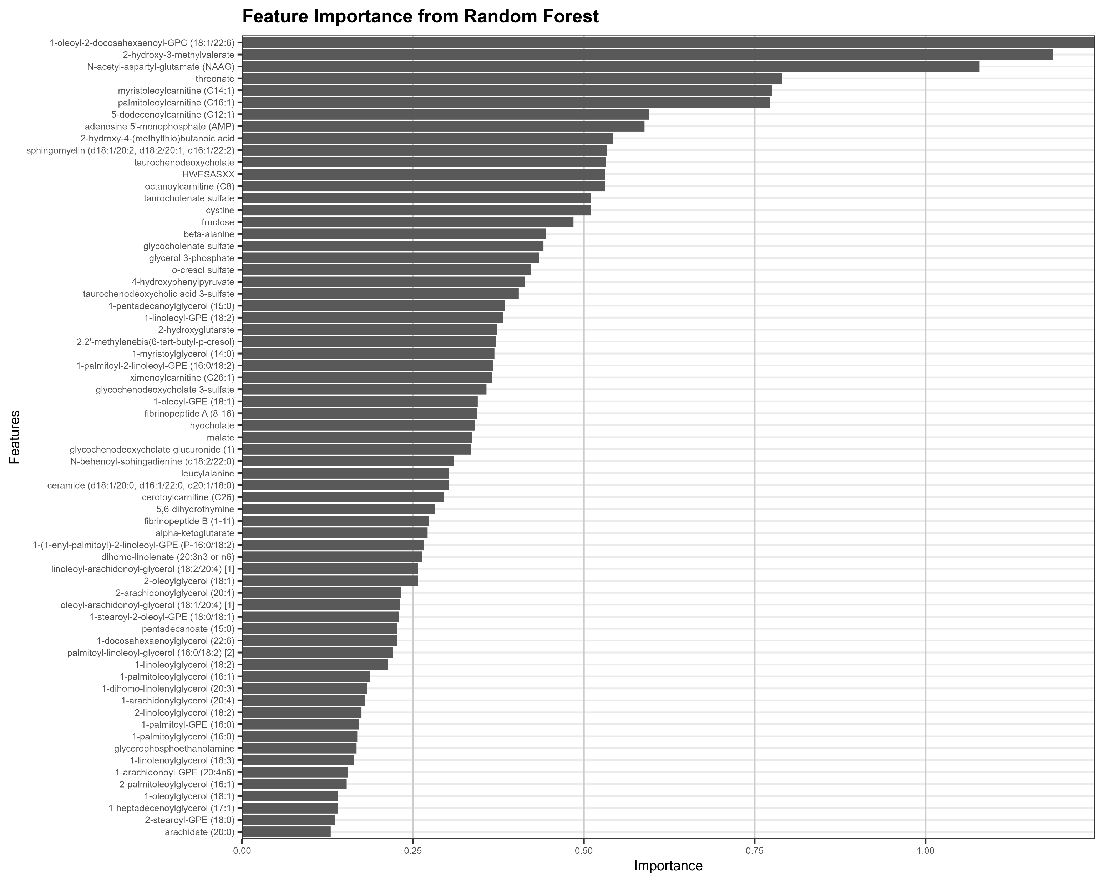
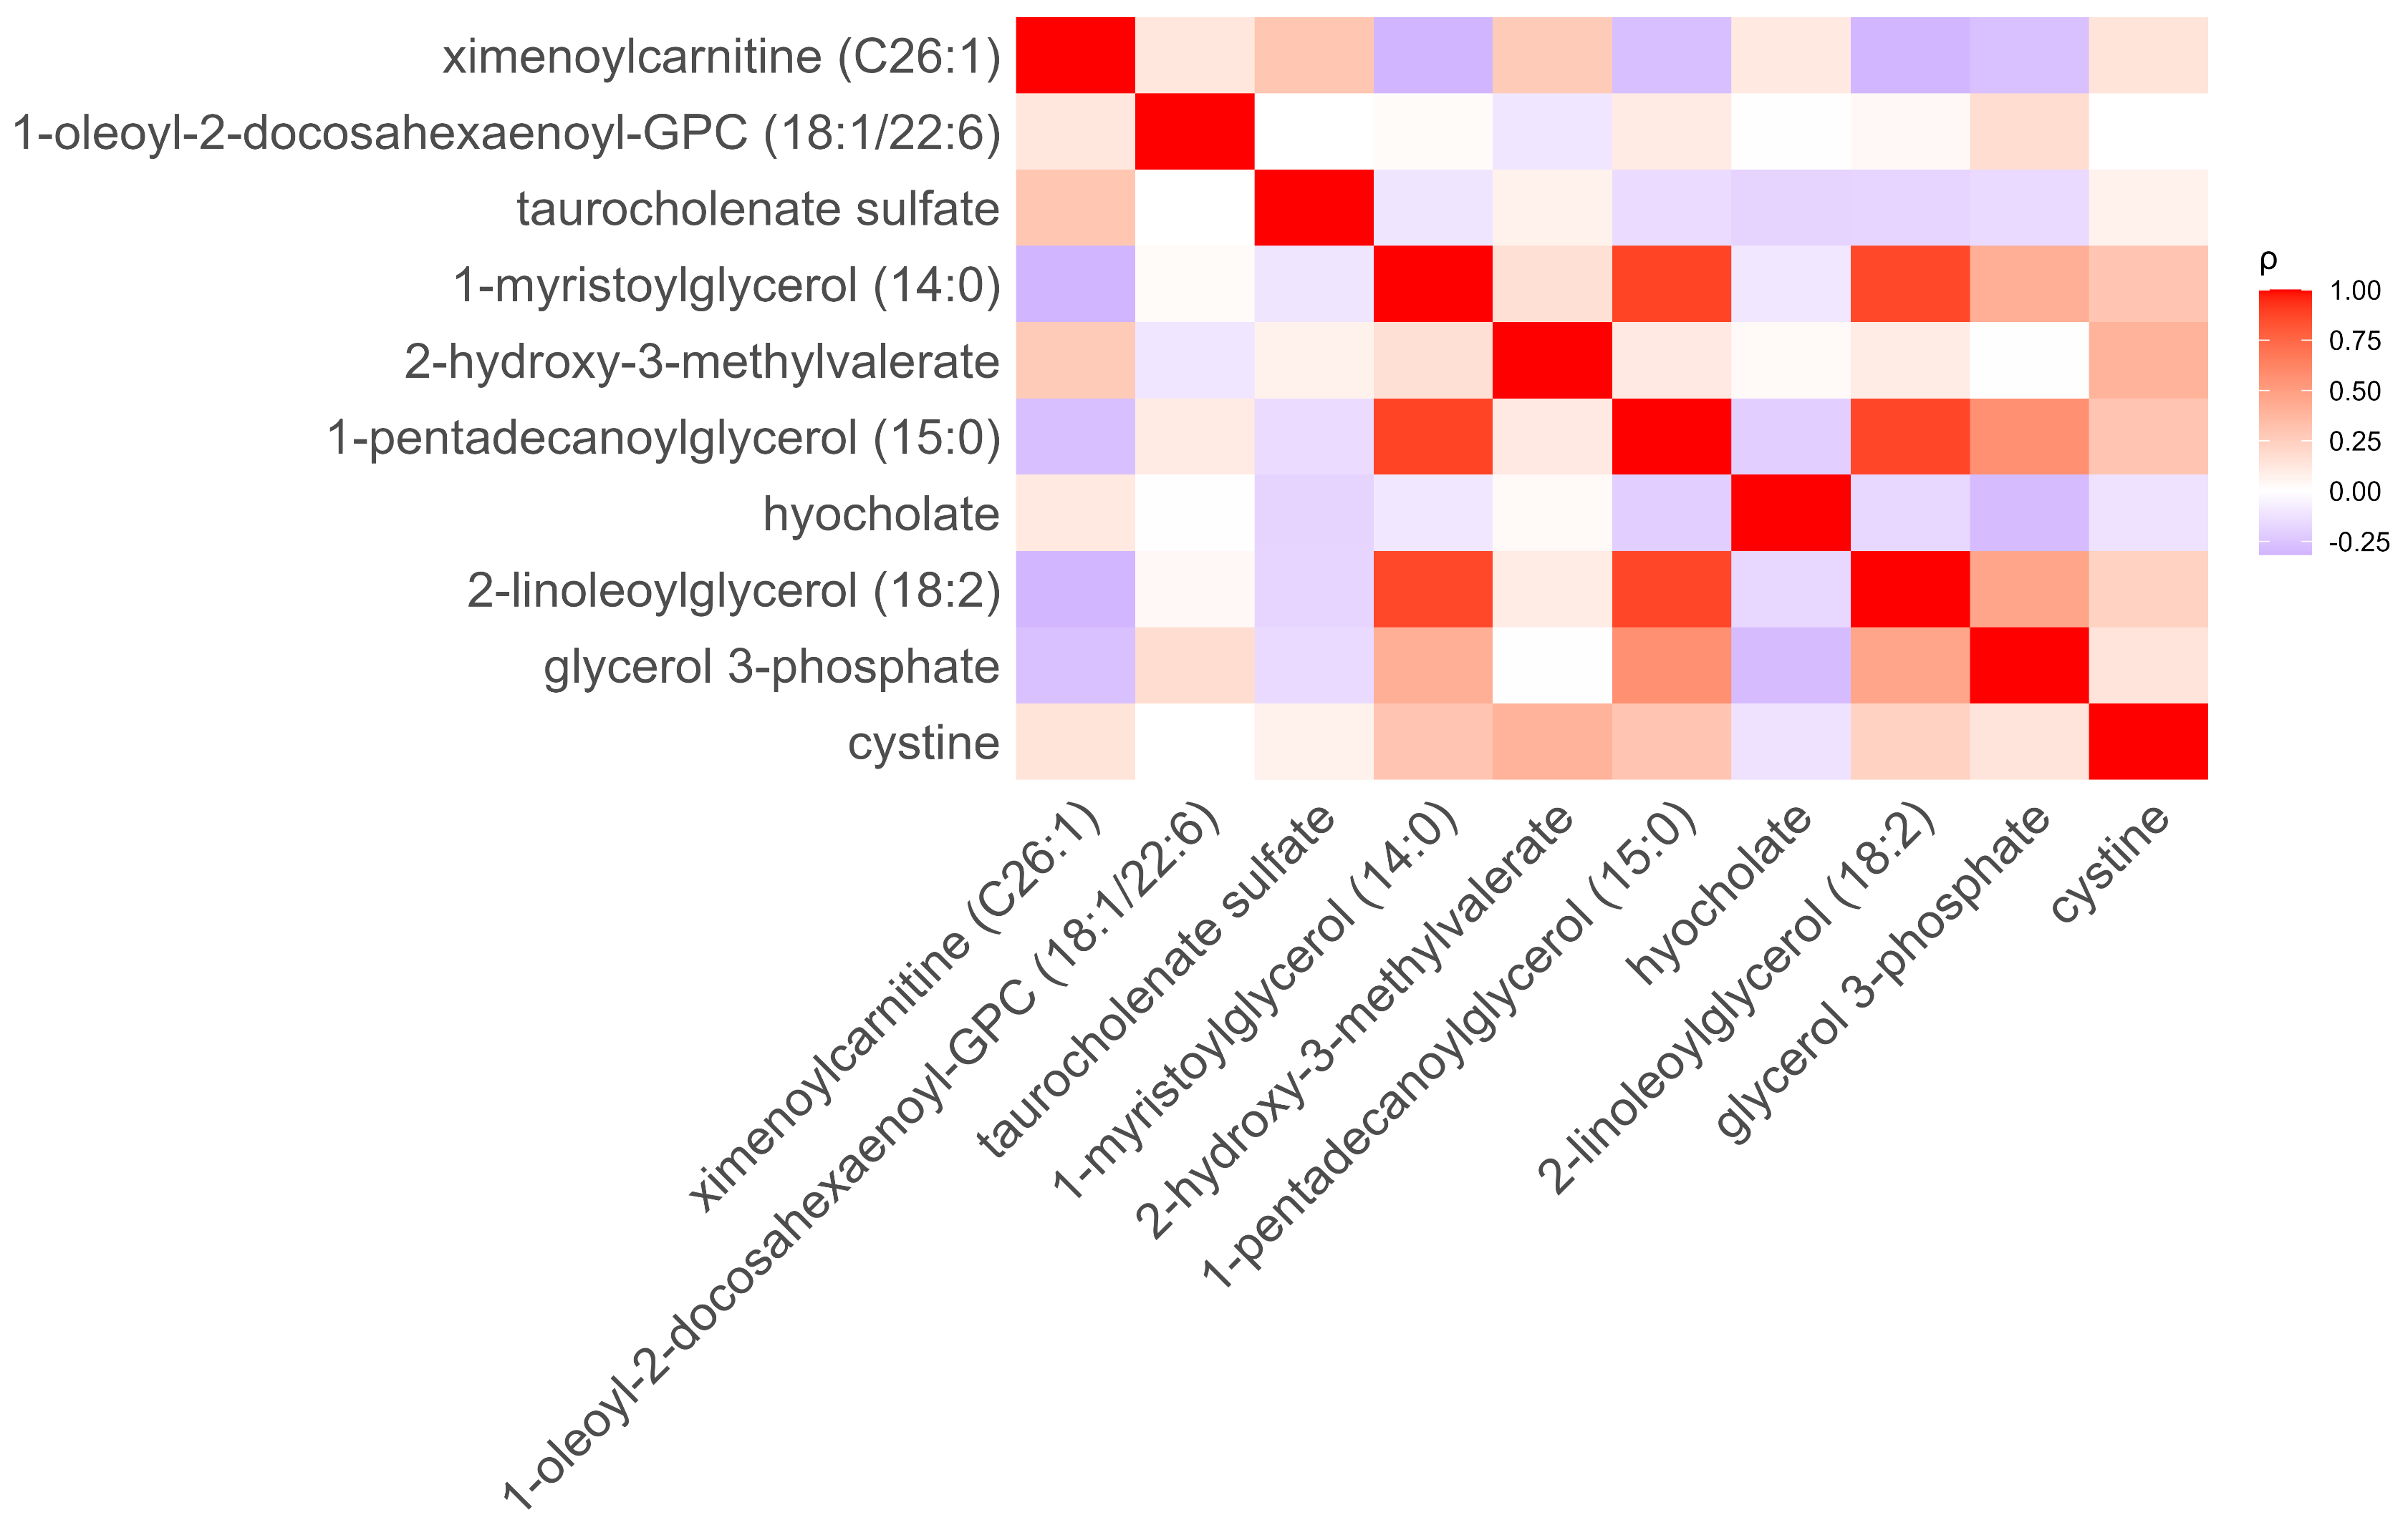
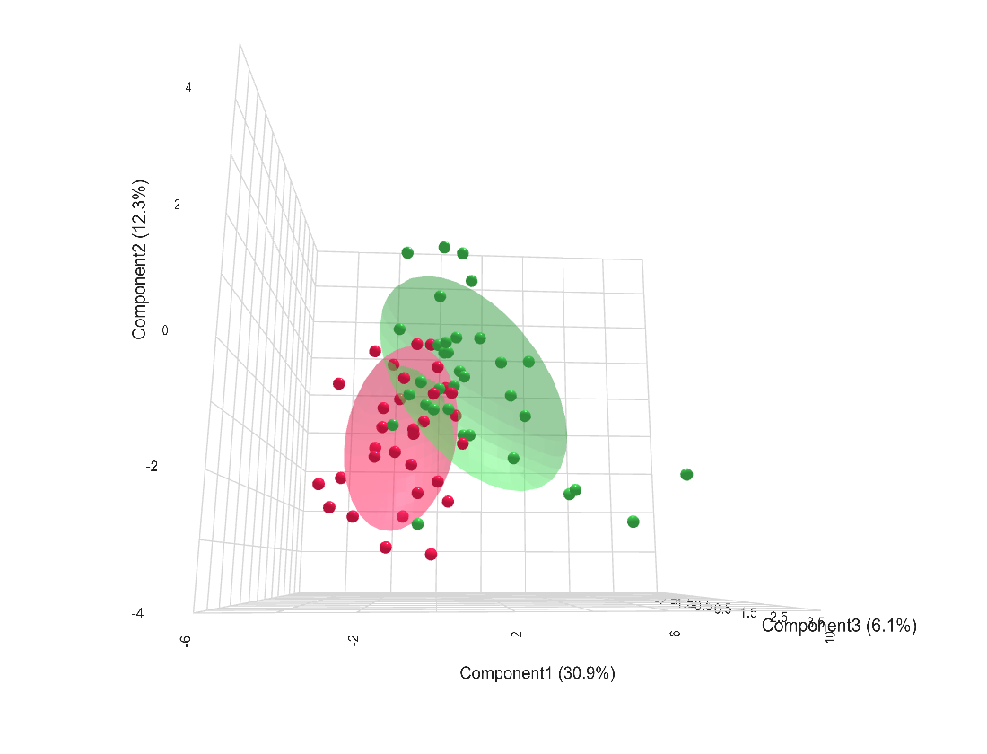
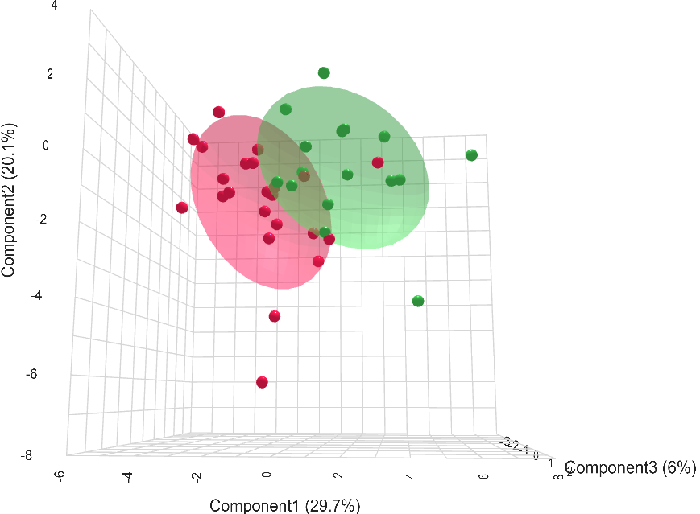
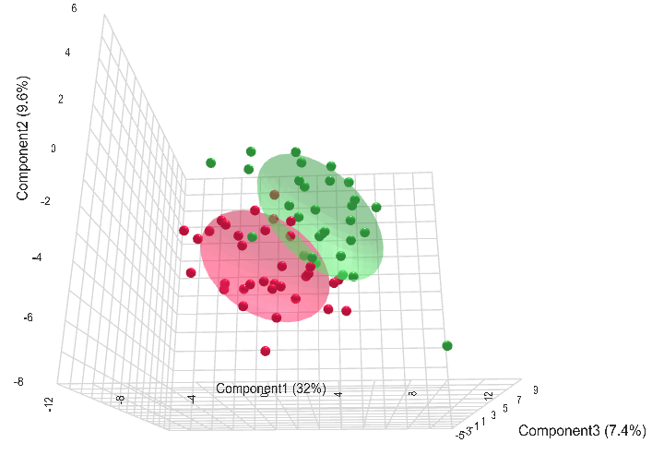
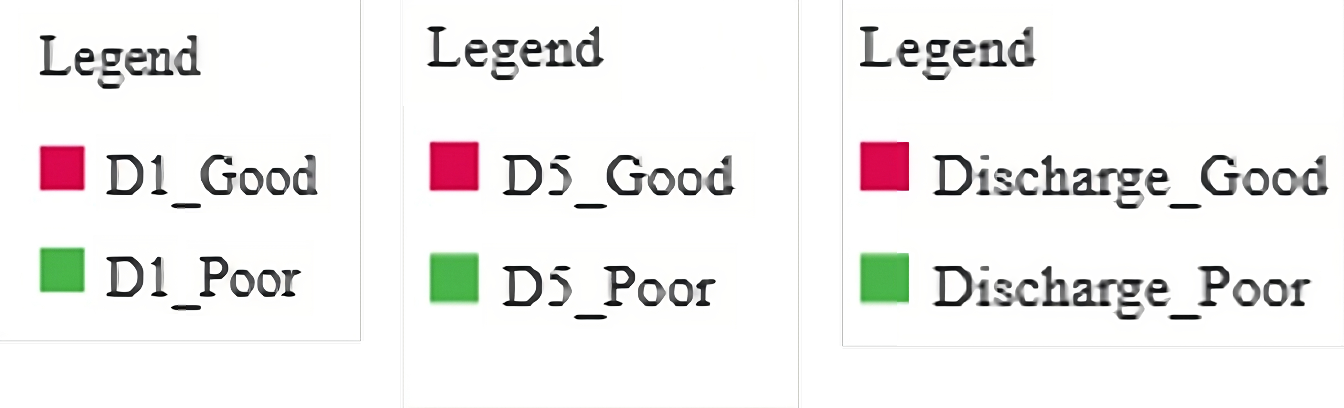

Metabolomic Signatures Associated with Physical Performance (SPPB) Identified by Machine Learning
Figure S4
A
B
C
D
E
Day 1
Day 5
Discharge
Supplementary Figure S3. Multivariate and machine learning-based identification of metabolite features associated with physical function at discharge. (A–C) Partial Least Squares Discriminant Analysis (PLS-DA) plot displaying the separation of patient groups based on metabolic profiles at day 1 day 5 and discharge. Patients were stratified into Discharge_Good (SPPB ≥7; red) and Discharge_Poor (SPPB ≤6; green) categories. Ellipsoids indicate the 95% confidence regions, suggesting good and better separation of metabolic signatures between the groups with minimal overlap at discharge compared to other time points. The top metabolites ranked by Variable Importance in Projection (VIP) score (See additional file 3) overlap partially but not completely, with those identified as highest-priority by the Random Forest classifier (B) Metabolite features are ranked by mean decrease in Gini from a Random Forest trained on metabolomic profiles to classify outcome groups. Larger bars indicate greater contribution to split purity (not direction of effect). Top contributors include 1-oleoyl-2-docosahexaenoyl-GPC (18:1/22:6), ximenoylcarnitine, and taurocholenate sulfate. (C) Spearman correlation matrix among the top 10 metabolites identified by both PLS-DA and Random Forest analyses. Red indicates strong positive correlation and blue indicates negative correlation. A correlation threshold of |ρ| > 0.8 was applied to identify metabolite pairs with potential collinearity. To further refine the feature set, a Bayesian logistic regression model incorporating leave-one-out cross-validation was employed, and Expected Log Predictive Density (ELPD) values were computed to access the contribution of metabolites to model performance. Based on this iterative evaluation, a final panel of seven non-redundant metabolites was selected for predictive modeling: cystine, glycerol 3-phosphate, hyocholate, 2-hydroxy-3-methylvalerate, taurocholenate sulfate, 1-oleoyl-2-docosahexaenoyl-GPC (18:1/22:6), and ximenoylcarnitine.

Slide 5
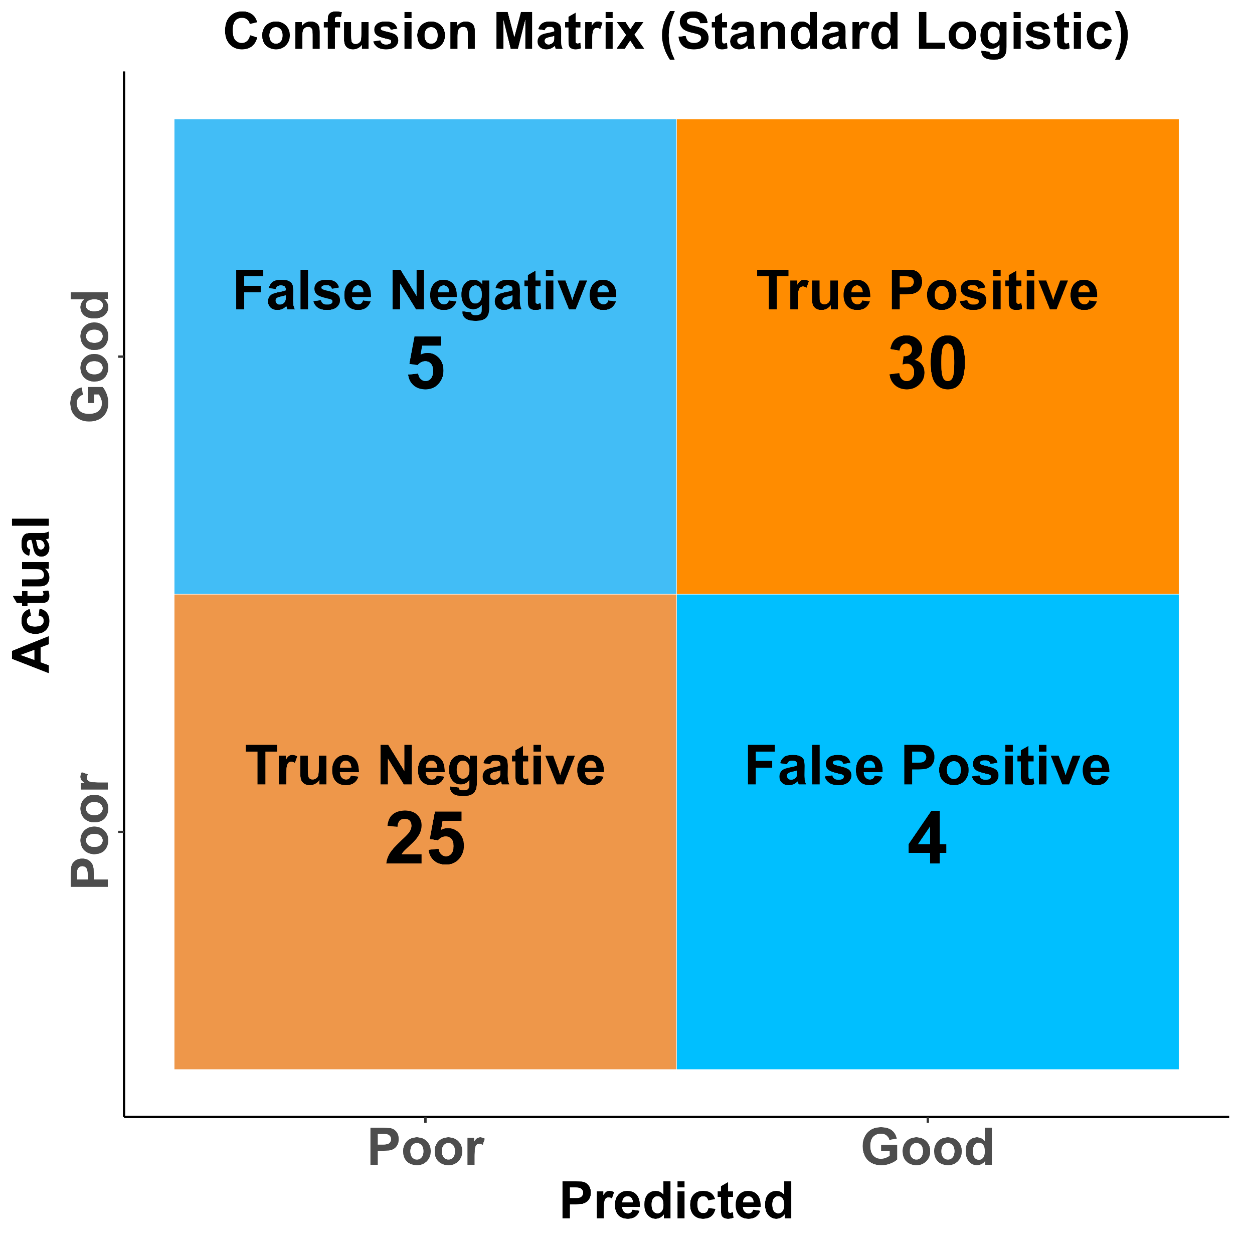
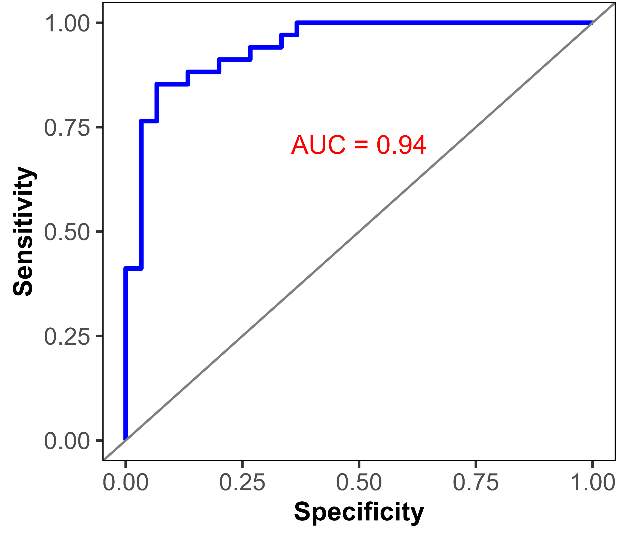
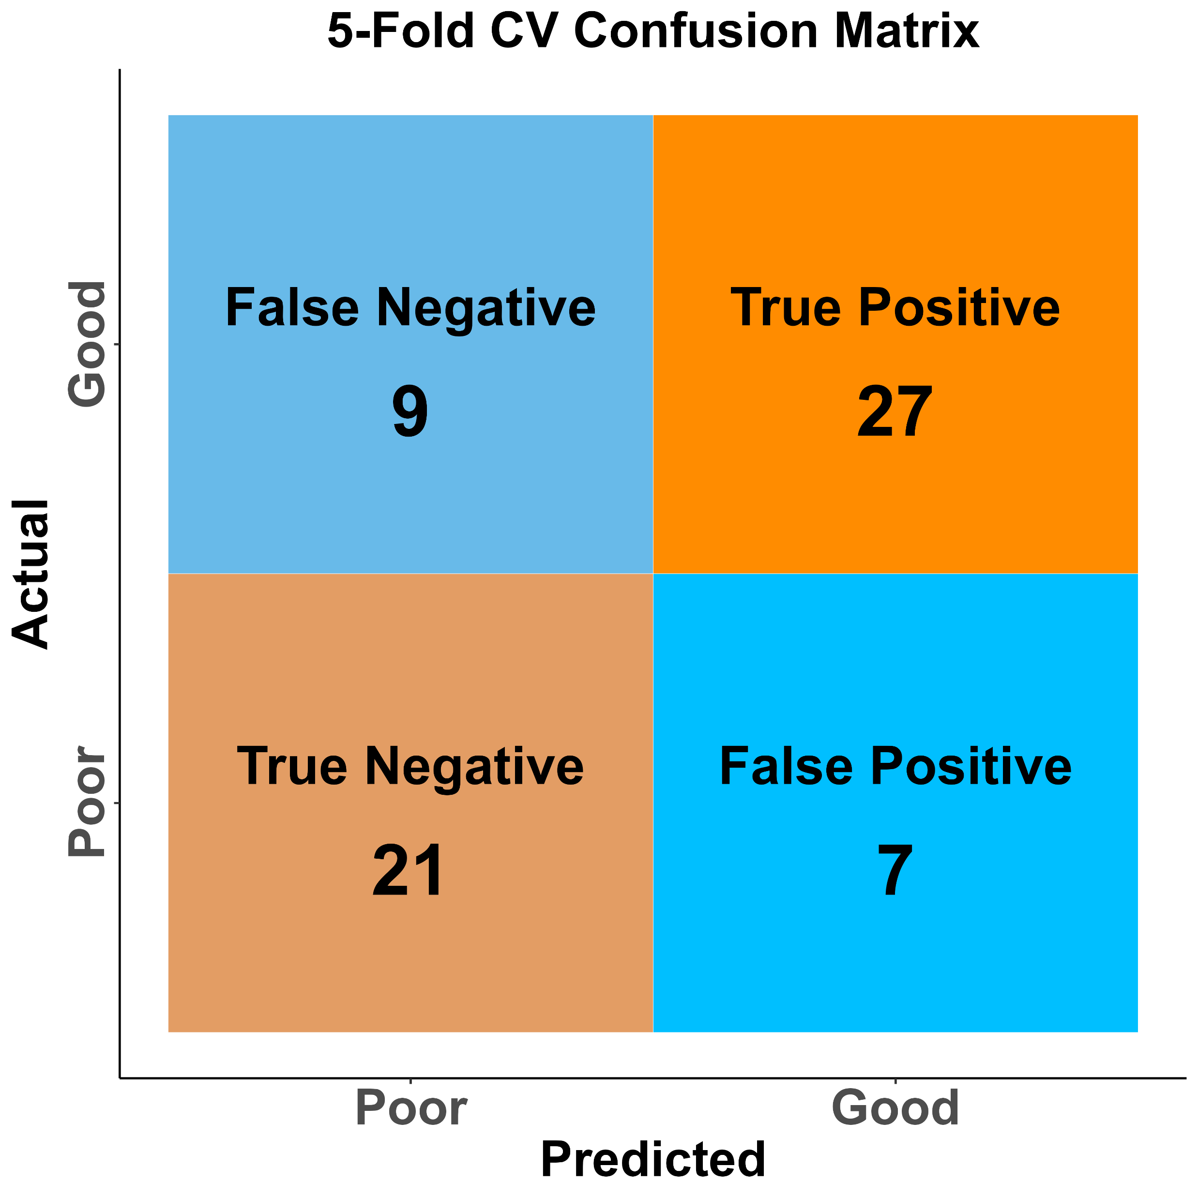
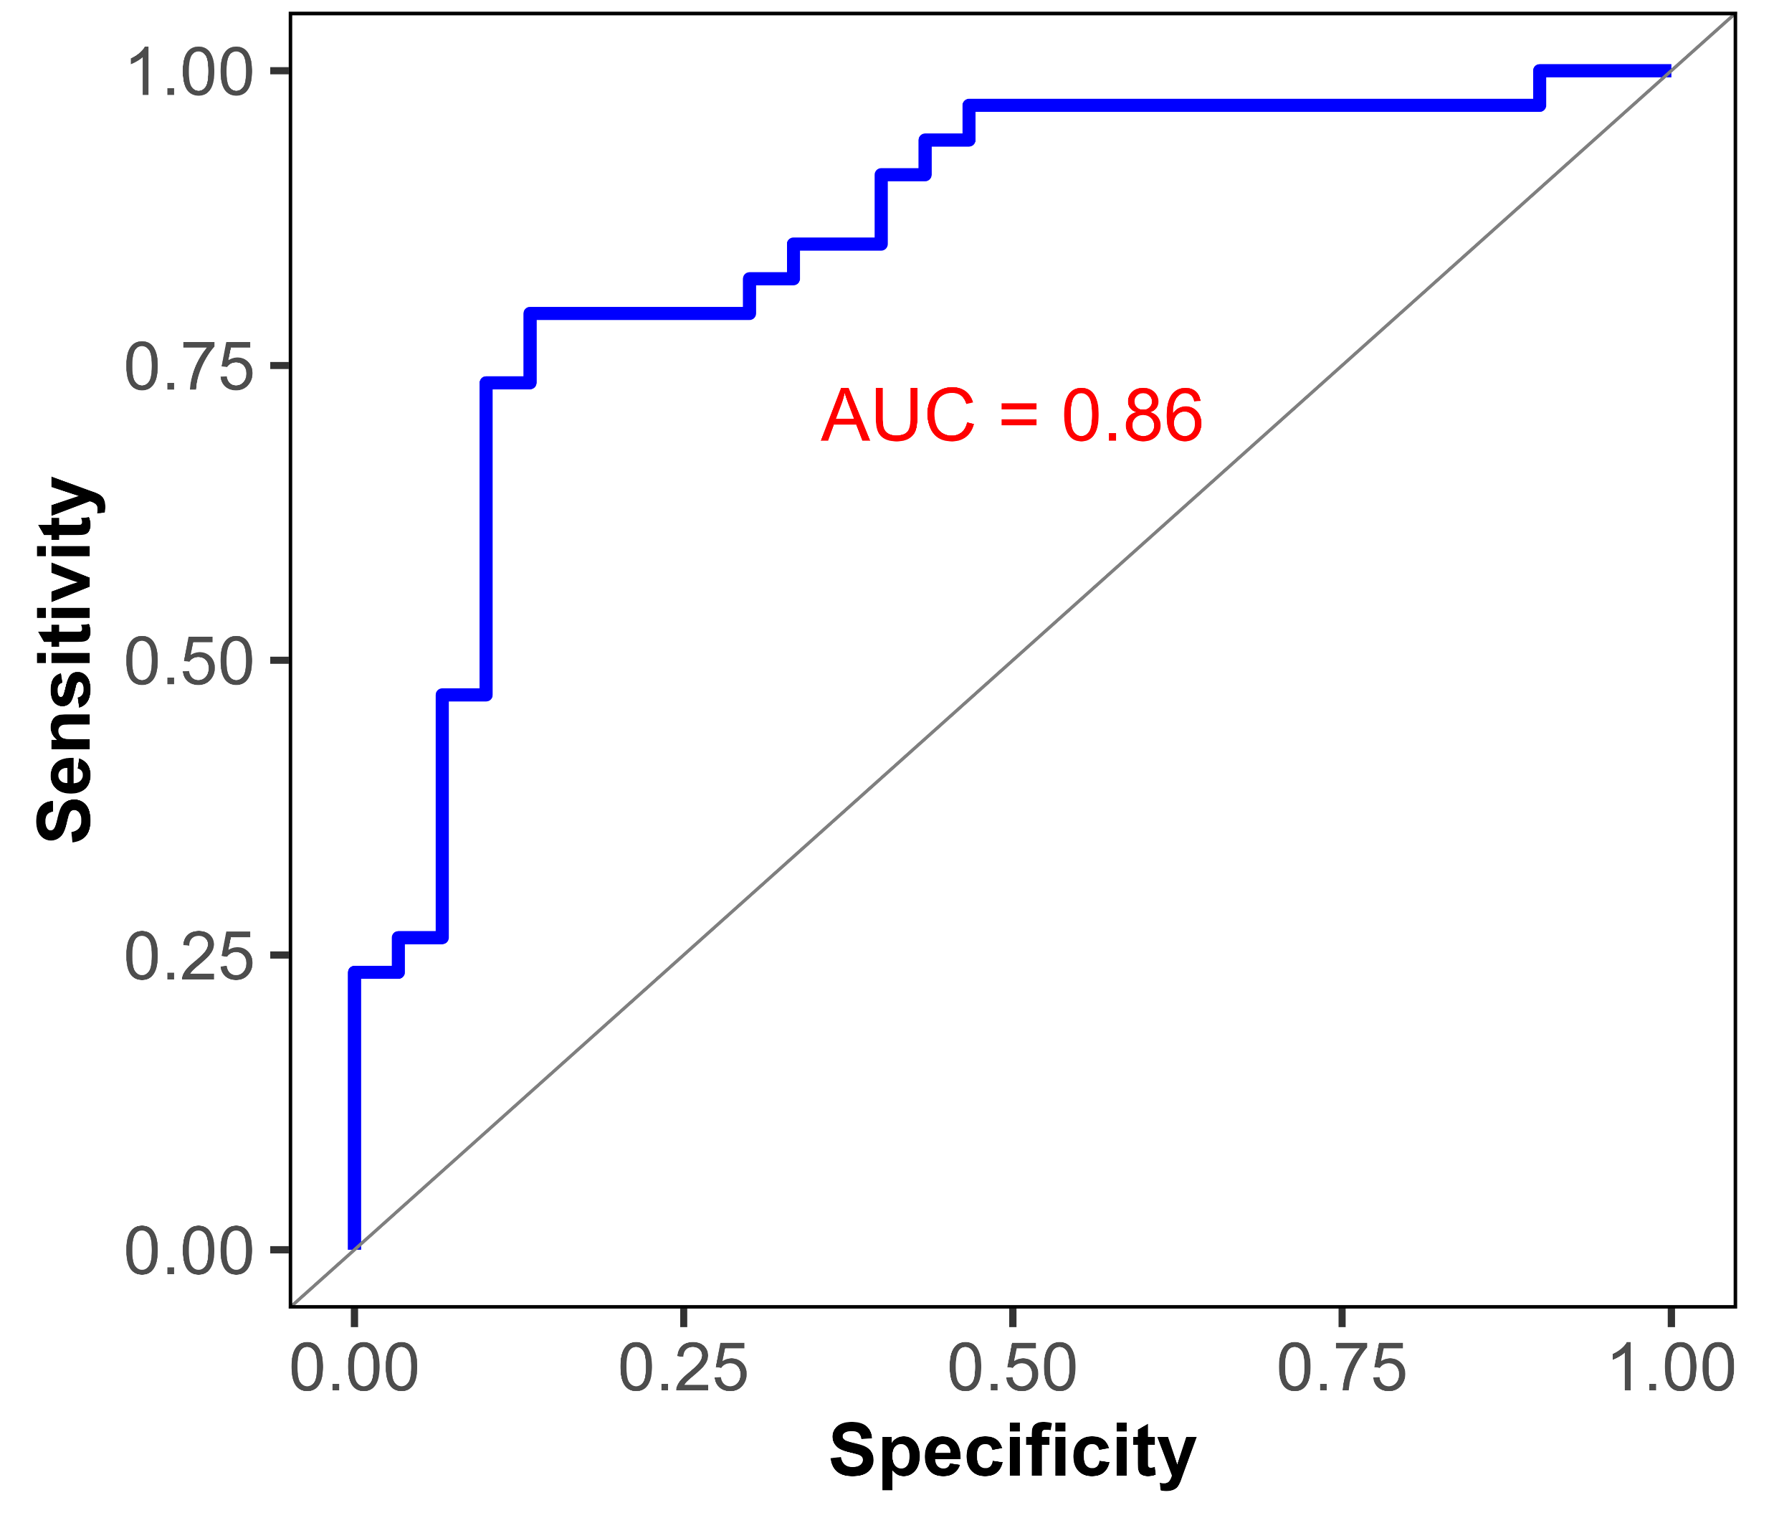
Figure S5
Standard Logistic Regression Model Classifying ARF Survivors Based on Selected Serum Metabolites at Discharge
A
B
Supplementary Figure S4: Performance of standard logistic regression and 5-fold cross-validation (CV) models.
(A) Confusion matrix for standard logistic regression showing classification of actual good vs. poor outcomes.
(B) ROC curve for standard logistic regression with AUC = 0.94, indicating strong discriminatory ability.
(C) Confusion matrix for 5-fold CV model showing reduced classification performance.
(D) ROC curve for 5-fold CV model with AUC = 0.86, demonstrating good but slightly lower performance than the standard model.
Overall, these results indicate similar but lower performance compared to Bayesian logistic regression, particularly after 5-fold cross-validation.
C
D
Standard Logistic Regression and 5-fold Cross Validation

Slide 6
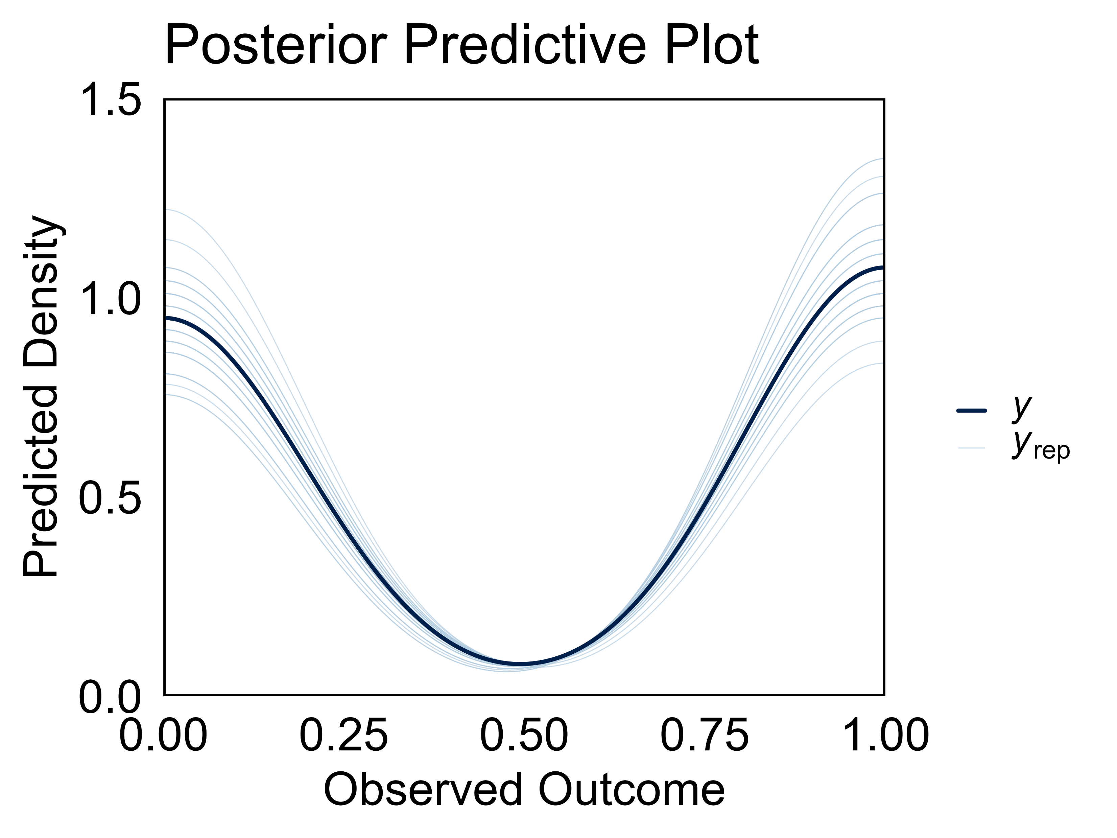
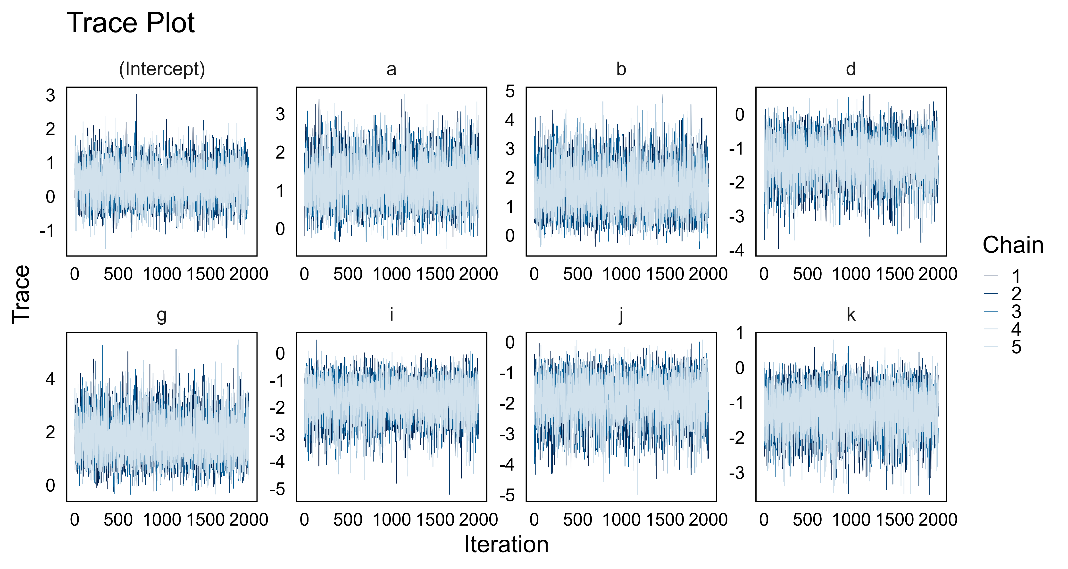
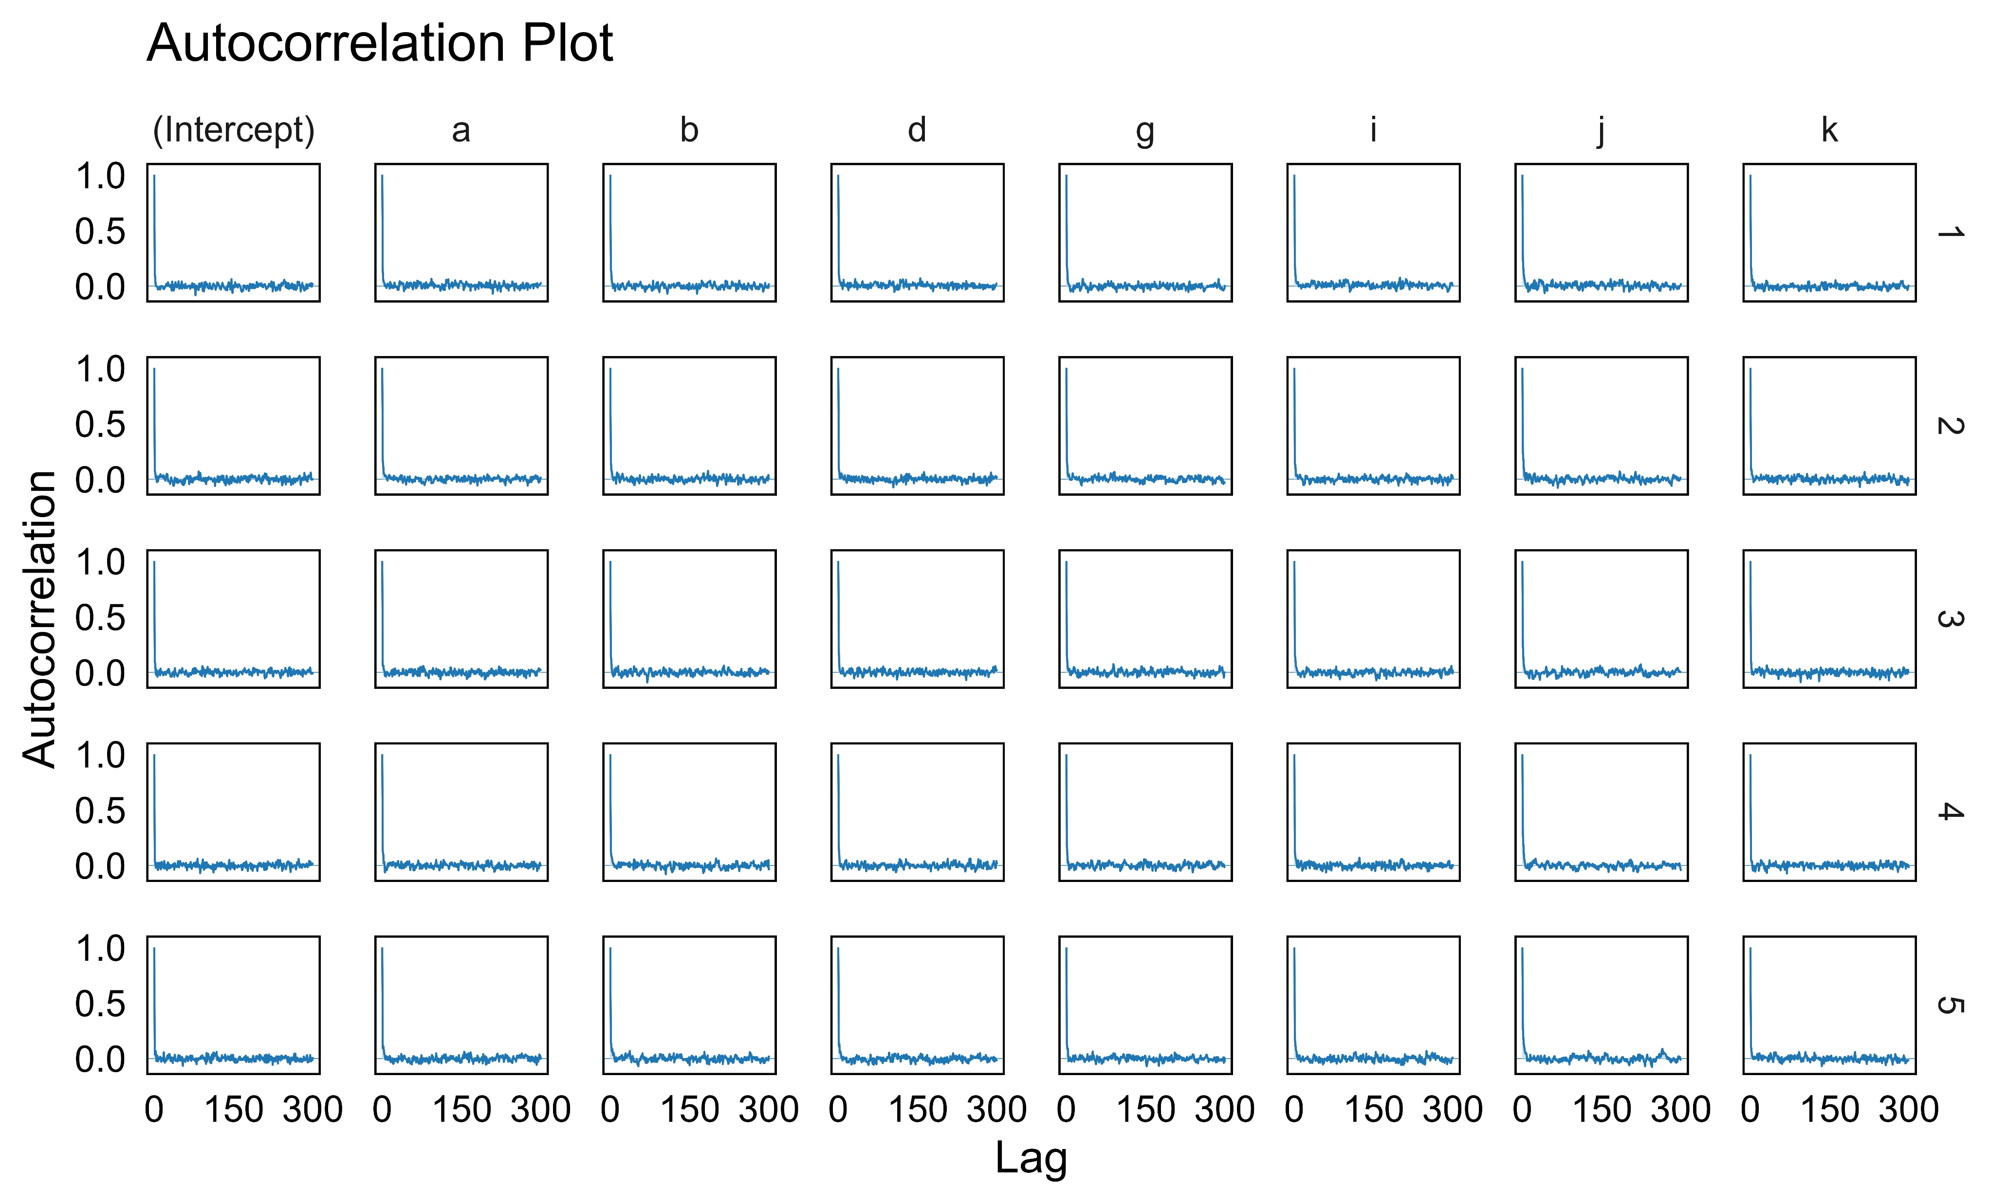
Figure S6
Bayesian Model Diagnostics for Classifying ARF Survivors by Physical Performance Outcomes
A
B
cystine
glycerol-3-phosphate
hyocholate
2-hydroxy-3-methylvalerate
taurocholenate sulfate
1-oleoyl-2-docosahexaenoyl-GPC (18:1/22:6)
ximenoylcarnitine
Supplementary Figure S5: Model diagnostics and posterior predictive check for the Bayesian logistic regression model.
(A) Posterior predictive plot showing alignment between observed outcomes (dark blue line, y) and predicted outcomes (lighter blue lines, y_rep), indicating the model accurately captures data trends.
(B) Trace plots for model parameters across MCMC chains, demonstrating convergence to the target posterior distribution.
(C) Autocorrelation plots showing low autocorrelation across parameters and chains, indicating efficient sampling and reliable posterior estimates. a, cystine; b, glycerol-3-phosphate; d, hyocholate; g, 2-hydroxy-3-methylvalerate; i, taurocholenate sulfate; j, 1-oleoyl-2-docosahexaenoyl-GPC (18:1/22:6); k, ximenoylcarnitine.
C

Slide 7
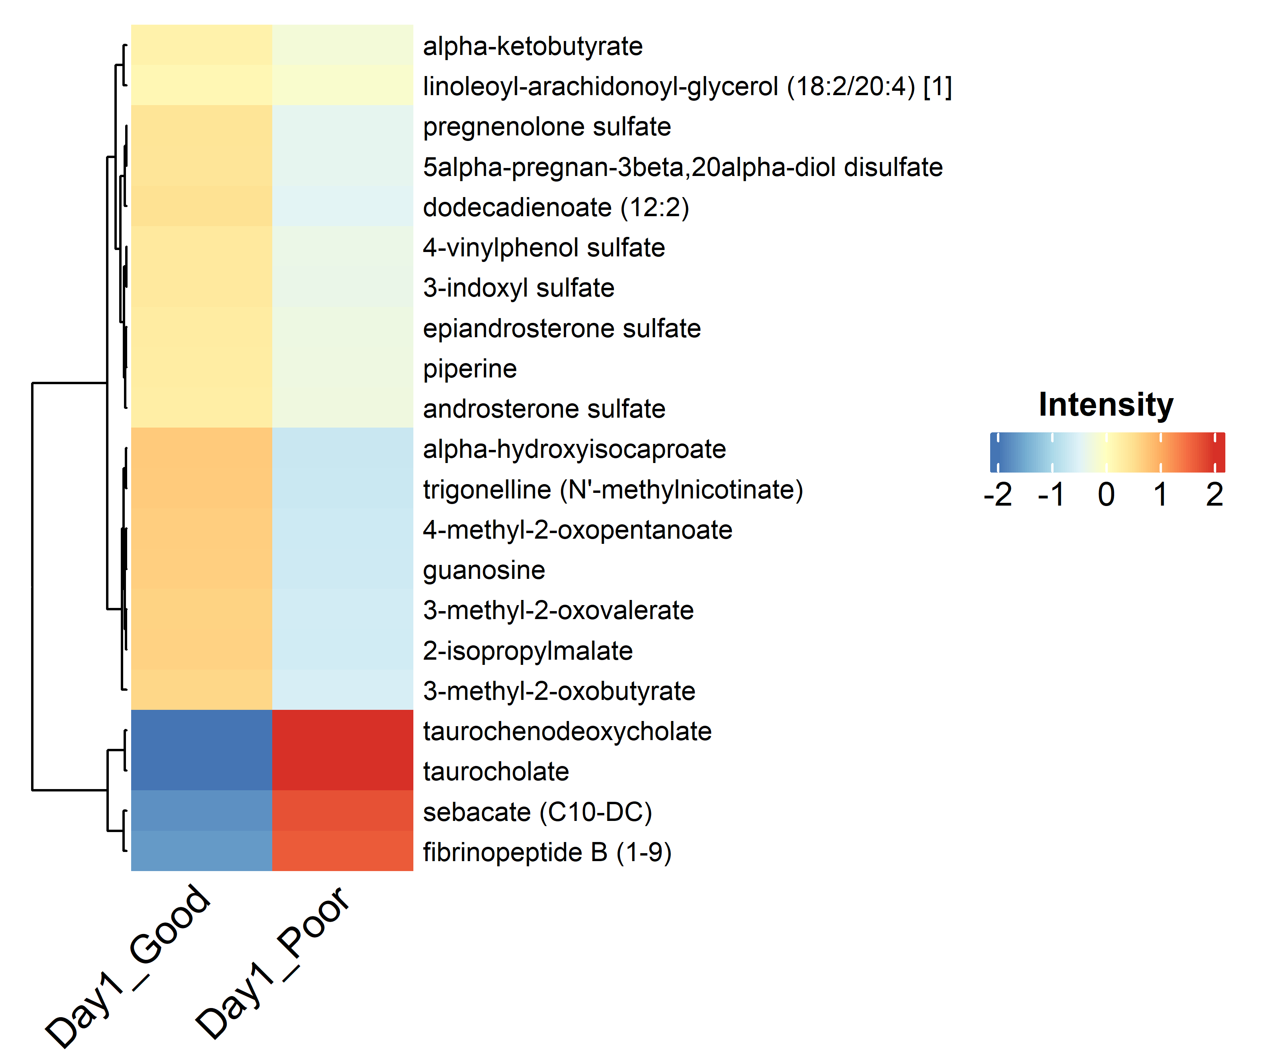
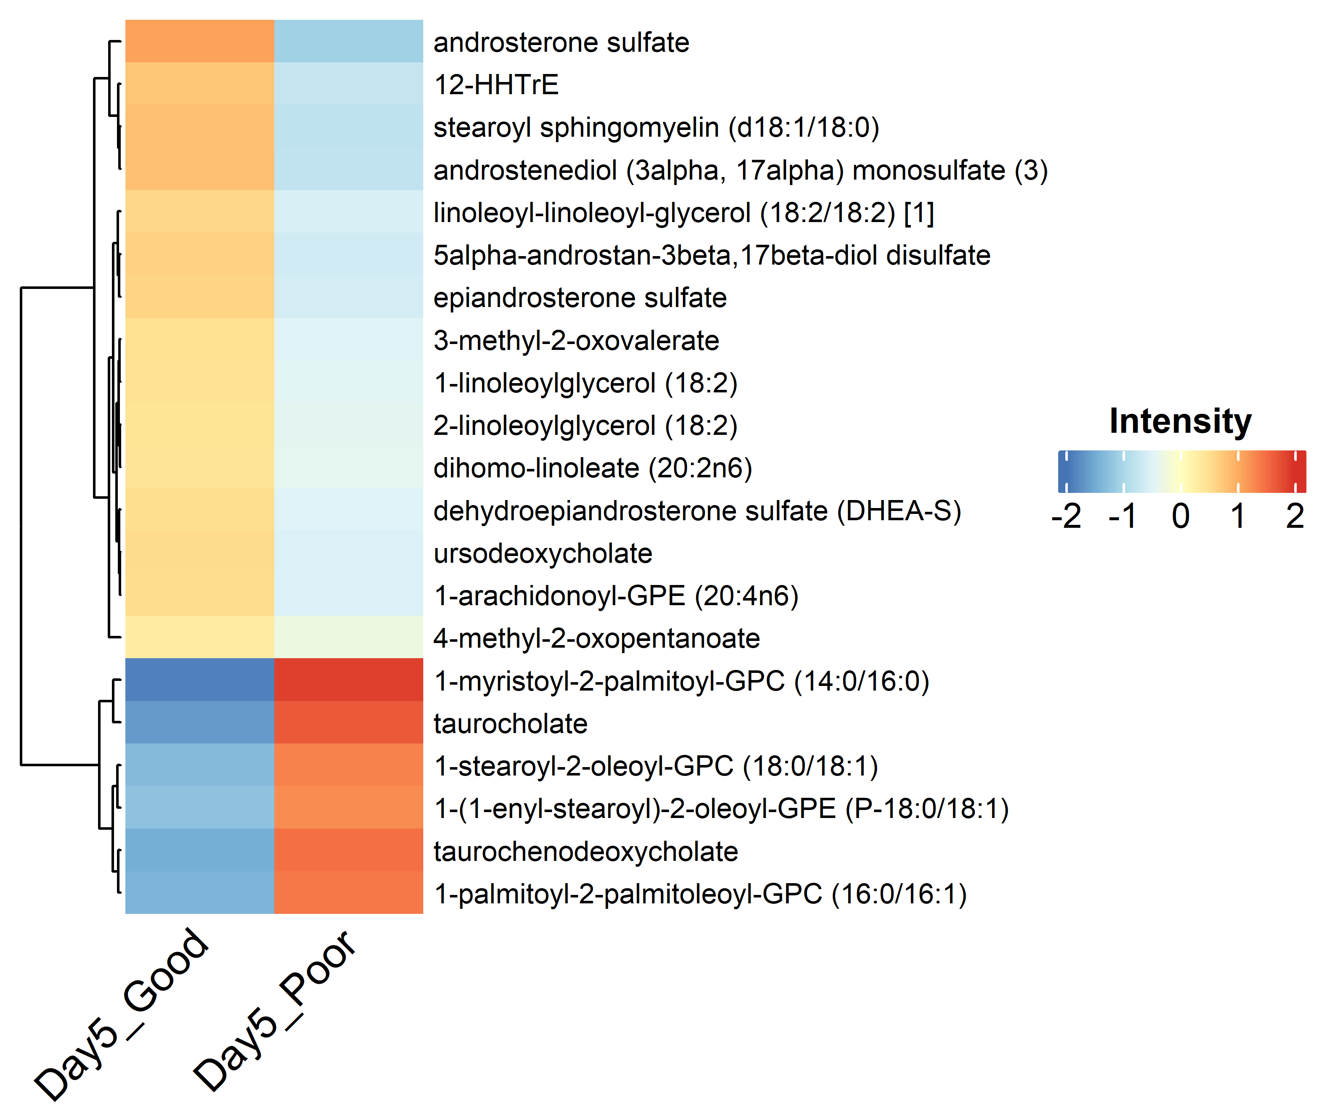
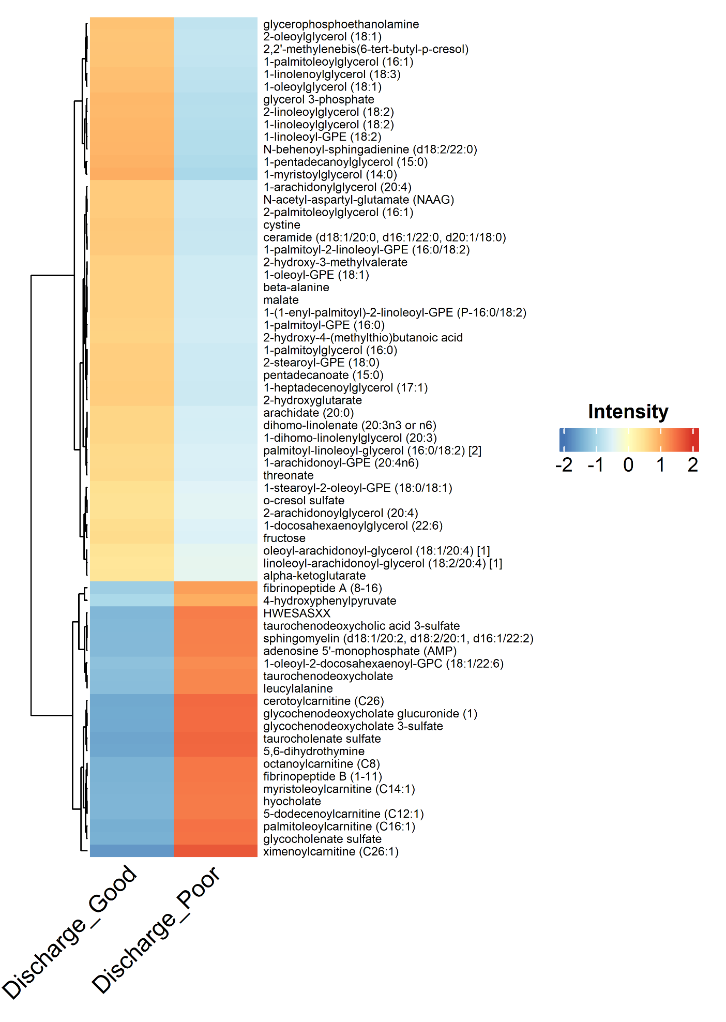
Figure S7
Heatmap of Differential Metabolites of ARF Survivors at Three Clinical Time Points
A
B
C
Day 5
Discharge
Day 1
Supplementary Figure S6. Hierarchical clustered heatmaps of Z-score–normalized intensities for metabolites significantly altered between “Good” and “Poor” SPPB groups at three clinical time points: (A) ICU admission (Day 1), (B) Day 5 post-admission, and (C) Hospital discharge. Only those metabolites reaching statistical significance are shown. Each row represents one significant metabolite, and each column displays the group-average Z-score intensity for Good or Poor outcomes. Color scale denotes relative abundance (blue = low; red = high), and the row dendrograms reflect hierarchical clustering by similarity of intensity profiles.

Slide 8
Table S1
Evaluation Metrics for Standard and Bayesian Logistic Regression Models
Metric | Standard Logistic Regression | Bayesian Logistic Regression | Standard Logistic Regression 5-fold CV | Bayesian Logistic Regression 5-fold CV
AUC | 0.94 | 0.94 | 0.86 | 0.88
Accuracy | 0.86 | 0.86 | 0.75 | 0.81
Precision | 0.88 | 0.88 | 0.76 | 0.86
Recall | 0.86 | 0.86 | 0.70 | 0.80
F1 Score | 0.87 | 0.87 | 0.72 | 0.80
MCC | 0.72 | 0.72 | 0.51 | 0.67
Cohen's Kappa | 0.72 | 0.72 | 0.50 | 0.62
Supplementary Table 1. Performance metrics of Standard Logistic Regression and Bayesian Logistic Regression models for predicting six-month physical function outcome (SPPB: “Good” vs. “Poor”) using discharge serum metabolites. When trained on the full dataset, both models achieved identical AUC (0.94) and accuracy (0.86). Under 5-fold cross-validation, the Bayesian model consistently outperformed the standard model across all evaluation metrics, including a higher aggregated AUC (0.88 vs. 0.86), accuracy (0.81 vs. 0.75), precision, recall, F1 score, MCC (Matthews Correlation Coefficient), and Cohen’s Kappa.

