Slide 1
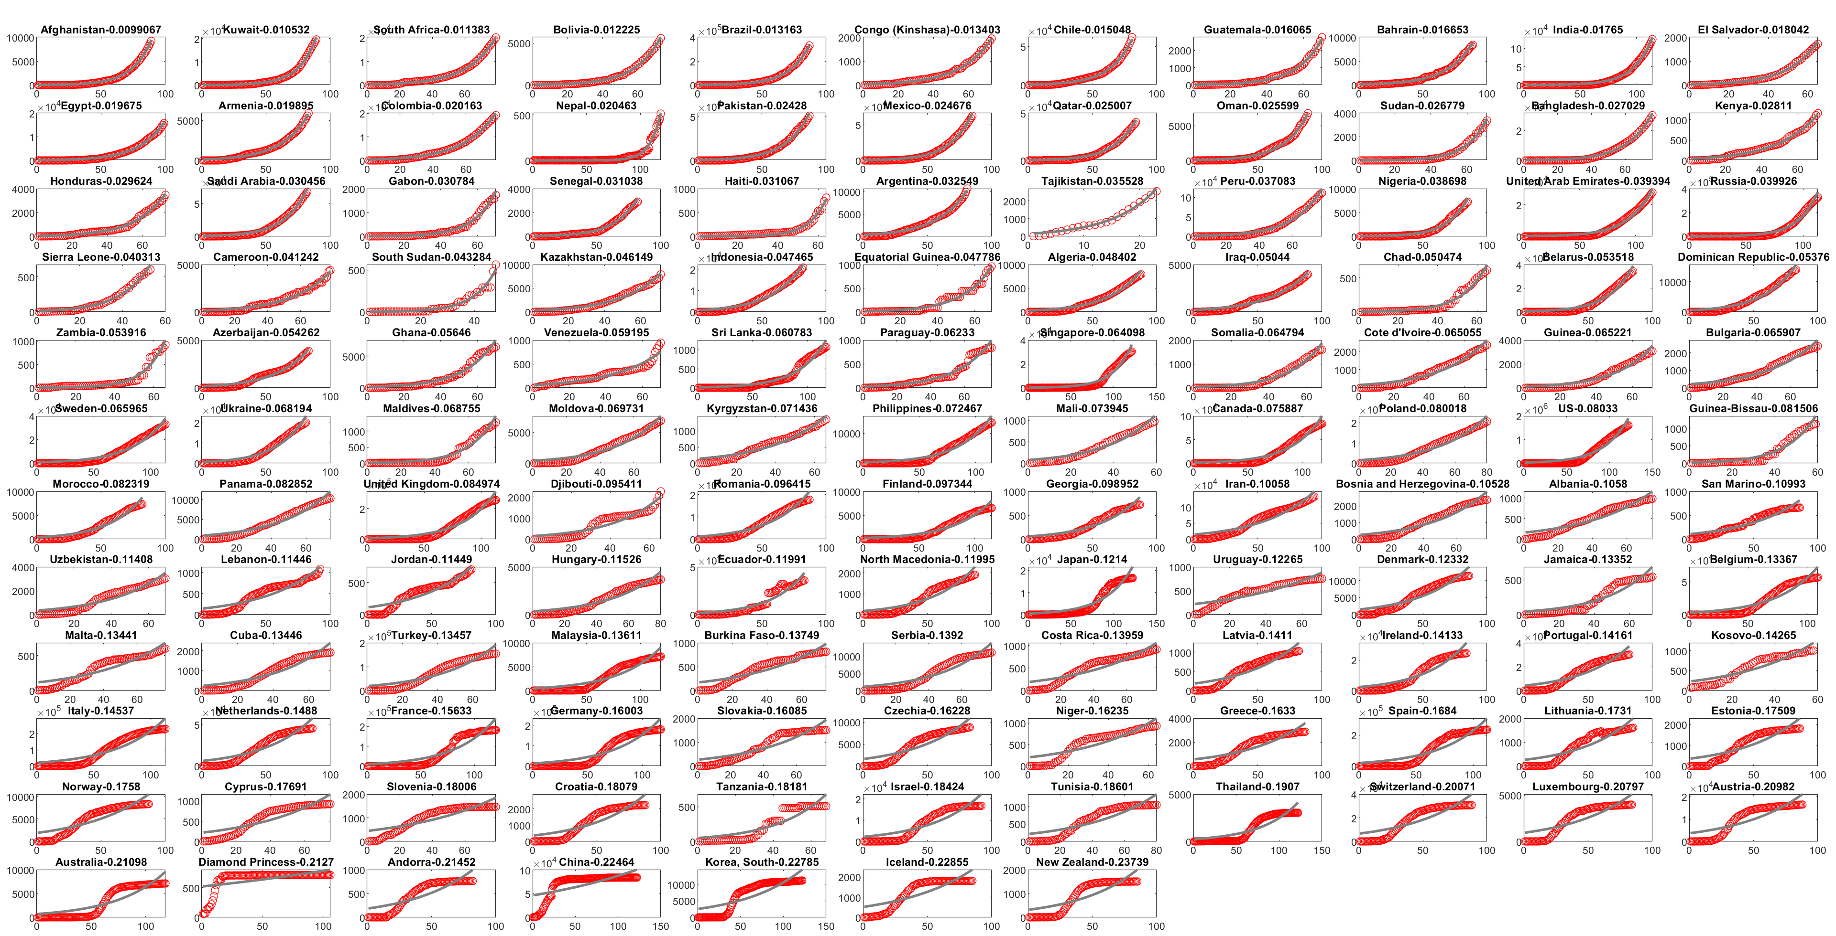
Countries with at least 500 cases sorted from best exponential fit to worst, May 22, 2020
Confirmed Cases
Time (days)

