Slide 1
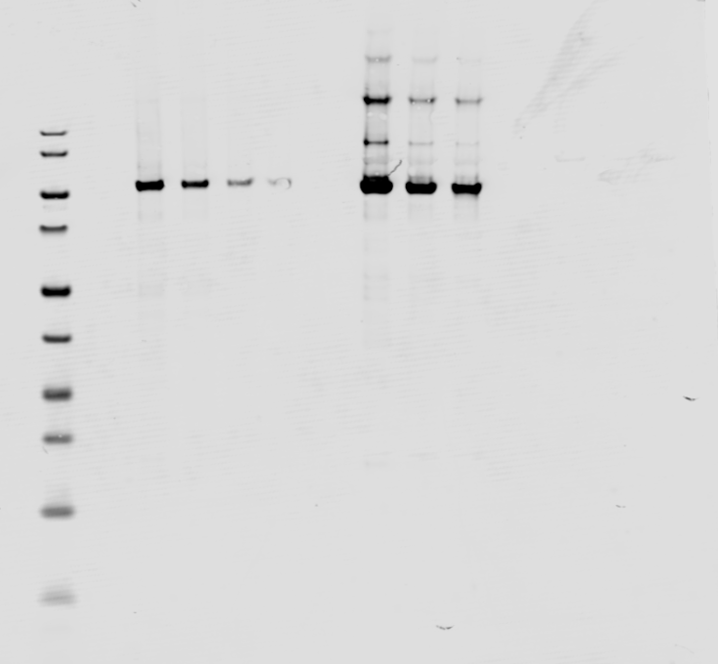
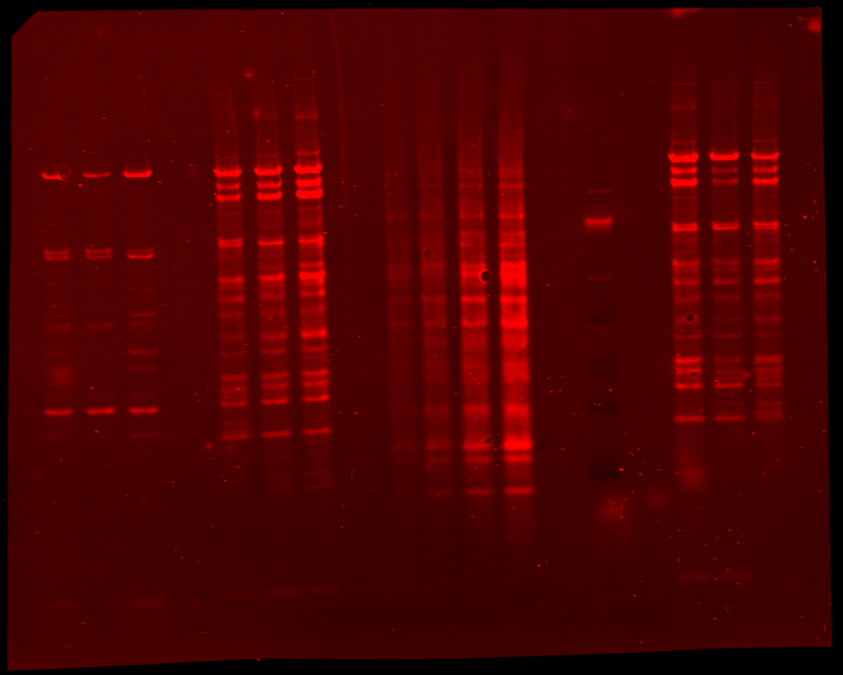
HSP90 - alpha
HEK 293
ChAdOx1 nCoV-19
Ad26.COV2.S
Revert 700 Total Protein stain
M 1.5 1.0 0.5 0.25 1 2 3 1 2 3
kDa
140
115
90 kDa
80
70
50
40
30
25
15
10

Slide 2
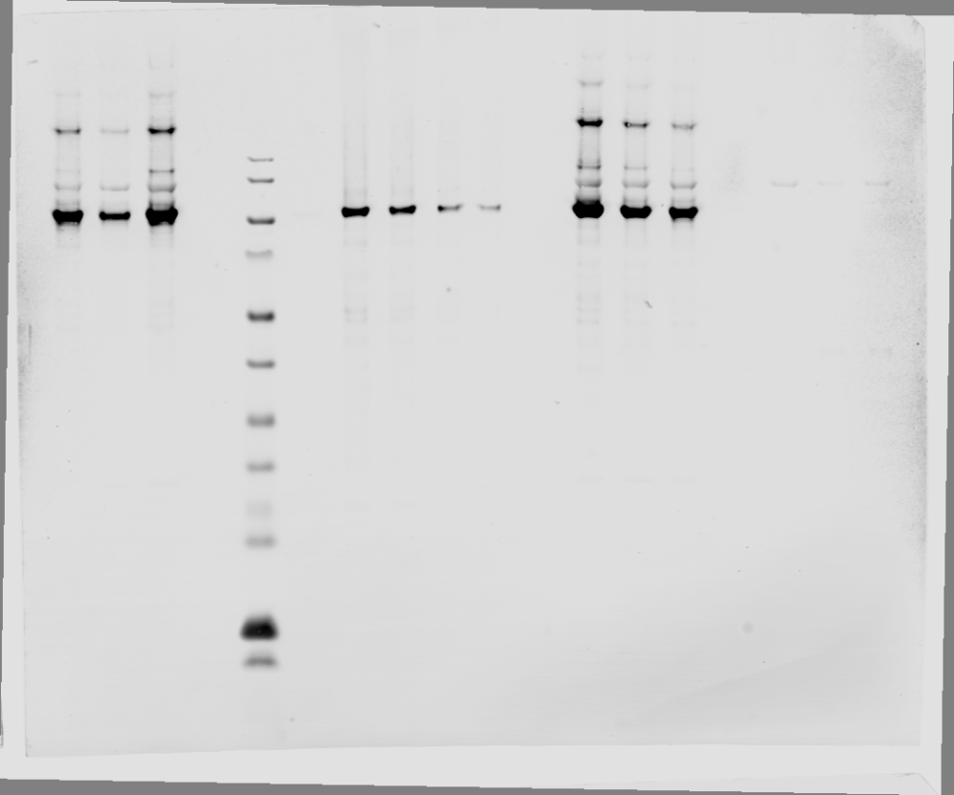
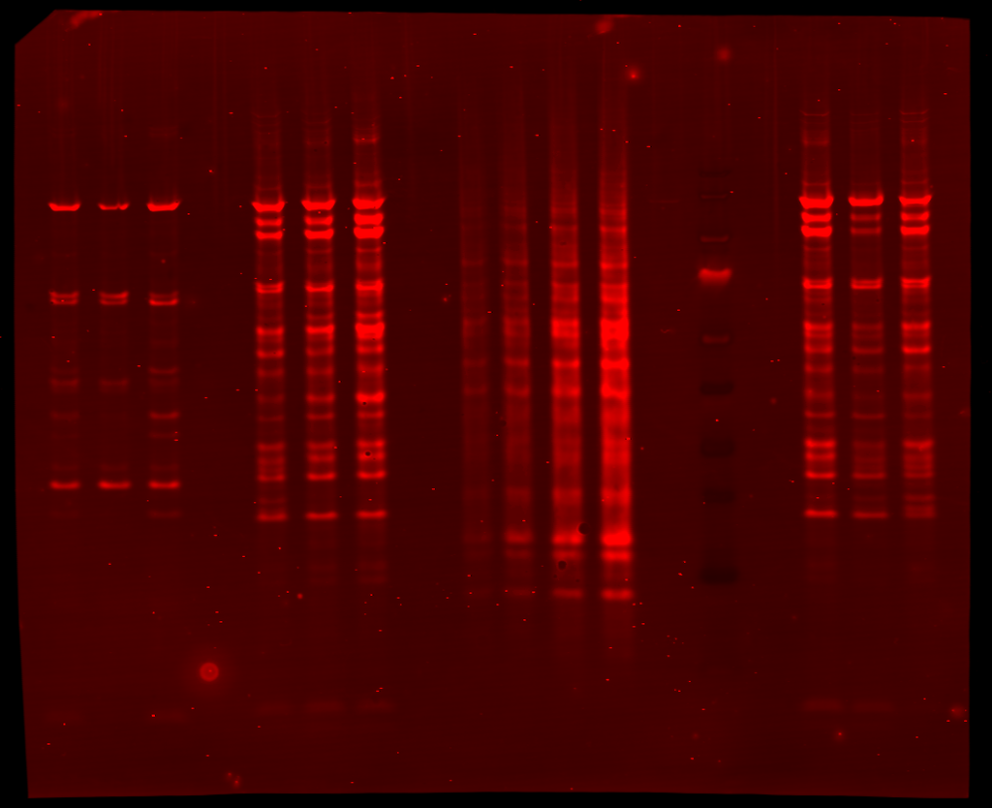
HSP90 - AB1
ChAdOx1 nCoV-19
HEK 293
Ad26.COV2.S
Revert 700 Total Protein stain
M 1.5 1.0 0.5 0.25 1 2 3 1 2 3
kDa
140
115
80
83 kDa
70
50
40
30
25
15
10

Slide 3
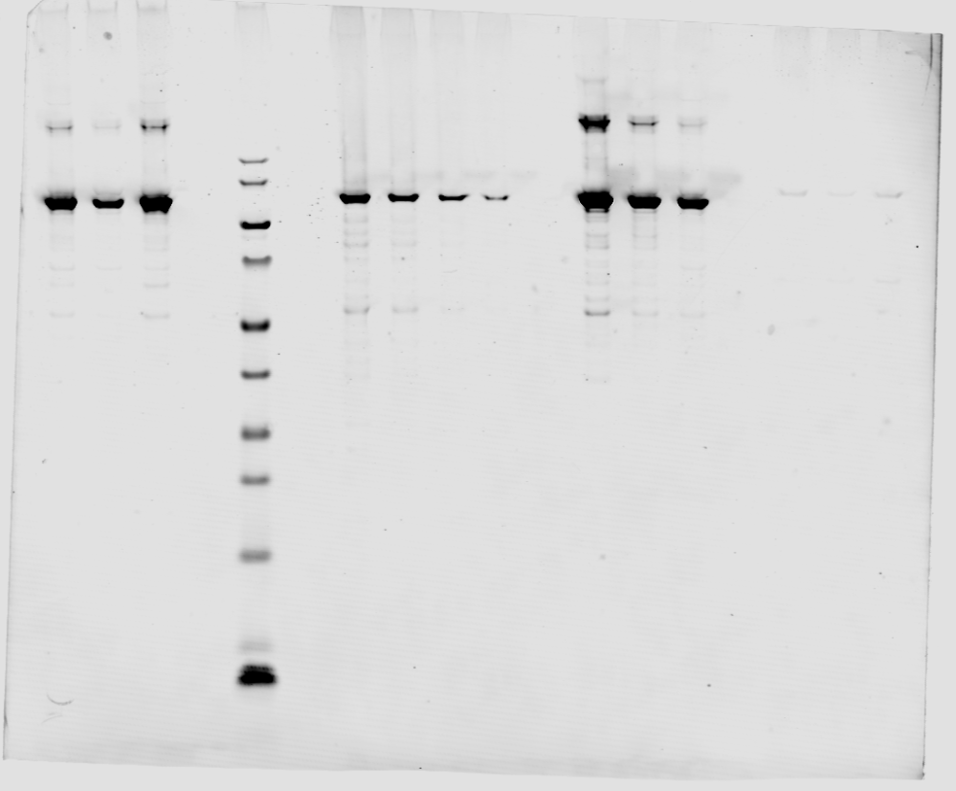
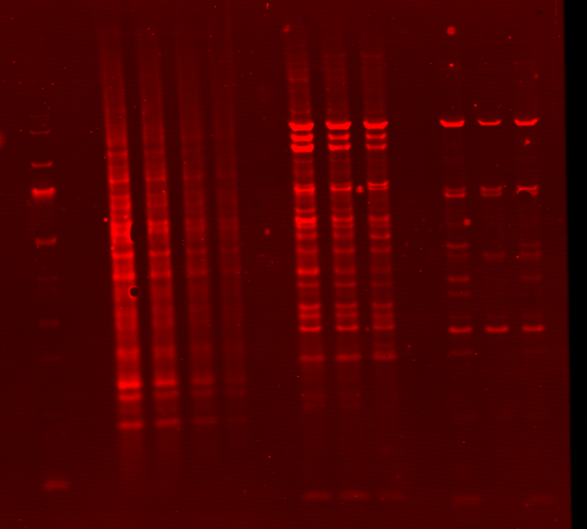
GRP94
ChAdOx1 nCoV-19
HEK 293
Ad26.COV2.S
Revert 700 Total Protein stain
M 1.5 1.0 0.5 0.25 1 2 3 1 2 3
kDa
140
115
92 kDa
80
70
50
40
30
25
15
10

Slide 4
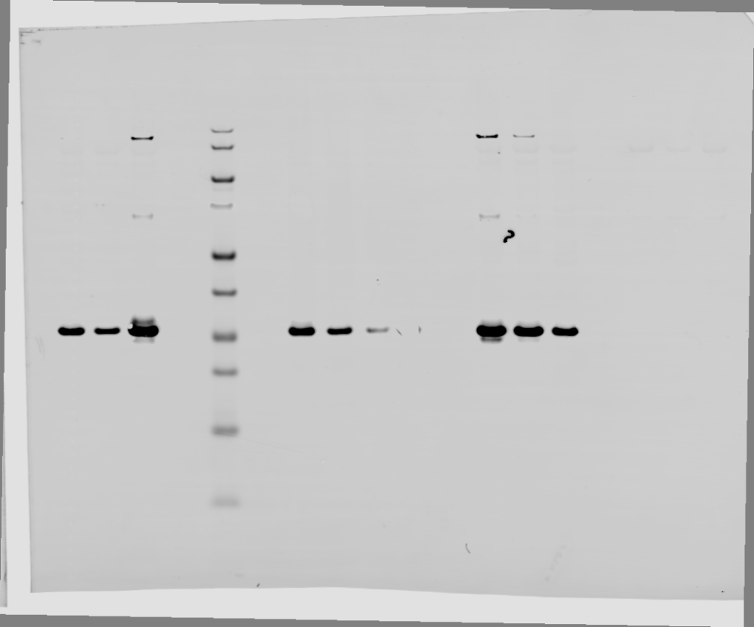
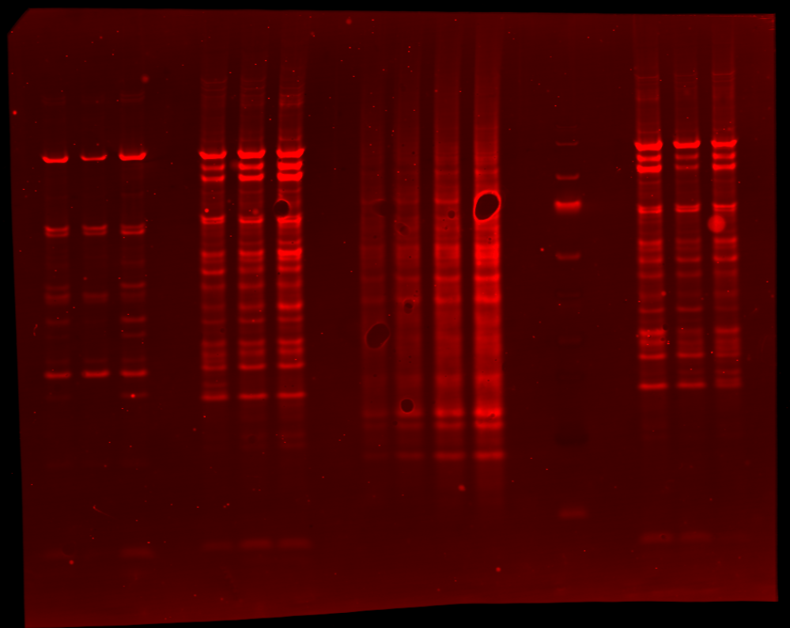
14-3-3 Epsilon
ChAdOx1 nCoV-19
HEK 293
Ad26.COV2.S
Revert 700 Total Protein stain
M 1.5 1.0 0.5 0.25 1 2 3 1 2 3
kDa
140
115
80
70
50
40
30
29 kDa
25
15
10

Slide 5
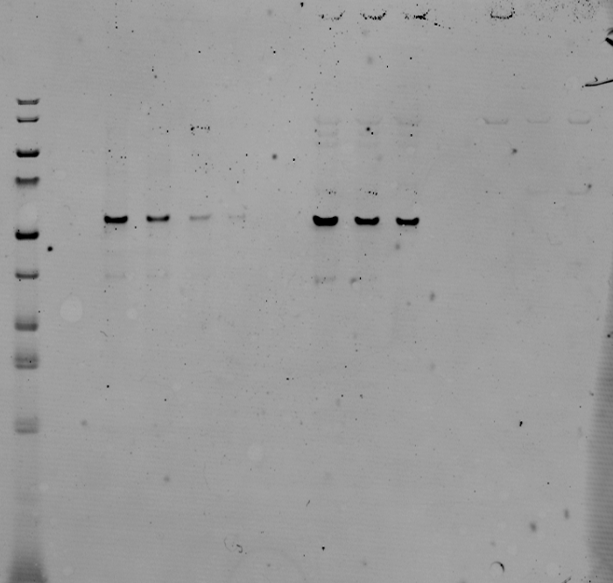
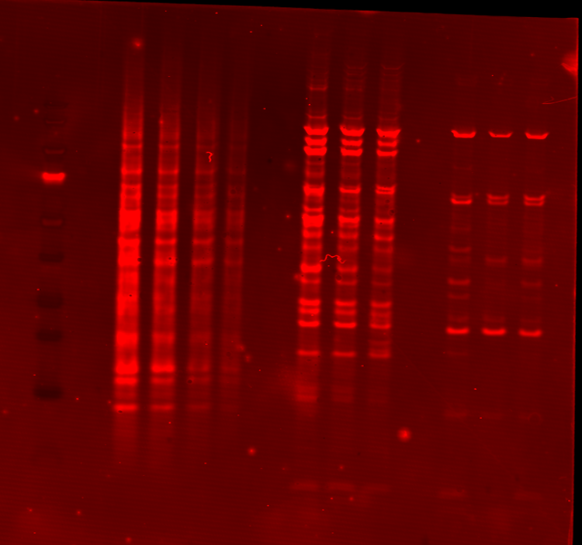
Tubulin alpha-1B
ChAdOx1 nCoV-19
HEK 293
Ad26.COV2.S
Revert 700 Total Protein stain
M 1.5 1.0 0.5 0.25 1 2 3 1 2 3
kDa
140
115
80
70
50
50 kDa
40
30
25
15
10

Slide 6
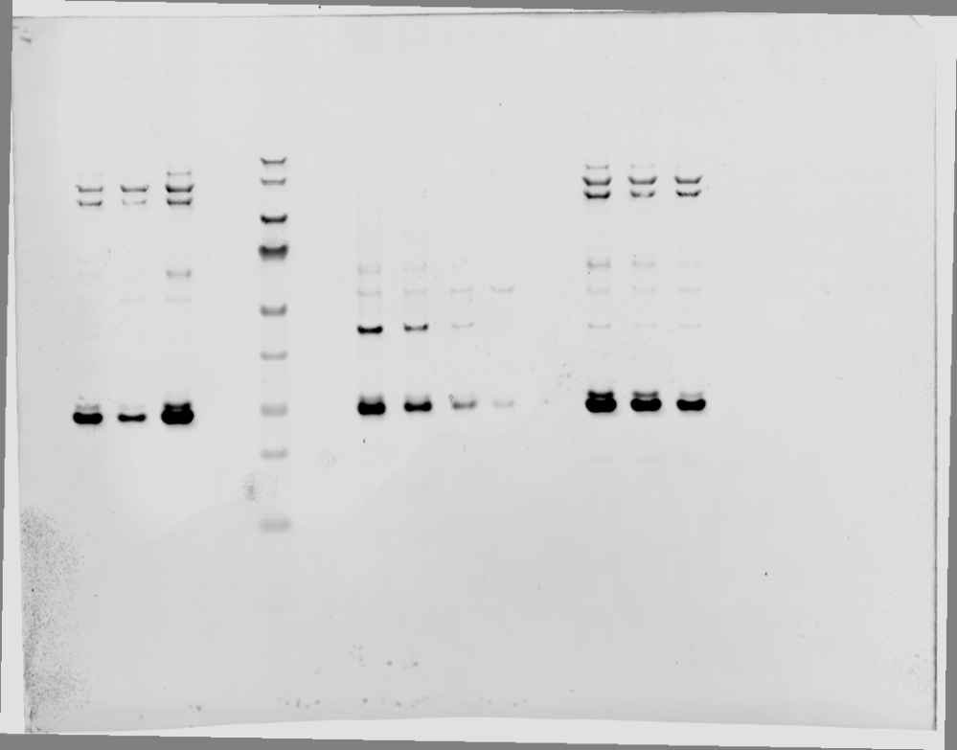
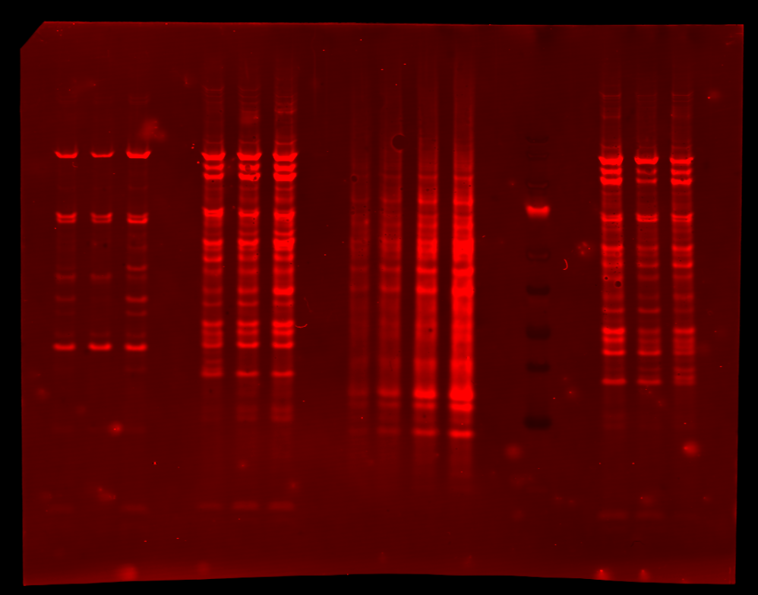
YWHAZ
ChAdOx1 nCoV-19
HEK 293
Ad26.COV2.S
Revert 700 Total Protein stain
M 1.5 1.0 0.5 0.25 1 2 3 1 2 3
kDa
140
115
80
70
50
40
30
28 kDa
25
15
10

Slide 7
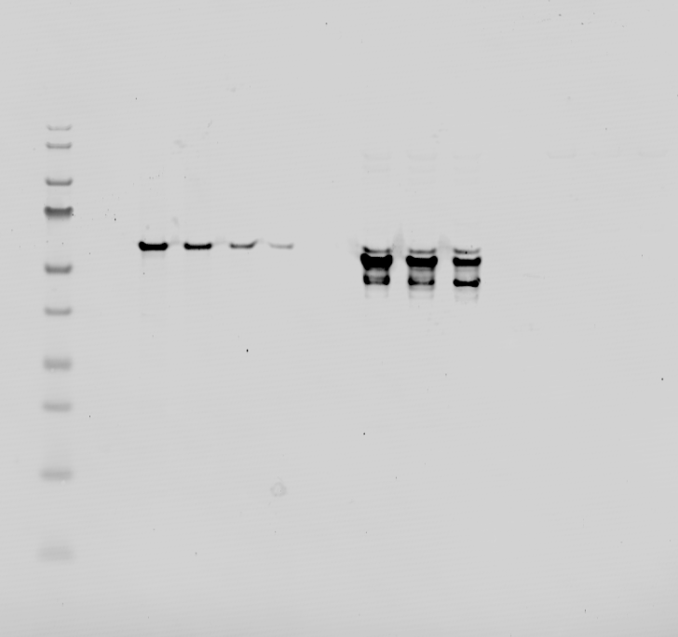
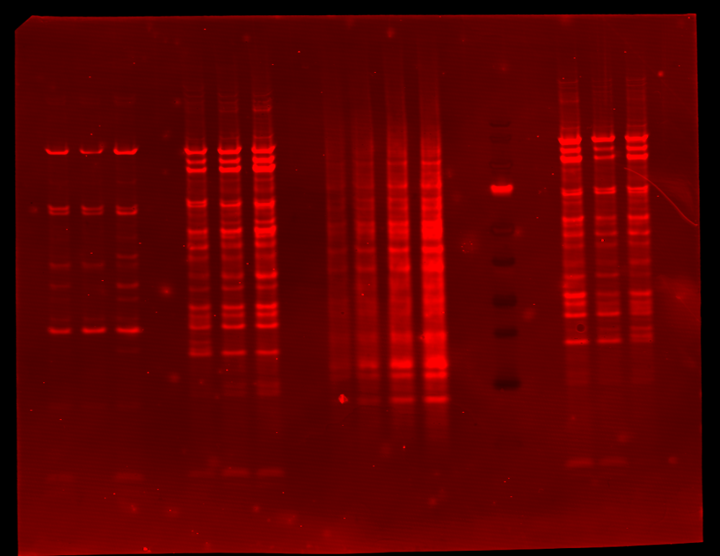
Vimentin
ChAdOx1 nCoV-19
HEK 293
Ad26.COV2.S
Revert 700 Total Protein stain
M 1.5 1.0 0.5 0.25 1 2 3 1 2 3
kDa
140
115
80
70
50
53 kDa
40
30
25
15
10

Slide 8
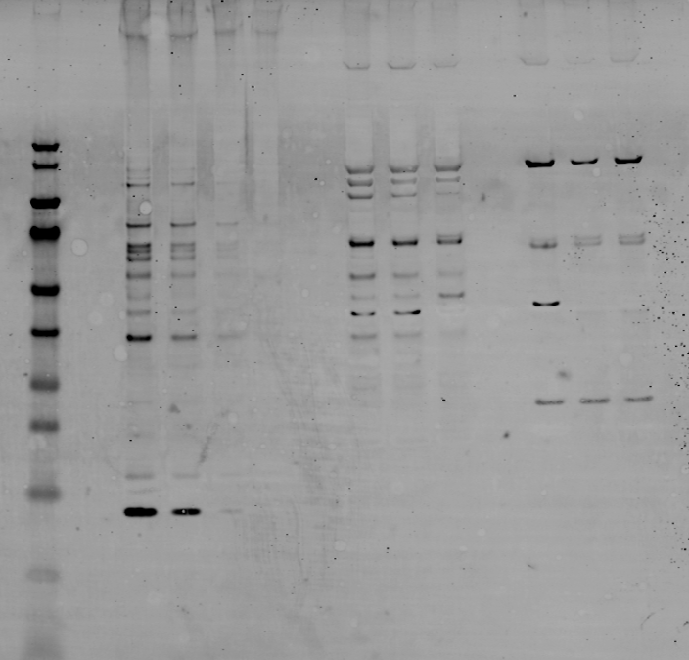
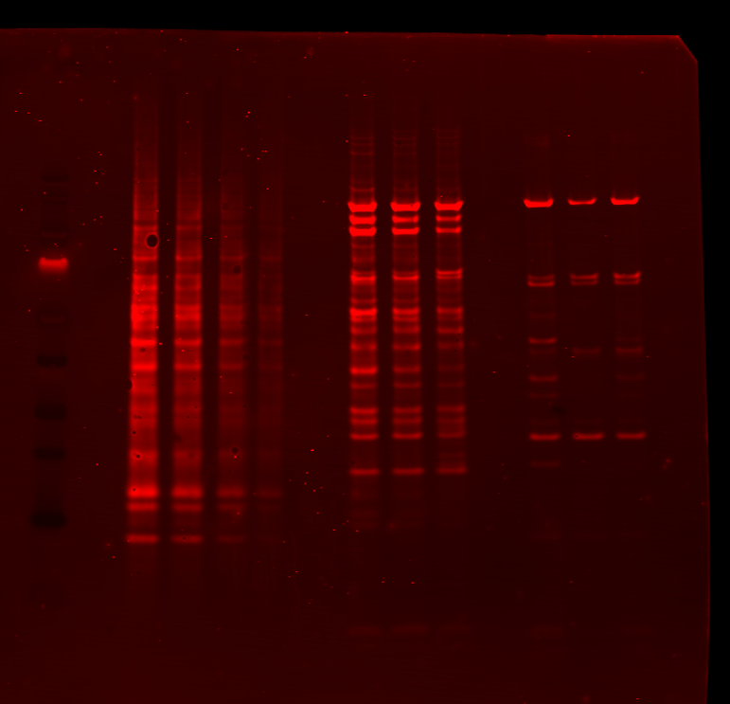
Histone H4
ChAdOx1 nCoV-19
HEK 293
Ad26.COV2.S
Revert 700 Total Protein stain
M 1.5 1.0 0.5 0.25 1 2 3 1 2 3
kDa
140
115
80
70
50
40
30
25
15
11 kDa
10

Slide 9
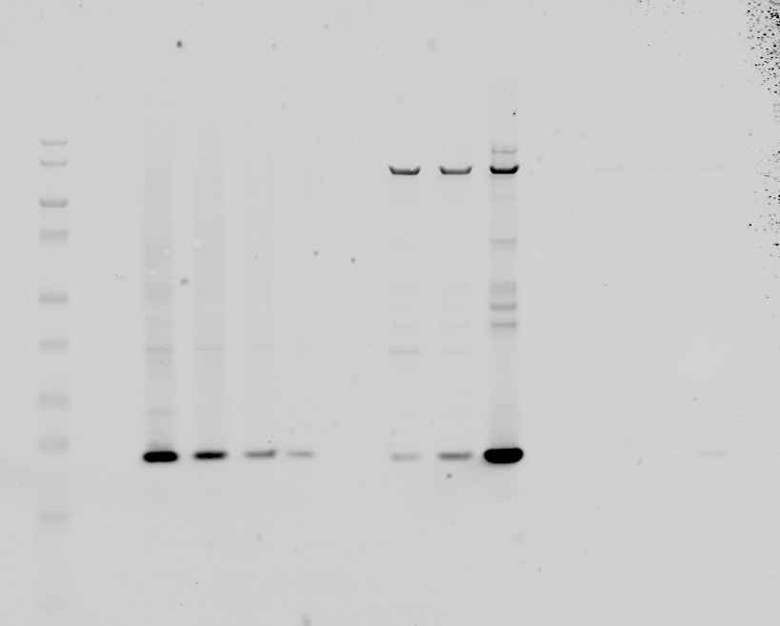
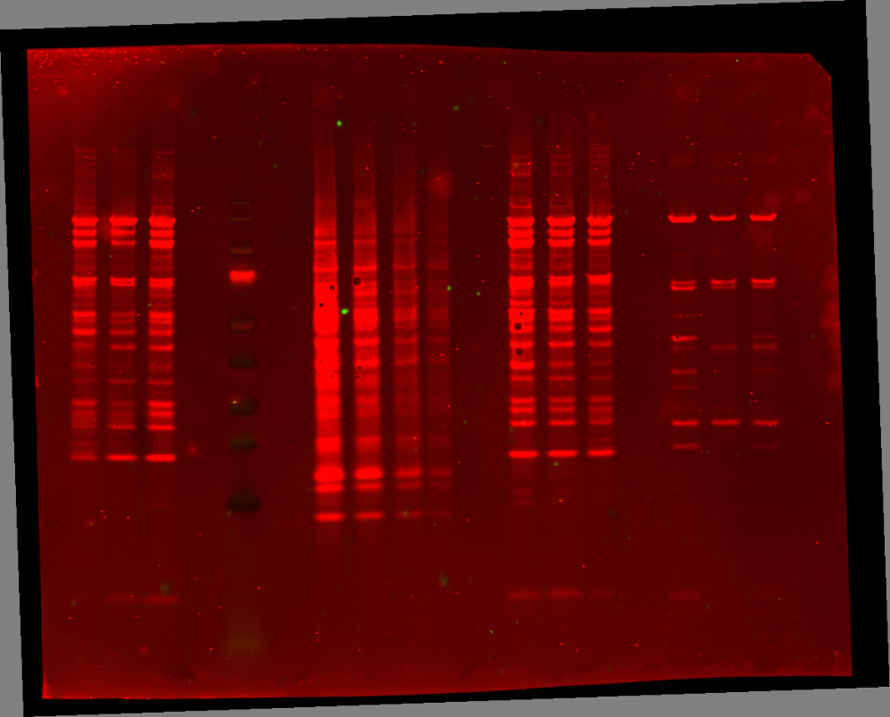
PSMB5 – MB1
ChAdOx1 nCoV-19
HEK 293
Ad26.COV2.S
Revert 700 Total Protein stain
M 1.5 1.0 0.5 0.25 1 2 3 1 2 3
kDa
140
115
80
70
50
40
30
25
22.3 kDa
15
10

Slide 10
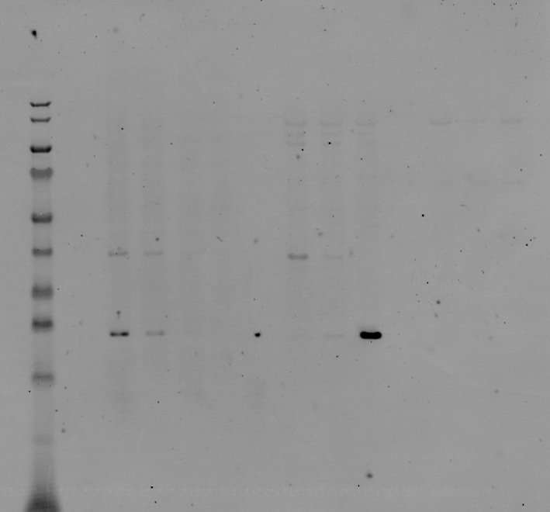
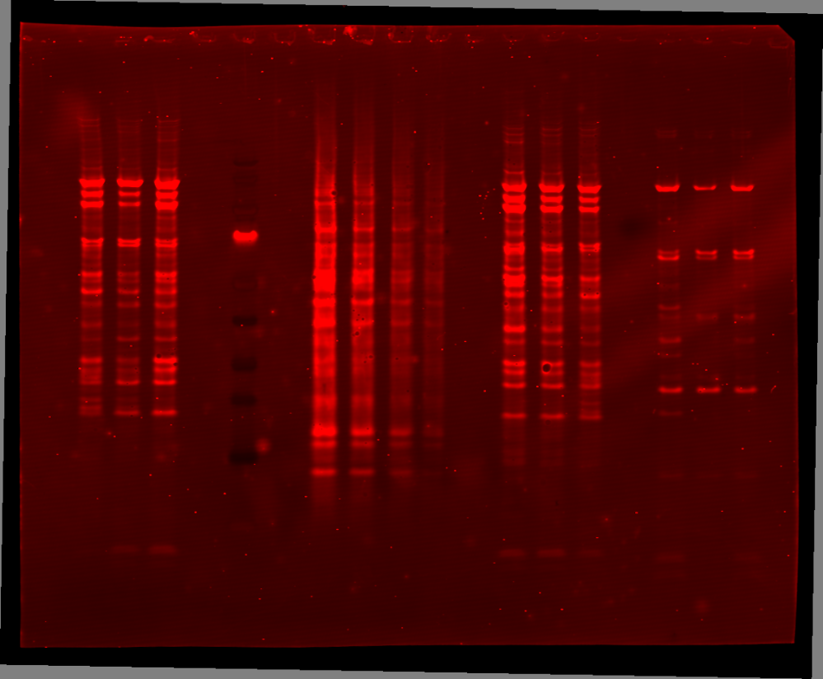
PSMB6 (Beta-1 delta )
ChAdOx1 nCoV-19
HEK 293
Ad26.COV2.S
Revert 700 Total Protein stain
M 1.5 1.0 0.5 0.25 1 2 3 1 2 3
kDa
140
115
80
70
50
40
30
25
22 kDa
15
10

Slide 11
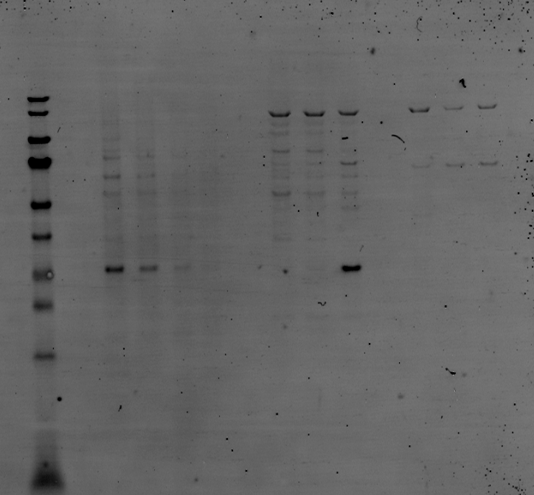
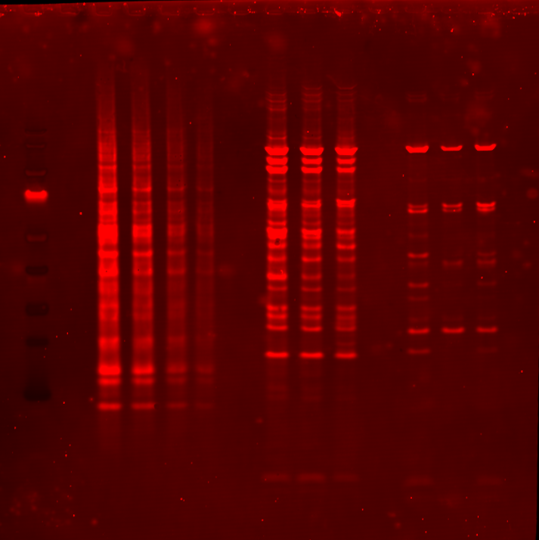
PSMA4
ChAdOx1 nCoV-19
HEK 293
Ad26.COV2.S
Revert 700 Total Protein stain
M 1.5 1.0 0.5 0.25 1 2 3 1 2 3
kDa
140
115
80
70
50
40
30
29.5 kDa
25
15
10

