Slide 1
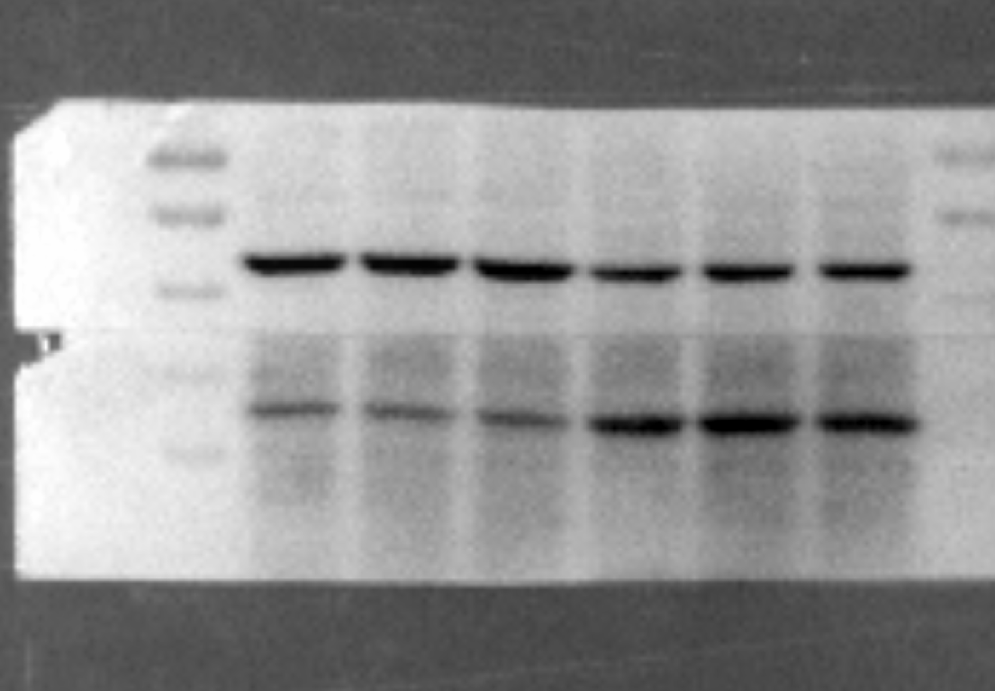
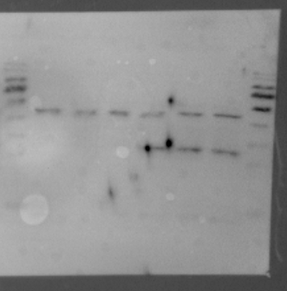
Full unedited blot for Fig.1c
kDa
70
55
Actin(42 kDa)
40
35
OX40L (30 kDa)
25
Full unedited blot for Fig.1d
kDa
70
55
Actin(42 kDa)
40
35
25
OX40L (30 kDa)

Slide 2
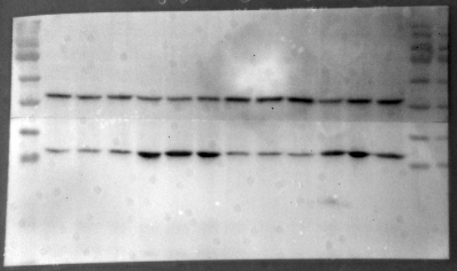
Full unedited blot for Fig.1e
kDa
70
Actin(42 kDa)
55
40
OX40L (30 kDa)
35
25
Full unedited blot for Fig.1f
kDa
70
55
Actin(42 kDa)
40
35
OX40L (30 kDa)
25

Slide 3
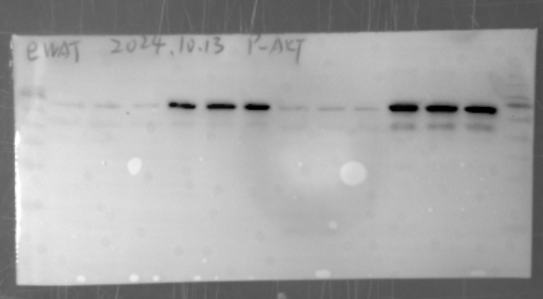
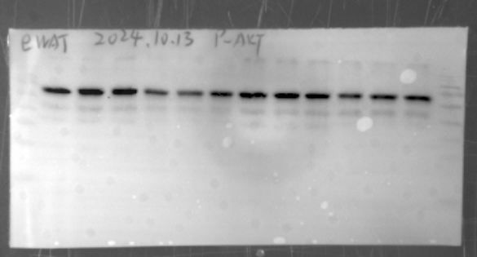
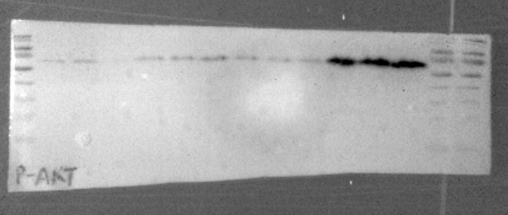
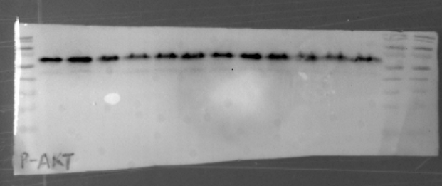
Full unedited blot for Fig.3i
kDa
70
55
pAKT (60 kDa)
40
35
25
kDa
70
AKT (60 kDa)
55
40
35
25
Full unedited blot for Fig.3j
kDa
70
pAKT (60 kDa)
55
40
35
25
kDa
70
AKT (60 kDa)
55
40
35
25

Slide 4
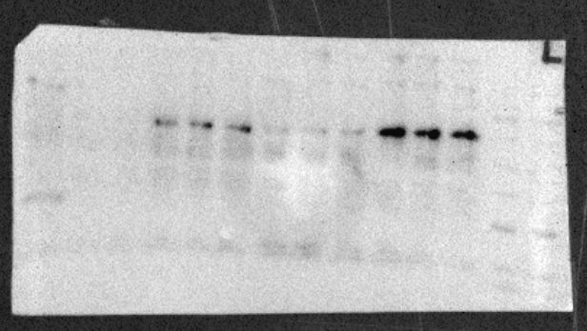
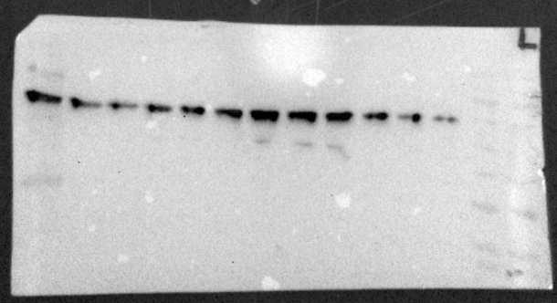
Full unedited blot for Fig.3k
kDa
70
pAKT (60 kDa)
55
40
35
25
kDa
70
AKT (60 kDa)
55
40
35
25

Slide 5
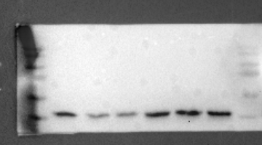
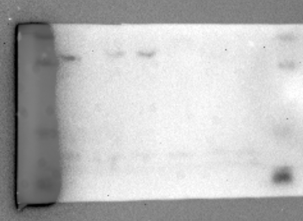
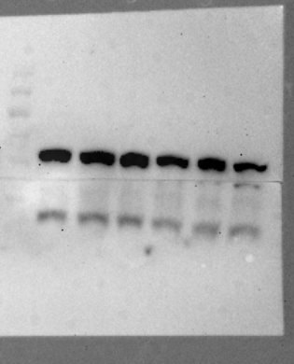
Full unedited blot for Supplementary Fig. 5c adipocyte
kDa
70
55
Actin(42 kDa)
40
35
OX40L (30 kDa)
25
Full unedited blot for Supplementary Fig. 5c SVF
kDa
70
55
40
Actin(42 kDa)
35
25
OX40L (30 kDa)

