Slide 1
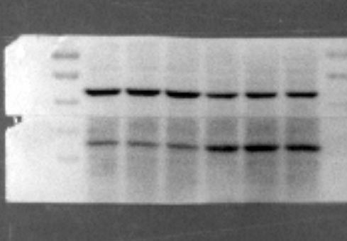
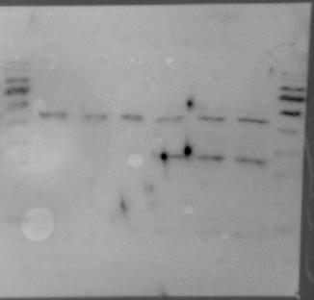
Full unedited blot for Fig.1c
kDa
70
55
Actin(42 kDa)
40
35
OX40L (30 kDa)
25
Full unedited blot for Fig.1d
kDa
70
55
Actin(42 kDa)
40
35
25
OX40L (30 kDa)

Slide 2
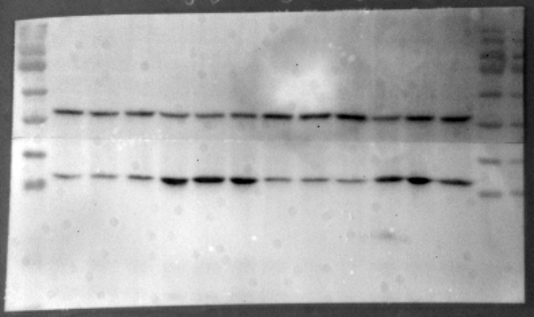
Full unedited blot for Fig.1e
kDa
70
Actin(42 kDa)
55
40
OX40L (30 kDa)
35
25
Full unedited blot for Fig.1f
kDa
70
55
Actin(42 kDa)
40
35
OX40L (30 kDa)
25

Slide 3
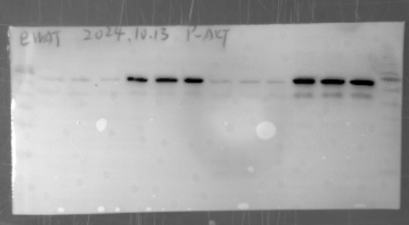
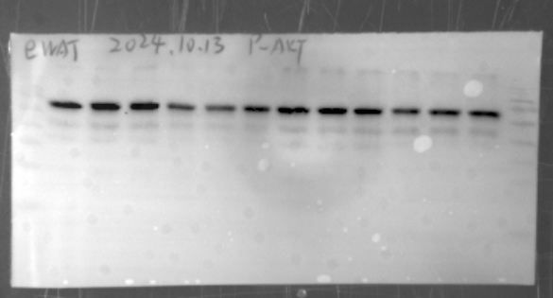
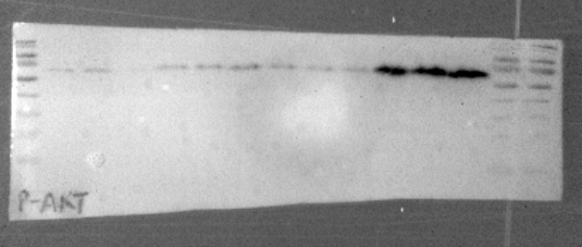
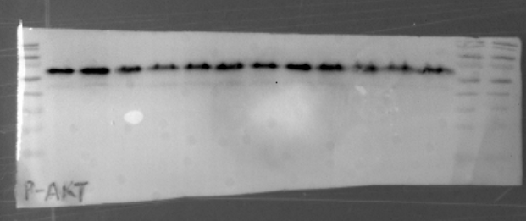
Full unedited blot for Fig.3i
kDa
70
55
pAKT (60 kDa)
40
35
25
kDa
70
AKT (60 kDa)
55
40
35
25
Full unedited blot for Fig.3j
kDa
70
pAKT (60 kDa)
55
40
35
25
kDa
70
AKT (60 kDa)
55
40
35
25

Slide 4
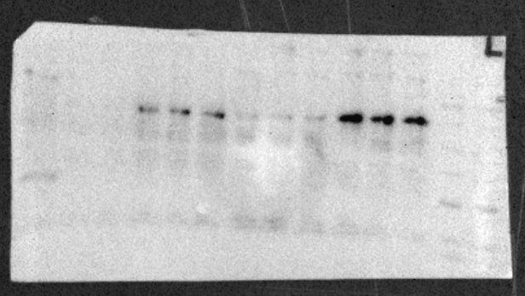
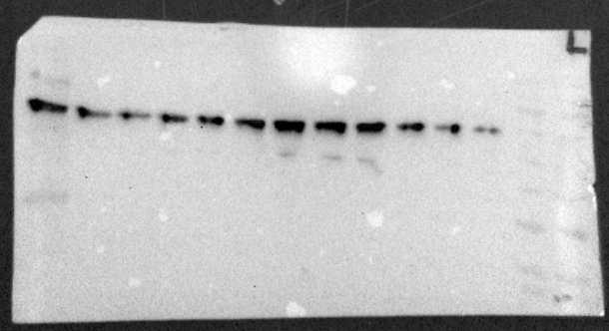
Full unedited blot for Fig.3k
kDa
70
pAKT (60 kDa)
55
40
35
25
kDa
70
AKT (60 kDa)
55
40
35
25

Slide 5
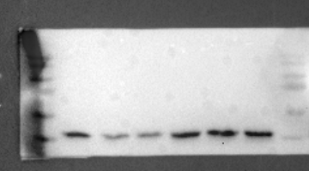
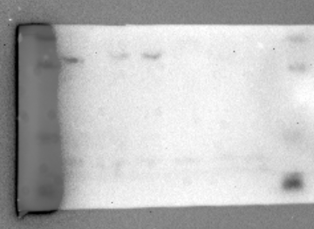
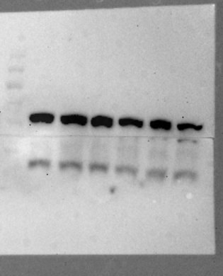
Full unedited blot for Supplementary Fig. 5c adipocyte
kDa
70
55
Actin(42 kDa)
40
35
OX40L (30 kDa)
25
Full unedited blot for Supplementary Fig. 5c SVF
kDa
70
55
40
Actin(42 kDa)
35
25
OX40L (30 kDa)

Slide 6
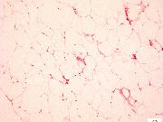
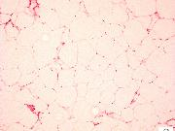
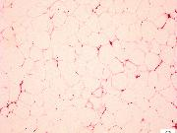
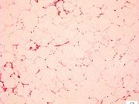
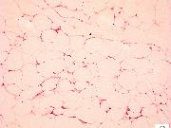
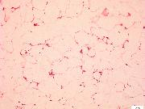
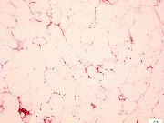
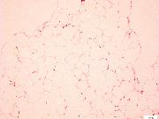
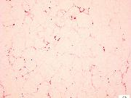
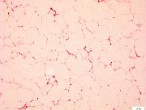
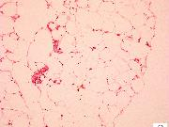
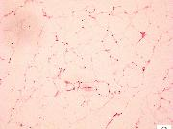
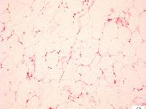
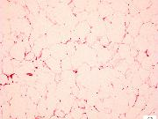
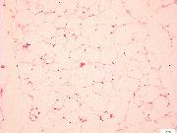
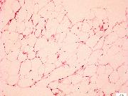
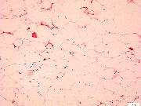
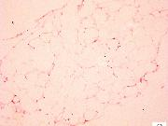
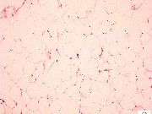
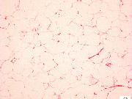
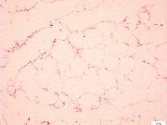
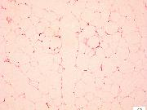
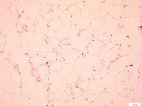
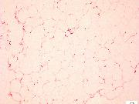
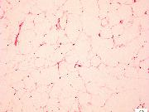
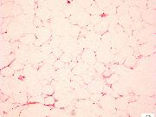
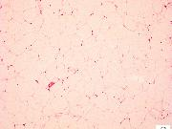
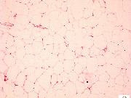
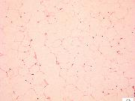
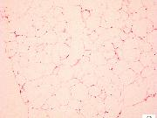
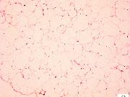
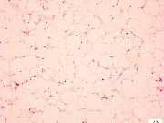
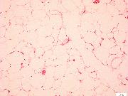
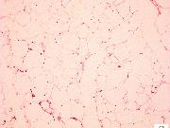
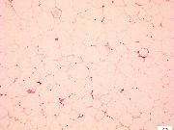
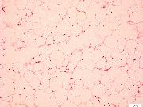
Fig.2g
WT1
WT2
WT3
WT4
WT5
WT6
OX40-KO1
OX40-KO2
OX40-KO3
OX40-KO4
OX40-KO5
OX40-KO6

Slide 7
Fig.4j
AWT1
AWT2
AWT3
AWT4
AWT5
AWT6
AKO1
AKO2
AKO3
AKO4
AKO5
AKO6

Slide 8
Supplementary Fig.2b
ND
HFD
ob/ob
Supplementary Fig.2c
Hochest
OX40L
Bodipy
Merge
ND
HFD
ob/ob

Slide 9
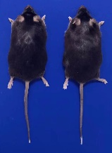
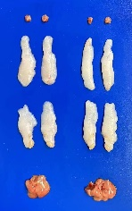




Fig.3b
Fig.3c
AWT
AKO
BAT
AWT
AKO
iWAT
eWAT
Liver
Supplementary Fig. 4d
Supplementary Fig. 4e
MWT
MKO
BAT
MWT
MKO
iWAT
eWAT
Liver
Supplementary Fig. 7a
IgG2b
α-OX40L
BAT
IgG2b
α-OX40L
iWAT
eWAT
Liver

