Slide 1
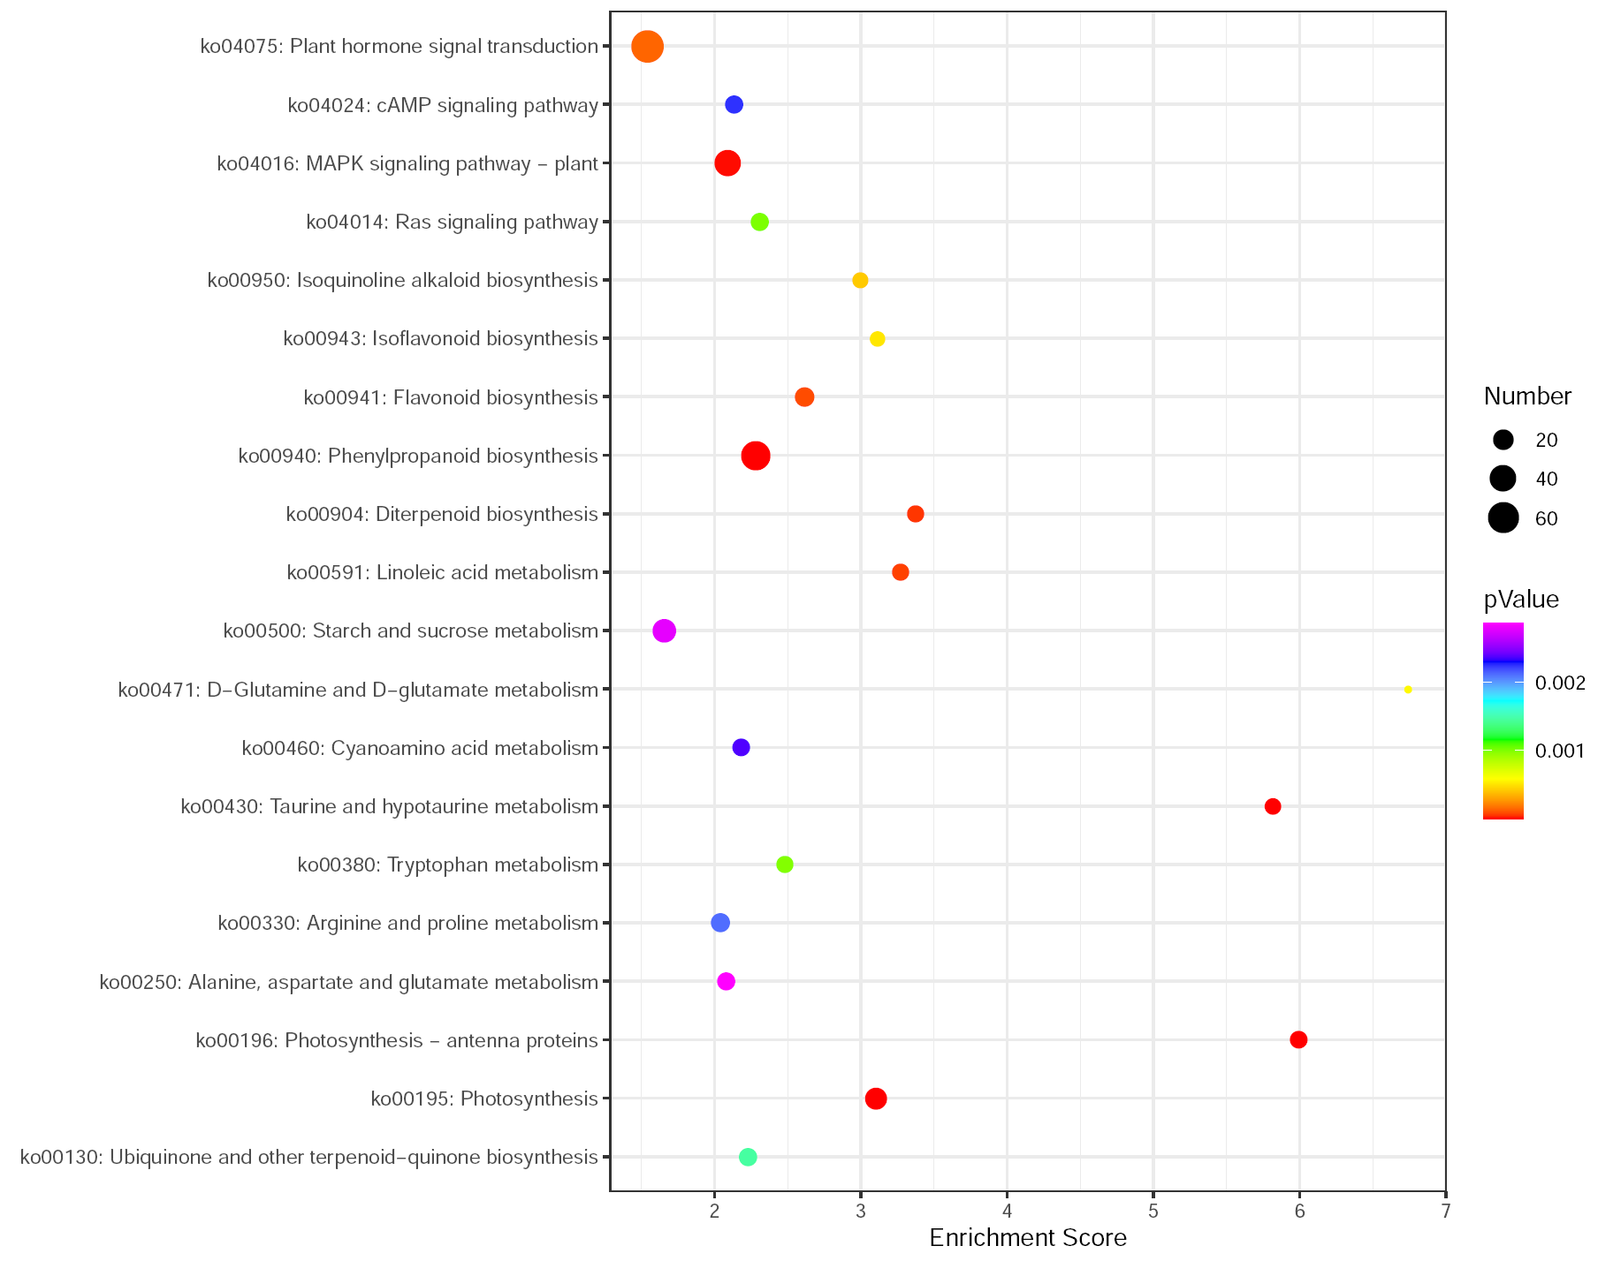
Fig. S4 KEGG analyses of the genes associated with the overlapping metabolites with significantly up-regulated but simultaneously down-regulated profiles (bottom) , respectively. . Only KEGG enrichment top20 were showed.

