Slide 1
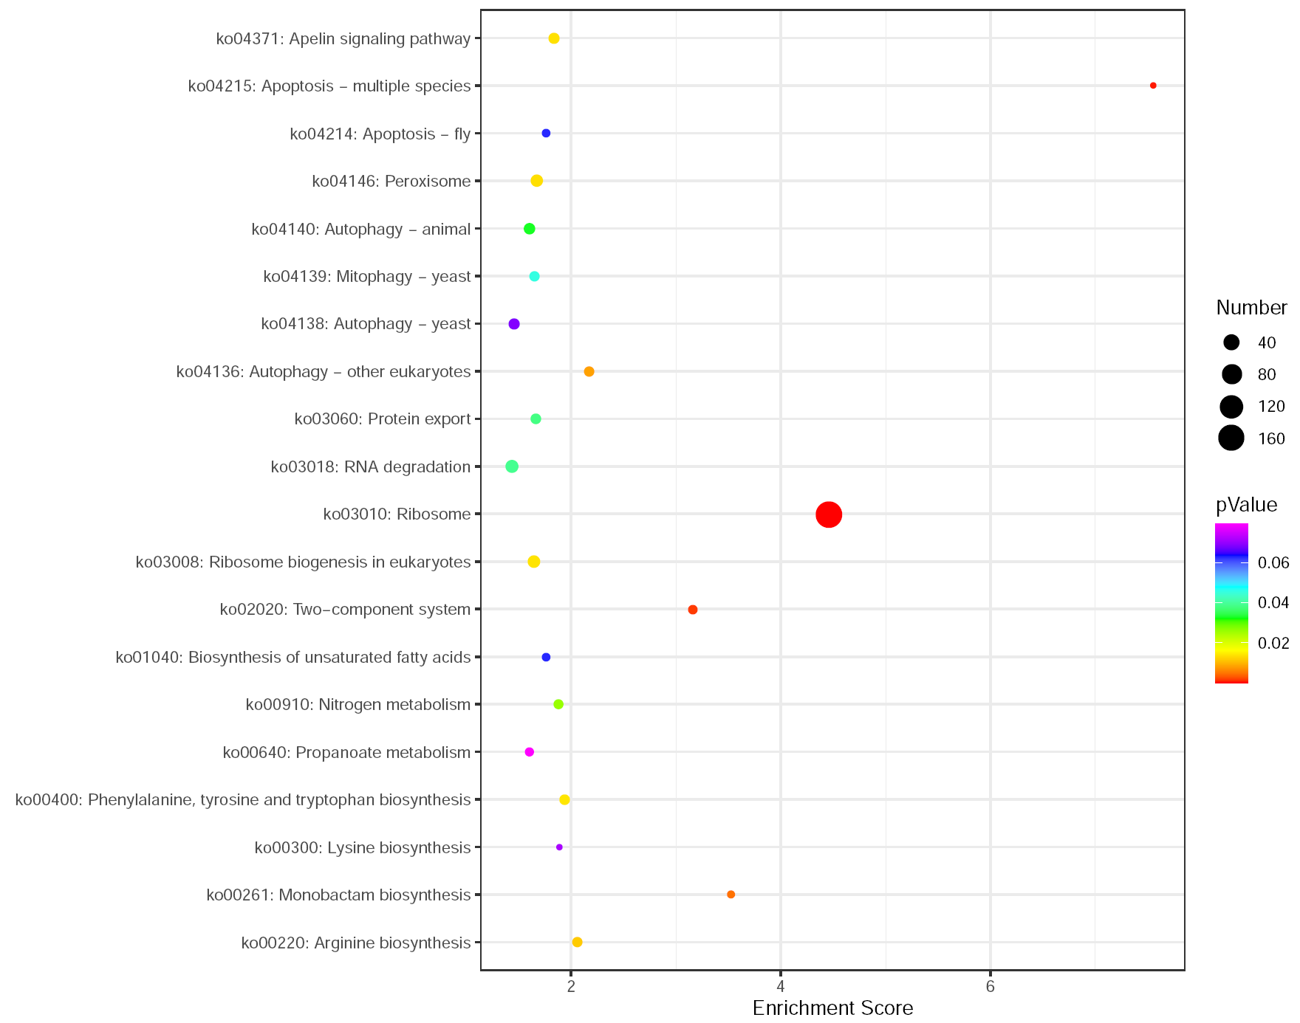
Fig. S3 KEGG analyses of the genes associated with the resistant soybean PI437654 –specific significantly up-regulated metabolites. Only KEGG enrichment top20 were showed.

