Slide 1
Supporting Figures

Slide 2
WM82 (_SCN vs _0)
HF47 (_SCN vs _0)
PI437654 (_SCN vs _0)
ZH13 (_SCN vs _0)
Fig. S1 Venn diagrams showing commonality uniqueness of the differential metabolites between resistant soybean and susceptible soybeans

Slide 3
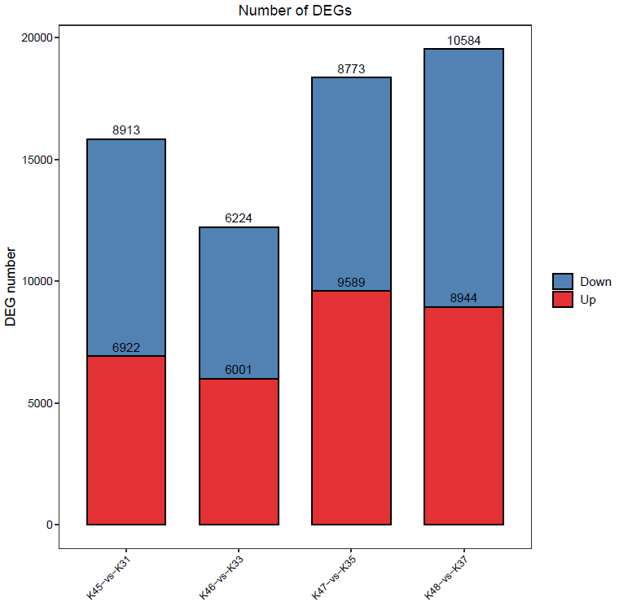
Fig S2 Transcription profiles of the number of differentially expressed genes (DEGs) among the resistant soybean PI437654 (K45_SCN and K31_0 ), and three susceptible soybean WM82 (K46_SCN and K33_0 ), ZH13 (K47_SCN and K35_0 ), and HF47 (K48_SCN and K37_0 ), respectively. Red represents the up-regulated DEGs, while blue represents the down-regulated DEGs.

Slide 4
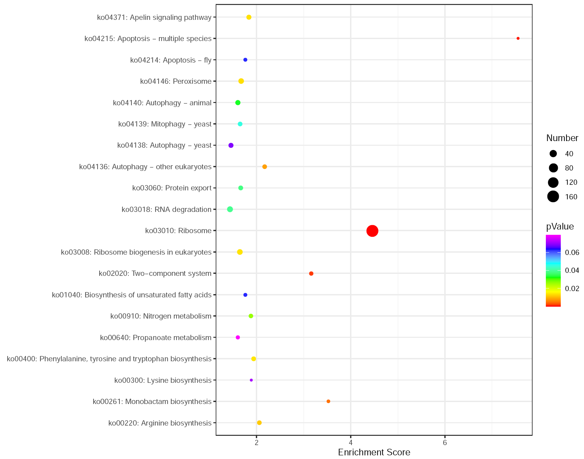
Fig. S3 KEGG analyses of the genes associated with the resistant soybean PI437654 –specific significantly up-regulated metabolites. Only KEGG enrichment top20 were showed.

Slide 5
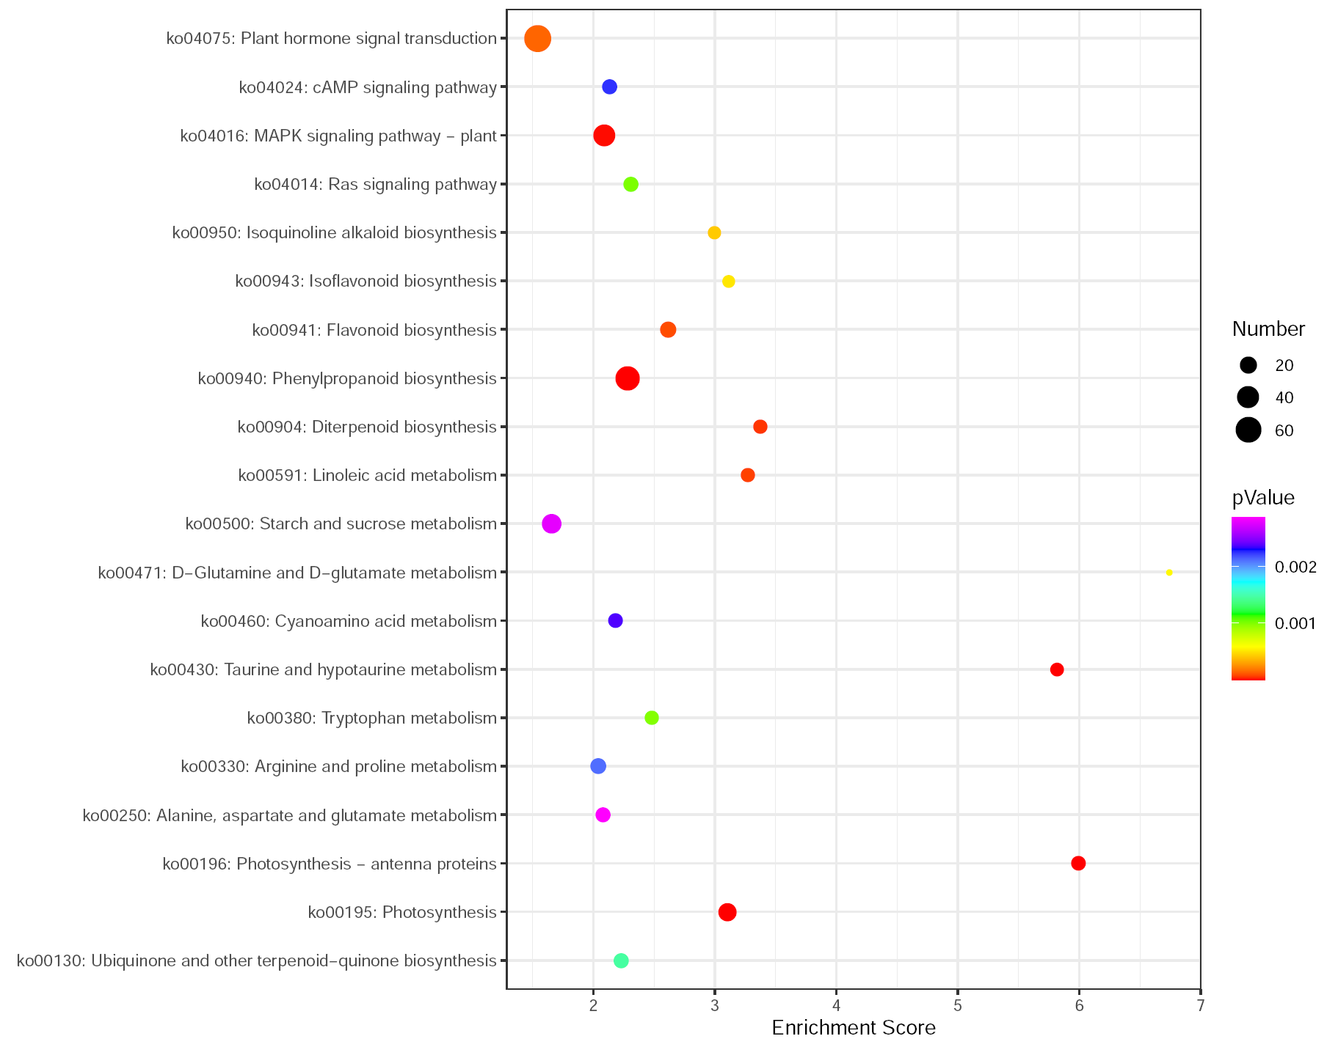
Fig. S4 KEGG analyses of the genes associated with the overlapping metabolites with significantly up-regulated but simultaneously down-regulated profiles (bottom) , respectively. . Only KEGG enrichment top20 were showed.

