Slide 1
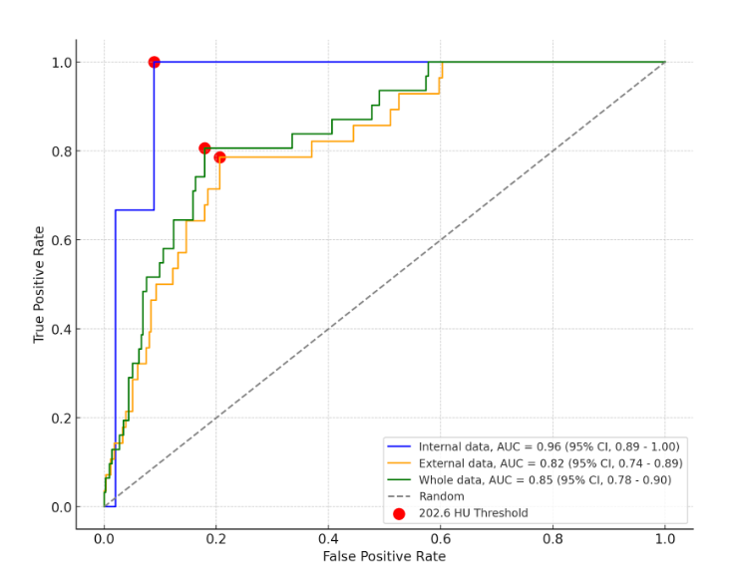

"Advancing Osteoporosis Opportunistic Screening: Multicenter Validation of a Deep Learning Algorithm Using Abdominal CT Scans"
Multicenter validation of a deep learning algorithm for osteoporosis screening on abdominal CTs.
The AUCs for distinguishing between normal bone mineral density and osteoporosis are presented on the image.
Notes:
Figure 1

