Slide 1
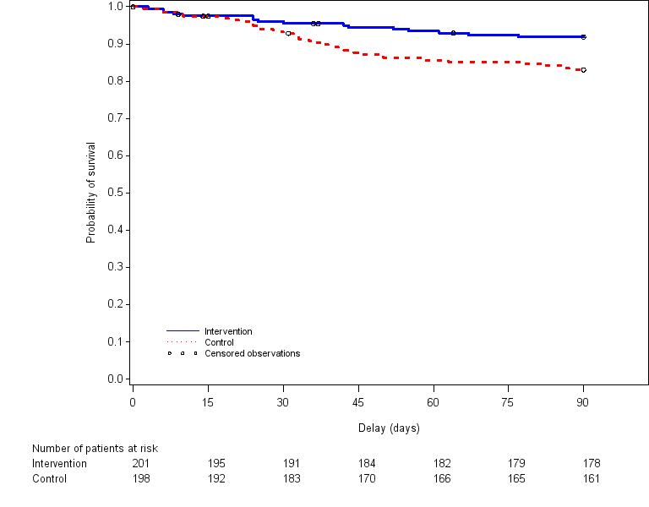
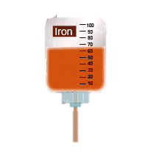

Interest of treating iron deficiency, diagnosed according to hepcidin quantification, on outcomes after a prolonged ICU stay compared to standard care: a multicenter, randomized, single-blinded trial.
405 Adult anemic critically ill patients
ICU Stay ≥5 days
About to be discharge
Anemia
Background
Iron Deficiency (ID) is probably frequent, but difficult to diagnosed in ICU patients
ID is associated with fatigue, muscular weakness and poorer outcome
Hepcidin is a new marker of ID
Survival at D90 according to study group
Randomization
Hypothesis
using hepcidin quantification to identify and treat ID in anemic patients about to be discharged after a prolonged ICU stay, will reduce the length of their post-ICU hospital stay as compared to standard of care.
202
Control
203
Intervention
Primary endpoint = post-ICU LOS: ns
33(13;90) vs 33(11;90) days for intervention and control,
median difference -1(-3;1) days, p=0.78
Log-rank p value= 0.009
Secondary outcome: D90 mortality
16(8%) vs 33(16·6%) deaths for intervention and control
absolute risk difference -8.7 (-15.1 to -2.3)%, p=0.008
CONTROL : standard care
NTERVENTION: Treatment of ID diagnosed according to Hepcicin quantification:
-HEPC < 20 µg/L: true ID
- 20≤ HEPC ≤41: Functional ID
1g Ferric
Carboxymaltose
Conclusions
Treatment of ID diagnosed according to hepcidin levels did not reduce the post-ICU LOS, but may reduce the long-term mortality in critically ill patients about to be discharged after a prolonged stay.
Trial Registration: www.clinicaltrial.gov NCT02276690 (October 28, 2014)
+
Epoietin 𝛼
40.000 UI

