Slide 1
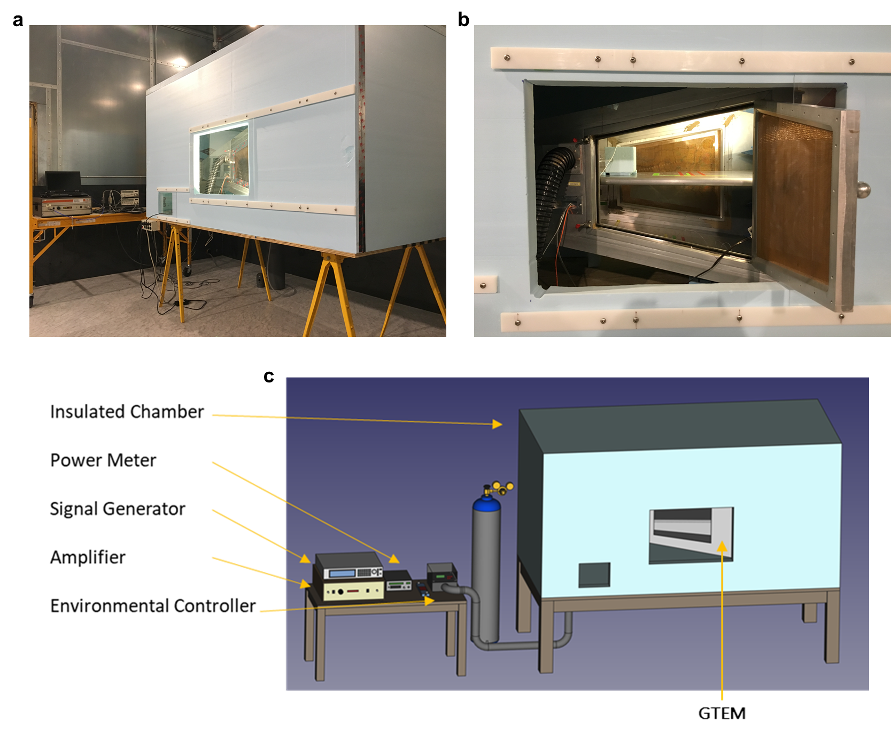
Supplementary Figure 1
GTEM enclosed RF-EMF exposure system. (a) The system consisted of a GTEM enclosed in an insulated, Styrofoam™ chamber. (b) The GTEM was retrofitted with an environmental controller that maintained the inner GTEM chamber at biological conditions (37 ºC, 5% CO₂, 95% RH). (c) Schematic of exposure setup: GTEM is enclosed in an insulation chamber and connected to a digital RF signal generator.

Slide 2
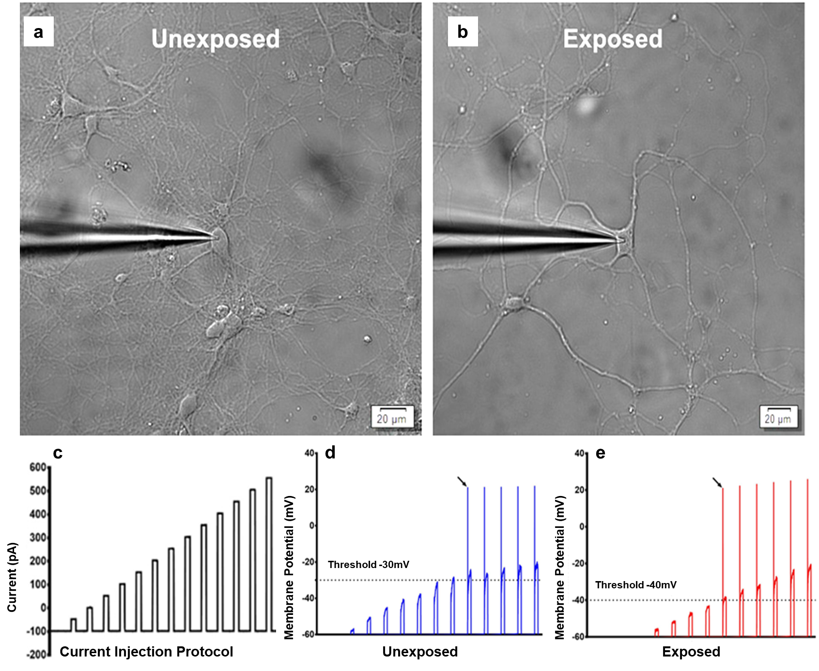
Supplementary Figure 2
Patch-clamp electrophysiology of PHNs. Representative images of patched PHNs are shown in unexposed (a) and RF-EMF exposed (b). (c) Current injection protocol used for PHNs. Examples of current-clamp recordings are shown in unexposed (d) and exposed (e). Note that smaller current injection required to elicit AP in RF-EMF exposed neuron.

Slide 3
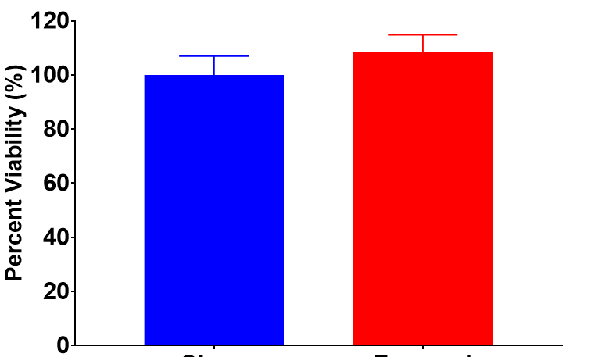
Supplementary Figure 3
Unexposed
Exposed
Cell viability profiles from unexposed and RF-EMFs exposed PHNs. Percent cell viability assessed at 24 hours following mock (unexposed) or RF-EMFs exposure. RF-EMFs was compared to unexposed that was set at 100%. Data are expressed as percent of the mean value ± SD, n=7.

