Slide 1
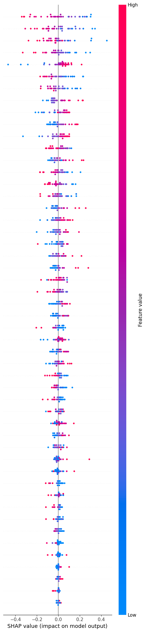
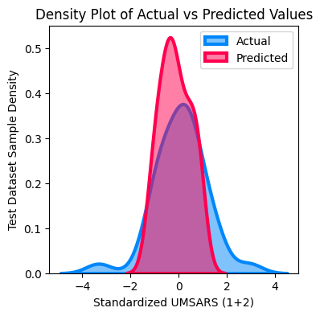
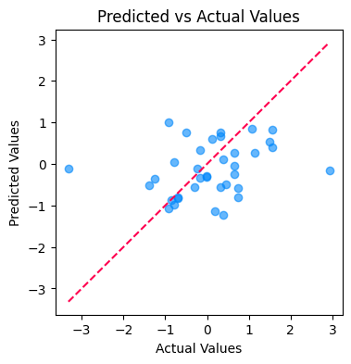
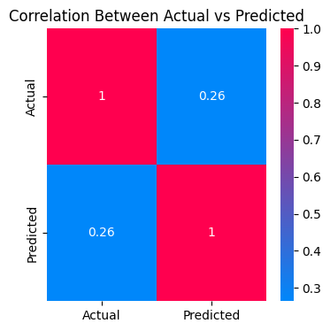
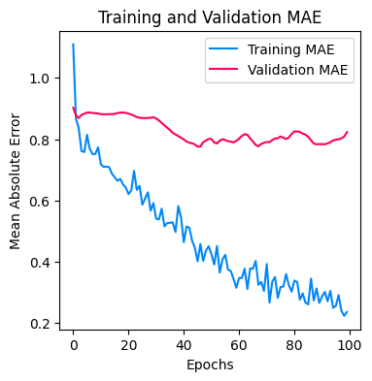
a)
b)
c)
1V
Sample Entropy
Approximate Entropy
Centroid (ms)
Corrected CE
Corrected CE (CCE)
α2 DFA
Mean RR (ms)
H DFA
2V%
Lempel Ziv Comlexity (LZC)
Shanon Entropy (SE)
Y (beats)
d)
MP
H Higuchi
N (ms)
Triangular Index
ρ
MP%
2V
M (ms)
TINN (ms)
1V%
α1 DFA
Ms/mmHg
SD1/SD2
e)
pLF1 (ms)
Conditional Entropy (CE)
2UV%
Normalized CCE (NCCE)
2UV
SDNN (ms)
Ptot (ms)
OV%
OV
LF/HF
LF/HF
X (ms)
SD1 (ms)
IMAI2
pHF1 (ms)
f)
Hurts
rMSSD (ms)
pLF2 (ms)
H Katz
pNN50 (%)
LF (ms)
pHF2 (ms)
IMAI1
HF (ms)
VLF (ms)

Slide 2
Supplementary Figure 5 – Neural network model for predicting standardized UMSARS 1 and 2 scores. A feed-forward neural network was developed to model complex relationships between HRV features and UMSARS scores. The architecture (a) includes an input layer, three hidden layers, and an output layer. Hyperparameters were tuned using grid search and trial-and-error. The model was optimized using the Adam optimizer with Mean Absolute Error (MAE) as the loss function. Dropout (rate = 0.2) was applied to reduce overfitting, and early stopping was used to prevent unnecessary training beyond the point of validation improvement. The final model parameters were the following. Number of hidden layers: 3, Units in input layer: 128, Optimizer: Adam, Best validation MAE: 0.8825 (b) The SHapley Additive exPlanations (SHAP) summary plot ranks the 50 HRV features by their importance in predicting UMSARS. Each point shows a feature’s contribution to an individual prediction in the test set (n = 36). SHAP values indicate direction and magnitude of influence: features like “1V,” “sample entropy,” and “approximate entropy” are associated with lower UMSARS predictions, while features like “Lempel-Ziv Complexity” and “H DFA” are linked to higher predicted scores. (c) Kernel density plots compare distributions of actual (blue) and predicted (pink) UMSARS scores. Close alignment between the two curves reflects strong model performance and accurate score estimation. (d) The scatter plot compares actual vs. predicted UMSARS scores, with a reference line indicating perfect prediction. Points clustering around the line suggest high model accuracy; deviations mark weaker predictions. (e) A correlation heatmap quantifies the relationship between actual and predicted scores. A high correlation coefficient indicates the model’s strong predictive alignment with true outcomes. (f) The training and validation MAE plot over epochs visualizes model convergence. A steady decline in training error alongside stable validation error suggests effective learning and minimal overfitting.

