Slide 1
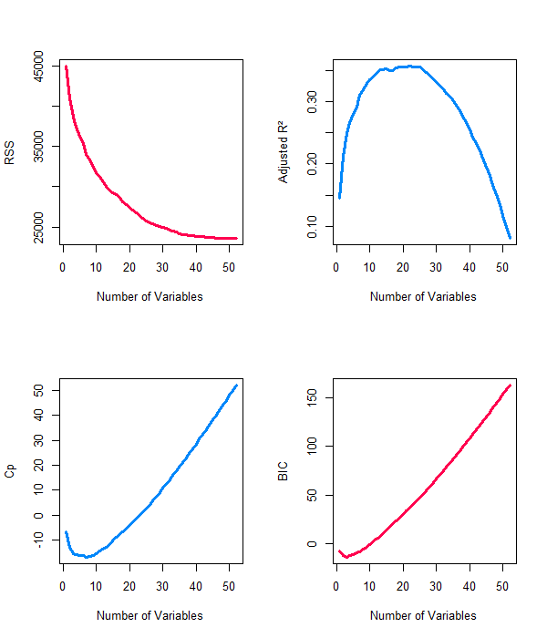
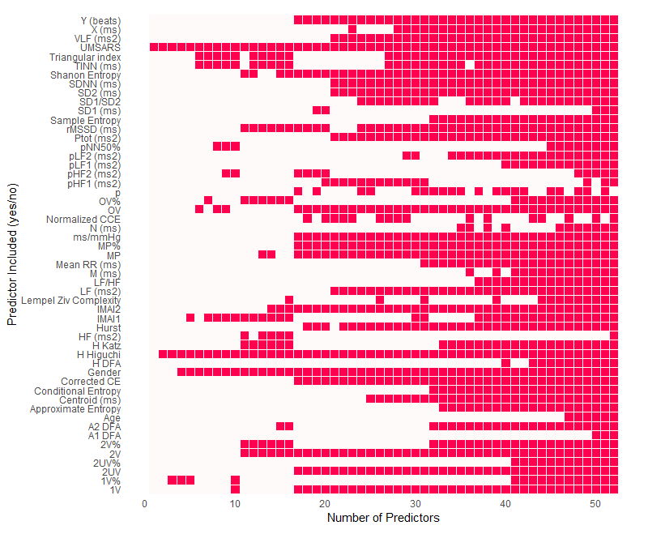
a)
b)
c)
d)

Slide 2
Supplementary Figure 11 – Predictive modeling of time-to-death in MSA patients using UMSARS, HRV features, age, and gender. (a) LASSO regression coefficients reveal a sparse selection of important variables, identifying 1V% and Higuchi as key predictors. LASSO’s regularization drives many coefficients to zero, simplifying interpretation and highlighting variables with the greatest predictive value. (b) In contrast, Ridge regression retains all predictors, shrinking coefficients based on relative contribution. While less interpretable for feature selection, Ridge helps evaluate the overall importance of each variable. (c) Four diagnostic plots assess best subset regression performance across varying model sizes. The adjusted R² plot shows the proportion of variance explained, adjusted for the number of predictors. The highest value identifies the most efficient model. The Mallow’s Cp plot evaluates bias and variance; optimal models have Cp values near the number of predictors (p), while higher Cp suggests overfitting. The Bayesian Information Criterion (BIC) curve assesses model fit vs. complexity. The lowest BIC indicates the best balance between parsimony and performance. The Residual Sum of Squares (RSS) curve shows total prediction error. RSS decreases as variables are added, but diminishing returns are observed as the model becomes more complex. (d) The variable inclusion matrix summarizes which features are selected in best subset models of increasing size. Columns represent model sizes; rows correspond to individual predictors. Filled cells indicate feature inclusion. This matrix enables quick identification of consistently selected predictors across models. Variables like 1V% and Higuchi that appear early and persist across larger models are likely strong predictors. The matrix also highlights potential redundancy or dependencies, as some features emerge only in conjunction with others. Together, these analyses emphasize the value of combining clinical (UMSARS), physiological (HRV), and demographic (age, gender) data for modeling survival in MSA patients.

