Slide 1
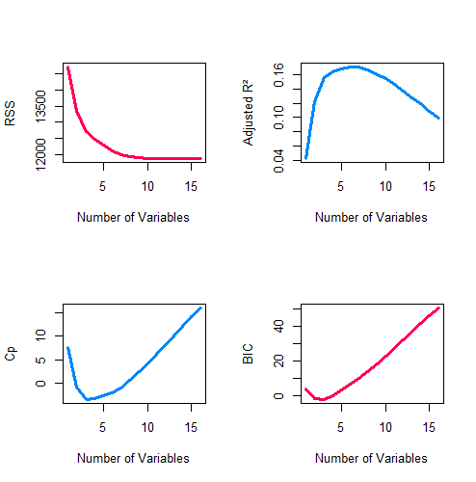
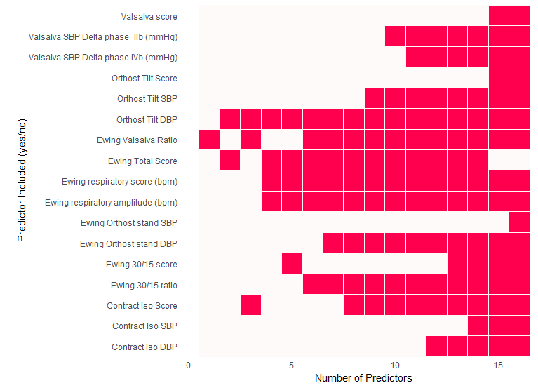
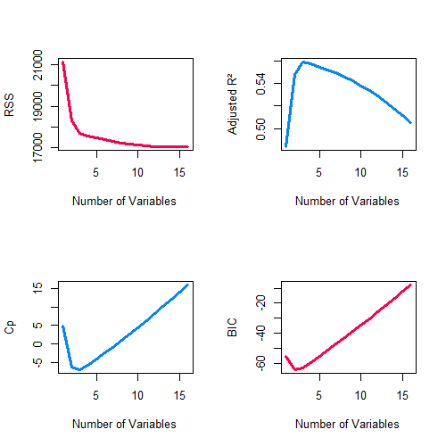
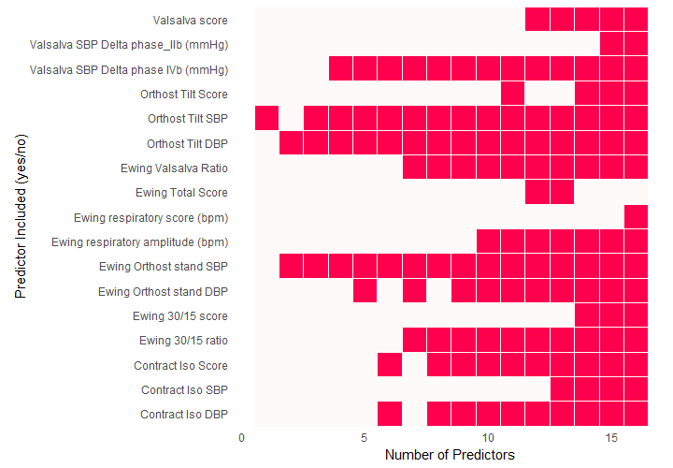
a)
b)
c)
d)
e)
f)
g)
h)

Slide 2
Supplementary Figure 13 – Ewing scores and disease severity in MSA. Predictive modeling of UMSARS (a–d) and supine-to-standing systolic blood pressure delta (Delta SBP; e–h) using Ewing (sub)scores in MSA patients. (a, e) LASSO model coefficients highlight key predictors by shrinking some coefficients to zero, effectively performing variable selection. (b, f) Ridge model coefficients retain all predictors, with magnitudes indicating their relative importance. (c, g) Diagnostic plots evaluating model performance as a function of included variables. Adjusted R² indicates variance explained adjusted for model complexity, with maximum values signaling the best fit without overfitting. Mallow’s Cp assesses bias and variance; values near the number of predictors (p) suggest well-balanced models, whereas higher values indicate overfitting. Bayesian Information Criterion (BIC) identifies the optimal trade-off between goodness-of-fit and parsimony, with minima indicating preferred model size. Residual Sum of Squares (RSS) tracks total residual error, typically decreasing with added variables but showing diminishing returns. (d, h) Best subset variable inclusion matrices illustrate which variables are selected across models of increasing size. Columns correspond to model sizes, rows to variables. Filled cells indicate inclusion, facilitating identification of consistently important predictors. Variables present in smaller models that persist in larger ones likely have strong explanatory power. The matrix also reveals potential redundancy or conditional importance of variables.

