Slide 1
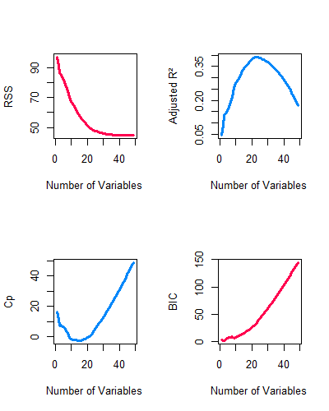
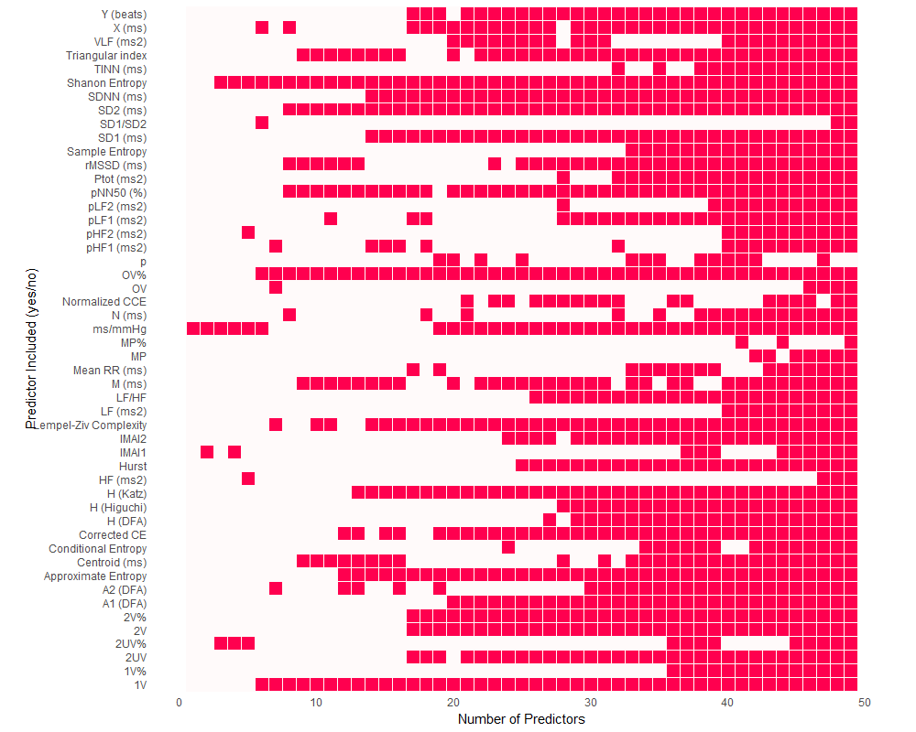
a)
b)
c)
d)

Slide 2
Supplementary Figure 7 – Feature selection results for HRV features in predicting UMSARS 3 supine-to-standing systolic blood pressure change. To identify HRV features predictive of UMSARS 3 (supine-to-standing systolic blood pressure delta), LASSO (L1) and Ridge (L2) regression were used to address multicollinearity and perform regularized feature selection. LASSO (a) shrinks some coefficients to zero, selecting only the most informative predictors. Ridge (b) retains all variables but shrinks their coefficients, distributing influence across features. These techniques reduce overfitting by penalizing large coefficients and encouraging simpler, more generalizable models. Both models were tuned using 10-fold cross-validation, selecting the optimal lambda (penalty parameter) by minimizing mean cross-validated error (MSE). All predictors were standardized prior to training, ensuring comparability across features—essential since regularization depends on coefficient magnitudes. Positive coefficients indicate features associated with an increase in systolic BP change; negative coefficients indicate a decrease. The magnitude of standardized coefficients reflects the strength of association. LASSO results highlight the most relevant variables through non-zero bars, while Ridge shows relative importance through smaller but comprehensive coefficients. Both models assume a linear relationship between predictors and the blood pressure delta, holding other factors constant. (c) Best subset regression diagnostics evaluate models with increasing variable counts. Adjusted R² measures explained variance while penalizing complexity; its peak indicates the most efficient model. Mallow’s Cp assesses bias and variance. Optimal models have Cp ≈ number of predictors; higher values may suggest overfitting. BIC favors models balancing fit and simplicity; lower BIC values are preferred. RSS tracks residual error. While RSS generally declines with added predictors, diminishing returns often emerge beyond a certain point. (d) The variable inclusion matrix visualizes selected features across model sizes. Columns represent model sizes; rows denote individual predictors. Filled cells indicate inclusion. Features consistently selected in smaller and larger models likely offer strong explanatory value. The matrix also reveals redundancy or interactions, where certain features appear only when others are present.

