Slide 1
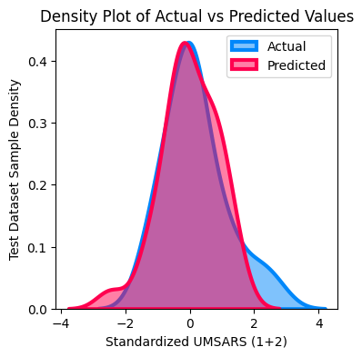
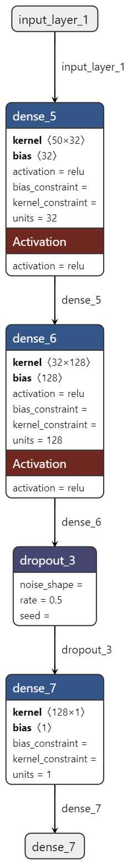
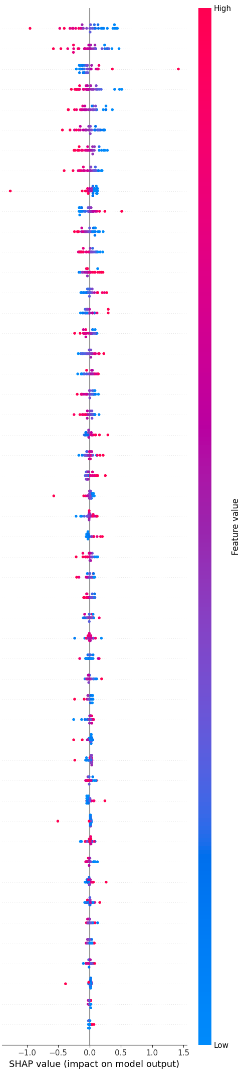
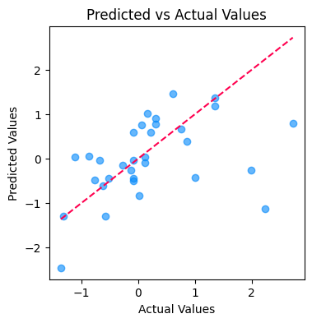
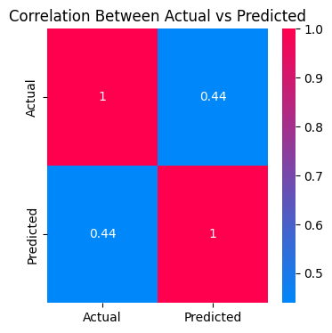
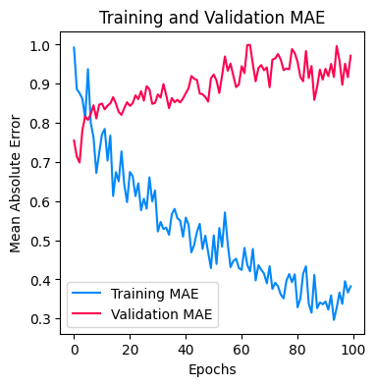
a)
b)
c)
2V%
Hurts
IMAI2
Approximate Entropy
1V
Y (beats)
α1 DFA
Centroid (ms)
pHF1 (ms)
H Katz
d)
2V
Mean RR (ms)
MP
SD1/SD2
Sample Entropy
M (ms)
α2 DFA
MP%
TINN (ms)
OV%
SD2 (ms)
Normalized CCE (NCCE)
N (ms)
e)
H Higuchi
H DFA
IMAI1
SDNN (ms)
X (ms)
1V%
LF/HF
Corrected CE
Ptot (ms)
Shanon Entropy (SE)
pLF1 (ms)
SD1 (ms)
OV
pLF2 (ms)
f)
pHF2 (ms)
Lempel Ziv Comlexity (LZC)
Conditional Entropy (CE)
ms/mmHg
2UV%
ρ
Triangular Index
2UV
HF (ms)
VLF (ms)
pNN50 (%)

Slide 2
Supplementary Figure 8 – Neural network model for predicting supine-to-standing systolic blood pressure delta A feed-forward neural network was developed to predict systolic blood pressure (SBP) change from supine to standing using HRV features. The architecture (a) includes an input layer, one hidden layer, and an output layer, designed to capture nonlinear relationships between input features and the target variable. Hyperparameter tuning involved grid search and trial and error. The model was trained using the RMSprop optimizer with Mean Absolute Error (MAE) as the loss function. Dropout (rate = 0.5) was applied for regularization, and early stopping halted training when validation performance plateaued. Final model parameters were as follows. Hidden layers: 1, Units in input layer: 32, Dropout rate: 0.5, Optimizer: RMSprop, Best validation MAE: 0.685 (b) The SHapley Additive exPlanations (SHAP) summary plot ranks the 50 HRV features by their contribution to the model’s predictions. Each point represents a feature’s impact on an individual prediction (test set n = 32). Positive and negative SHAP values indicate the direction of influence: higher “sample entropy” values increase predicted SBP deltas, while higher “2V %” and “1V” values reduce them. (c) Kernel density plots compare the distribution of actual (light blue) and predicted (light pink) SBP deltas. A strong overlap between the distributions indicates good predictive alignment. (d) The scatter plot shows the relationship between actual and predicted SBP deltas, with a reference line representing perfect prediction. Close clustering around this line reflects strong model performance; outliers highlight areas of weaker prediction. (e) The heatmap displays the correlation between actual and predicted values. A high correlation coefficient indicates that the model reliably captures the underlying trend in the data. (f) The training and validation MAE over epochs track model learning. A steady decline in training MAE and stabilization of validation MAE indicate convergence and effective regularization, with minimal overfitting.

