Slide 1
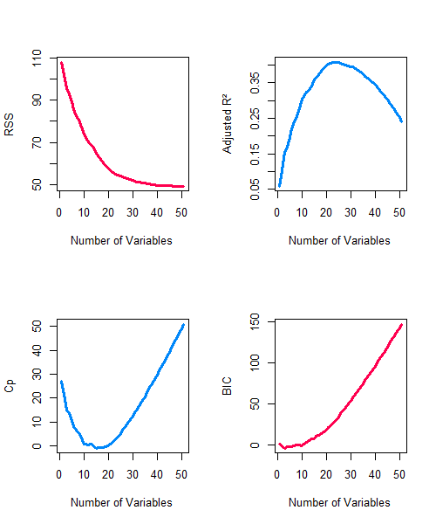
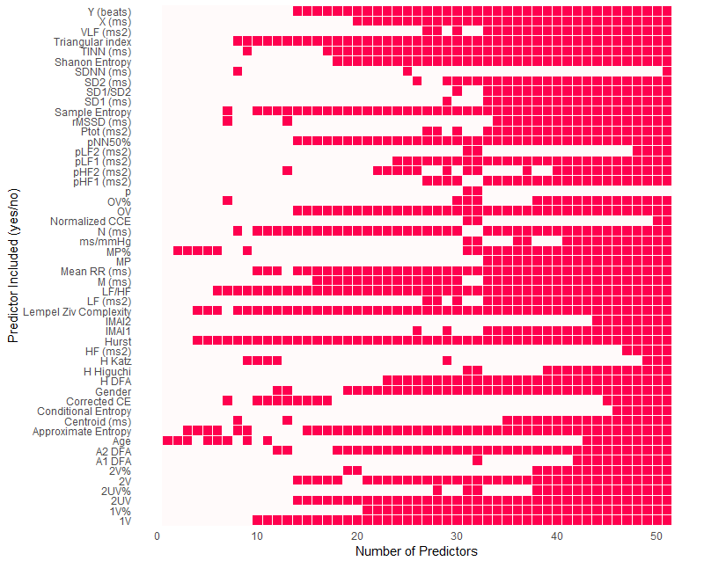
a)
b)
c)
d)

Slide 2
Supplementary Figure 4 – Feature selection results for HRV features + Age + Gender in predicting UMSARS. To identify which HRV features best predict the gold-standard UMSARS (parts 1 + 2), while accounting for age, gender, and extreme multicollinearity, both Ridge (L2) and LASSO (L1) regularized regressions were applied. These models penalize large coefficients to reduce overfitting and enhance interpretability. LASSO (a) performs variable selection by shrinking some coefficients to zero, highlighting the most informative predictors. Ridge (b), in contrast, shrinks all coefficients but retains all variables, distributing influence more broadly. Both models were tuned via 10-fold cross-validation, selecting the optimal penalty parameter (lambda) by minimizing mean cross-validated error (MSE). All predictors were standardized before training, a critical step since regularization penalties depend on coefficient magnitudes. Positive coefficients indicate variables associated with higher UMSARS scores, while negative coefficients indicate an association with lower scores. The coefficient magnitude reflects the strength of association in the context of standardized variables. LASSO plots highlight the selected features; Ridge coefficients, though less sparse, remain informative in terms of relative importance. These models assume a linear relationship between predictors and the UMSARS score, holding other factors constant. (c) Best subset regression diagnostics evaluate model performance across varying numbers of variables. Adjusted R² reflects variance explained while penalizing complexity; its peak marks the most efficient model. Mallow’s Cp assesses bias and variance, with optimal models showing Cp ≈ number of predictors. BIC identifies the best trade-off between fit and simplicity, favoring models with minimized values. RSS tracks residual error, decreasing with more variables but flattening as added predictors contribute less. (d) The variable inclusion matrix shows which variables are selected across models of increasing size. Columns represent model size, rows represent predictors. Filled cells mark inclusion. Variables consistently selected across smaller and larger models are likely strong predictors. Patterns in the matrix may suggest redundancy or interaction among predictors.

