Slide 1
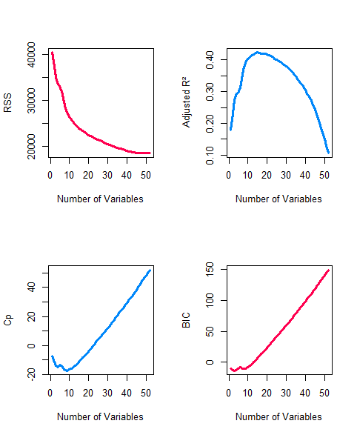
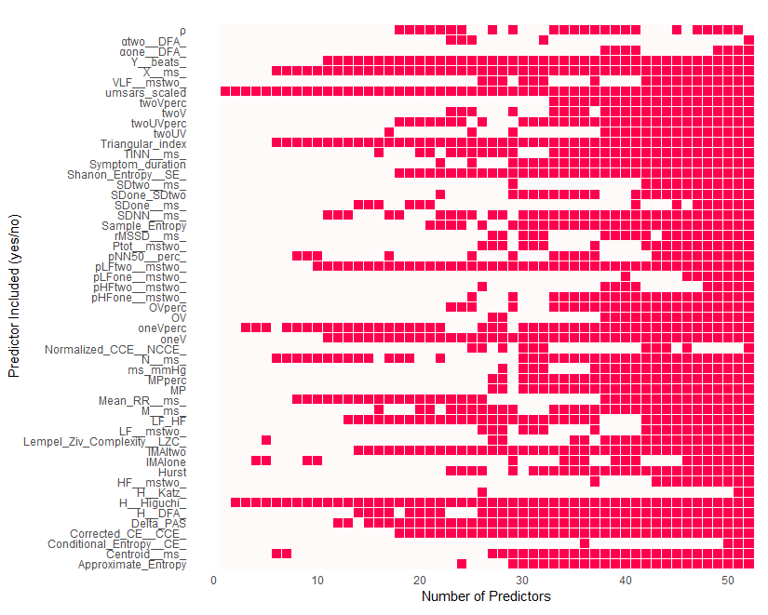
a)
b)
c)
d)

Slide 2
Supplementary Figure 10 – Predictive modeling of time-to-death in MSA patients using UMSARS, HRV features, symptom duration, and maximum SBP delta. (a) Coefficients from the LASSO model show a sparse selection of key predictors. Notably, UMSARS, 1V%, and Higuchi emerged as dominant contributors to time-to-death prediction, with LASSO’s regularization eliminating less informative variables. (b) Ridge regression retains all variables, assigning smaller coefficients based on relative importance. Though less interpretable for selection, Ridge provides a comprehensive view of variable contribution. (c) This panel presents four diagnostic plots to evaluate best subset regression model performance across varying numbers of predictors. The adjusted R² plot shows explained variance, penalizing for model complexity. The peak adjusted R² indicates the most efficient model. The Mallow’s Cp plot assesses model bias and variance. Cp values near the number of predictors (p) suggest an optimal model; higher values indicate potential overfitting. The Bayesian Information Criterion (BIC) curve reflects the trade-off between model fit and simplicity. The model size with the lowest BIC is preferred. The Residual Sum of Squares (RSS) curve captures total residual error. While RSS generally decreases with more variables, diminishing returns are observed as complexity increases. (d) The variable inclusion matrix displays the features selected across models of increasing complexity. Columns represent model sizes, while rows represent individual predictors. Filled cells indicate inclusion. This matrix allows rapid identification of variables consistently chosen across small and large models. Variables like UMSARS and 1V% that appear early and persist across sizes are strong candidates for robust predictors. Additionally, patterns in inclusion may reveal redundancy or dependencies among features, offering insights into multivariate relationships. Together, these modeling approaches highlight the predictive value of integrating clinical (UMSARS, symptom duration), physiological (HRV), and autonomic (SBP delta) measures for survival modeling in MSA.

