Slide 1
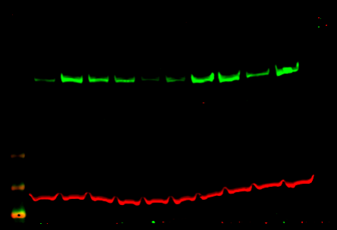
Non-IPF Col 1A1 (rabbit/green) and Tubulin (mouse/Red) (dose response Treprostinil 1nM to 1uM and isoproterenol 1nM to 1uM)
Representative blot 1
TGF-β
- + + + + + + + + +
Col1A1
TGF-β
Control
Tubulin
Control
1 nM 1 µM
Treprostinil
1 nM 1 µM
Isoproterenol

Slide 2
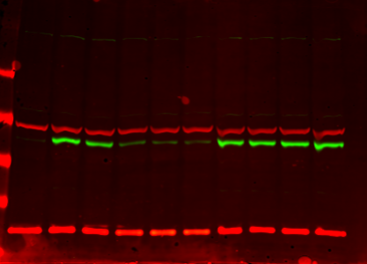
Non-IPF PAI-1 (rabbit/green) and Tubulin (mouse/Red) (dose response Treprostinil 1nM to 1uM and isoproterenol 1nM to 1uM)
Representative blot 1
TGF-β
- + + + + + + + + +
Tubulin
PAI-1
HSP20
Control
1 nM 1 µM
Treprostinil
1 nM 1 µM
Isoproterenol

Slide 3
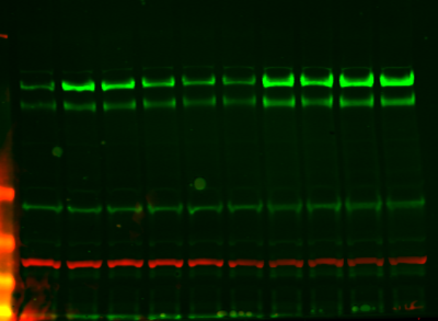
IPF Col 1A1 (rabbit/green) and Tubulin (mouse/Red) (dose response Treprostinil 1nM to 1uM and isoproterenol 1nM to 1uM)
Representative blot 2
TGF-β
- + + + + + + + + +
Col1A1
Tubulin
Control
1 nM 1 µM
Treprostinil
1 nM 1 µM
Isoproterenol

Slide 4
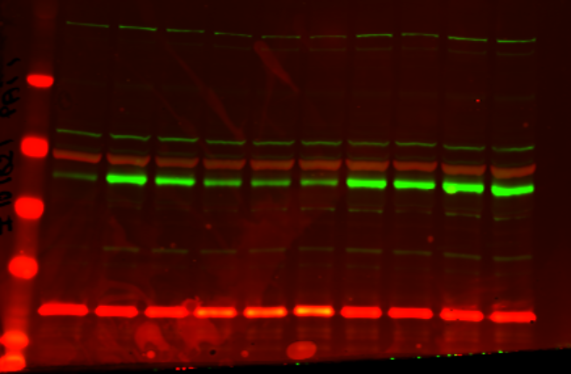
IPF PAI1 (rabbit/green) and Tubulin (mouse/Red) (dose response Treprostinil 1nM to 1uM and isoproterenol 1nM to 1uM)
Representative blot 2
TGF-β
- + + + + + + + + +
Tubulin
PAI-1
HSP20
Control
1 nM 1 µM
Treprostinil
1 nM 1 µM
Isoproterenol

Slide 5
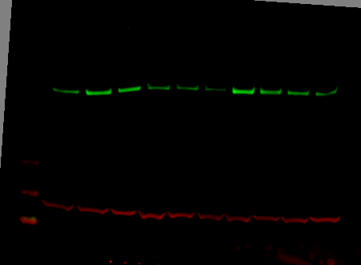
Non IPF Col 1A1 (rabbit/green) and Tubulin (mouse/Red) (dose response Treprostinil 1nM to 1uM and isoproterenol 1nM to 1uM)
Representative blot 3
TGF-β
- + + + + + + + + +
Col1A1
Tubulin
Control
1 nM 1 µM
Treprostinil
1 nM 1 µM
Isoproterenol

Slide 6
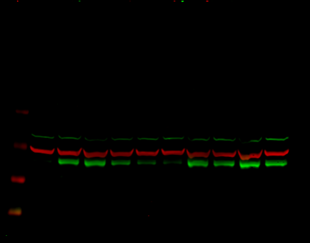
Non-IPF PAI1 (rabbit/green) and Tubulin (mouse/Red) (dose response Treprostinil 1nM to 1uM and isoproterenol 1nM to 1uM)
Representative blot 3
TGF-β
- + + + + + + + + +
Tubulin
PAI-1
Control
1 nM 1 µM
Treprostinil
1 nM 1 µM
Isoproterenol

Slide 7
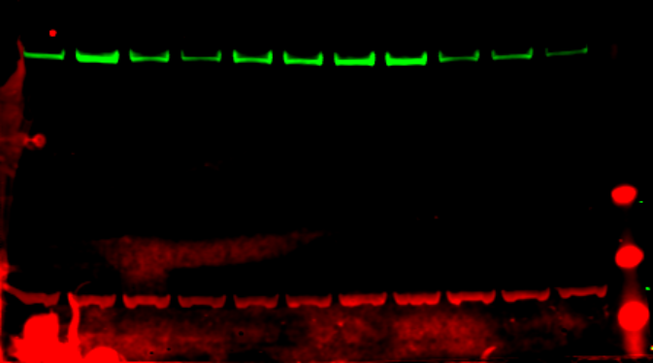
Non-IPF Col1A1 (rabbit/green) and Tubulin (mouse/Red) (Treprostinil 10nM and dose response PGE2 10uM to 1nM)
Representative Blot 4
TGF-β
- + + + + + + + + + +
Col1A1
Tubulin
Control
Tre 10nM
10 μM 1 nM
PGE2
100 nM 1 nM
EP4 antagonist + Treprostinil 10nM

Slide 8
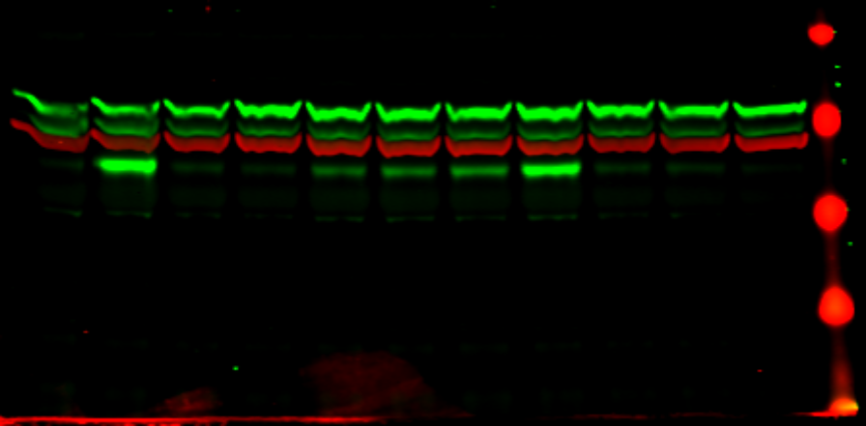
Non-IPF PAI1 (rabbit/green) and Tubulin (mouse/Red) (Treprostinil 10nM and dose response PGE2 10uM to 1nM)
Representative blot 4
TGF-β
- + + + + + + + + + +
Tubulin
PAI-1
Control
Tre 10nM
10 μM 1 nM
PGE2
100 nM 1 nM
EP4 antagonist + Treprostinil 10nM

Slide 9
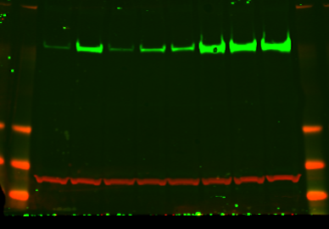
Non-IPF Col 1A1 (rabbit/green) and Tubulin (mouse/Red) (NT siRNA, Gαs siRNA)
Representative blot 5
TGF-β
- + + + - + + +
Col1A1
Tubulin
Control
Tre 10nM
Control
Tre 10nM
PGE2 10nM
PGE2 10nM
NT SiRNA
Gαs SiRNA

Slide 10
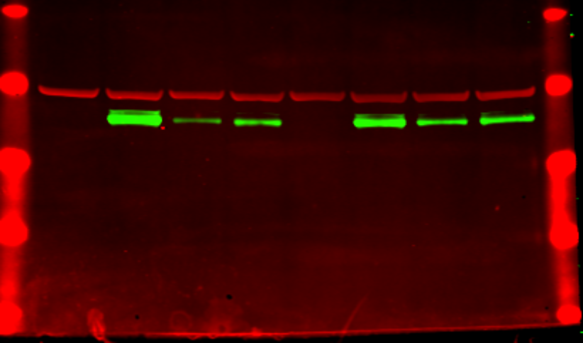
Non-IPF PAI-1 (rabbit/green) and Tubulin (mouse/Red) (NT siRNA, Gαs siRNA)
Representative blot 5
TGF-β
- + + + - + + +
Tubulin
PAI1
Tre 10nM
Control
Tre 10nM
Control
PGE2 10nM
PGE2 10nM
NT SiRNA
Gαs SiRNA

Slide 11
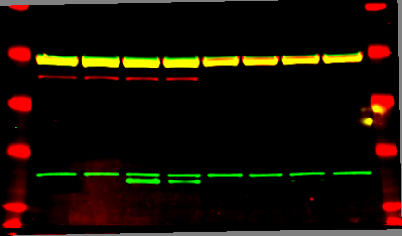
Non-IPF pHSP20(rabbit/green) and Tubulin and Gαs (mouse/Red) (NT siRNA, Gαs siRNA)
Representative blot 5
TGF-β
- + + + - + + +
Tubulin
Gαs
pHSP20
Control
Tre 10nM
Control
Tre 10nM
PGE2 10nM
PGE2 10nM
NT SiRNA
Gαs SiRNA

Slide 12
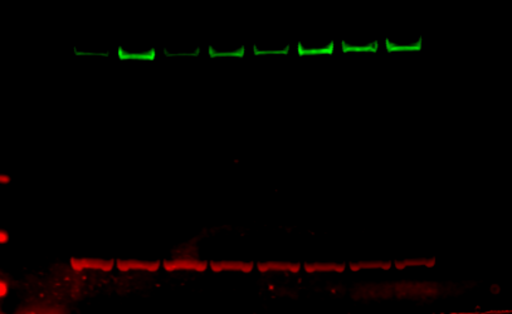
Non-IPF Col1A1 (rabbit/green) and Tubulin (mouse/Red) (with and without IPR blocker)
Representative blot 6
TGF-β
- + + + - + + +
Col 1A1
Tubulin
Control
Tre 10nM
Control
Tre 10nM
PGE2 10nM
PGE2 10nM
IPR blocker

Slide 13
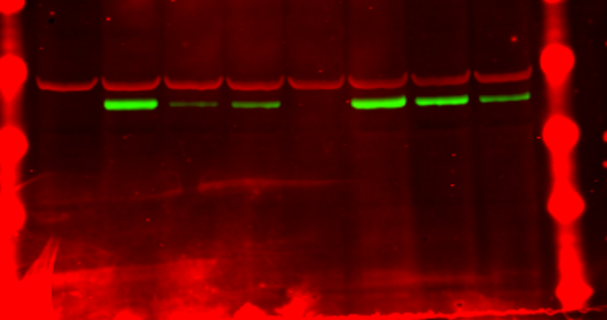
Non-IPF PAI1 (rabbit/green) and Tubulin (mouse/Red) (with and without IPR blocker)
Representative blot 6
TGF-β
- + + + - + + +
Tubulin
PAI1
Control
Tre 10nM
Control
Tre 10nM
PGE2 10nM
PGE2 10nM
IPR blocker

Slide 14
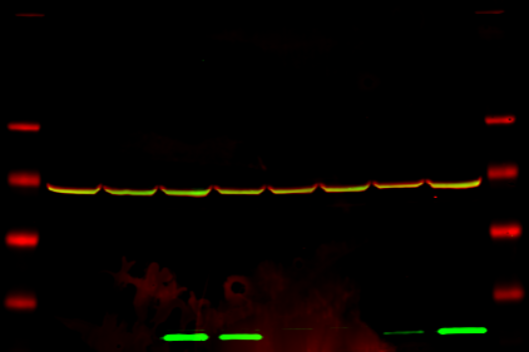
Non-IPF pHSP20 (rabbit/green) and Tubulin (mouse/Red) (with and without IPR blocker)
Representative blot 6
TGF-β
- + + + - + + +
Tubulin
pHSP20
Control
Tre 10nM
Control
Tre 10nM
PGE2 10nM
PGE2 10nM
IPR blocker

Slide 15
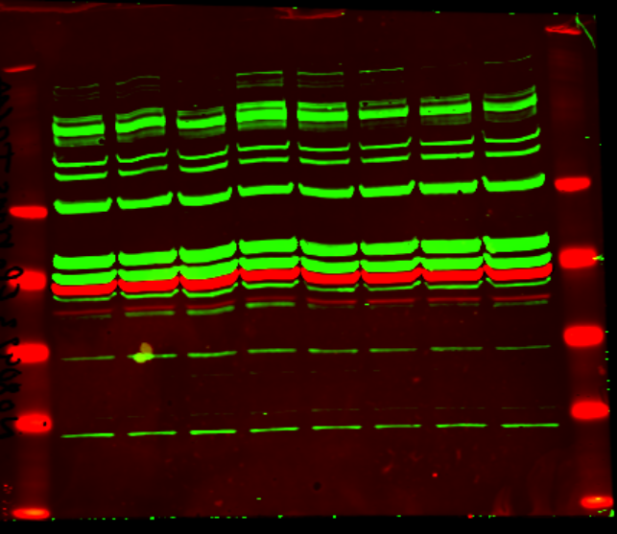
Non-IPF EP2(rabbit/green) and Tubulin (mouse/Red) (NT siRNA, EP2 siRNA)
Representative blot 6
TGF-β
- + + + - + + +
EP2
Control
Tre 10nM
Control
Tre 10nM
PGE2 10nM
PGE2 10nM
NT siRNA
EP2 siRNA

Slide 16
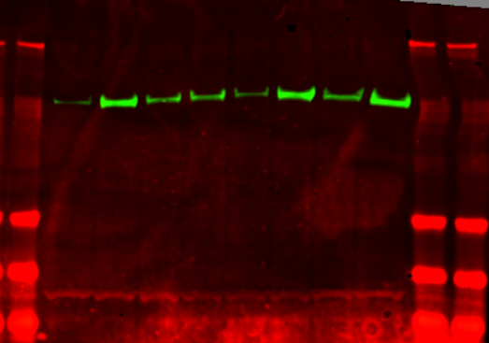
Non-IPF Col 1A1(rabbit/green) and Tubulin (mouse/Red) (NT siRNA, EP2 siRNA)
Representative blot 6
TGF-β
- + + + - + + +
Col1A1
Tubulin
Control
Tre 10nM
Control
Tre 10nM
PGE2 10nM
PGE2 10nM
NT siRNA
EP2 siRNA

Slide 17
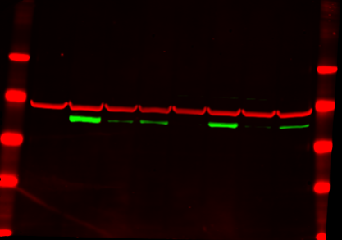
Non-IPF PAI-1(rabbit/green) and Tubulin (mouse/Red) (NT siRNA, EP2 siRNA)
Representative blot 6
TGF-β
- + + + - + + +
Tubulin
PAI1
Control
Tre 10nM
Control
Tre 10nM
PGE2 10nM
PGE2 10nM
NT siRNA
EP2 siRNA

Slide 18
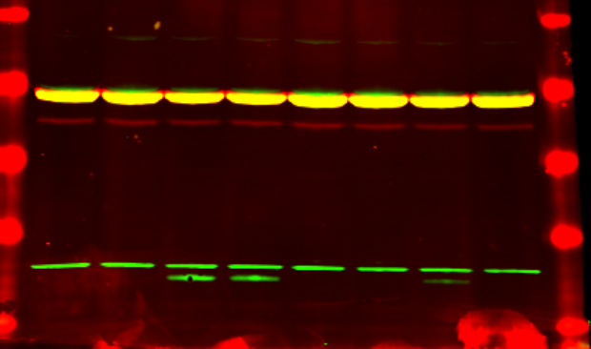
Non-IPF pHSP20(rabbit/green) and Tubulin (mouse/Red) (NT siRNA, EP2 siRNA)
Representative blot 6
TGF-β
- + + + - + + +
Tubulin
pHSP20
Control
Tre 10nM
Control
Tre 10nM
PGE2 10nM
PGE2 10nM
NT siRNA
EP2 siRNA

