Slide 1
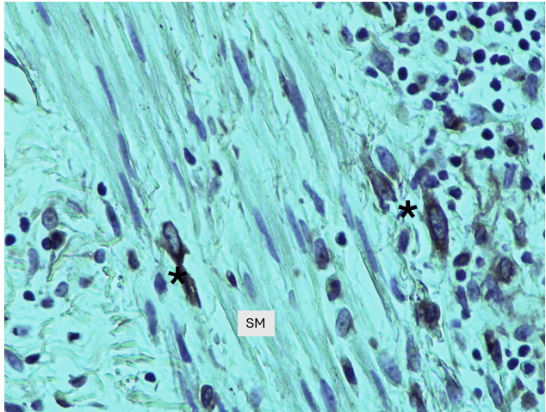
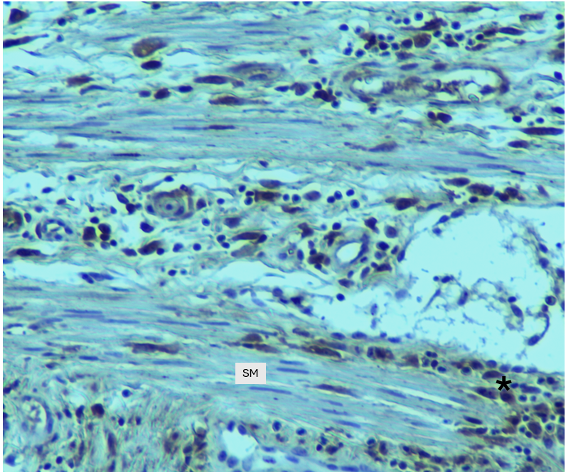
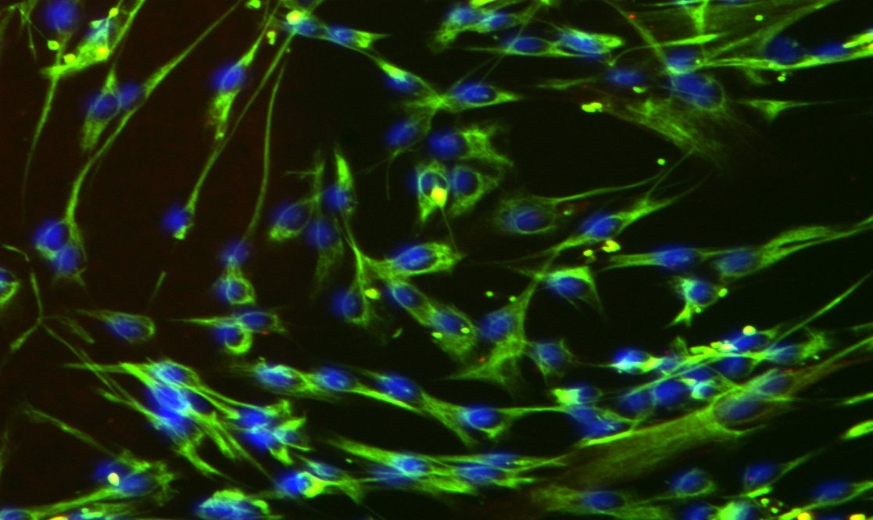
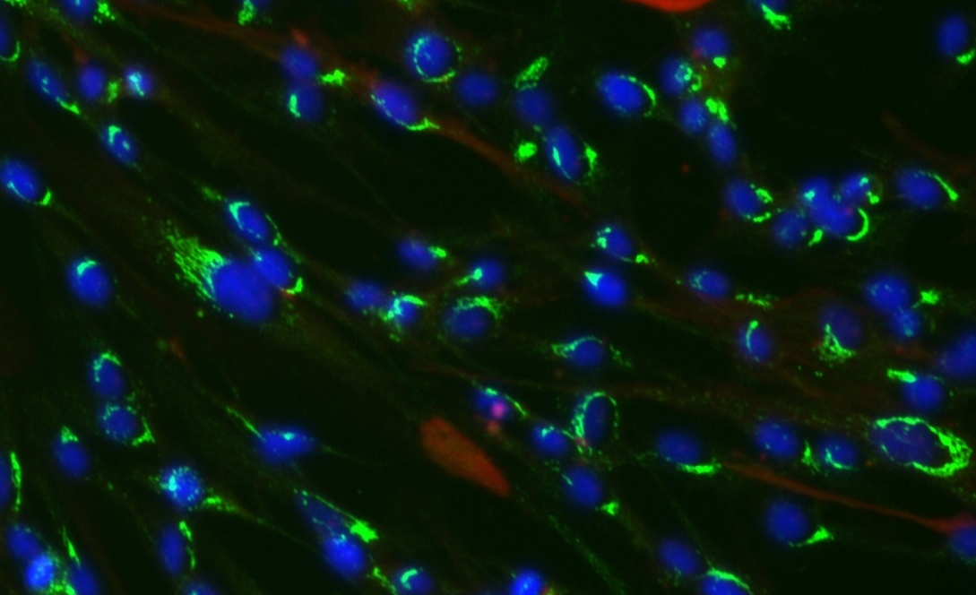
Supplemental Figure 1
A
B
C
D

Slide 2
Supplemental Figure 2
Age | Race/Ethnicity | Sex | Disease state
42 | Black | F | Non-IPF
54 | Caucasian | M | Non-IPF
48 | Asian | F | Non-IPF
50 | Caucasian | F | Non-IPF
44 | Caucasian | M | Non-IPF
35 | Black | F | Non-IPF
57 | Caucasian | M | Non-IPF
44 | Caucasian | M | Non-IPF
60 | Caucasian | M | Non-IPF
36 | Caucasian | M | Non-IPF
47 | Caucasian | F | Non-IPF
45 | Caucasian | M | Non-IPF
57 | Caucasian | M | Non-IPF
35 | Caucasian | F | Non-IPF
42 | Caucasian | M | Non-IPF
53 | Native American | M | Non-IPF
42 | Caucasian | M | Non-IPF
57 | Hispanic | M | Non-IPF
53 | Black | F | Non-IPF
Age | Race/Ethnicity | Sex | Disease state
69 | Caucasian | F | IPF
64 | Caucasian | M | IPF
65 | Caucasian | M | IPF
65 | Caucasian | M | IPF
62 | Hispanic | M | IPF
64 | Caucasian | M | IPF

Slide 3
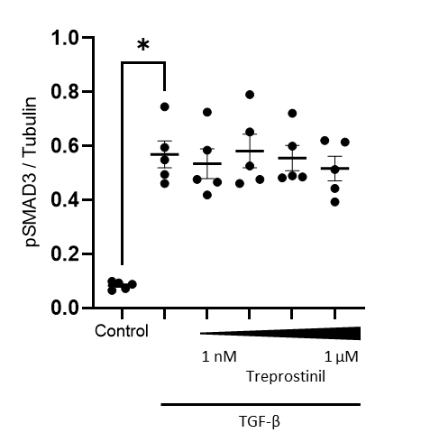
Supplemental Figure 3

Slide 4
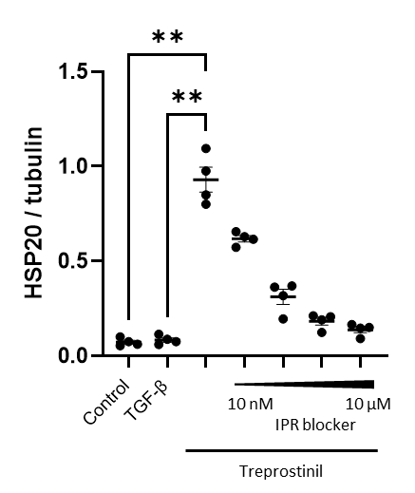
Supplemental Figure 4

