Slide 1

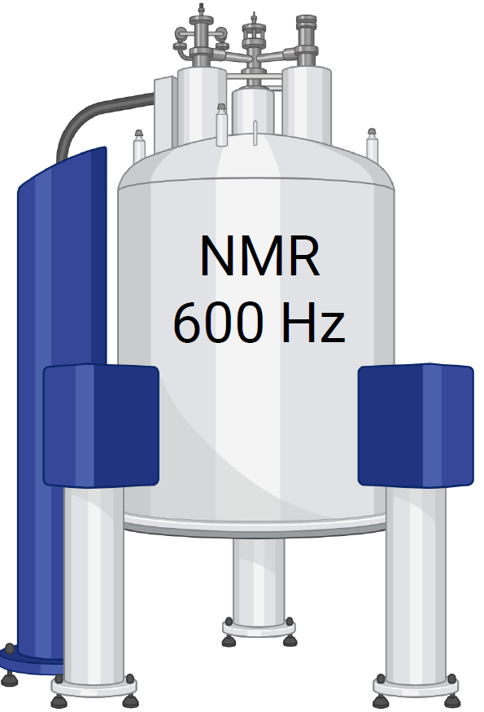
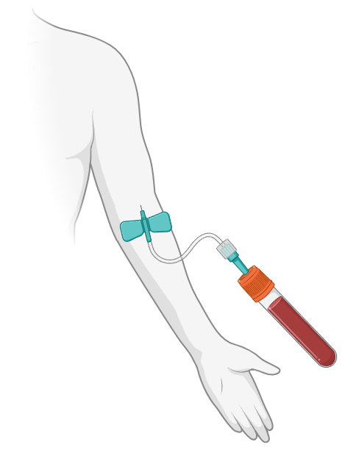

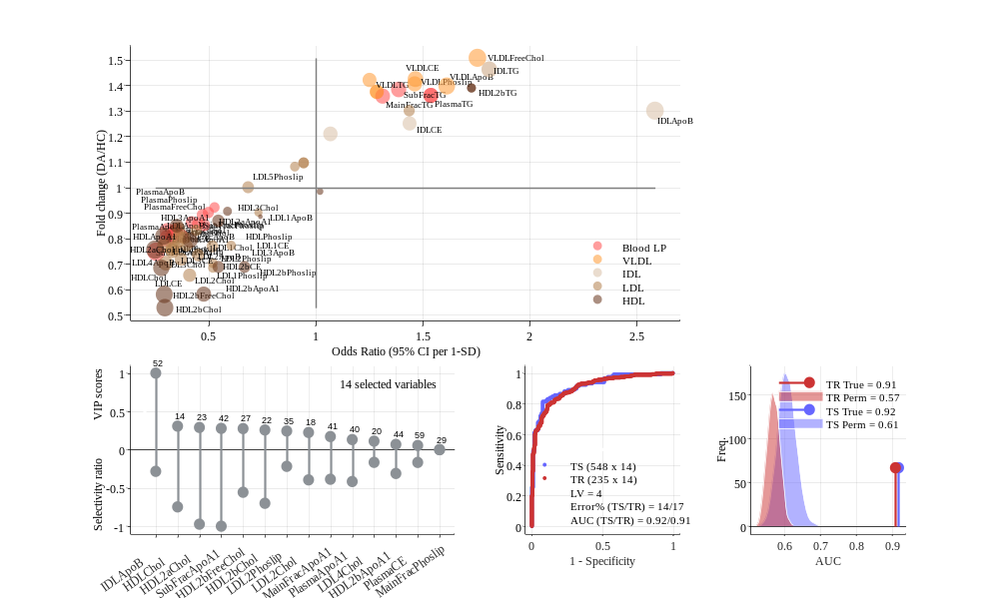

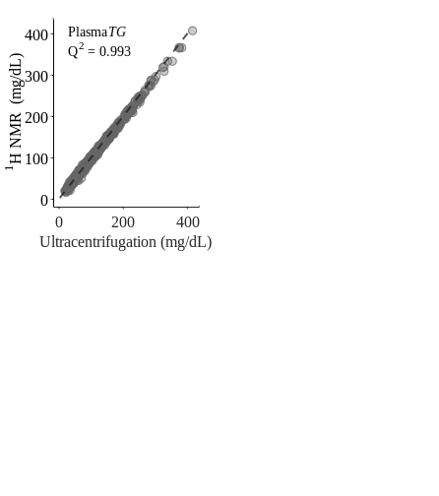

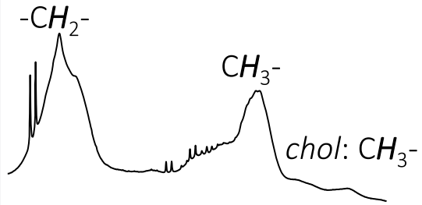

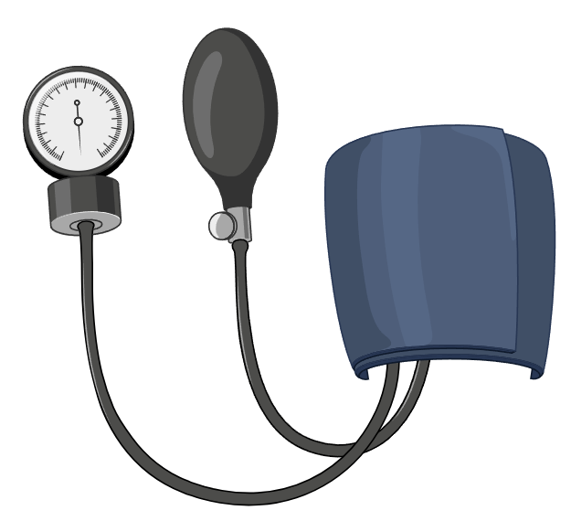
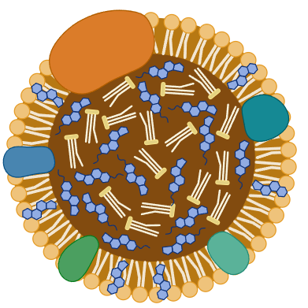


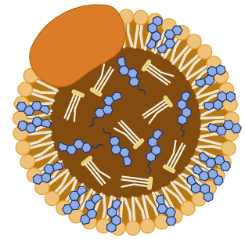
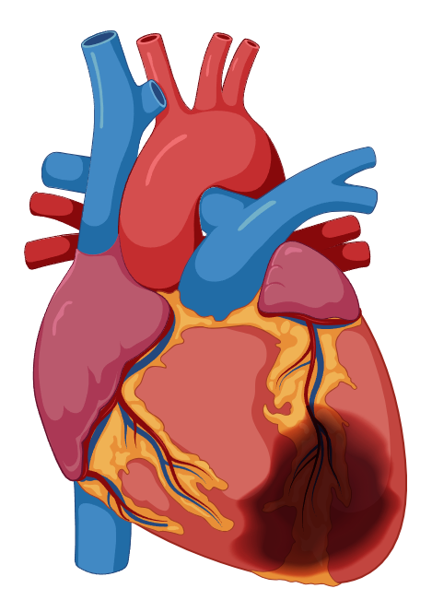
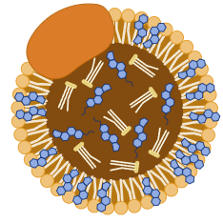
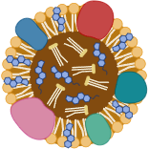
350 µl plasma + 350 µl buffer
HEALTHY (N=393)
T2DM
Plasma ¹H NMR spectra
↑GLU
T2DM (N=88)
HEALTHY
PLSR
↑GLU
1.4
1.0
0.6
↑BP
T2DM+HYP (N=105)
VLDL
65 LIPOPROTEINS (mg/dL)
↑GLU
IDL
HEALTHY
↑BP
Size
LDL
CHD
T2DM+HYP+CHD (N=197)
HDL
T2DM
Density
Alterations in lipoprotein subfractions are associated with T2DM, while differences between patients with and without cardiovascular comorbidities were minor, indicating that T2DM is the primary factor driving lipoprotein dysregulation. *GLU – Glucoe, BP – Bloob Pressure, CHD – Coronary Heart Diseases, T2DM - Type 2 Diabetes Mellitus, Very Low-Density Lipoproteins (VLDL), Intermediate-Density Lipoproteins (IDL), Low-Density Lipoproteins (LDL), High-Density Lipoproteins (HDL), DA – all T2DM patients, and HC – healthy control.
Notes:
##-AccessibilityAssistant: Skip layout check-##

