Slide 1
Supplementary Materials

Slide 2
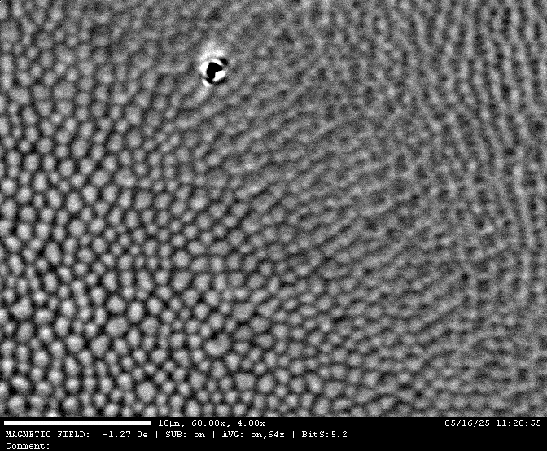
Supplementary Video S1. Magnetic field-induced ordering of magnetic bubble domains.
This video demonstrates the evolution of magnetic bubble domains under a gradually increasing out-of-plane magnetic field, reaching up to 1800 Oe. As the field strength increases, the initially disordered bubbles rearrange into a hexagonal lattice with a uniform size distribution, highlighting the field-induced ordering effect.

Slide 3
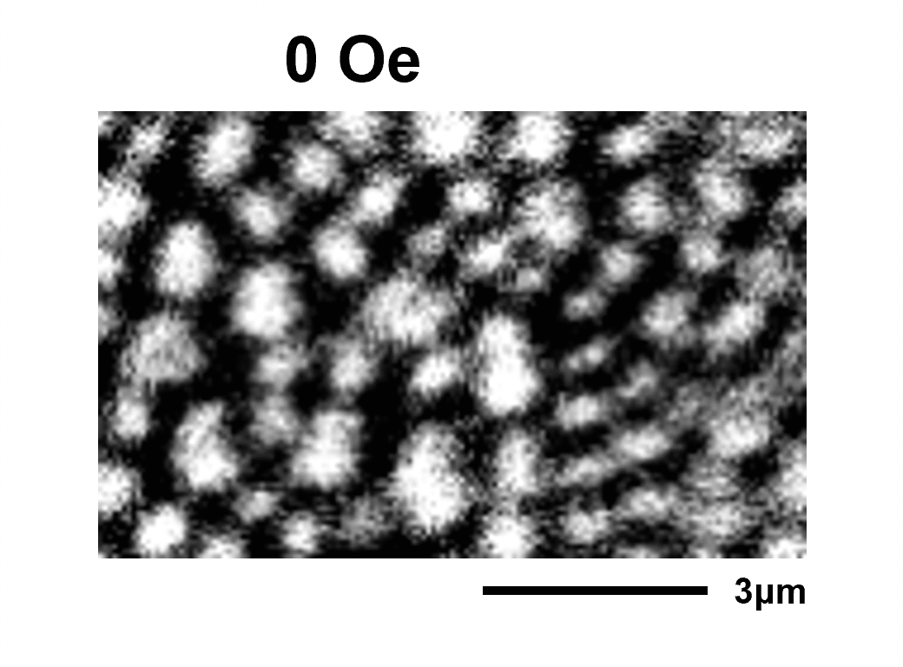
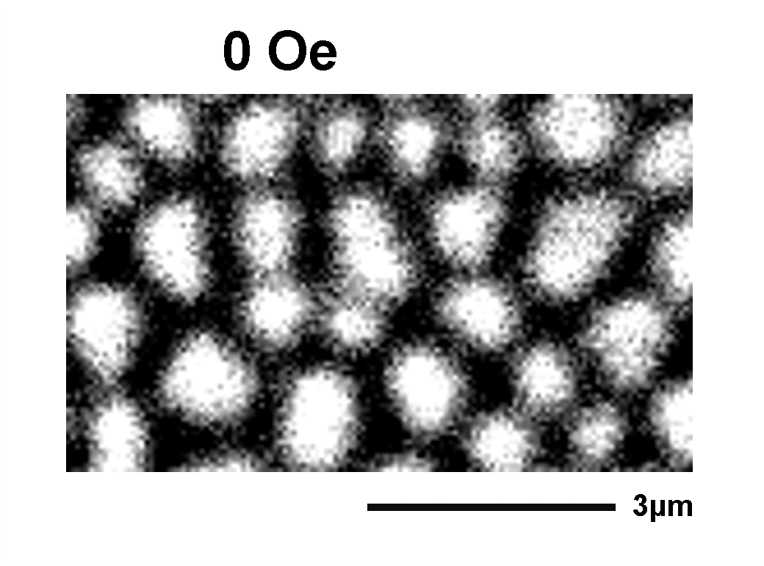
Supplementary Video S2. In situ effects of positive and negative magnetic fields on magnetic domain evolution.
This video demonstrates the contrasting effects of applying negative and positive out-of-plane magnetic fields on the magnetic bubble domains. Left panel: Negative magnetic fields enlarge the bubble size and promote the development of hexagonal ordering. Right panel: Positive magnetic fields shrink the bubble size while enhancing the hexagonal ordering more effectively.

Slide 4
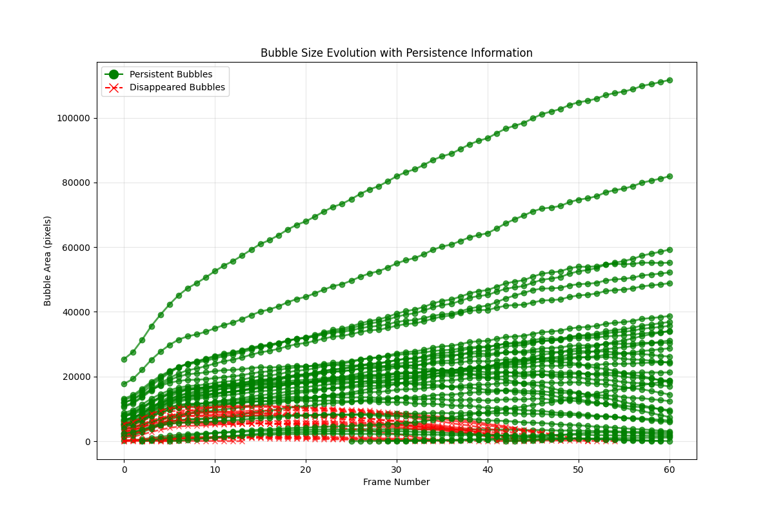
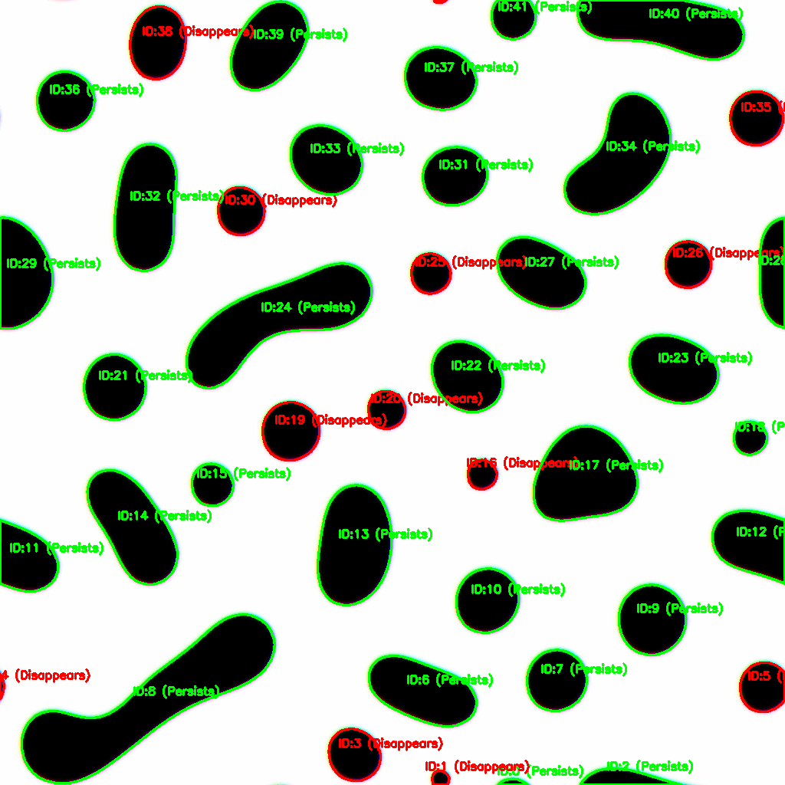
0 Oe → 3000 Oe (200 Oe/200 ps)
Supplementary Video S3. Simulated time-dependent expansion of magnetic bubbles under an increasing external magnetic field.
Left panel: Simulated video showing the evolution of magnetic bubble domains as the external out-of-plane magnetic field increases from 0 Oe to 3000 Oe at a rate of 200 Oe per 200 ps. Right panel: Time-dependent size evolution of individual bubbles tracked in the simulation. Red curves represent bubbles outlined in red in the left panel, which collapse under the applied field. Green curves correspond to the green-outlined bubbles, which remain stable throughout the field application.

